Slide 1

SOMA
AI-Driven Personalized Fitness Planning System
FINAL REVIEW PRESENTATION
Dheresh Soni
Prince Singh (25BCE10155)
Aadi Jain (25BCE10331)
Kaustubh Shekhar (25BCE10135)
Aditya Kumar Singh (25BCE11333)
Ayan Maiti (25BCE10423)
TECHNOLOGY STACK
React
Node / Express
FastAPI
MongoDB

Slide 2





Introduction
01 · WHY SOMA IS NEEDED
Fitness plans are often generic and do not continuously reconcile a user’s body baseline, goal, injuries, lifestyle and progress.
Approach
Design principle
SOMA combines computer vision with an explainable rule engine to generate goal-oriented fitness plans.
The system separates AI estimation from deterministic planning, making the final recommendations easier to explain and modify.
PRIMARY OUTPUTS
Nutrition guidance
Workout plans
Injury-aware constraints
Progression

Slide 3




Existing Work & Limitations
02 · GAP IDENTIFIED BY THE PROJECT
Generic fitness apps
Manual coaching
AI-only approaches
Predefined plans; limited adaptation to individual baseline.
Personalization is possible, but time, cost and consistency are constraints.
Prediction alone does not explain how goals change the final plan.
KEY GAP
Need a system that combines objective baseline estimation with transparent goal-based adjustments.

Slide 4




Proposed Work & Methodology
03 · METHODOLOGY
User Data
Silhouette Image
AI Baseline
Goal-Delta Rules
Plan Generation
Tracking
AI estimates the physique baseline from a silhouette image using EfficientNet-B0.
User biometrics, activity, goal and injury information are handled by the application/rule modules.
1
2
The Goal-Delta Engine reconciles the baseline with the selected goal before nutrition and workout generation.
Progress data feeds back into future progression decisions.
3
4

Slide 5
Novelty of the Project
04 · CORE CONTRIBUTION
01
02
03
Objective baseline
Goal-Delta Rule Engine
Closed-loop planning
Computer vision provides a repeatable physique-class baseline rather than relying only on self-description.
Deterministic, explainable rules alter calorie targets, macros, conditioning and warnings based on the gap between baseline and goal.
Nutrition, workouts, injury constraints and progression are connected instead of being isolated recommendations.

Slide 6


Real-Time Usage
05 · EXAMPLE USER JOURNEY
STEP 1
STEP 2
During use, the user can move from onboarding to an individualized plan without manually calculating BMR, macros or workout progression.
Register
Enter Biometrics
STEP 3
STEP 4
Upload Silhouette
Select Goal
AI inference and backend rule processing produce the plan through the application workflow.
STEP 5
STEP 6
Progression rules can update training load/level based on completion performance.
Generate Plan
Track Progress

Slide 7










Hardware & Software Requirements
06 · REQUIREMENTS
Hardware
Software
Development laptop/desktop
React + Tailwind CSS
Node.js + Express
Camera or phone for silhouette capture
Python + FastAPI
EfficientNet-B0 model service
Internet/network for application deployment
MongoDB
JWT + bcrypt authentication
Optional GPU for faster model experimentation

Slide 8
Overall System Architecture
07 · SYSTEM DESIGN
APPLICATION FLOW
User / React UI
Node / Express
FastAPI AI Service
Goal-Delta Engine
MongoDB
Onboarding • goals • tracking
Auth • API • orchestration
Silhouette → EfficientNet-B0
Baseline + goal → rules
Users • plans • progress
PLAN GENERATION
Nutrition Engine
Workout Engine
Injury Filter
Progression
BMR • TDEE • macros
4/8/12-week plans
Acute/chronic constraints
Completion → load/level

Slide 9


Literature Review
08 · THEMES USED TO POSITION SOMA
Computer Vision
SOMA GAP
Image classification and transfer learning support automated visual feature extraction/classification.
The project combines these themes into one pipeline:
Fitness Personalization
1 Baseline
Existing systems motivate personalized nutrition and exercise recommendations but often rely on fixed templates.
2 Goal adjustment
3 Plan
Explainable Rules
Rule-based decision layers make recommendations auditable and understandable to users.
4 Progression

Slide 10
Module Description
09 · EIGHT CORE MODULES
Authentication
Onboarding
Vision Classifier
Goal-Delta Engine
Registration, login, JWT sessions, bcrypt password hashing
Age, sex, height, weight, lifestyle, goal and injury inputs
Silhouette image → Ectomorph / Mesomorph / Endomorph / No-Person
Baseline + goal → calorie, macro and training adjustments
Nutrition
Workout
Injury Management
Progression
Mifflin–St Jeor BMR, activity factor, calorie and macro targets
4/8/12-week programs using experience, schedule, goal and equipment
Acute/chronic injury constraints and exercise filtering
Completion-based load/level adjustment and tracking

Slide 11
Module Workflow Explanation
10 · FROM INPUT TO PLAN
01
02
03
04
05
06
07
Input
AI Classification
Goal Rules
Nutrition + Workout
Injury Filter
Plan
Progress
EXAMPLE RULE
EXAMPLE NUTRITION
EXAMPLE PROGRESSION
Endomorph + Muscle Gain → smaller calorie surplus (+200 kcal cap) plus conditioning emphasis.
BMR
→ maintenance
→ goal adjustment
→ macro distribution
<70%
hold weight
70–84%
+2.5 kg
≥85%
+2.5 kg + level promotion

Slide 12


Implementation & Coding
11 · KEY IMPLEMENTATION LOGIC
AI Service
FastAPI endpoint receives silhouette input and returns class probabilities/prediction using the trained EfficientNet-B0 model.
Backend
Node/Express manages application APIs, authentication, user data, plan generation and orchestration.
Rule / Plan Logic
Deterministic functions calculate BMR/TDEE, apply goal deltas, select workouts, filter injuries and apply progression.

Slide 13
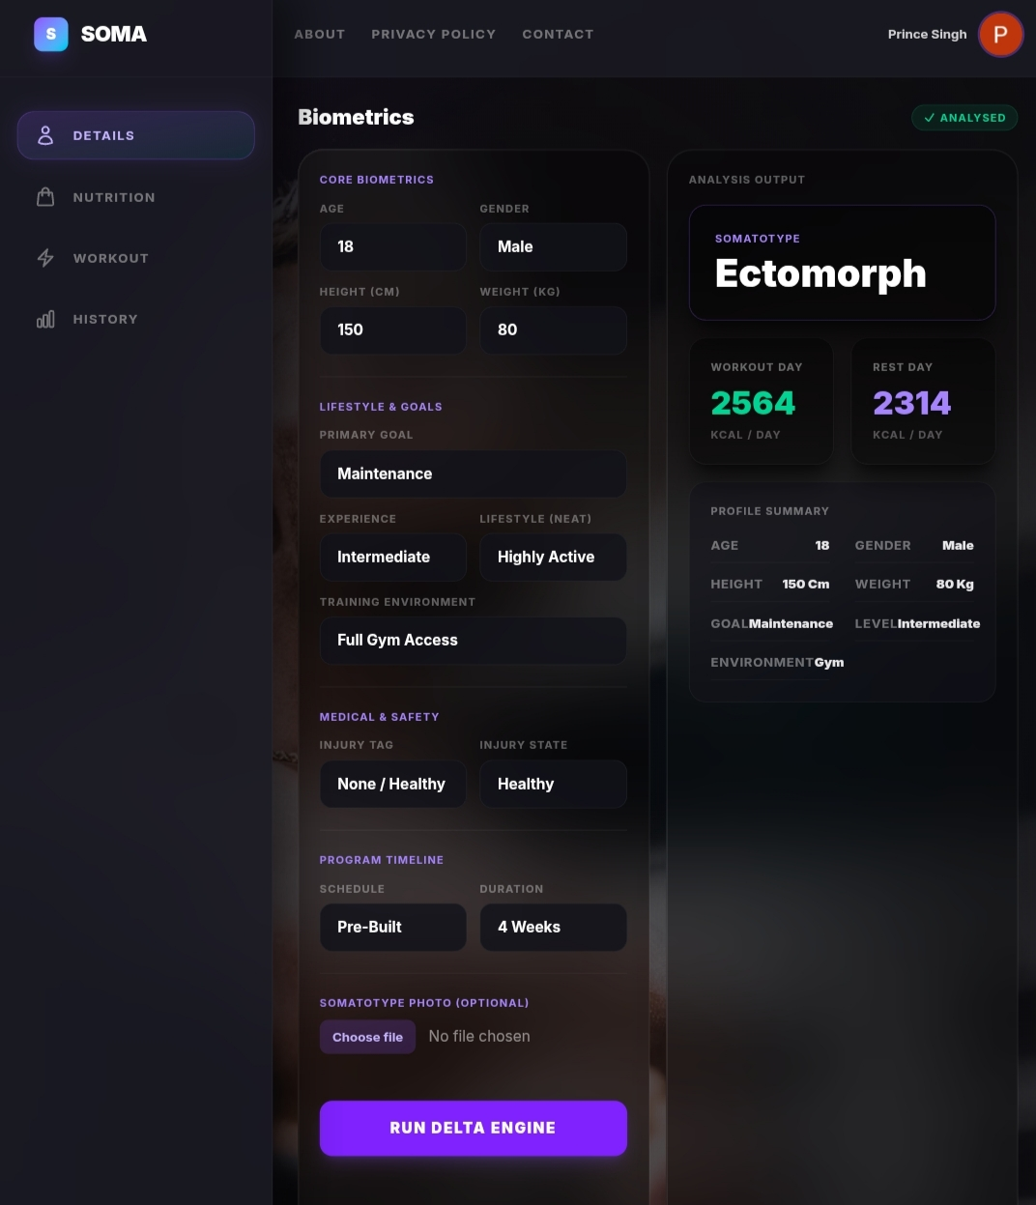
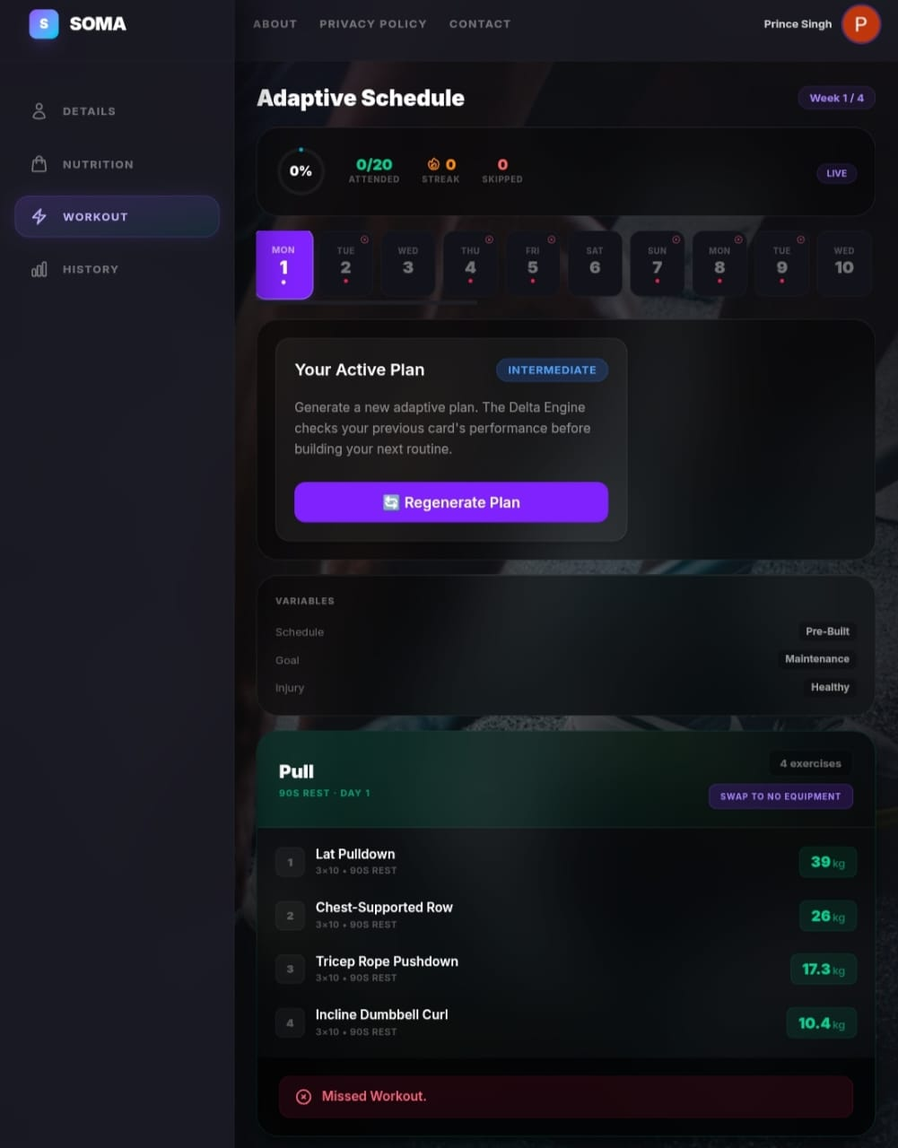
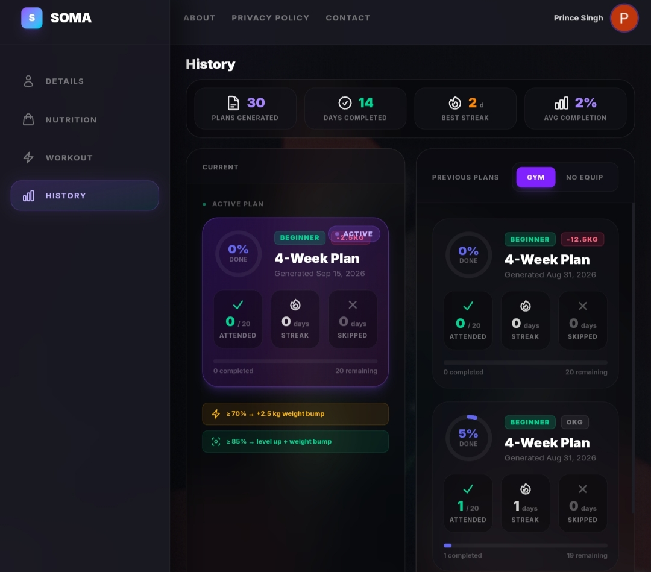
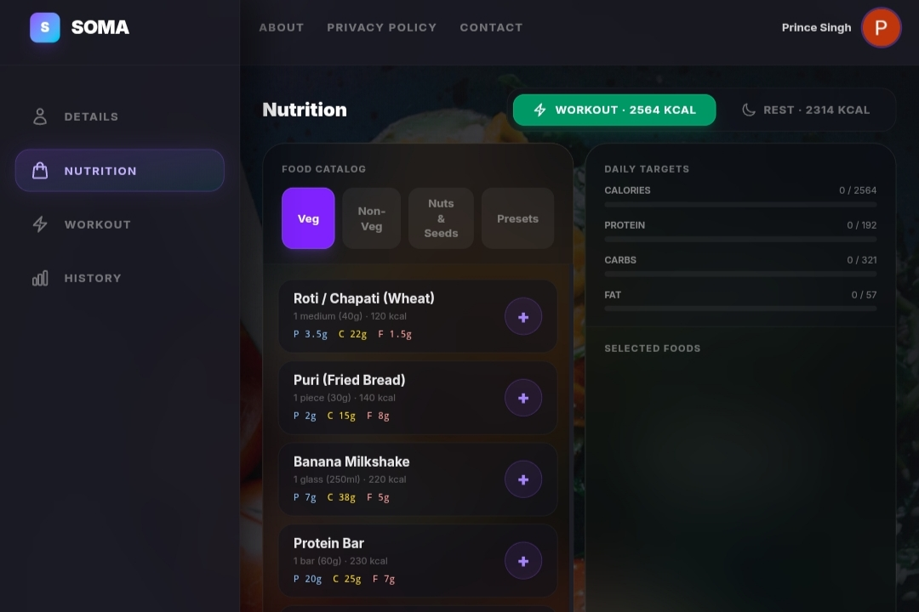
Project Snapshots
13 · ACTUAL SOMA APPLICATION SCREENS
Biometrics / Analysis
Nutrition
Adaptive Workout
History & Progression

Slide 14


Testing
14 · WHAT SHOULD BE DEMONSTRATED IN THE FINAL REVIEW
Functional Testing
ML Evaluation
System Testing
Authentication
Onboarding
Image upload/classification
Plan generation
Injury filtering
Progression updates
Held-out test set
Accuracy
Precision
Recall
F1-score
Confusion matrix
Per-class results
API integration
Database persistence
End-to-end workflow
Error handling
Inference latency
Important: The report currently does not provide populated classification metrics or measured latency. Add actual values before claiming quantitative performance.

Slide 15

Result & Discussion
15 · INPUT → PROCESSING → OUTPUT
INPUT
PROCESSING
OUTPUT
Silhouette image
Age / sex
Height / weight
Activity
Goal
Injury / lifestyle
EfficientNet-B0
Somatotype baseline
BMR/TDEE
Goal-Delta rules
Workout selection
Injury filtering
Physique class + confidence
Calorie targets
Macro targets
Personalized workout
Safety constraints
Progression plan

Slide 16

Conclusion
16 · TAKEAWAYS
SOMA demonstrates a hybrid AI + deterministic rule-engine approach to personalized fitness planning.
The key contribution is the explainable Goal-Delta Engine that converts a physique baseline and user goal into concrete plan adjustments.
The architecture integrates vision, nutrition, workouts, injury management and progression in one workflow.
FINAL-REVIEW PRIORITY
LOOKING AHEAD
Present measured ML evaluation results and ensure the PPT matches the final implementation (EfficientNet-B0 + MongoDB).
Future work can improve dataset diversity, validate rule constants, and expand personalization beyond three simplified somatotype classes.

Slide 17

THANK YOU
Questions & Discussion
SOMA · AI-Driven Personalized Fitness Planning System

