Slide 1

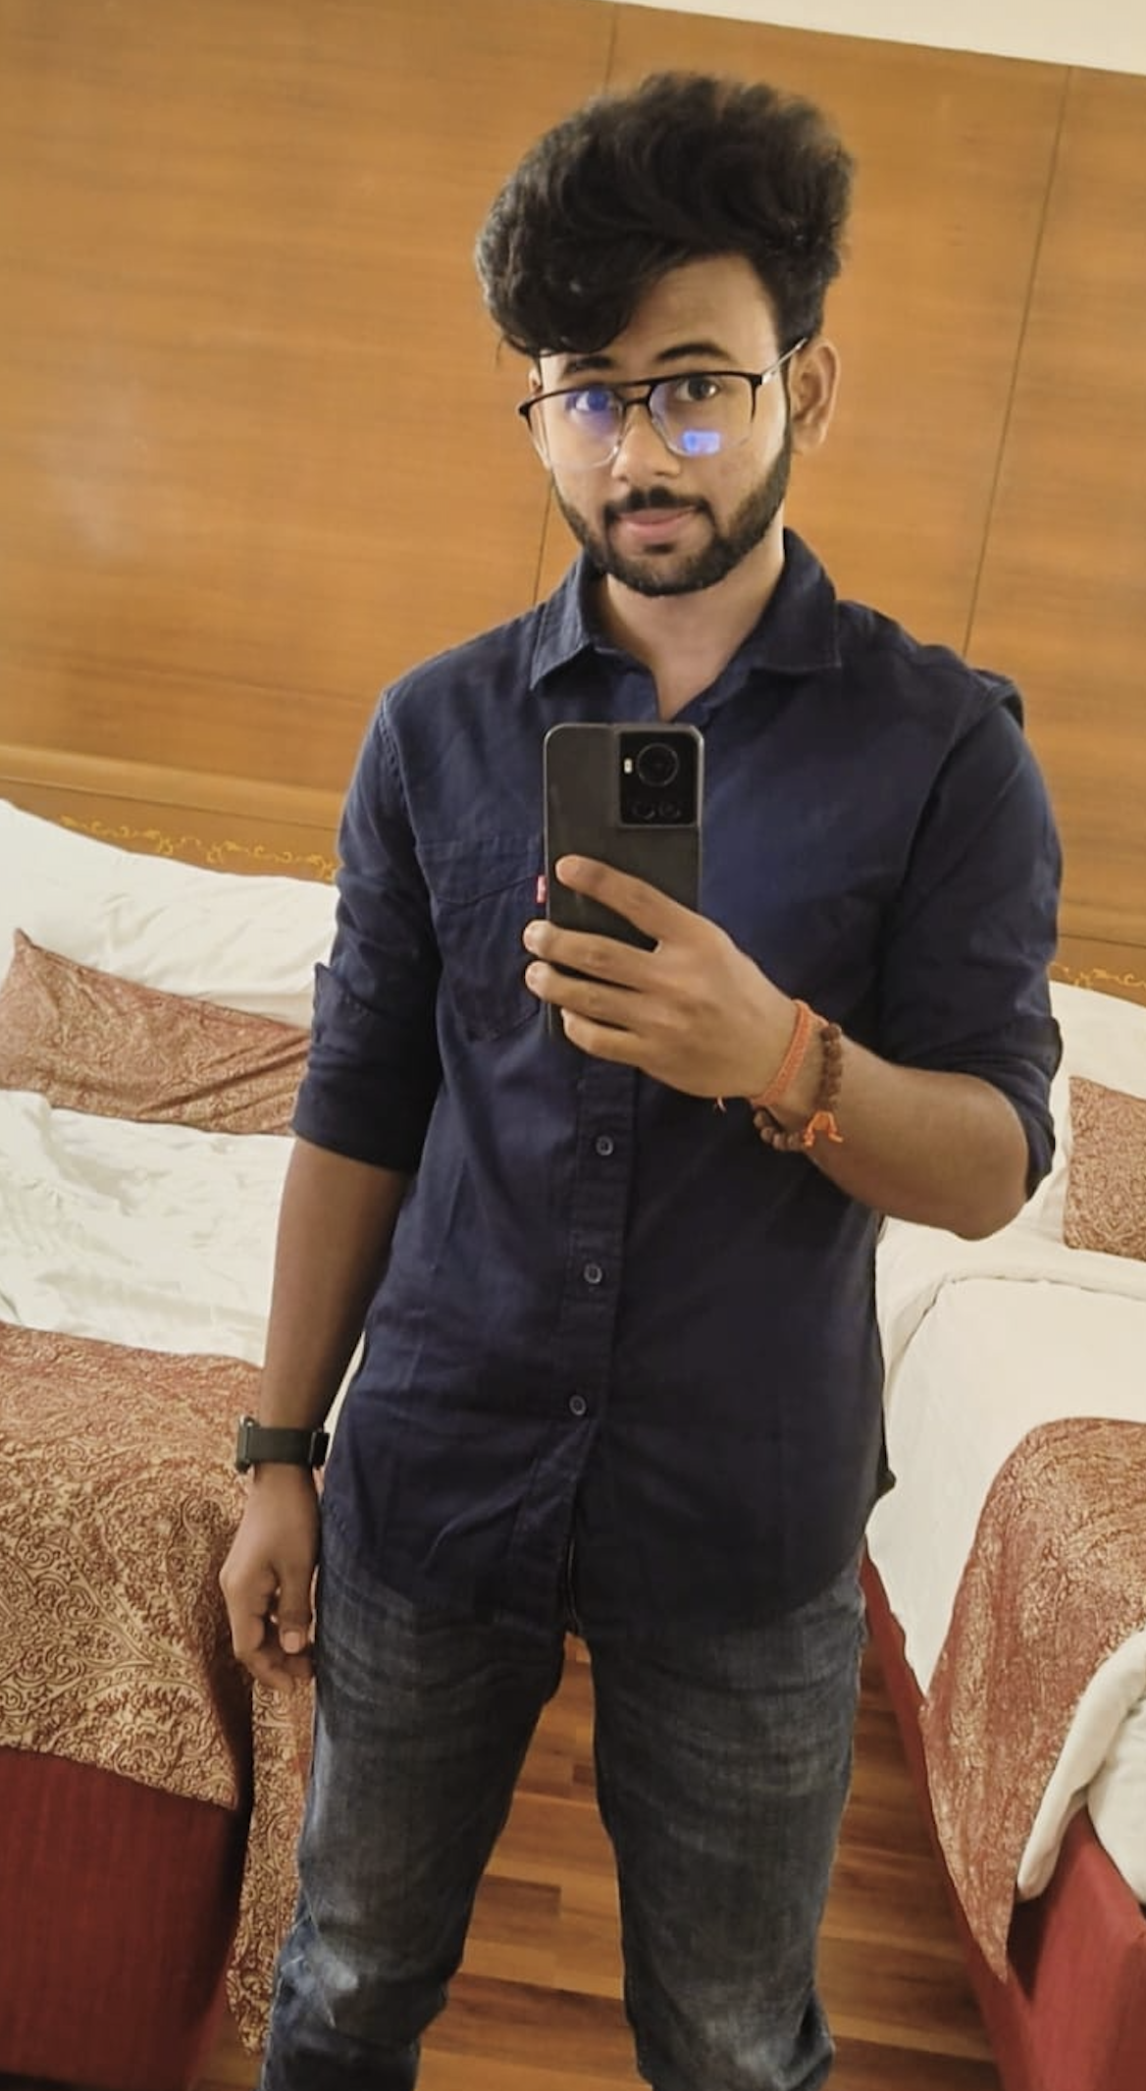
BIO DATA
PERSONAL DETAILS
Name : Roshan Kumar Sinha
Date of Birth : 07 Feb 1999
Height : 165 cm
Complexion : Fair
Religion / Caste : Hindu / Kurmi (Ghamaila)
Occupation : Senior Software Engineer
Company : Cimpress System
Income : 28,00,000
Permanent Address : Patna
Residential Address : Bangalore
EDUCATION
B.Tech : BIT, Bangalore (8.2 CGPA)
12th : K V, Pune (93.2%)
10th : K V, Bareilly (10 CGPA)
FAMILY DETAILS
Father’s Name : Sanjay Kumar Sinha
Father’s Occupation : W/O in Indian Air Force
Mother’s Name : R K Sinha
Mother’s Occupation : Housewife
Brother’s Name (Younger) : Prince Sinha
Brother’s Occupation : Senior Software Engineer, Cisco
Grandfather’s Name : Late Satyendra Sinha
Grandfather’s Occupation : Bada Babu
CONTACT DETAILS
Contact Number : 9763188830/7887354877
Address : Jakariyapur, Patna, Bihar 800007

