Slide 1
Exploratory Data Analysis of
Airbnb Pricing & Availability
Trends in London
Balihar Singh Sohal
605IT Individual Computing Science Project · Coventry University · April 2026
Dataset: Inside Airbnb London · 96,871 listings · Python / scikit-learn / Jupyter

Slide 2
AIM & OBJECTIVES
Project Aim & Objectives
Aim
To investigate the factors influencing Airbnb listing prices and availability across London using EDA, in order to identify patterns and generate actionable insights for hosts, guests, and platform stakeholders.
Collect & prepare the Inside Airbnb London dataset — cleaning, missing values, IQR outlier removal
Analyse pricing patterns & availability trends across boroughs and room types via EDA & visualisation
01
02
Investigate relationships between key features — price, location, accommodates, reviews — using correlation analysis
Develop & evaluate two ML models: Random Forest classifier (room type) and Linear Regression (price prediction)
03
04
Balihar Singh Sohal · 605IT Individual Computing Science Project · Coventry University · 2026

Slide 3
DATASET & METHODOLOGY
Dataset & Methodology
96,871
35.4M
2.1M
57,768
Raw listings
Calendar rows
Review records
Clean listings
1
Data Loading
listings.csv, calendar.csv.gz, reviews.csv.gz from insideairbnb.com
2
Data Cleaning
Null handling, type fixes, dropped irrelevant columns, filled missing values with median/unknown
3
Outlier Removal
IQR method applied to price column — removed 4,195 extreme outliers above upper bound
4
EDA & Visualisation
Price distribution, neighbourhood analysis, room types, correlation heatmap, superhost comparison
5
Machine Learning
Random Forest classifier (room type) + Linear Regression (price prediction) with train/test split 80/20
Balihar Singh Sohal · 605IT Individual Computing Science Project · Coventry University · 2026

Slide 4
EDA FINDINGS
Pricing & Room Type Analysis
£126
£147
67%
£184
Median price/night
Mean price/night
Entire home/apt
Avg entire home price
Price distribution
Right-skewed — most listings cluster £50–£150/night. Mean (£147) is pulled above median (£126) by higher-priced listings, confirming positive skew.
Room type breakdown
Entire home/apt dominates at 38,492 listings (67%). Private rooms account for 33% at avg £74/night — 60% cheaper than entire homes.
Availability patterns
Mean availability of 213 days/year. Large spike at 365 days suggests significant commercial/professional host activity in London.
Balihar Singh Sohal · 605IT Individual Computing Science Project · Coventry University · 2026

Slide 5
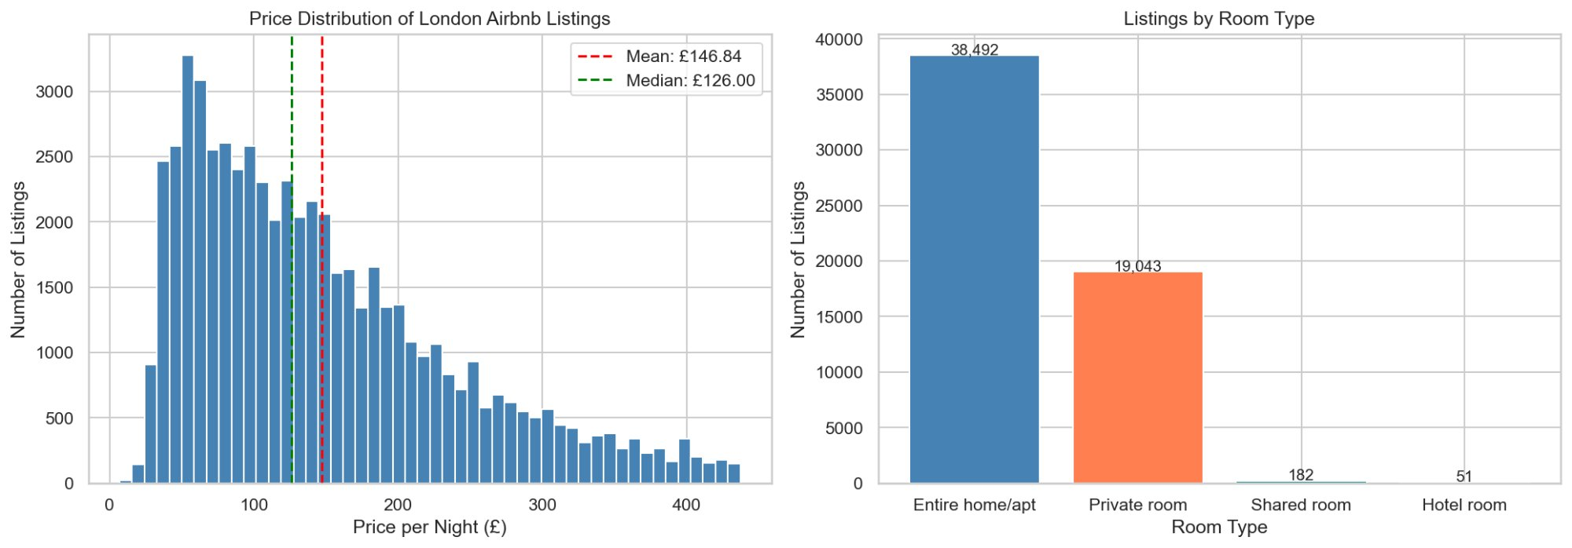
EDA CHARTS
Price Distribution & Room Type Breakdown
Balihar Singh Sohal · 605IT Individual Computing Science Project · Coventry University · 2026

Slide 6
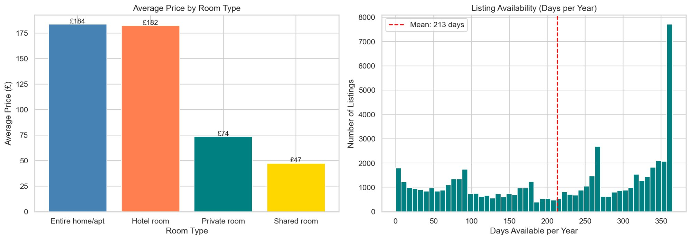
EDA CHARTS
Average Price by Room Type & Availability Distribution
Balihar Singh Sohal · 605IT Individual Computing Science Project · Coventry University · 2026

Slide 7
EDA FINDINGS
Neighbourhood & Correlation Analysis
£229
6,911
0.57
0.04
City of London avg
Westminster listings
Price-Accommodates r
Price-Rating r
Neighbourhood pricing
Clear central London premium — City of London (£229), Kensington & Chelsea (£210), Westminster (£202) are the most expensive. Westminster also has the most listings (6,911), showing high demand drives both supply and price.
Correlation analysis
Accommodates is the strongest price predictor (r=0.57). Bedrooms (0.48) and beds (0.42) also significant. Review score has near-zero correlation with price (r=0.04), confirming that high ratings do not necessarily command higher prices.
Superhost effect
Superhosts charge a modest £8 premium on average (£153 vs £145). The small difference suggests superhost status alone does not substantially drive pricing in London's competitive market.
Balihar Singh Sohal · 605IT Individual Computing Science Project · Coventry University · 2026

Slide 8
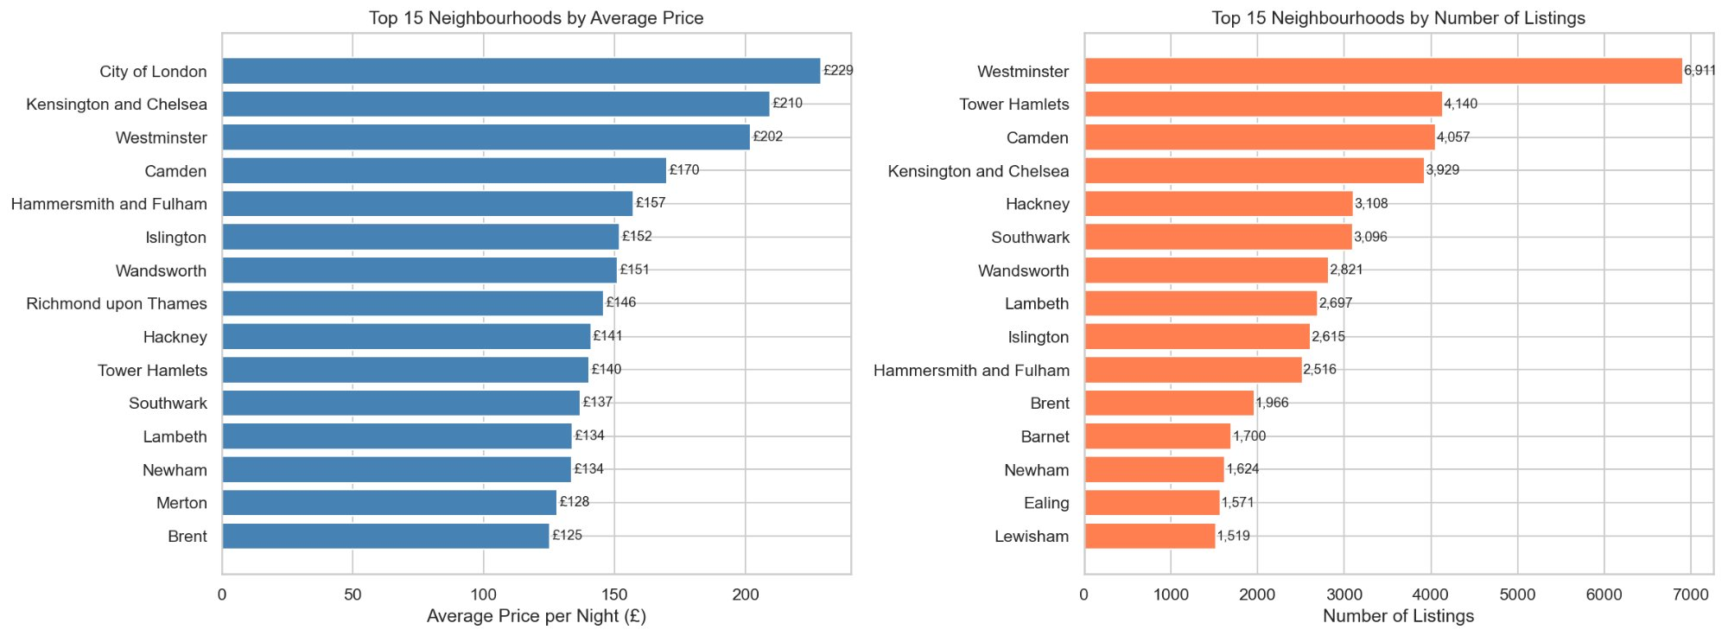
EDA CHARTS
Neighbourhood Pricing & Listing Count Analysis
Balihar Singh Sohal · 605IT Individual Computing Science Project · Coventry University · 2026

Slide 9
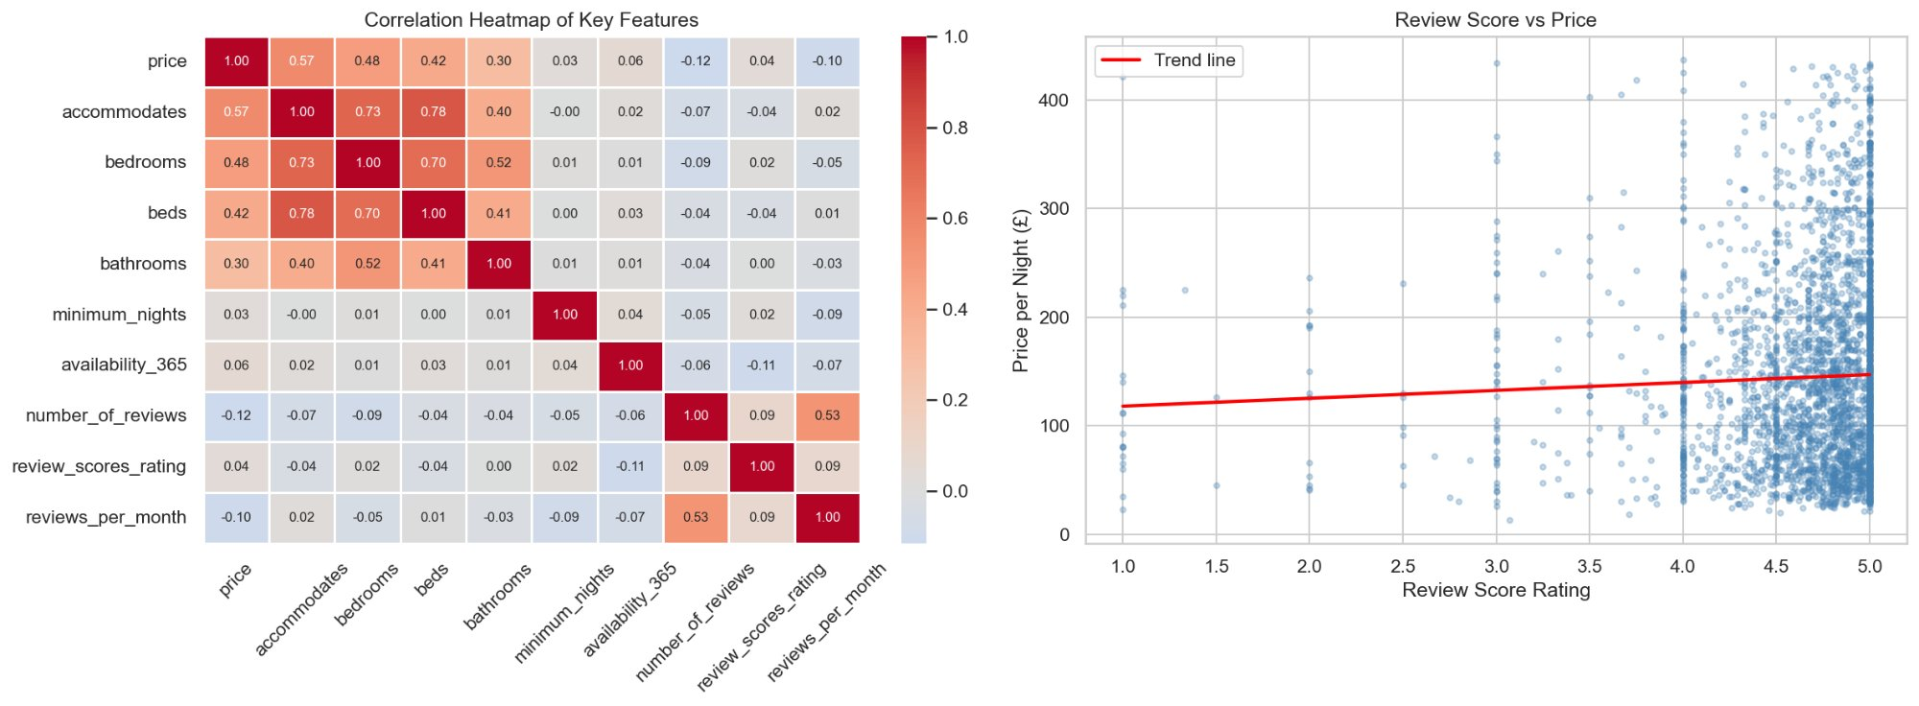
EDA CHARTS
Correlation Heatmap & Review Score vs Price
Balihar Singh Sohal · 605IT Individual Computing Science Project · Coventry University · 2026

Slide 10
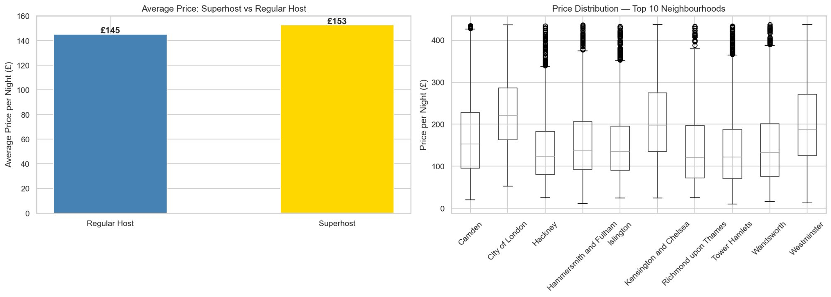
EDA CHARTS
Superhost Comparison & Neighbourhood Price Distribution
Balihar Singh Sohal · 605IT Individual Computing Science Project · Coventry University · 2026

Slide 11
MACHINE LEARNING
Model 1 — Random Forest Classifier
Problem type
91.12%
Multi-class classification
Target variable
Room type (4 classes)
Key features
Accuracy
Price, accommodates, bedrooms, neighbourhood
Entire home precision
200 trees · max depth 15
80/20 train-test split
random_state = 42
92% precision · 95% recall
Private room precision
89% precision · 83% recall
Limitation
Class imbalance — hotel/shared rooms underrepresented
Balihar Singh Sohal · 605IT Individual Computing Science Project · Coventry University · 2026

Slide 12
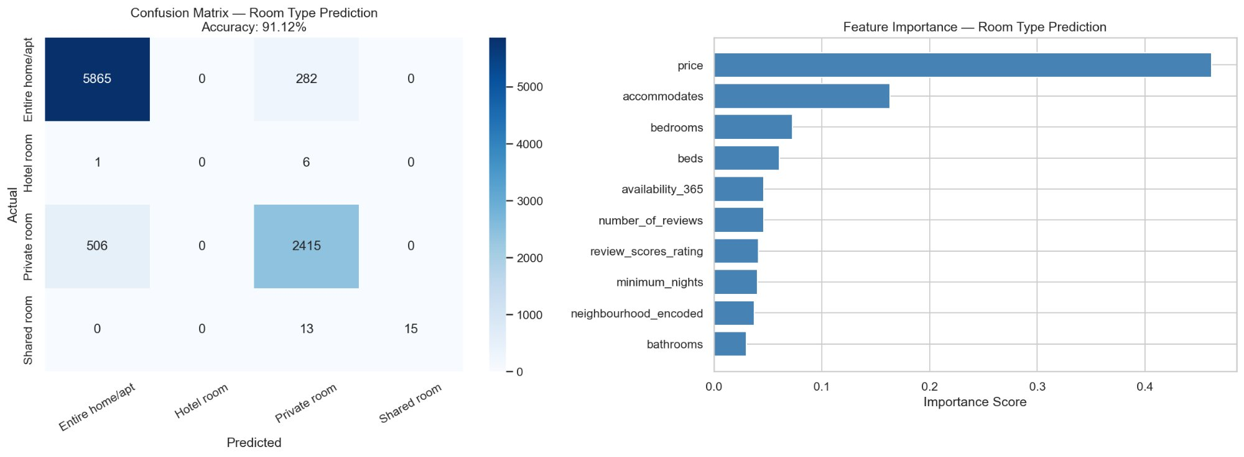
ML CHARTS
Random Forest — Confusion Matrix & Feature Importance
Balihar Singh Sohal · 605IT Individual Computing Science Project · Coventry University · 2026

Slide 13
MACHINE LEARNING
Model 2 — Linear Regression (Price Prediction)
0.51
£45.89
£63.00
80/20
R² Score
Mean Abs Error
RMSE
Train/Test Split
What it predicts
Nightly listing price (£) based on accommodates, bedrooms, beds, bathrooms, minimum nights, availability, reviews, rating, neighbourhood, and room type.
Key coefficient findings
Bathrooms (+£19) and bedrooms (+£17) are the strongest positive price drivers. Accommodates (+£12) and review score (+£10) also contribute positively. Room type encoding has the largest negative coefficient, reflecting the price gap between entire homes and private rooms.
Comparison with literature
Paper 3 (Airbnb Pricing Based on Statistical ML Models) achieved R²=0.63 using XGBoost. Linear regression at R²=0.51 is expected to be lower — this is consistent with findings in the literature that ensemble methods outperform linear models for Airbnb price prediction.
Balihar Singh Sohal · 605IT Individual Computing Science Project · Coventry University · 2026

Slide 14
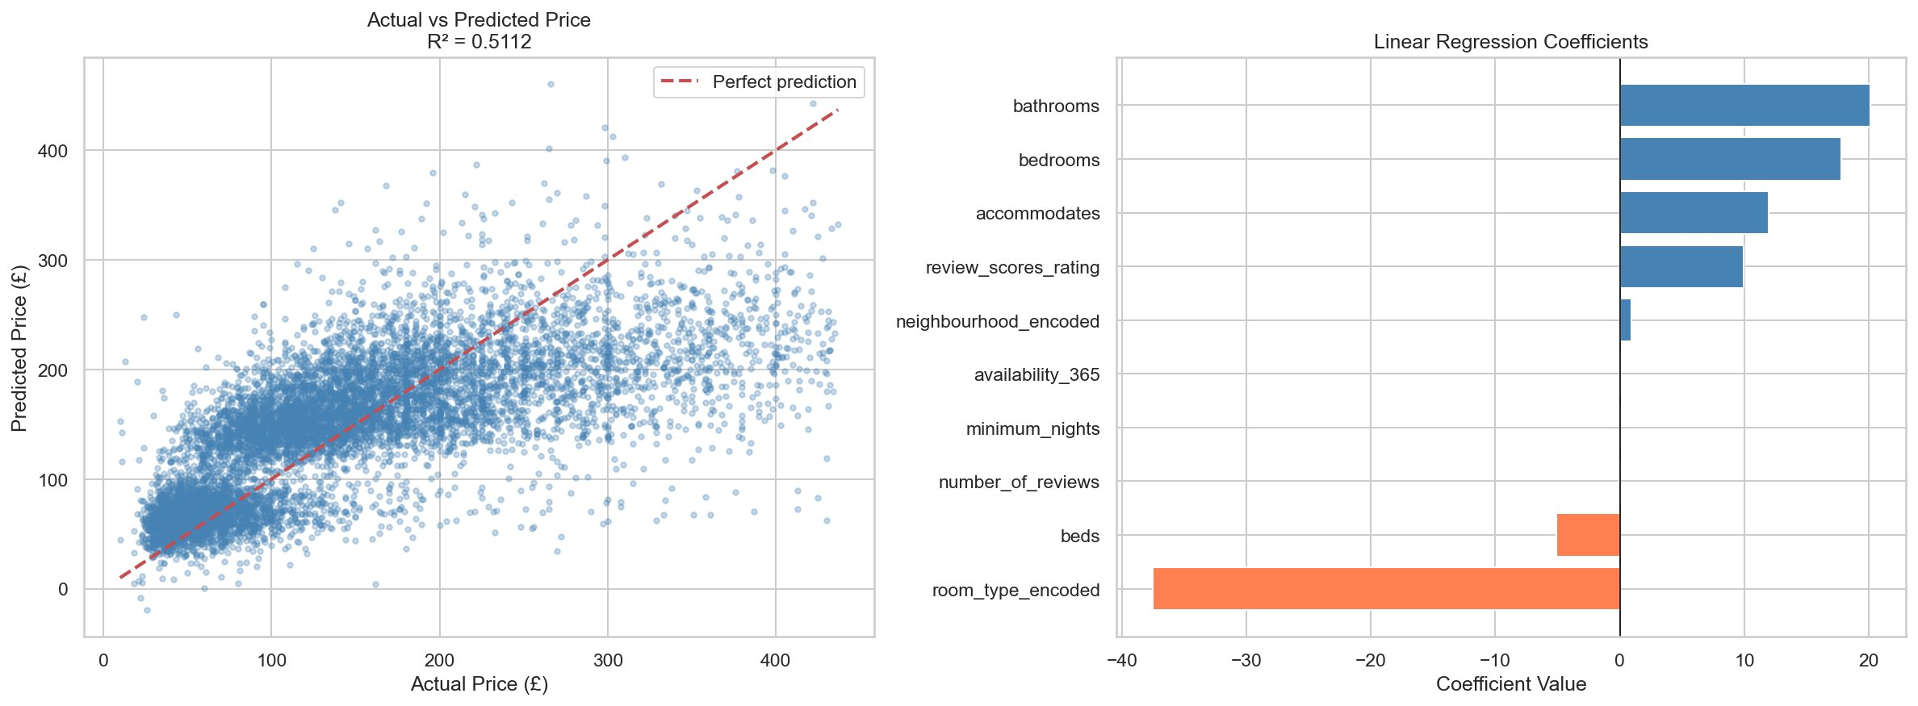
ML CHARTS
Linear Regression — Actual vs Predicted & Coefficients
Balihar Singh Sohal · 605IT Individual Computing Science Project · Coventry University · 2026

Slide 15
REFLECTION
Critical Reflection
What went well
W
Data cleaning was thorough and methodical. EDA produced clear, meaningful visualisations. The Random Forest classifier exceeded the 80% accuracy target at 91.12%. Ethics application successfully completed and approved.
Challenges faced
C
Availability prediction plateaued at 65% due to external factors not captured in the dataset (cancellations, host blocking, events). Large calendar dataset (35M rows) required careful memory management and sampling strategies.
What I learned
L
Importance of thorough EDA before modelling. How to identify and address class imbalance. That model choice should be driven by the problem type — regression vs classification. How to critically justify switching models when initial results are insufficient.
Balihar Singh Sohal · 605IT Individual Computing Science Project · Coventry University · 2026

Slide 16
FUTURE WORK
Recommendations & Future Work
01
XGBoost price prediction
03
Geographic heatmap visualisation
Replace linear regression with XGBoost or Random Forest Regressor to improve R² score beyond 0.51, consistent with Paper 3's finding of R²=0.63 using XGBoost.
Incorporate GeoPandas or Folium to produce interactive geographic heatmaps of pricing and availability across London boroughs.
02
Sentiment analysis on reviews
04
Power BI interactive dashboard
Apply NLP techniques to analyse review text sentiment and explore whether positive/negative sentiment correlates with pricing or booking rates.
Deploy findings into a Power BI dashboard — connecting directly to the Inside Airbnb dataset to enable interactive filtering by borough, room type, and price range. This would make insights accessible to non-technical stakeholders such as hosts and policymakers without requiring any coding knowledge.
Balihar Singh Sohal · 605IT Individual Computing Science Project · Coventry University · 2026

Slide 17
Key Findings & Conclusion
1
Price is driven primarily by property size (accommodates, bedrooms) and location — central London boroughs command a significant premium
2
Entire home/apt listings dominate London's market (67%) and cost 2.5x more than private rooms on average
3
Review scores have near-zero correlation with price — guest satisfaction does not significantly influence nightly rates
4
Random Forest classifier achieved 91.12% accuracy in predicting room type — exceeding the 80% target
5
Linear Regression explains 51% of price variance (R²=0.51) — consistent with literature using linear models
Thank you — happy to take questions

