Slide 1
CLOUD & DEVOPS · PROJECT 6
Create EC2 Instances in Public and
Private Subnets and Test Connectivity
Launch one EC2 instance in a public subnet and another in a private subnet within the
same custom VPC, then verify connectivity between them using their private IP addresses.
AWS Account ID: 638596943163 Branch: Computer Science & Engineering — Cloud & DevOps
TEAM
Prince
Sohit Sharma
Mudit Chaudhary
Anshika Rai
Group Leader ★
Member
Member
Member
2415001181
2415001582
2415000995
2415000261

Slide 2
TEAM & WORKFLOW
Who Did What
The build was split into four sequential phases across the team
Phase 1
Phase 2
Phase 3
Phase 4
S
M
P
A
Sohit Sharma
Mudit Chaudhary
Prince
Anshika Rai
Group Leader
VPC & Subnet Setup
Gateway, Routing & Security
Connectivity Testing
EC2 Instance Deployment
Created the custom VPC (10.0.0.0/16) and carved out the public (10.0.1.0/24) and private (10.0.2.0/24) subnets.
Attached the Internet Gateway, configured public/private route tables, and set up the security groups.
Connected to the public instance via SSH and verified connectivity to the private instance using ping.
Launched the public and private EC2 instances with the correct subnet, IP, and security group settings.
Project 6 — EC2 in Public/Private Subnet & Connectivity Test
2

Slide 3
AIM
Aim & Prerequisites
AIM
To launch one Amazon EC2 instance in a Public Subnet and another in a Private Subnet within the same VPC, and verify network connectivity between them using their private IP addresses.
PREREQUISITES
✓
AWS Account
✓
IAM User with EC2 and VPC permissions (or Root User)
✓
Custom VPC
✓
Public Subnet and Private Subnet
✓
Internet Gateway
✓
Route Table for the Public Subnet
✓
Amazon Linux AMI
✓
EC2 Key Pair
Project 6 — EC2 in Public/Private Subnet & Connectivity Test
3

Slide 4
ARCHITECTURE
☁
Network Architecture
Internet
Project6-VPC • 10.0.0.0/16
Project6-IGW
PUBLIC SUBNET • Project6-Public-Subnet • 10.0.1.0/24
PRIVATE SUBNET • Project6-Private-Subnet • 10.0.2.0/24
🖥
ping 10.0.2.62
🖥
Project6-Public-EC2
Project6-Private-EC2
10.0.1.x (public IP)
10.0.2.62 (no public IP)
NAT Gateway
— Internet Gateway route --- NAT outbound route --- Connectivity test (ping via private IP)
Project 6 — EC2 in Public/Private Subnet & Connectivity Test
4

Slide 5
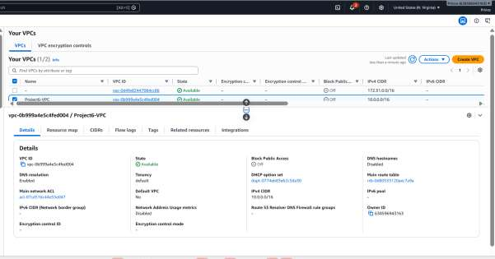
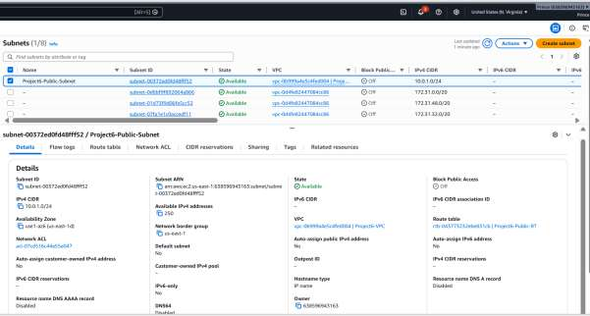
PHASE 1 — SOHIT SHARMA
Create the VPC & Subnets
1
Create the VPC
Project6-VPC created with CIDR block 10.0.0.0/16 and verified as Available.
2
Create the Public Subnet
Project6-Public-Subnet — IPv4 CIDR 10.0.1.0/24.
VPC console — Project6-VPC (Available)
Subnets console — public & private
3
Create the Private Subnet
Project6-Private-Subnet — IPv4 CIDR 10.0.2.0/24, in the same Availability Zone.
RESULT
A custom VPC was verified as Available, with a public subnet (10.0.1.0/24) and a private subnet (10.0.2.0/24) both provisioned inside it — the network foundation the rest of the project builds on.
Project 6 — EC2 in Public/Private Subnet & Connectivity Test
5

Slide 6
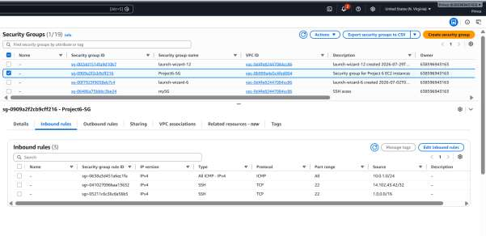
PHASE 2 — MUDIT CHAUDHARY
Gateway, Routing & Security Groups
Internet Gateway & Route Tables
Created Project6-IGW and attached it to Project6-VPC
Project6-Public-RT: added route 0.0.0.0/0 → Internet Gateway
Associated the Public Subnet with Project6-Public-RT
Associated the Private Subnet with a separate Project6-Private-RT
No Internet Gateway route was added to the Private Route Table
Security Groups
Public EC2 SG —
Inbound SSH (port 22) — Source: My IP
Security Groups console — inbound rules (SSH 22, ICMP)
🔒
🔒
Private EC2 SG —
Inbound All ICMP – IPv4 — Source: 10.0.1.0/24 (lets the public EC2 ping the private EC2)
WHY IT MATTERS
Keeping the Internet Gateway route out of the private route table is what actually makes the private subnet private — even though its security group allows ICMP, there is simply no path to the internet.
Project 6 — EC2 in Public/Private Subnet & Connectivity Test
6

Slide 7
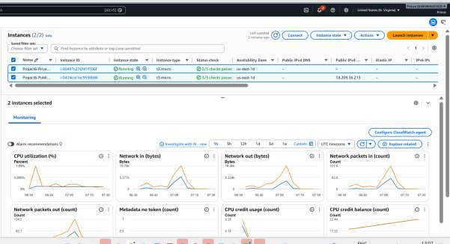
PHASE 3 — PRINCE (GROUP LEADER)
Launch the EC2 Instances
🖥
Project6-Public-EC2
🖥
Project6-Private-EC2
AMI: Amazon Linux
Subnet: Project6-Public-Subnet
Auto-assign Public IP: Enable
Security Group: Project6-Public-SG
Result: Public IPv4 assigned (18.209.36.213)
AMI: Amazon Linux
Subnet: Project6-Private-Subnet
Auto-assign Public IP: Disable
Security Group: Project6-Private-SG
Result: No public IPv4 — private IP 10.0.2.62
Both instances Running — same VPC, 2/2 status checks passed
Project 6 — EC2 in Public/Private Subnet & Connectivity Test
7

Slide 8
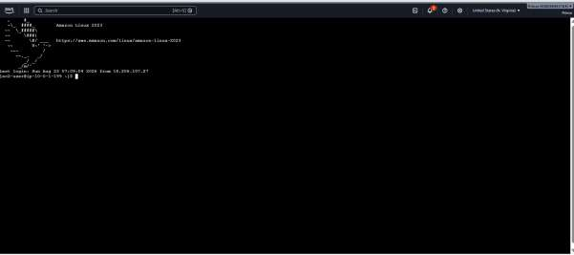
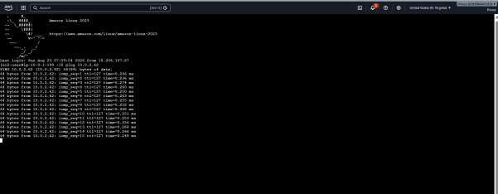
PHASE 4 — ANSHIKA RAI
Connect & Test Connectivity
1
Connect to the Public EC2
2
Ping the Private EC2
Logged into Project6-Public-EC2 via SSH using the EC2 key pair. A successful login returns the Amazon Linux shell prompt — confirming the public instance is reachable.
From the Public EC2 terminal: ping 10.0.2.62 — the private instance replied with repeated "64 bytes from 10.0.2.62" messages, confirming connectivity over the private IP.
✓
Result: the Public EC2 successfully reached the Private EC2 (10.0.2.62) using its private IP address — while the private instance itself remains unreachable directly from the internet.
Project 6 — EC2 in Public/Private Subnet & Connectivity Test
8

Slide 9
FINAL CHECK
Network Configuration Checklist
Both EC2 instances are in the same VPC
Public EC2 is in the Public Subnet
✓
✓
Private EC2 is in the Private Subnet
Public EC2 has a Public IPv4 address
✓
✓
Private EC2 has no Public IPv4 address
Public Route Table routes 0.0.0.0/0 → Internet Gateway
✓
✓
Public EC2 can reach Private EC2 using its Private IP
Security Group allows ICMP between the required subnet/instances
✓
✓
Project 6 — EC2 in Public/Private Subnet & Connectivity Test
9

Slide 10
RESULT & CONCLUSION
Project Outcome
RESULT
The Public and Private EC2 instances were successfully launched in their respective subnets within the same VPC. The Public EC2 was reachable via SSH, and connectivity to the Private EC2 was verified using its private IP address.
CONCLUSION
This project demonstrated how to deploy EC2 instances across public and private subnets in a custom VPC — giving the public instance internet access through an Internet Gateway, while keeping the private instance unreachable from the internet. Connectivity between the two was confirmed using private IP addresses.
Prince (Group Leader) · Sohit Sharma · Mudit Chaudhary · Anshika Rai
Project 6 · Computer Science & Engineering — Cloud & DevOps · AWS Account 638596943163

