Slide 1
DATA ANALYSIS CAPSTONE PROJECT
An analytical dive into the world of Polycystic Ovary Syndrome (PCOS) with Princess Imelda.

Slide 2
Inspiration
September marks the start of PCOS awareness month.
Polycystic ovary syndrome is a common condition that affects hormones in women.
Women can get PCOS any time after puberty. Most people are diagnosed in their 20s or 30s when trying to get pregnant.
PCOS is very common with up to 15% of women of reproductive age having PCOS.
Despite this fact, PCOS remains under-studied and often misdiagnosed –up to 70% of the cases–for other issues and illnesses.

Slide 3
Problem Statements
To what extent do biological and lifestyle factors correlate with the diagnosis and severity of PCOS?
Can a predictive model be built using routine clinical and biochemical markers to accurately distinguish PCOS from its most common mimics?

Slide 4
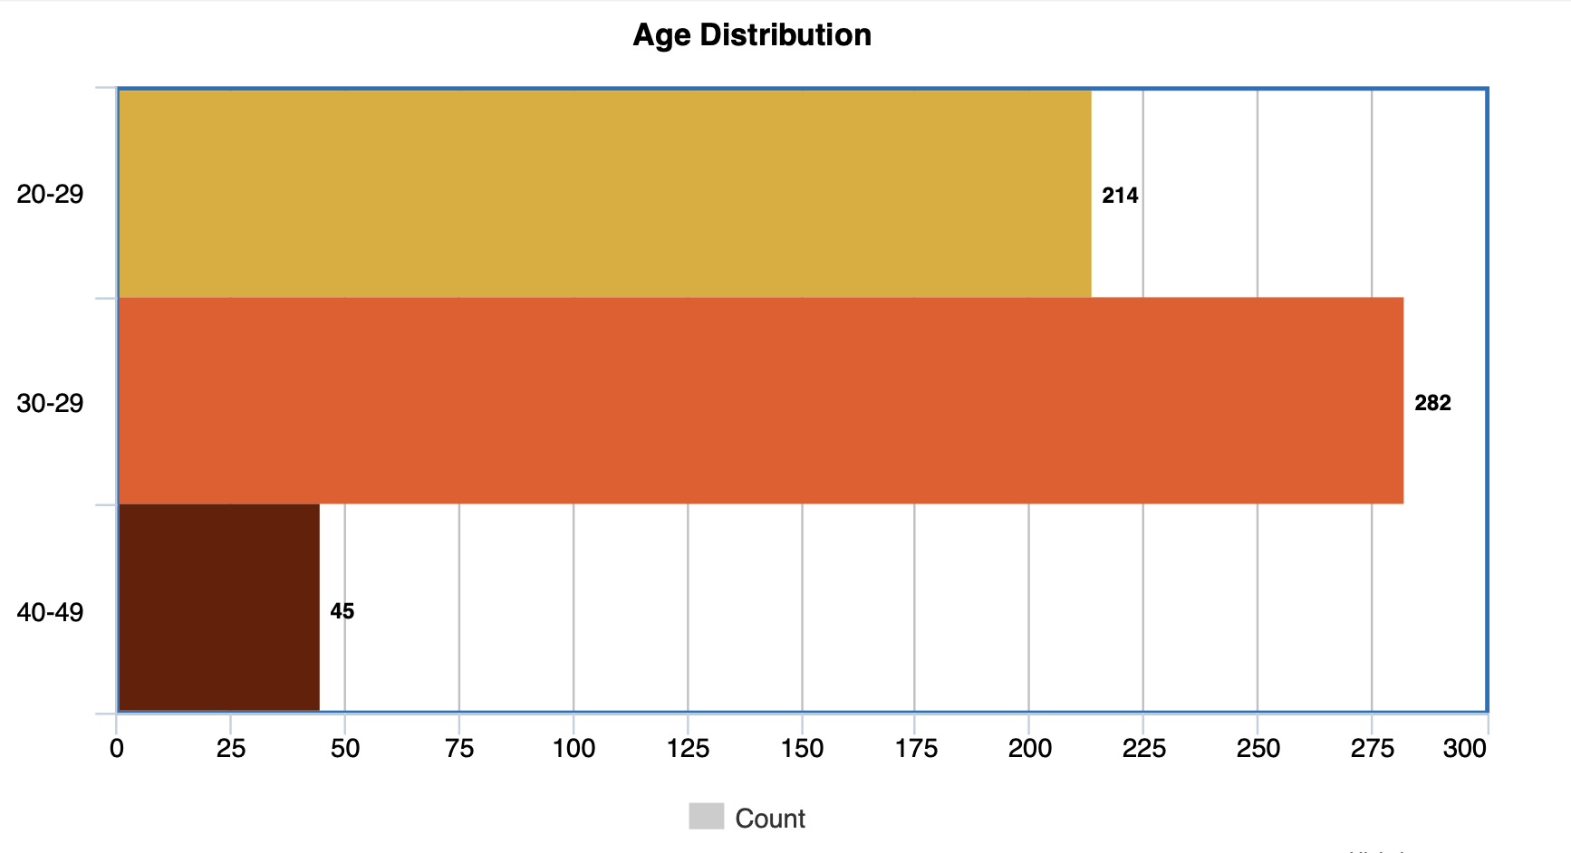
Data Overview
Total Number of Patients: 541

Slide 5

Case Study 1: Obesity
Total No. of Patients with Obesity: 13
Percentage of Obese patients: 2.40%
Obesity vs PCOS Diagnosis
0
358
169
Case study one focused on understanding if there is an association between obesity status and PCOS diagnosis.
This is because obesity is one of the symptoms of PCOS and pre-dispositions the women to various cardio-vascular disorders.
The results showed that there was no statistically significant association between PCOS and obesity (p-value = 0.05204)
Obese ( 0 = No, 1= Yes )
5
8
1
0
1
PCOS (Y/N)

Slide 6
Case Study 2: Impact of Exercise
Case study two went even deeper to investigate if regular exercise modifies the association between obesity and PCOS.
Evidently, the analysis revealed that there is an extremely strong statistical evidence that regular exercise modifies the obesity-PCOS association.

Slide 7
Case Study 3: Hormone Levels
One of the key indicators of PCOS is hormone levels. 4-6 hormones are required to be used at any moment for proper assessment of PCOS.
The analysis done showed that there is strong statistical evidence that the PCOS hormone indicator can distinguish patients with PCOS and those without.
The indicator created used dictated cut-offs for each relevant hormone to check whether the it was positive or negative.
PCOS Hormone Indicator vs PCOS Diagnosis
0
172
43
PCOS Hormone Indicator
1
192
134
0
1
PCOS(Y/N)

Slide 8
Case Study 4: The Rotterdam Criterion
The Rotterdam Criterion utilised to diagnose PCOS uses biochemical and clinical markers to check for presence of PCOS. Anovulation is checked using irregularity of periods and the cycle length.
Hyperandrogenism is assessed using clinical markers like hirsutism, acne and androgenic alopecia, and biochemical markers like elevated androgens.
Finally, polycystic ovarian morphology is confirmed by checking the number of follicles in each ovary, and the ovarian volume.
At least 2 out of 3 must be present for a PCOS diagnosis. All other causes are excluded before applying Rotterdam criteria.

Slide 9
Continuation…
The analysis conducted made it clear that the Rotterdam Criterion is an elimination criterion.
It works well to exclude false positives as opposed to also thoroughly checking to include true positives.
It is correct 96% of the time (when this dataset is used) with very few false positives.
On the sensitivity aspect, the criterion identifies 28% of the people who do have PCOS, meaning 72% of actual PCOS cases are being missed-which is evident in the high number of false negatives.
362
True Neg
2
False Pos
127
False Neg
50
True Pos
Accuracy: 76% Precision: 96% Sensitivity: 28%

Slide 10
Can the criterion be improved?
An attempt to add clinical and biological markers was made in order to check if it will improve the sensitivity of the Rotterdam criterion while still keeping the specificity high.
The results of the model used never correctly predicted patients without PCOS and all of the non-PCOS cases were wrongly flagged as PCOS cases.
Furthermore, the issue of specificity wasn’t well addressed by the model and it completely fails at ruling out the non-PCOS cases. These are issues that arose due to class imbalance (dataset has more non-PCOS patients than PCOS patients).
Therefore, until a better model is applied alongside other technologies, the Rotterdam Criterion is useful in diagnosis of PCOS

Slide 11
Case study 5: Identification of Risk Factors
Patient File No. | PCOS Status | Risk Count
10126 | 0 | 3
10190 | 1 | 3
10249 | 1 | 3
As earlier mentioned, PCOS is a medical issue associated with certain risks. Due to its nature of affecting hormones in women, patients are pre-disposed to certain illnesses related to said hormones if no action is taken.
The risks assessed in this study were hyperprolactinemia, vitamin D3 deficiency and hyperplasia.
The table compiled below shows the patients that were found with maximum risk count.

Slide 12
Case Study 6: Misdiagnosis
PCOS is often mis-diagnosed for other illnesses and issues due to the overlap of symptoms and the lack of a single definitive test for PCOS. Additionally, some of these illness mimic PCOS further complicating accurate diagnosis.
This case study focused on flagging the illnesses that mimic PCOS therefore acting as screening signals. They are not diagnoses.
PCOS can be misdiagnosed for a number of illneses but the ones investigated in this study were: thyroid dysfunction, puberty, stress, congenital adrenal hyperplasia, pituitary tumours and fibroid polyps.

Slide 13
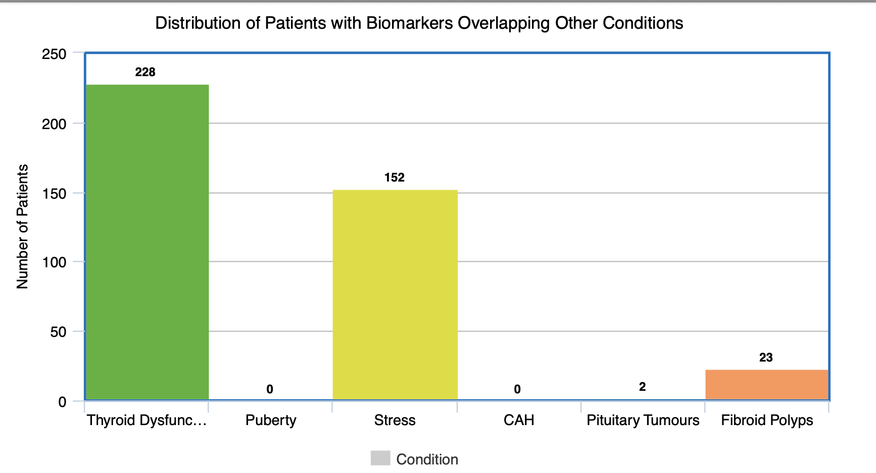

Slide 14
Final Thoughts
Our analysis so far has been able to sufficiently show the relationship between PCOS diagnosis and various lifestyle and biological factors.
It has also shown that the Rotterdam Criterion, despite its problem areas, it works well to isolate PCOS patients by thoroughly eliminating those without.
Nonetheless, a better model for prediction of PCOS can be developed to aid healthcare professionals in their assessment. This model would further help in reducing misdiagnosis, identifying risk factors, and support medical professionals in properly advising patients on how to better their health post diagnosis.

Slide 15
QUESTIONS?

