Slide 1
TEAM MEMBERS
I2C DISPLAY DRIVER IMPLEMENTATION
AKASH
PRINCE
SANKET
TEAM 6
‹#›

Slide 2
PROJECT OVERVIEW
GOAL
Developed an I2C driver for the SH1106 OLED display to control it from user space on a Raspberry Pi 4.
WHATS ACHEIVED
User-space applications can control the display by lighting a single pixel using an ioctl call.

Slide 3
HARDWARE USED
Raspberry Pi 4 running Raspbian OS.
SH1106 OLED Display (128x64) connected via I2C.
GPIO Pins: Communication is established using Raspberry pi’s GPIO pins.
Logical Analyser: 8 channel.

Slide 4
COMMUNICATION FLOW
User Space:
User applications call functions (like SET_pixel()) from a display library.
Commands are sent to the display driver using ioctl().
Kernel Space (Driver):
The driver receives the commands and translates them into I2C instructions.
It interacts with the hardware (SH1106) via I2C to update the display.

Slide 5
BLOCK DIAGRAM
Userspace (Applications)
Display IOCTLs
(API’s)
Driver Kernel Space
Fops: read(),write(),ioctl
I2C Bus
(Communication)
SH1106 Display
(Hardware Target)

Slide 6
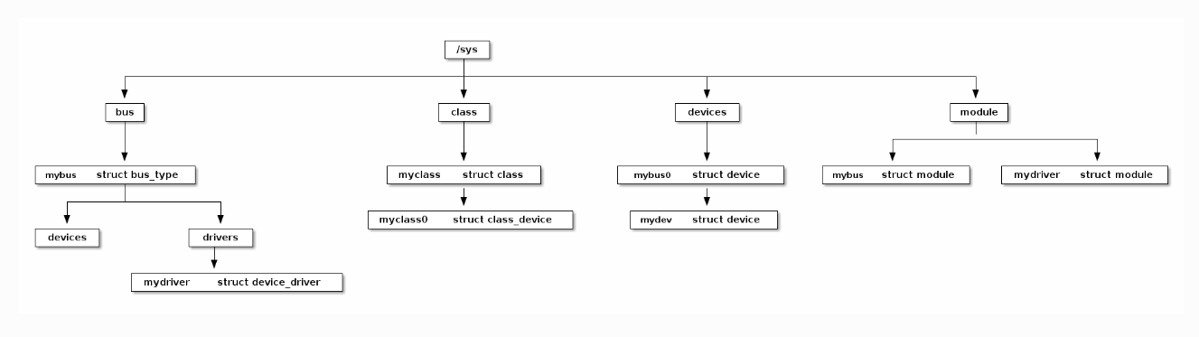
DEVICE DRIVER MODEL
The Device Driver Model in Linux is a system that helps the kernel communicate with hardware devices through drivers, making it easier for software to interact with hardware.

Slide 7
METHODS
Methods Considered:
Platform Driver Method (Chosen).
Device Tree Source (DTS).

Slide 8
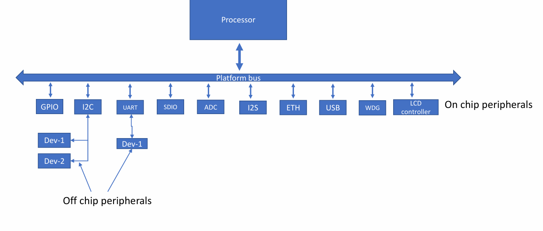
PLATFORM BUS
The Platform Bus in Linux is a virtual bus used to represent non-discoverable devices on embedded systems, allowing the kernel to manage them without needing external hardware detection.

Slide 9
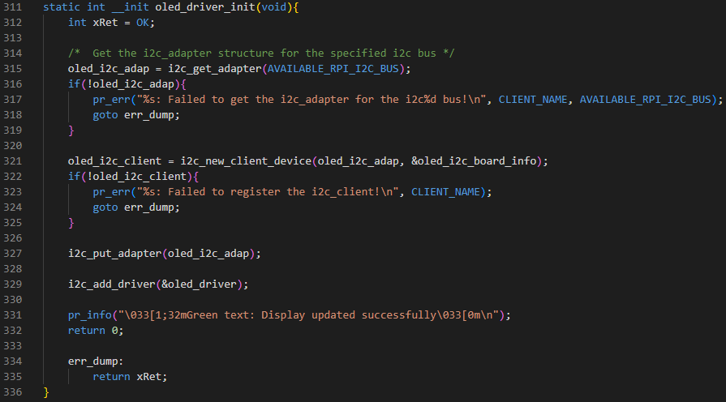
CODE SNIPPETS

Slide 10
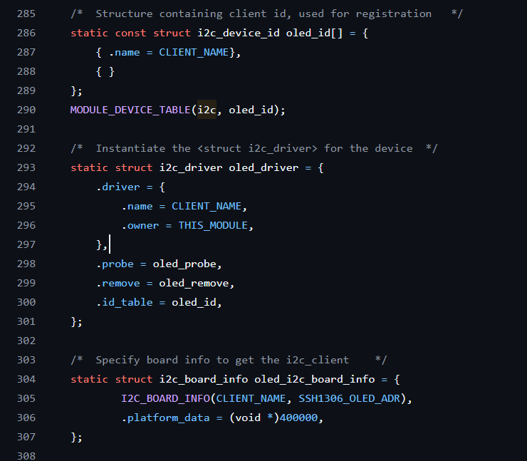
CODE SNIPPETS

Slide 11
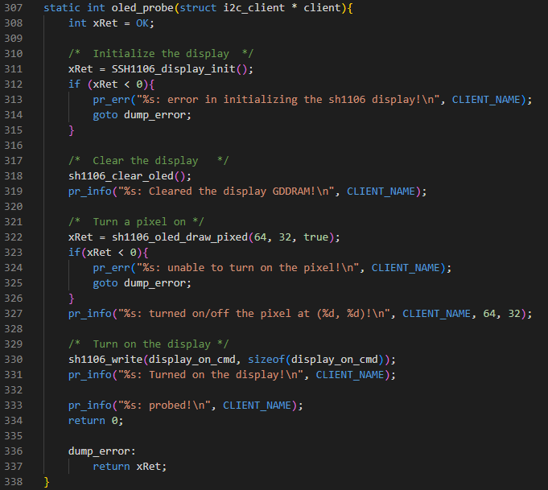
CODE SNIPPETS

Slide 12
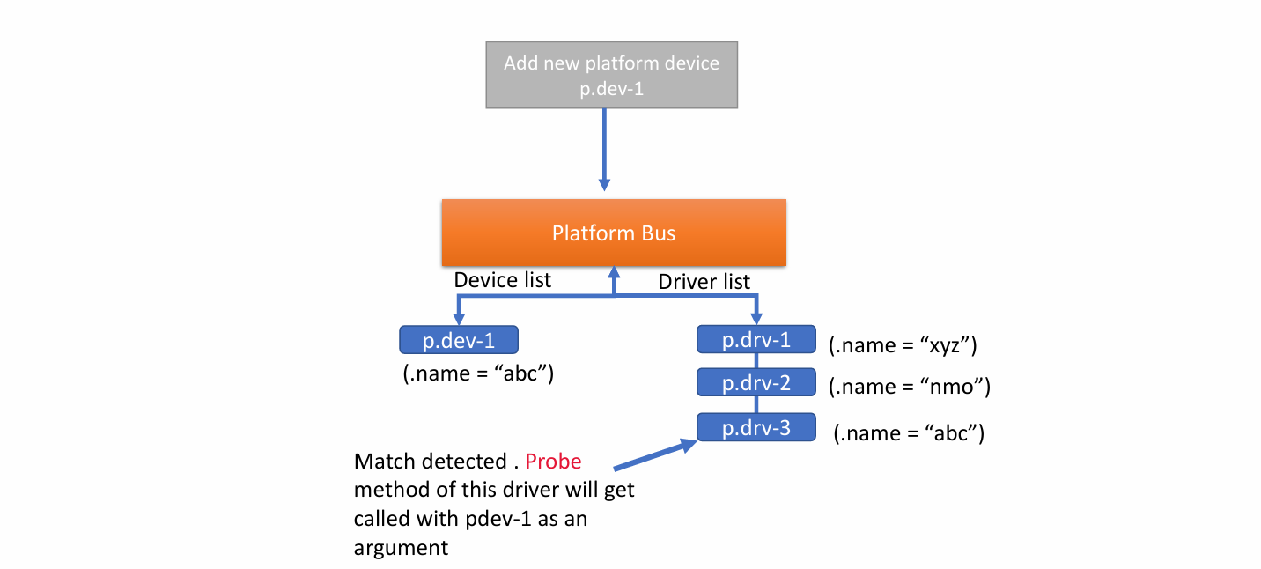
DRIVER MATCHING
Driver matching in Linux is when the kernel connects a device to the right driver based on properties like the device name or compatibility details.

Slide 13
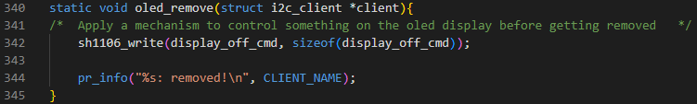
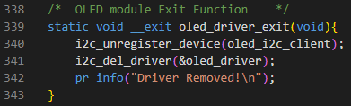
CODE SNIPPETS

Slide 14
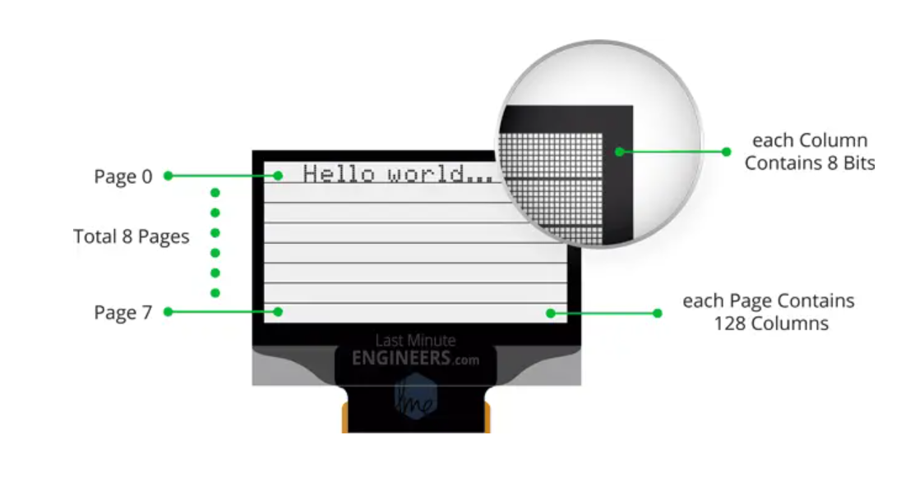
SH1106 DISPLAY

Slide 15
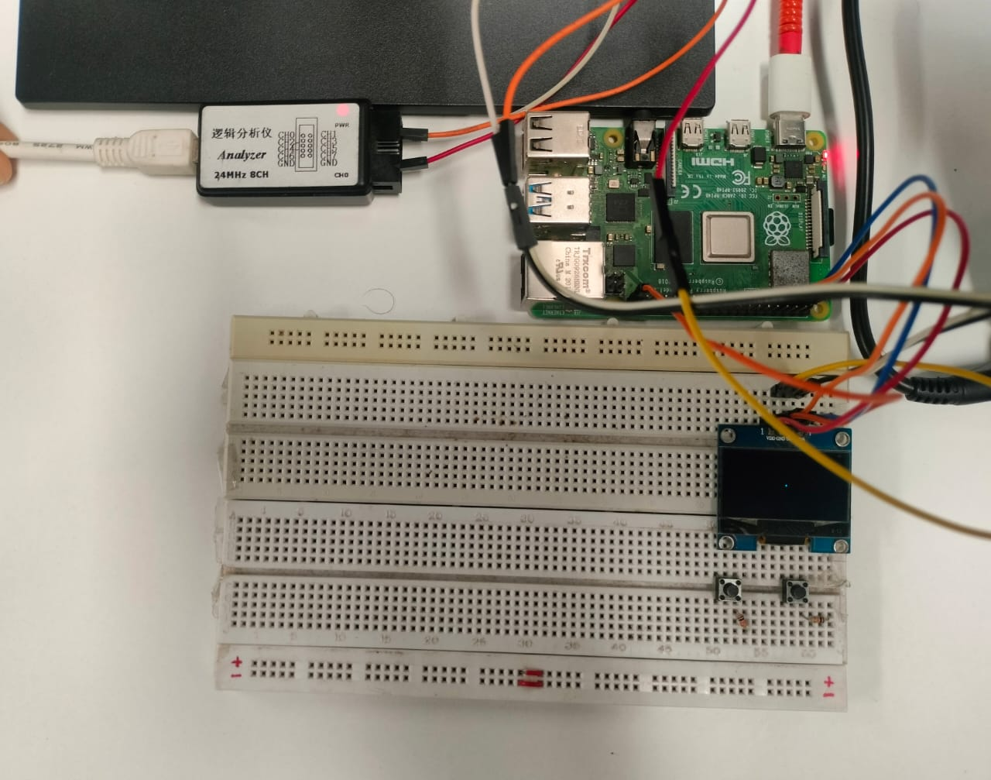
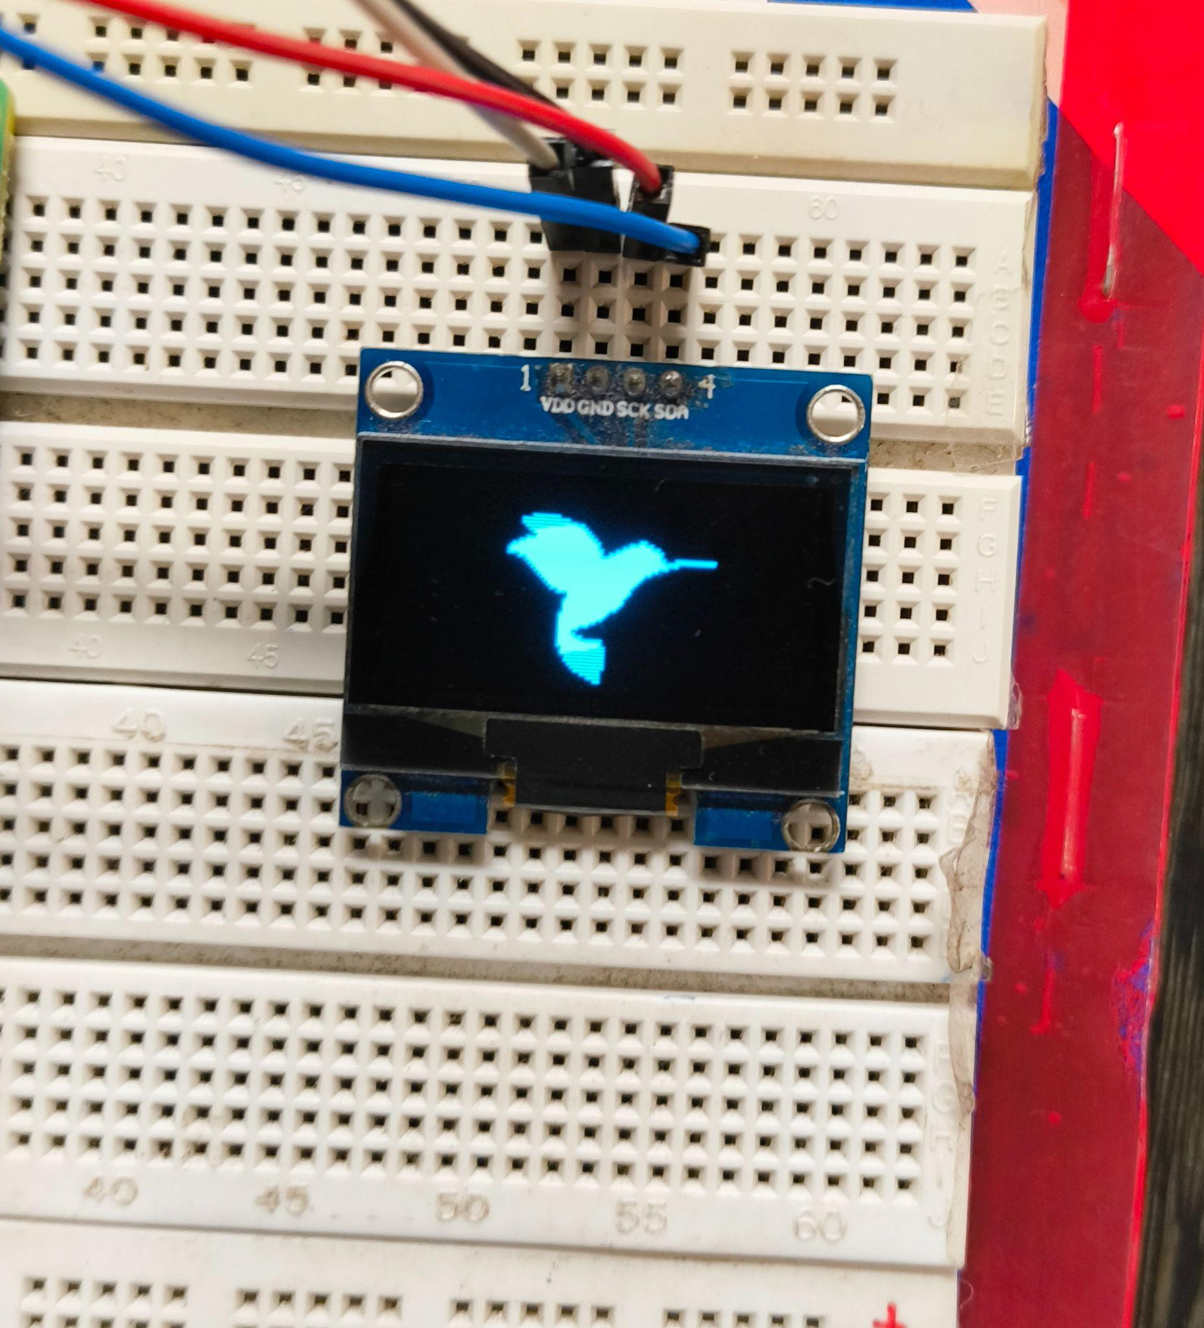
OUTPUT ACHIEVED

Slide 16
TESTING AND DEBUGGING
Testing Tools:
dmesg for kernel logs.
I2C utilities: i2cdetect, i2cset, i2cget.
Implemented our own Logger.
Debugging Techniques:
pr_info and pr_err for logging.
Testing using Logical Analyzer.
Step-by-step validation with the SH1106 datasheet.

Slide 17
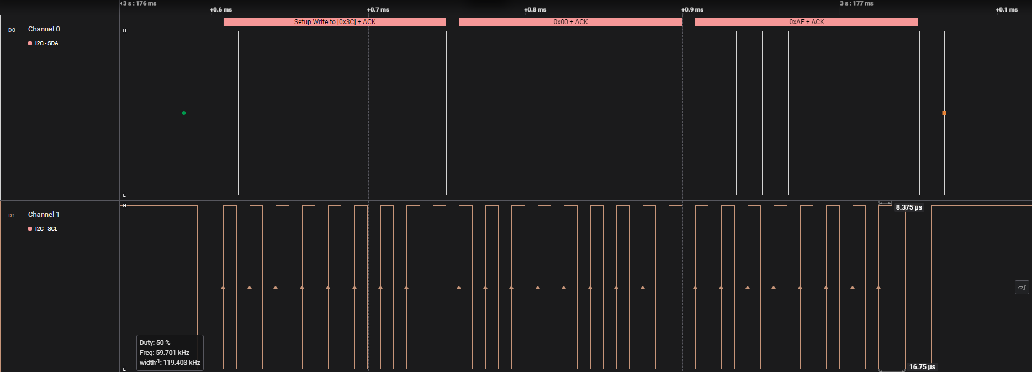
LOGICAL ANALYSER OUTPUT

Slide 18
CHALLENGES FACED
Driver-Device Matching:
Had trouble ensuring the driver and device matched correctly.
Display Driver Setup:
Struggled with initializing the display driver properly.
Segmentation Fault on Module Reload:
Faced a segmentation fault when removing and adding the module due to improper cleanup.

Slide 19
CONCLUSION
KEY LEARNINGS
Learned the Platform Driver Model for managing embedded devices.
Worked with the I2C protocol to communicate with hardware.
Implemented user-space to kernel-space communication using ioctl.
Developed a driver to control an OLED display and manage hardware interactions.

Slide 20
WHATS NEXT?(Future Work)
Dynamic Configurations Via DTS:
Experiment with DTS for dynamic configurations.
Video Output Support:
Enable video output to display advanced graphics or play videos on the screen.
DMA Integration:
Leverage DMA for efficient, high-speed data transfers to the OLED, minimizing CPU load.
Synchronization Mechanisms:
Use interrupts or locks to synchronize CPU and DMA, ensuring safe and consistent data updates.

Slide 21
THANK YOU

