Slide 1


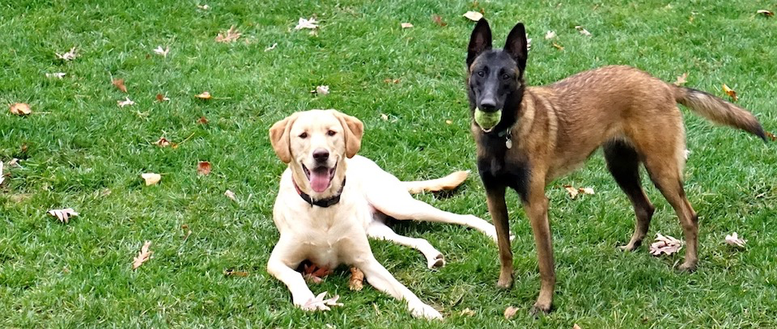
Kulolo
Sai
Owner
© Monkey D. Luffy
2016

