Slide 1


Trade Fair Stall Booking System
Presented By : Prince Pratapsinh Thakur
: Keval Girishbhai Patel
Under Guidance By : Dr. Saziya Saiyed

Slide 2
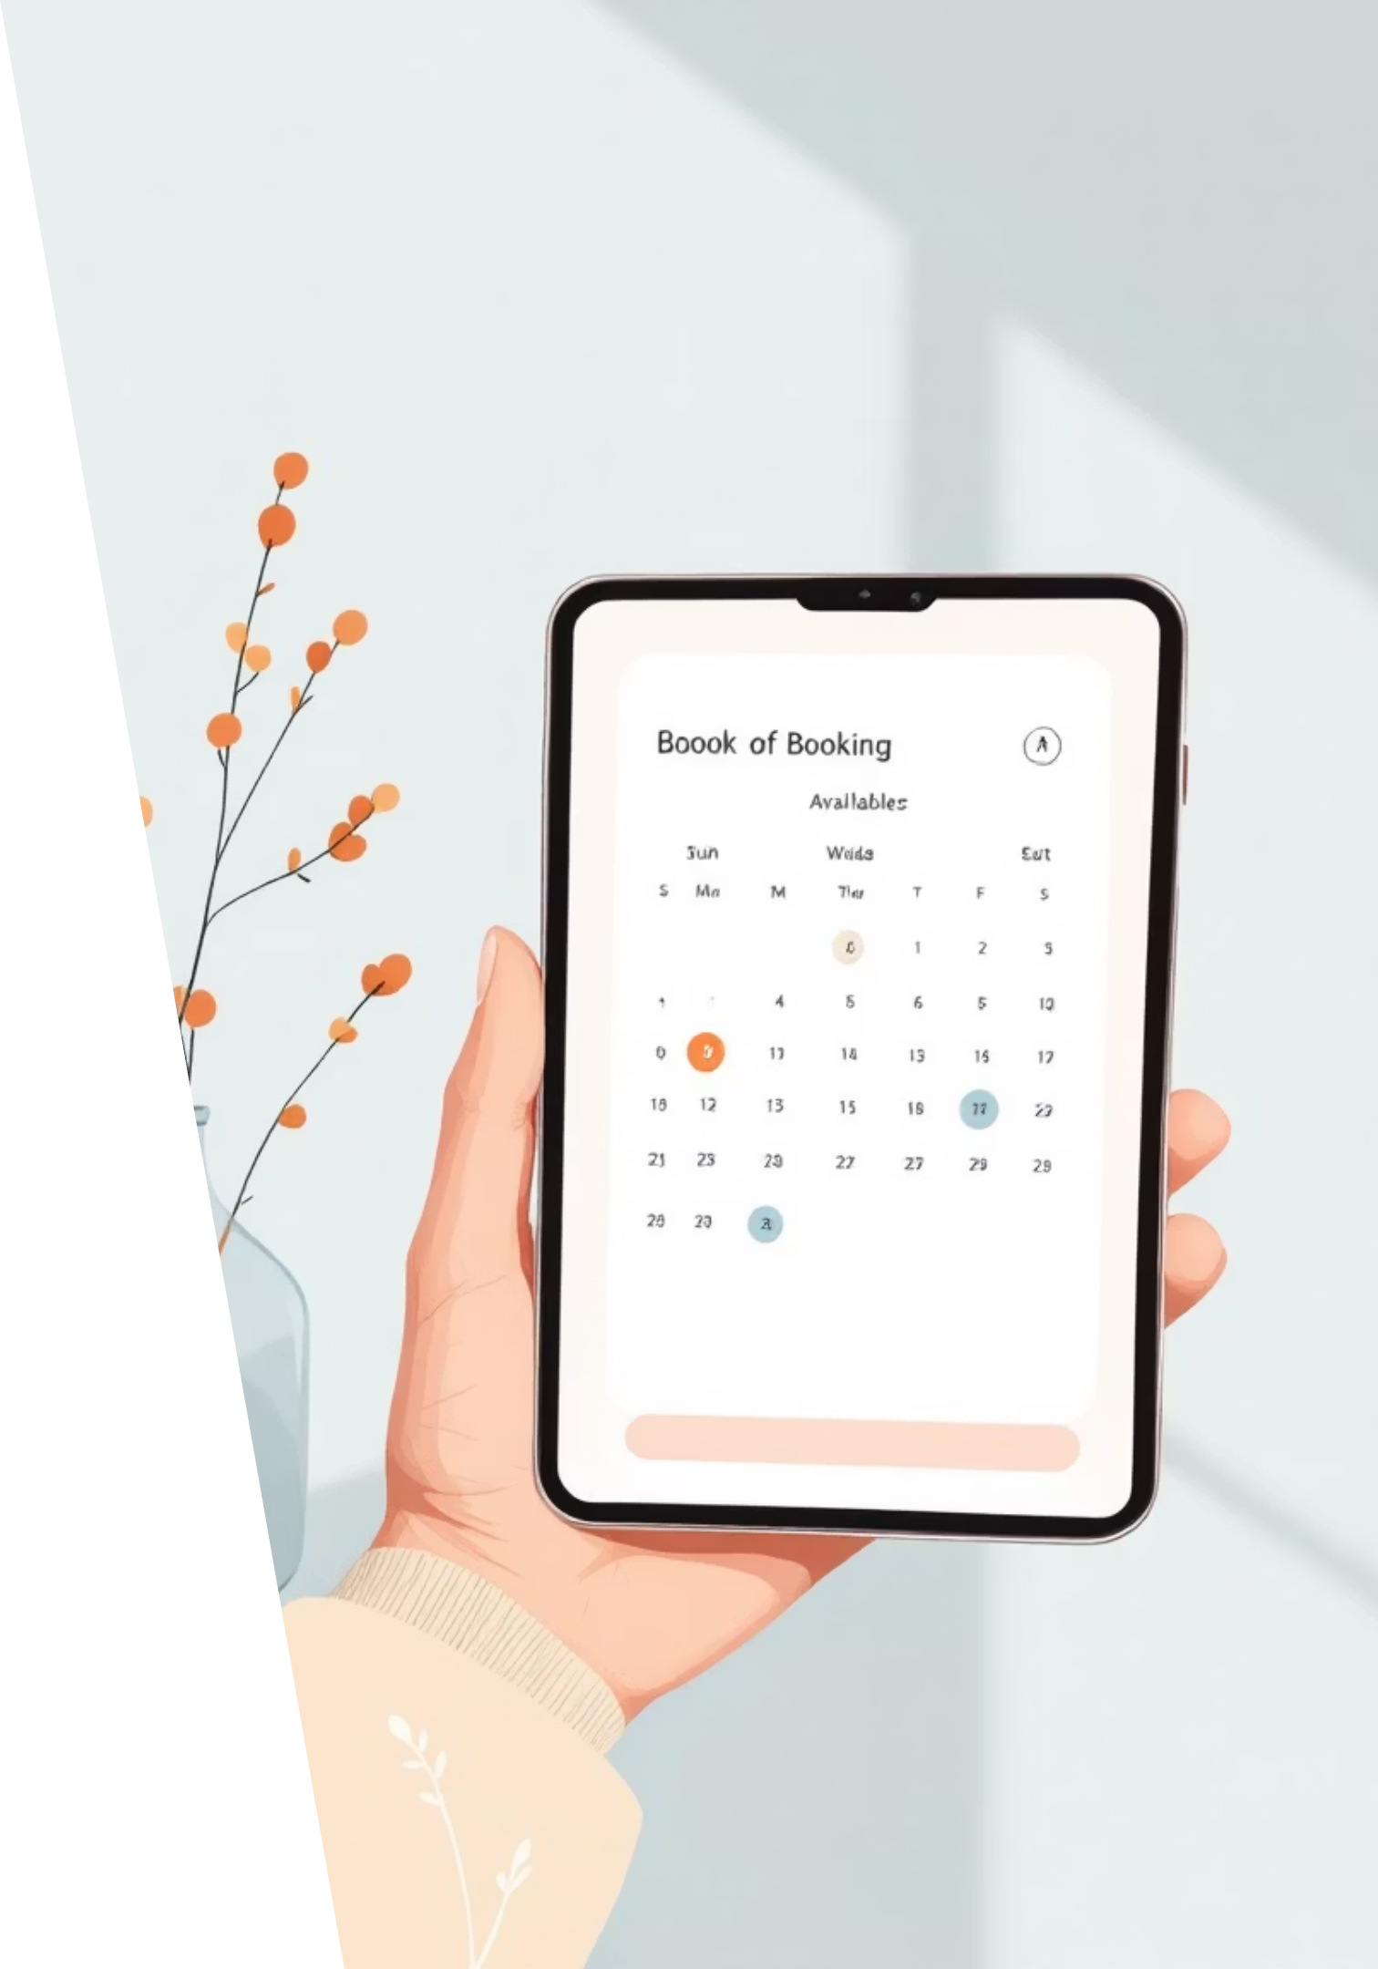
Objective
To provide an online stall booking platform
To reduce manual work and paperwork
To display domes, stalls, and pricing details
To enable easy and quick stall reservation
To improve transparency and accuracy
To help organizers manage bookings efficiently

Slide 3
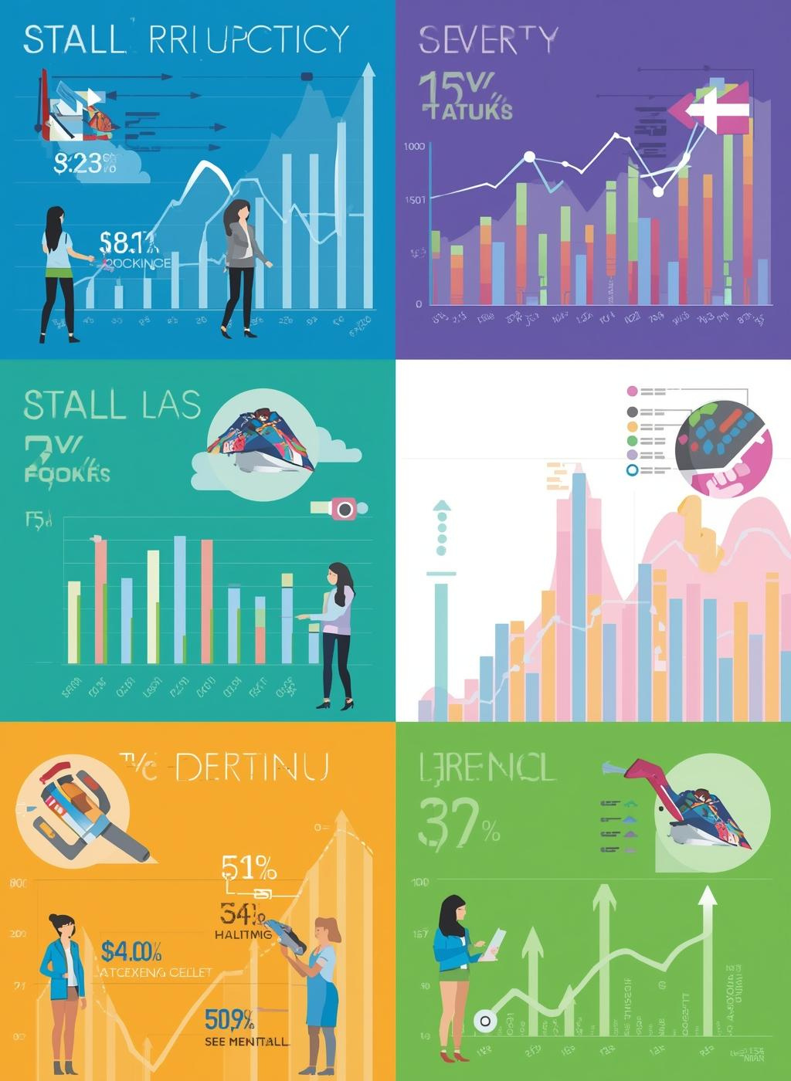

Project Scope
Covers only one location: Mumbai
Includes multiple domes
Different stall prices for each dome
User can view, select, and book stalls
Admin can manage domes, stalls, and bookings
Accessible through a web browser

Slide 4


Abstract
The Trade Fair Stall Booking System is a web- based application developed to automate the process of booking stalls in trade fairs.
It reduces manual work and provides an easy way for exhibitors to view available stalls, check prices, and book stalls online.
The system focuses on a single location, Mumbai, with multiple domes having different stall prices.
This project improves efficiency, transparency, and user experience for both organizers and exhibitors.

Slide 5

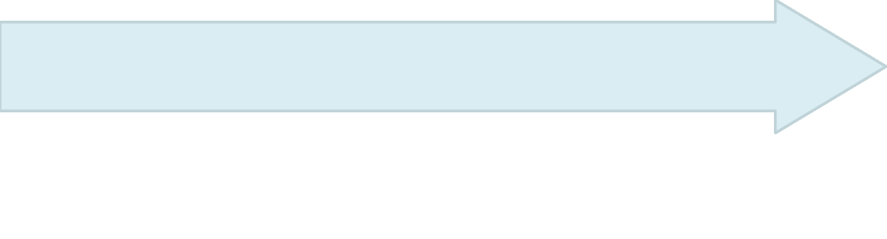


Introduction
This system simplifies the booking process and helps organizers manage stalls efficiently.
The Trade Fair Stall Booking System provides an online solution where users can easily book stalls by selecting domes and checking prices.
Trade fairs are important platforms for businesses to showcase their products and services. Traditionally, stall booking is done manually, which is time-consuming and error-prone..

Slide 6


Literature Review

Slide 7


Requirement Gathering
User
Requirements
Admin
Requirements
User registration and login
View available domes in Mumbai
View stall details and pricing
Select and book stalls online
View booking confirmation
Admin login
Add and manage domes
Manage stalls and pricing
View and manage
bookings
Update stall availability

Slide 8

Requirement Gathering
System Functional Requirement
Non Functional Requirement
Role Based Access(Admin / User)
Prevent double booking of stalls
Automatic status update of stalls(Available / Booked)
Store and retrieve booking data from database.
Displays alert and confirmation message .
Non-functional requirements describe how the system performs.
Usability Requirements
Performance Requirements
Security Requirements
Reliability Requirements

Slide 9





Feasibility Study
Technical Feasibility
The system can be developed using web technologies like HTML, CSS, JavaScript, React, Node.js, and MongoDB.
Required hardware and software are easily available.
No complex or expensive technology is needed.
Econimic Feasibility
Development cost is low as open-source tools are used
No additional hardware investment required
Reduces operational costs by minimizing manual work
Operational Feasibility
Easy to use for both users and admin
Minimal training required
Improves efficiency and reduces human errors

Slide 10


Conclusion
The Trade Fair Stall Booking System makes stall booking simple, fast, and
reliable.
It reduces manual effort, saves time, and ensures better management of trade fair stalls.
The system can be enhanced in the future by adding online payment, multiple locations, and mobile support.

Slide 11


Thank You!

