Slide 1

Performance Isolation and Fairness for Multi-Tenant Cloud Storage
David Shue*, Michael Freedman*, and Anees Shaikh✦
*Princeton ✦IBM Research
Notes:
I will discuss our work on PIsces for providing predictable performance for shared cloud storage ...

Slide 2





Setting: Shared Storage in the Cloud
Y
Y
Z
Z
F
F
T
T
Shared Key-Value Storage
S3
EBS
SQS
Notes:
In the typical cloud environment, tenants lease (compute) resources from infrastructure providers like Amazon, generally in the form of virtual machines.
However, these providers also offer shared back-end services ranging from object-storage (like S3), block-storage (like EBS), and messaging services (like SQS).
In our work we focus specifically on (X) multi-tenant shared key-value storage. In particular, we examine simple KV stores that support basic GET/SET operations, asynchronous durability where all writes are persisted to disk in the background - much like the MySQL MyISAM engine, and operate in a full-bisectional bandwidth network environment where network bandwidth is not a bottleneck.
Now, even given these (reasonable, but somewhat restrictive ) assumptions, achieving predictable performance is hard (X).

Slide 3
Predictable Performance is Hard
Z
Z
Z
Y
Y
Y
Y
T
T
F
F
F
F
F
DD
Shared Key-Value Storage
DD
DD
DD
Multiple co-located tenants ⇒ resource contention
Notes:
Anytime you have multiple tenants accessing common resources, you get resource contention which often/easily leads to unpredictable performance (X).

Slide 4
Predictable Performance is Hard
Z
Z
Z
Y
Y
Y
Y
T
T
F
F
F
F
F
Fair queuing
@ big iron
DD
DD
Shared Key-Value Storage
DD
DD
DD
DD
DD
DD
Multiple co-located tenants ⇒ resource contention
Notes:
If Yelp and Foursquare are misbehaving or are attempting to consume a larger share of resources, this could easily lead to performance degradation for the other two tenants.
Now, if the storage service were implemented on a single monolithic service, we could simply apply fair queuing (X) to enforce fairness and isolation between the tenants and call it a day.
However, unlike traditional DB systems, these services are designed as distributed systems (X) for (scale-out) scalability and fault-tolerance/reliability.

Slide 5
Predictable Performance is Hard
Z
Z
Z
Y
Y
Y
Y
T
T
F
F
F
F
F
SS
SS
SS
SS
Multiple co-located tenants ⇒ resource contention
Distributed system ⇒ distributed resource allocation
Notes:
So the problem of resource allocation and isolation on a single node becomes a distributed resource allocation problem across the entire system wherever tenants contend for resources (X).

Slide 6
Predictable Performance is Hard
data partition
popularity
Z
keyspace
Y
keyspace
T
keyspace
F
keyspace
Z
Z
Z
Y
Y
Y
Y
T
T
F
F
F
F
F
SS
SS
SS
SS
Multiple co-located tenants ⇒ resource contention
Distributed system ⇒ distributed resource allocation
Notes:
In multi-tenant key-value storage systems, each tenant has an independent keyspace (X) for their data. Each keyspace is then divided into disjoint partitions (X) and distributed across the system for horizontal scalability. However, even if each tenant’s objects are evenly distributed across the partitions, object popularity is often skewed, exhibiting power-law of zipfian distributions/behavior. Even with equal dispersion, this can result in skewed demand across the tenant’s partitions.
When these partitions are assigned to individual servers, we often get variable per-node demand (X).

Slide 7
Predictable Performance is Hard
GET
1kB
GET
10B
SET
1kB
SET
10B
(large reads)
(small reads)
(large writes)
(small writes)
Z
Z
Z
Z
Z
Z
Y
Y
Y
Y
Y
Y
Y
Y
T
T
T
T
F
F
F
F
F
F
F
F
F
F
SS
SS
SS
SS
Multiple co-located tenants ⇒ resource contention
Distributed system ⇒ distributed resource allocation
Skewed object popularity ⇒ variable per-node demand
Disparate workloads ⇒ different bottleneck resources
Notes:
But, not only are tenant objects non-uniform in popularity, tenants often have disparate workloads (X) - some may be read heavy, others write heavy and object sizes may vary from large to small, which can stress different bottleneck resources.
Before we attempt to address this rather imposing set of challenges, we first need to ask - what do tenants really want from the system (shared key-value storage) in terms of performance/resource guarantees? Do they really care how many resources they receive on any particular node? Do they even know what their particular demand is for objects on that node?
We would hazard to guess -no. (X)

Slide 8
Tenants Want System-wide Resource Guarantees
demandz = 120 kreq/s
80 kreq/s
120 kreq/s
40 kreq/s
160 kreq/s
ratez = 80 kreq/s
Zynga
Yelp
TP
Foursquare
demandf = 120 kreq/s
Z
Z
Z
Y
Y
Y
Y
T
T
F
F
F
F
F
ratef = 120 kreq/s
Hard limits ⇒ lower utilization
Shared Key-Value Storage
SS
SS
SS
SS
Multiple co-located tenants ⇒ resource contention
Distributed system ⇒ distributed resource allocation
Skewed object popularity ⇒ variable per-node demand
Disparate workloads ⇒ different bottleneck resources
Notes:
Instead, tenants want to treat the entire system as a single black-box (as if it were a big-iron machine) and receive guarantees in terms of system-wide, aggregate resources, often in the form of throughput or request rate (X).
However, we prefer not to treat these desired rates as hard reservations or limits, as this can leave the system under-utilized when some tenants consume less than their reserved share while others want more.
Instead, we convert these request to proportions (X) of total system resources.

Slide 9
Pisces Provides Weighted Fair-shares
wz = 20%
wy = 30%
wt = 10%
wf = 40%
Zynga
Yelp
TP
Foursquare
demandz = 30%
Z
Z
Z
Y
Y
Y
Y
T
T
F
F
F
F
F
ratez = 30%
demandf = 30%
ratef = 30%
Shared Key-Value Storage
Max-min fair share ⇒ lower bound on system performance
SS
SS
SS
SS
Multiple co-located tenants ⇒ resource contention
Distributed system ⇒ distributed resource allocation
Skewed object popularity ⇒ variable per-node demand
Disparate workloads ⇒ different bottleneck resources
Notes:
By treating these proportions as weights, our system: PIsces gives each tenant a weighted max-min fair share of aggregate system resources, which translates to a min guarantee. This ensures that the system remains work-conserving and can achieve high utilization. If any tenant uses less than its share, other tenants are free to consume the excess (X).

Slide 10
Pisces: Predictable Shared Cloud Storage
Pisces
  Per-tenant max-min fair shares of system-wide resources ~ min guarantees, high utilization
  Arbitrary object popularity
  Different resource bottlenecks
Amazon DynamoDB
  Per-tenant provisioned rates
  ~ rate limited, non-work conserving
  Uniform object popularity
  Single resource (1kB requests)
Notes:
We present Pisces: a system for predictable shared cloud storage
While there is a considerable amount of related work in the area, the most similar (work) system to Pisces is Amazon’s DynamoDB (X), which was released earlier this year. DynamoDB is also a shared key-value storage system, but they provide rate-limited provisioned resources to each tenant, which could leave the system underutilized when some tenants use less than their guaranteed share while others want to consume more.
Moreover, DynamoDB assumes uniform object popularity and provides guarantees in terms of a single resource: normalized 1kB request rate.
If these assumptions doesn’t hold, dynamoDB makes no guarantees on the provisioned rates.
Let’s take a look at what mechanisms we might use to solve these decidedly difficult conundrums.

Slide 11
Predictable Multi-Tenant Key-Value Storage
Tenant A
Tenant B
VM
VM
VM
VM
VM
VM
PP
GET 1101100
Controller
RR
RS
FQ
Notes:
As we’ve seen, in any multi-tenant KV storage system, tenant data partitions must be assigned to specific storage nodes. We call this process Partition Placement (X). To access their data, tenant requests must be routed (by the request router) to the node(s) housing the desired data partition. Since tenant data is often replicated for fault-tolerance, the RR can also load-balance GET/read requests across replicas. We call this LB-mechanism Replica Selection (X).
As we’ve mentioned before, when requests from different tenants arrive at the same node, they will contend for shared resources (bandwidth, cpu, etc). To enforce fairness and isolation, we need to apply some form of fair queuing (X) to mediate between their requests.
Here we see three mechanisms we can use that are either natural components of the KV storage architecture, or generally necessary to achieve any form of resource guarantees.
In addition to these three “necessary” mechanisms, we add a fourth (X).
Each tenant has its own independent logical keyspace which is divided into a set number of (equal-sized in terms of # of keys) disjoint partitions (sharding for horizontal scale-out) which are then replicated (for fault tolerance) and assigned to the service nodes.
We call this assignment process: partition placement
When a client issues a request (GET/SET) for a key, it must be routed to the appropriate node hosting the key’s partition. In Pisces, we use the notion of request router to represent the routing logic - the RR can be an intermediate proxy or reside on either end of the system (client lib or server re-direction).
The RR determines the key’s partition (prefix bits) and directs the request to the node containing the partition. If the partition is replicated (for FT) and the KV store is designed to allow anycast (replicated) reads (i.e. eventual consistency or fully replicated writes-2pc), then the RR can load-balance between the replicas.
One natural extension to the basic KV architecture is:
When requests from multiple tenants arrive at a storage node, the server must schedule the requests based on available resources using some form of (weighted) fair queuing to enforce fairness and isolation.
These 3 mechanisms are:
PP and RS are inherent to the architecture (shared-nothing)
FQ is necessary for resource allocation (fairness) and isolation at the point of resource contention
Since our goal in Pisces is to provide per-tenant max-min fair shares of system-wide resources according to tenant-specified (weights/service-levels/rates), we need to introduce one more mechanism

Slide 12
Predictable Multi-Tenant Key-Value Storage
WeightA
WeightB
Tenant A
Tenant B
VM
VM
VM
VM
VM
VM
PP
GET 1101100
Controller
WA
WA2 WB2
RR
RS
FQ
WA1 WB1
WA2 WB2
Notes:
Since the goal of Pisces to provide per-tenant weighted fair shares of aggregate system resources, the system must
translate (X) these global weights (or shares) into local weights (or allocations) on the storage nodes. We call this mechanism Weight Allocation. This is especially necessary because tenant demand could vary across nodes and hence, and we should give tenants weight (or local shares) where they need it most.
Again, we see that the 4 mechanisms we’ve introduced are natural products of the KV storage architecture, the need to enforce fairness and isolation at the point of contention (local nodes), and the goal of system-wide fair-shares. But our main contribution is not the fact that we use (or identify) these mechanisms, but in how we implement and combine them to achieve per-tenant system-wide fair sharing.
In the following slides, we’ll dive into the details of each mechanism and see how the simple/strawman/naive approach can fail to achieve fairness and how Pisces solves the problem. And by the end, we’ll see how the mechanisms function together to solve different aspects of a global optimization problem designed to achieve fairness with high utilization (X).

Slide 13
Strawman: Place Partitions Randomly
WeightA
WeightB
Tenant A
Tenant B
VM
VM
VM
VM
VM
VM
PP
Controller
WA
WA2 WB2
RR
RS
FQ
Notes:
If we take a strawman approach to partition placement and assign partitions to nodes uniformly at random, hot partitions for different tenants could easily wind up colliding on the same server (X).

Slide 14
Strawman: Place Partitions Randomly
WeightA
WeightB
Tenant A
Tenant B
VM
VM
VM
VM
VM
VM
PP
Controller
WA
WA2 WB2
Overloaded
RR
RS
FQ
Notes:
If we look at the aggregate demand for each tenant on the storage nodes, the combination of tenant A and tenant B’s demand on the left node exceeds the node throughput capacity which leads to overload and prevents the tenants from achieving the full fair shares.
So what should we do? Instead, of blindly placing partitions, Pisces places (or in reality migrates) data partitions according to tenant per-partition demand and node capacity constraints (X).

Slide 15
Pisces: Place Partitions By Fairness Constraints
WeightA
WeightB
Tenant A
Tenant B
VM
VM
VM
VM
VM
VM
PP
Collect per-partition
tenant demand
Controller
WA
WA2 WB2
RR
RS
FQ
Bin-pack partitions
Notes:
A centralized controller collections per-partition tenant demand and computes each tenant’s per-partition fair-share. It then runs a bin-packing algorithm (X) to fit the partition demand within the node capacity limits (X).

Slide 16
Pisces: Place Partitions By Fairness Constraints
WeightA
WeightB
Tenant A
Tenant B
VM
VM
VM
VM
VM
VM
PP
Controller
WA
WA2 WB2
RR
RS
FQ
Results in feasible partition placement
Notes:
This gives us a feasible (X) partition placement which allows each tenant to “potentially” receive their full system-wide fair share. While the problem in general is NP-hard, we only need to find a feasible (rather than optimal) solution and many approx. algorithms exist. We don’t fully explore PP and its associated issues (migration costs, replicate vs. migrate, etc) which we leave for future work.
With the partitions properly placed, the next question is how should we divide the global shares among the local storage nodes (X).

Slide 17
Strawman: Allocate Local Weights Evenly
WeightA
WeightB
Tenant A
Tenant B
VM
VM
VM
VM
VM
VM
PP
Controller
WA
WA2 WB2
excessive
demand
Overloaded
RR
RS
FQ
WA1 = WB1
WA2 = WB2
Notes:
The simplistic approach would be to simply distribute the global weights evenly among the local weights by simply copying them down. In this example, since tenants A and B have the same global weight, they also have equal local weights on both nodes. Because each tenant has different demand on each node (again due to skewed partition demand), we can easily see that this results in a mismatch. Fortunately Pisces is designed to be a work-conserving system, each tenant can consume the unused excess of the other tenant and achieve their full fair shares.
However, if tenant B increases its overall demand (X), it can consume the originally unused excess on the left node which prevents tenant A (X) from achieving its system-wide fair share. A better approach to the problem would be to match the local weights as closely as possible to the tenant demand: give the tenants weight where they need it most (X).

Slide 18
Pisces: Allocate Local Weights By Tenant Demand
WeightA
WeightB
Tenant A
Tenant B
VM
VM
VM
VM
VM
VM
PP
max
mismatch
Compute per-tenant
+/- mismatch
Controller
WA
WA2 WB2
M/M/1
queuing delay
RR
RS
FQ
WA1 = WB1
WA2 = WB2
WA1 > WB1
WA2 < WB2
Reciprocal weight swap
A←B
A→B
Notes:
In Pisces, a centralized controller collects (X) per-tenant demand statistics from each node and computes the demand-weight mismatch. It then finds the max mismatch and attempts to minimize it by shifting weight (X) from a tenant with excess weight to the under-provisioned tenant. In this case, tenant B gives weight to tenant A at the left node, which resolves the imbalance. To preserve the global weight proportions, however, we need to reciprocate (X) the weight swap at a different node. Here, A gives the same amount of weight back to B on the right node, which alleviates its mismatch (win-win).
With partitions placed and local weights matched, we look at how replica selection effects fairness (X).

Slide 19
Strawman: Select Replicas Evenly
WeightA
WeightB
Tenant A
Tenant B
VM
VM
VM
VM
VM
VM
PP
GET 1101100
Controller
WA
WA2 WB2
50%
RR
50%
RS
FQ
WA1 > WB1
WA2 < WB2
Notes:
Say each tenant has replicated partitions. If replica selection is enabled, then it can direct requests to either node.
If we take a (extremely) naive approach and simply distribute requests evenly between the nodes, tenant A will fail (X) to consume the additional resources (weight) on the left node and face overload on the right node. Now you would probably say that this is a rather clumsy way of doing things. We know the weights, so why don’t we inform the RR and distributed requests accordingly. However, sending these weight updates, from every node for every tenant to each RR (which could be in the client library) could be prohibitive (X).

Slide 20
Pisces: Select Replicas By Local Weight
WeightA
WeightB
Tenant A
Tenant B
VM
VM
VM
VM
VM
VM
PP
GET 1101100
Controller
WA
WA2 WB2
detect weight
mismatch by
request latency
50%
60%
40%
50%
RR
RS
FQ
WA1 > WB1
WA2 < WB2
Notes:
Instead, in Pisces, each request router implicitly detects (X) the mismatch between its selection policy (demand) and the local weights using request latency as a proxy. It then adjusts its proportions accordingly to match the local weights which allows tenant A (X) to consume the weighted shares at each local node and achieve full system-wide fairness. Now that we have tenant demand and their weighted shares adjusted at the local and global level, let’s go to where the rubber meets the road (X).
Thus, PISCES uses a replica selection policy that distributes load according to the local shares (weights). However, instead of explicitly measuring demand, computing the distribution weights (per-node), and pushing updates out to the RR from the centralized controller, PISCES distributes the computation across the RR’s themselves using a FAST-TCP like (windowed) algorithm that uses implicit demand/weight measurements (observed request latency - shadow price of violating the per-node tenant weight capacity constraints) to send more requests to nodes with lower latency (greater weight). Additional details on the algorithm are in the paper.
Detect demand-weight mismatch (request latency)Adjust per-tenant, per-node request windowsSelect replicas based on request windows

Slide 21
Strawman: Queue Tenants By Single Resource
Tenant A
Tenant B
VM
VM
VM
VM
VM
VM
PP
Bandwidth limited
Request Limited
bottleneck resource
(out bytes) fair share
Controller
WA
WA2 WB2
RR
RS
GET 0100111
GET 1101100
FQ
WA1 > WB1
WA2 < WB2
out
req
out
req
Notes:
Again, whenever data from different tenants reside on the same node, their requests will contend for shared resources. Fair Queuing (X) is the canonical way for mediating between these requests to enforce fairness and isolation in a work-conserving manner. However, if we simply queue based on a single bottleneck resource, then we’ll miss the fact that tenant workloads (X) can stress different resources. In this example, tenant A consumes mostly out bytes (read) and is bandwidth limited while tenant B is request (or cpu) limited. If we apply single resource fair queuing (X), each tenant receives its fair share of the bottleneck (out bytes) resources, but tenant B wins out and is able to consume a proportionally larger share of the request resource. Since we’re dealing with multiple resources and each tenant may have a different “dominant” resource, in Pisces we apply dominant resource fair queuing (X).

Slide 22
Pisces: Queue Tenants By Dominant Resource
Tenant A
Tenant B
VM
VM
VM
VM
VM
VM
PP
Bandwidth limited
Request Limited
dominant resource
fair share
Controller
WA
WA2 WB2
RR
RS
bottlenecked by out bytes
FQ
Track per-tenant
resource vector
WA2 < WB2
out
req
out
req
Notes:
In Pisces, each node tracks a per-tenant resource vector and periodically determines each node’s dominant resource. Using these resource vectors, it then computes (X) the dominant resource fair share which gives each tenant each shares of the resource it wants the most. In this example, compared to single-resource queuing, this would mean reducing tenant B’s out bytes share to ensure that both tenants receive the same amount of their dominant resource (X).
Now that we’ve seen how each mechanism addresses a particular aspect of the fairness problem, let’s take a look at how they work together to achieve global fairness (X).
Now we examine the per-node fair queuing Pisces employs when under resource contention between multiple tenants.
In general, workloads can differ drastically between tenants, both in terms of request type (read/write) and request size (10B -> 1MB) and consume (bottleneck) on different resources, not just due to different distribution skew.
Let’s consider 3 resources: in bytes, out bytes, and requests (packets/interrupts) (both tenants have the same local weight)
Say tenant A has a bandwidth limited (out bytes) resource profile, corresponding to a read-heavy workload of > 1kB objects
Tenant B on the other hand, consumes proportionally far more requests with a read-heavy workload of < 100B objects
If we apply a straight-forward single-resource fair-queueing algorithm (DWRR), then both tenant’s will receive a fair share of the queued/bottleneck resource, but tenant B will consume proportionally more (62.5 > 50) of its dominant resource (requests).

Slide 23

Pisces Mechanisms Solve For Global Fairness
Maximum bottleneck flow weight exchange
PP
Controller
feasible partition placement
global
WA
WA2 WB2
FAST-TCP basedreplica selection
demand-driven
weight allocation
fairness and capacity
constraints
RR
System Visibility
RS
weight-sensitive
selection policy
...
RR
DRR token-basedDRFQ scheduler
Weight Allocations
dominant resource
fair shares
SS
local
...
FQ
Replica Selection
Policies
SS
microseconds
seconds
minutes
Timescale
Notes:
Pisces mechanisms operate on a different timescales and with different system visibility.
PP (X) runs on the order of minutes to a centralized controller to resolve partition demand overload/infeasibility. This is partly due to the fact that migrating large data partitions is expensive and should only be done sparingly, when necessary.
The other mechanisms operate on faster timescales to adapt to dynamic conditions. WA (X) also runs at the centralized controller since it needs per-node statistics for every tenant, but on the order of seconds since adjusting weights causes little disruption in the system. RS (X) and FQ (X) operate in real-time at their respective components to adjust the selection policy and mediate between requests in a fully distributed fashion. Each RR computes its selection policy independently using implicit information (request latency) and storage nodes simply enforce their configured weights.
We can also view the global fairness problem as a search for a particular weight allocation (X) and RS policy (X) that achieves fairness and high utilization (X). But as we’ve seen in our strawman examples not every solution (X) leads to fairness because they violate the fair-share and node capacity constraints. PP moves the search into the space of feasible solutions. Weight allocation adapts local weights (X) to tenant demand, moving the solution towards the optimum. As FQ enforces the local weights RS detects the mismatch (X) and adjusts its selection policy (X). In its next iteration, WA detects (X) the change in demand and repeats the process. Thus, together WA and RS iteratively (X) converge to an optimal point through coordinate gradient ascent.
I will only briefly touch on a few technical highlights that are detailed in the paper. While we’ve shown a bilateral reciprocal weight swap for WA, we can do better with multilateral exchanges (X) which we model as a MBF weight exchange problem. For RS (X) we use a FAST-TCP based scheme to adjust per-tenant per-node request windows. FAST-TCP is a latency based congestion control algorithm that allows us to adapt to rate-weight mismatch. We implement our FQ (X) using a token-based DRR scheme. Most of our technical challenge was getting this right by reducing lock contention for multi-core efficiency and accounting for resource consumption at the right level (X).
Pisces achieves its goals through a unique/novel decomposition of the global fair-sharing problem into 4 complementary mechanisms that operate (in-tandem) on different timescales (components) with varying levels of system visibility to solve different aspects of the distribute resource allocation/isolation problem.
decomposition based on NUM (distributed convex optimization) primal-allocation and master-slave dual-decomposition
Longer time-scale mechanisms operate on system-wide information (PP + WA)
Shorter (real) time mechansims operate on localized information (per-node, or per RR: RS + FQ)
Which we will proceed to describe in detail

Slide 24
Evaluation
Does Pisces achieve (even) system-wide fairness?
  Is each Pisces mechanism necessary for fairness?
  What is the overhead of using Pisces?
Does Pisces handle mixed workloads?
Does Pisces provide weighted system-wide fairness?
Does Pisces provide local dominant resource fairness?
Does Pisces handle dynamic demand?
Does Pisces adapt to changes in object popularity?

Slide 25
Evaluation
Does Pisces achieve (even) system-wide fairness?
  Is each Pisces mechanism necessary for fairness?
  What is the overhead of using Pisces?
Does Pisces handle mixed workloads?
Does Pisces provide weighted system-wide fairness?
Does Pisces provide local dominant resource fairness?
Does Pisces handle dynamic demand?
Does Pisces adapt to changes in object popularity?
Notes:
We will only address a few here. Additional results can be found in the paper.

Slide 26
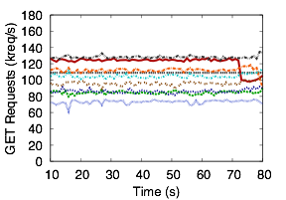
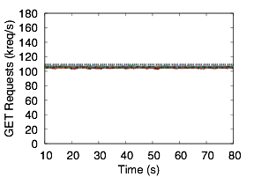
Pisces Achieves System-wide Per-tenant Fairness
Ideal fair share: 110 kreq/s (1kB requests)
Unmodified Membase
Pisces
0.57 MMR
0.98 MMR
8 Tenants - 8 Client - 8 Storage Nodes
Zipfian object popularity distribution
Min-Max Ratio: min rate/max rate (0,1]
Notes:
Pisces is built on top of the Membase multi-tenant key value storage system (persistent memcached).
8 tenants spread over 8 clients accessing an 8 node storage system
Each tenant has an independent key-space with 100k objects spread over 1024 partitions which are then mapped onto the servers
Each partition is replicated twice for fault tolerance and to enable replica selection
Client requests are generated using the YSCB with a skewed (zipfian) distribution (parameter 0.99)
We measure fairness using the min-max ratio - (optimal fairness = 1) which directly mirrors max-min fair sharing
As a baseline we measure the fairness of an unmodified membase system. As expected, fairness is quite poor due to the infeasible placement of the skewed demand partition.
With all mechanisms active to solve for an optimal solution to the global fairness problem, Pisces is able to achieve near ideal fairness. Let’s probe a level deeper to see how each mechanism contributes to global fairness (X).

Slide 27
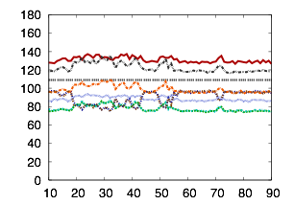
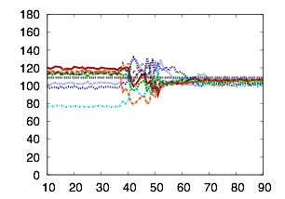
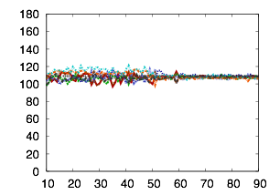
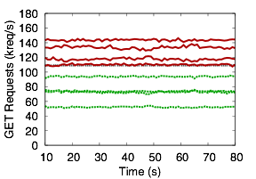
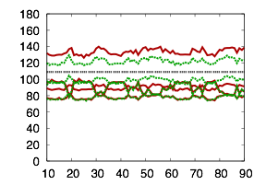
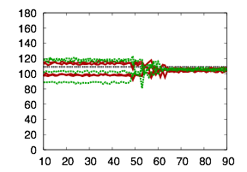
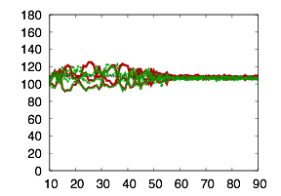
Each Pisces Mechanism Contributes to System-wide Fairness and Isolation
Unmodified Membase
FQ
FQ
PP
WA
FQ
PP
RS
WA
 | usually | sometimes | always
 | always | always | always
0.57 MMR
0.59 MMR
0.64 MMR
0.93 MMR
0.90 MMR
0.98 MMR
PP
WA
WA2 WB2
FQ
2x vs 1x demand
RS
RS
0.36 MMR
0.58 MMR
0.74 MMR
0.96 MMR
0.89 MMR
0.97 MMR
Notes:
To our original set of experiments, we add an additional set of experiments to stress the isolation properties of the system. In these experiments, half the tenants (red) send twice the demand of the others (green). With the unmodified system, tenants receive no isolation. The high demand tenants are able to consume extra resources at the expense of the lower demand tenants. When we add in FQ (X), isolation is established and the high demand tenants are barred from exploiting the system. But, as expected, overall fairness doesn’t improve since the partition demand still exceeds local node capacities. With PP enabled (X), partition demand fits within node capacity and fairness improves, but not to the level we expect. The problem here is the mismatched local weights, which remain statically set. This allows some tenants to consume their “excess” local shares at the expense of others. At 45s, we start WA (X) which adjusts the local weights to tenant demand and provides much better fairness. Interestingly, with RS (X), fairness improves over the non-RS case because RS smooths the demand distribution across multiple replicas, alleviating hotspots and relaxing the overall fairness (PP) problem. However, there are still some imbalances that it can’t resolve due to the local weight mismatch. Again, once WA activates, fairness improves as RS and WA iteratively solve for the optimal solution (X).

Slide 28
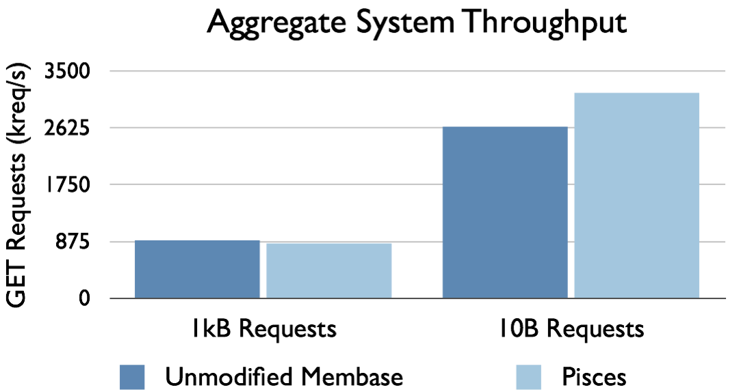
Pisces Imposes Low-overhead
> 19%
< 5%
Notes:
Pisces imposes low overhead on system throughput compared to the unmodified base system. For 1kB requests, the overhead largely arises from the combination of congestion-controlled RS throttling throughput based on detected latency and implementation artifacts in the scheduler needed for achieving proper fairness. In 10B case, Pisces actually exceeds the performance of basic Membase due to its more efficient work-stealing scheduler.

Slide 29
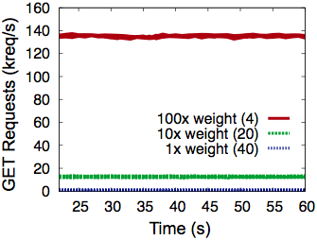
Pisces Achieves System-wide Weighted Fairness
0.98 MMR
0.89 MMR
0.91 MMR
4 heavy hitters
20 moderate demand
40 low demand
0.91 MMR
0.56 MMR
Notes:
We ran two larger scale experiments where the number of tenants far exceeded the number of servers, to mimic more realistic service scenarios where T >> N.
64 tenants reside on 4 out of the 8 available servers with each server housing 32 tenants. To reflect the highly skewed nature of tenant shares, i.e. a few heavy hitters and many small, low-demand users, we configured the tenant weights along a log-scale: 4 tenants with weight 100, 20 with weight 10, and 40 with weight 1.
Within each weight class, Pisces achieves > 0.91 MMR. Between classes, however, weighted fairness decreases to 0.56 MMR. This deviation is due to the limits of the DWRR scheduler token granularity. With such highly skewed weights, tenants in the smallest weight class (1) only receive fractional tokens, which means their requests are processed once every few rounds, which results in a lower relative share. Fairness between the weight 100 and weight 10 tenants, however, remains high (0.91 MMR).
We are working on techniques to work around the token granularity limits of our WFQ scheduler.
In practice, to work around the limited resolution of the WFQ scheduler, the service provider can cap the number of tenants per server to ensure reasonable local weights (token) and match the desired rate guarantees.

Slide 30
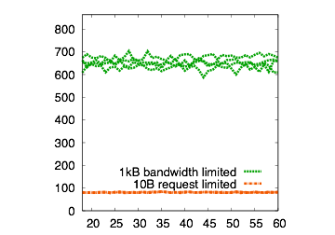
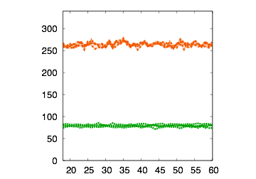
Pisces Achieves Dominant Resource Fairness
1kB workload
bandwidth limited
10B workload
request limited
76% of bandwidth
76% of request rate
GET Requests (kreq/s)
Bandwidth (Mb/s)
24% of request rate
Time (s)
Time (s)
Notes:
Pisces achieves dominant resource fairness (on a per-node level) between tenants:
Here we have 4 tenants with a bandwidth limited GET (read) workload: 1kB objects
and 4 tenants with a request (packet) limited GET workload: 10B objects
As expected (X), the bandwidth limited tenants receive a much higher proportion of bandwidth, while the (X) request limited tenants receive the lion’s share of request throughput. The key, however, is that Pisces gives each tenant equal shares of their dominant resource. We can see from the bottleneck (request rate) resource that any adjustment to the request rate resource sharing will result in unfair allocation of the tenant’s dominant resource shares (X).

Slide 31
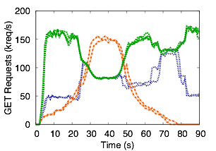
Pisces Adapts to Dynamic Demand
Tenant
Demand
Constant
Diurnal (2x wt)
Bursty
even
~2x
Notes:
Dynamic workloads present a challenge for any system to provide consistent, predictable performance.
In these experiments we have 3 types of tenants issuing requests according to different demand patterns.
Constant tenants issue requests at the same rate over the duration of the experiment. Diurnal tenants follows a central mode demand curve (with 2x weight - 2x global shares). Bursty tenants issue periodic bursts of requests.
Initially, the tenants consume less than the full system capacity which allows the constant tenants to consume a larger proportion. As the diurnal tenants ramp up between 0 and 20 seconds, they begin to consume their share of throughput which cuts into the excess share consumed by the constant tenants. Around 20s, both the bursty tenants and diurnal tenants ramp up to their full load, which results in a nearly 2 to 1 ratio, according to the tenant weights.
The diurnal tenants tail off around 50s along with the bursty tenants which al- lows the constant demand tenants to, once again, consume in excess of their fair share (∼ 80 kreq/s). Lastly, at 70s, the bursty tenants issue one last barrage of requests, which forces the constant tenants to share the throughput equally.

Slide 32
Conclusion
Pisces Contributions
  Per-tenant weighted max-min fair shares of system-wide resources w/ high utilization
  Arbitrary object distributions
  Different resource bottlenecks
  Novel decomposition into 4 complementary mechanisms
PP
Partition
Placement
WA
Weight
Allocation
RS
Replica
Selection
FQ
Fair
Queuing

