Slide 1
Regular Sequential Serializability
Jeffrey Helt◊
Matthew Burke○, Amit Levy◊, Wyatt Lloyd◊
◊Princeton University ○Cornell University

Slide 2





Distributed Applications and Services
App
Web
Database
Service
Consistency Model

Slide 3



Existing Models Offer Trade-Off
Application
Invariants
Strict Serializability
Serializability
R(X) != null
Consistency Model
Serializability
Strict Serializability
Service
Design Space

Slide 4

Regular Sequential Serializability (RSS)
Application
Invariants
Strict Serializability
Strict Serializability/RSS
Serializability
Consistency Model
Serializability
RSS
Spanner-RSS
Spanner-RSS
Strict Serializability
Spanner
Service
Design Space

Slide 5
Definition of RSS
Guarantees total order of transactions
Order must respect causality
Within each process
Across messages
Across service interactions
Order must respect some real-time constraints
Reads must return up-to-date values
Invariant Equivalence To
Strict Serializability
Avoids Most
User-Visible
Anomalies
(See paper)

Slide 6
Example: RSS vs. Strict Serializability
W₁(X = 1, Y = 1)
App-1
RSS gives more flexibility
to read-only transactions
without breaking applications
R₁(X = 1)
App-2
R₂(Y = 1)
R₂(Y = 0)
App-3
RSS only requires
causally later read-only transactions
to return new value
Strict serializability requires
all future read-only transactions
to return new value

Slide 7






App
Invariant-Equivalence Theorem:
Any application invariant that holds
with a strictly serializable service
also holds with an RSS service
Strict Serializability
RSS
DB
DB

Slide 8
Invariant-Equivalence Proof Intuition
Transform RSS executions into indistinguishable, strictly serializable ones
Same invariants hold under RSS and strict serializability
Key Idea: Transform RSS executions into indistinguishable, strictly serializable ones
Total order: R₂, W₁, R₁
W₁(X = 1, Y = 1)
App-1
R₁(X = 1)
App-2
R₂(Y = 0)
App-3

Slide 9

Spanner (Strict Serializability)
App-W
Shard-X
Shard-Y

Slide 10
Spanner (Strict Serializability)
App-W
App-R1
Shard-X
Shard-Y
App-R2
Strict serializability forces read-only transactions to sometimes block

Slide 11
Spanner-RSS
App-W
App-R1
Shard-X
Shard-Y
App-R2
RSS allows lower read-only transaction latency

Slide 12
Evaluation of Spanner-RSS
Our evaluation demonstrates:
Spanner-RSS improves tail read-only transaction latency
Spanner-RSS’s protocol changes impose minimal overhead
Experimental Setup:
Compared against re-implementation of Spanner’s protocol
Ran on Amazon’s EC2
Retwis (Twitter-like) workload
Keys generated using Zipfian distribution
More details in paper…
This talk
See paper

Slide 13
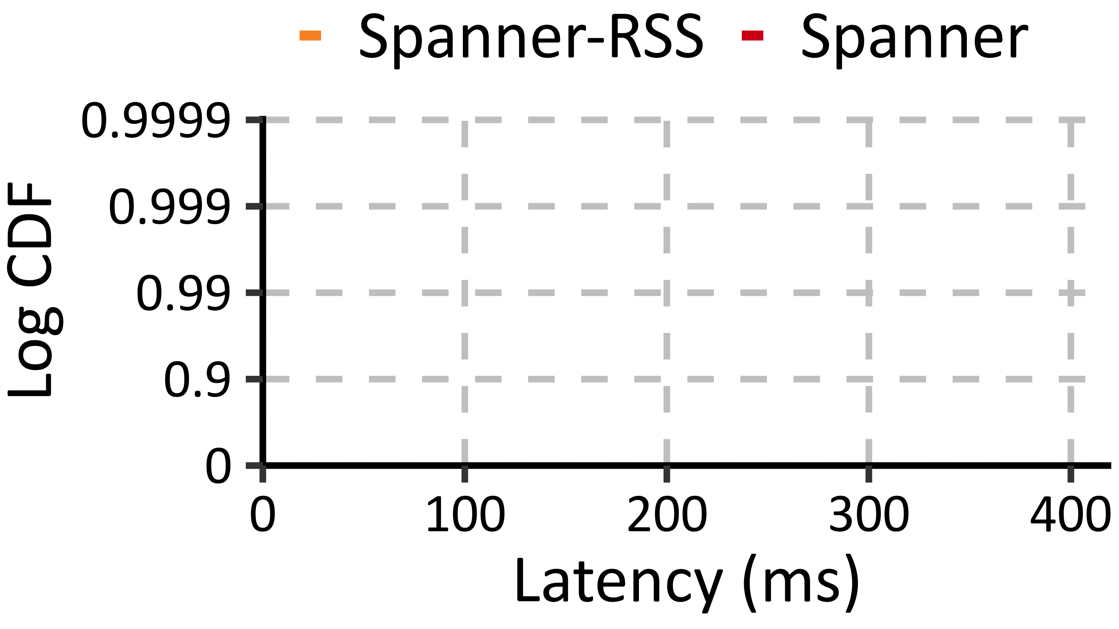
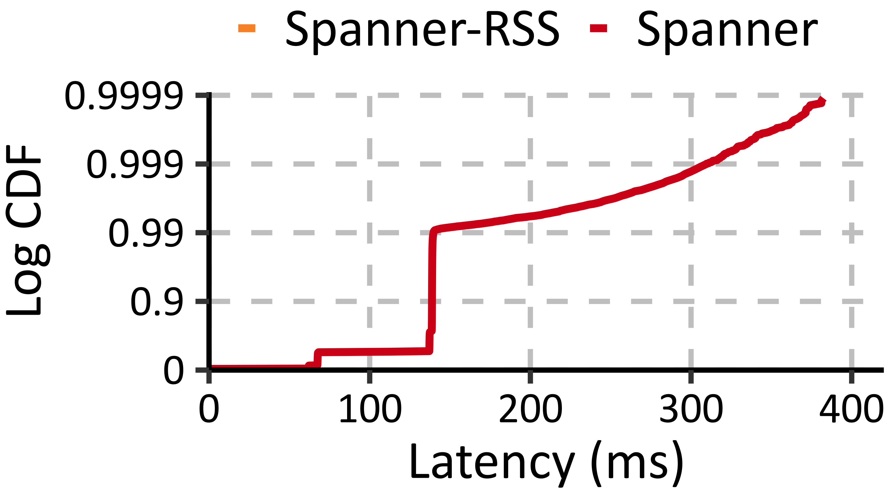
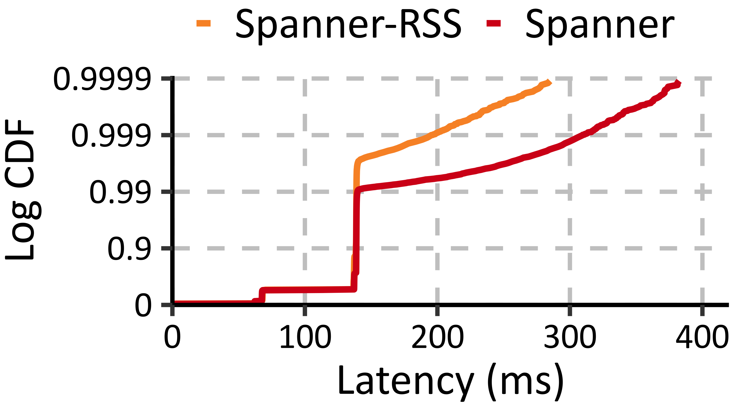
Spanner-RSS Improves Tail RO Latency
45%
Read-only transactions
start blocking
Skew 0.7

Slide 14
Gryff-RSC
Variant of Gryff (key-value store from NSDI ‘20)
Supports non-transactional reads, writes, and read-modify-writes
Relaxes consistency model from linearizability to regular sequential consistency (RSC)
Cuts quorum round trips in read protocol from two to one
Evaluation demonstrates:
Reduces tail read latency by about 50%
Protocol changes impose little overhead

Slide 15
Contact Info:
jhelt@cs.princeton.edu
Spanner-RSS: https://github.com/princeton-sns/spanner-rss
Gryff-RSC: https://github.com/princeton-sns/gryff-rs
Invariant-Equivalent
To Strict Serializability
Spanner-RSS:
reduces tail read-only
transaction latency
by up to 50%
Regular
Sequential
Serializability
Correct Applications
Better Services
Regular
Sequential
Consistency
Invariant-Equivalent
To Linearizability
Gryff-RSC:
reduces tail
read latency
by up to 50%

