Slide 1

Project Title - Seasonal Agriculture Performance Analysis
Student Name: prince sharma
College Name: JSS Academy Of Technical Education
AICTE STU ID: STU6a26ed8a592401780936074
Track: Data Visualization & Analytics | Batch 1 (2026-2027)

Slide 2

PROBLEM STATEMENT
• High Meteorological & Seasonal Vulnerability: Farming outcomes in India are characterized by extreme weather swings across Monsoon (Kharif), Winter (Rabi), and Summer (Zaid).
• Over-Reliance on Monsoon Precipitation: Lack of predictive moisture and climate telemetry leaves smallholders vulnerable to sudden droughts and intense humidity-driven pest surges (54.5% risk in Kharif).
• Resource Mismatch & Economic Deficits: High energy, labor, and water pumping costs in summer cycles (Zaid) outpace realized crop revenues, resulting in an average seasonal deficit of -₹24,452 per farm.
• Lack of Empirical Decision Support: Absence of localized crop-season affinity modeling and micro-irrigation guidance leads to sub-optimal crop selection and resource squandering.

Slide 3
Project Description: Empirical Agronomic Analytics
• Comprehensive Dataset Analysis: In-depth examination of 4,000 agricultural farm samples across 8 major Indian agrarian states (Andhra Pradesh, Gujarat, Karnataka, Madhya Pradesh, Maharashtra, Punjab, Tamil Nadu, Telangana).
• Multi-Dimensional Feature Set: Evaluates 28 variables spanning environmental conditions (Rainfall, Temperature, Humidity, Sunlight), soil parameters (N-P-K, pH, Moisture), agrochemicals (Fertilizers, Pesticides), and farm economics.
• Data Pipeline & Imputation: Implemented stratified group-median imputation based on Season and Crop to address missing values in Rainfall, Soil Moisture, and Yield without distorting seasonal variance.
• Inferential & Statistical Testing: Executed One-Way ANOVA and Kruskal-Wallis hypothesis tests confirming statistically significant differences in seasonal profitability (F = 34.40, p = 1.54 × 10⁻¹⁵) and crop productivity.
• Strategic Agritech Framework: Generates actionable crop-season affinity matrices, irrigation efficiency rankings, and risk-adjusted farmer advisories.

Slide 4

WHO ARE THE END USERS?
👨‍🌾 Smallholder Farmers
• Select optimal high-margin crop-season combinations.
• Adopt Drip irrigation to double net profit (₹25,544/Ha vs ₹9,005/Ha).
• Time pesticide sprays with humidity alerts to prevent crop failure.
🏦 Agri-Fintech & Insurers
• Underwrite parametric weather insurance tied to rainfall thresholds.
• Assess creditworthiness using empirical profit-per-hectare metrics.
• Reduce loan default rates through automated seasonal risk scoring.
🚚 Supply Chain & FMCG
• Forecast harvest tonnage across Kharif and Rabi with high fidelity.
• Optimize warehousing capacity before seasonal harvest arrivals.
• Secure direct farmer contracting for high-value crops (Chilli, Sugarcane).
🏛️ Extension Officers & Policy
• Direct government subsidies towards high-efficiency micro-irrigation.
• Deploy Integrated Pest Management (IPM) in high-risk Kharif zones.
• Formulate soil health interventions based on N-P-K deficiency maps.

Slide 5

Technology Used
• Python 3.10+ Analytics Engine: Core programming environment for high-performance data wrangling, automation, and mathematical modeling.
• Pandas & NumPy: Vectorized operations, data aggregation, stratified median imputation, and derived KPI feature engineering.
• Scipy.stats & Statsmodels: Rigorous statistical hypothesis testing including One-Way ANOVA ($F$-test), Kruskal-Wallis non-parametric tests, and linear OLS regression.
• Matplotlib & Seaborn: Publication-quality 1200 DPI visualizations (dual-axis charts, heatmaps, regression subplots, and grouped financial bar charts).
• Google Colab & Jupyter Notebook: Cloud-native interactive execution with automated repository cloning, environment detection, and 1-click execution.
• python-pptx & Git/GitHub: Programmatic generation of executive submission presentation deck and Git version control repository management.

Slide 6
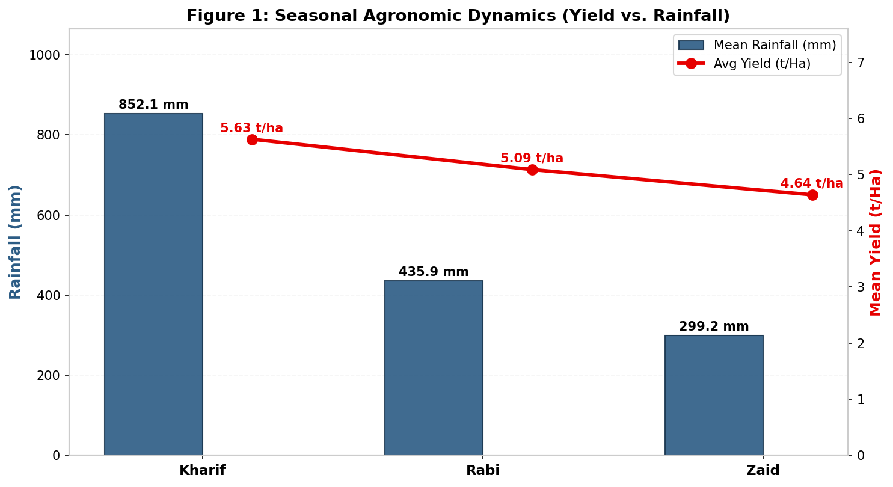
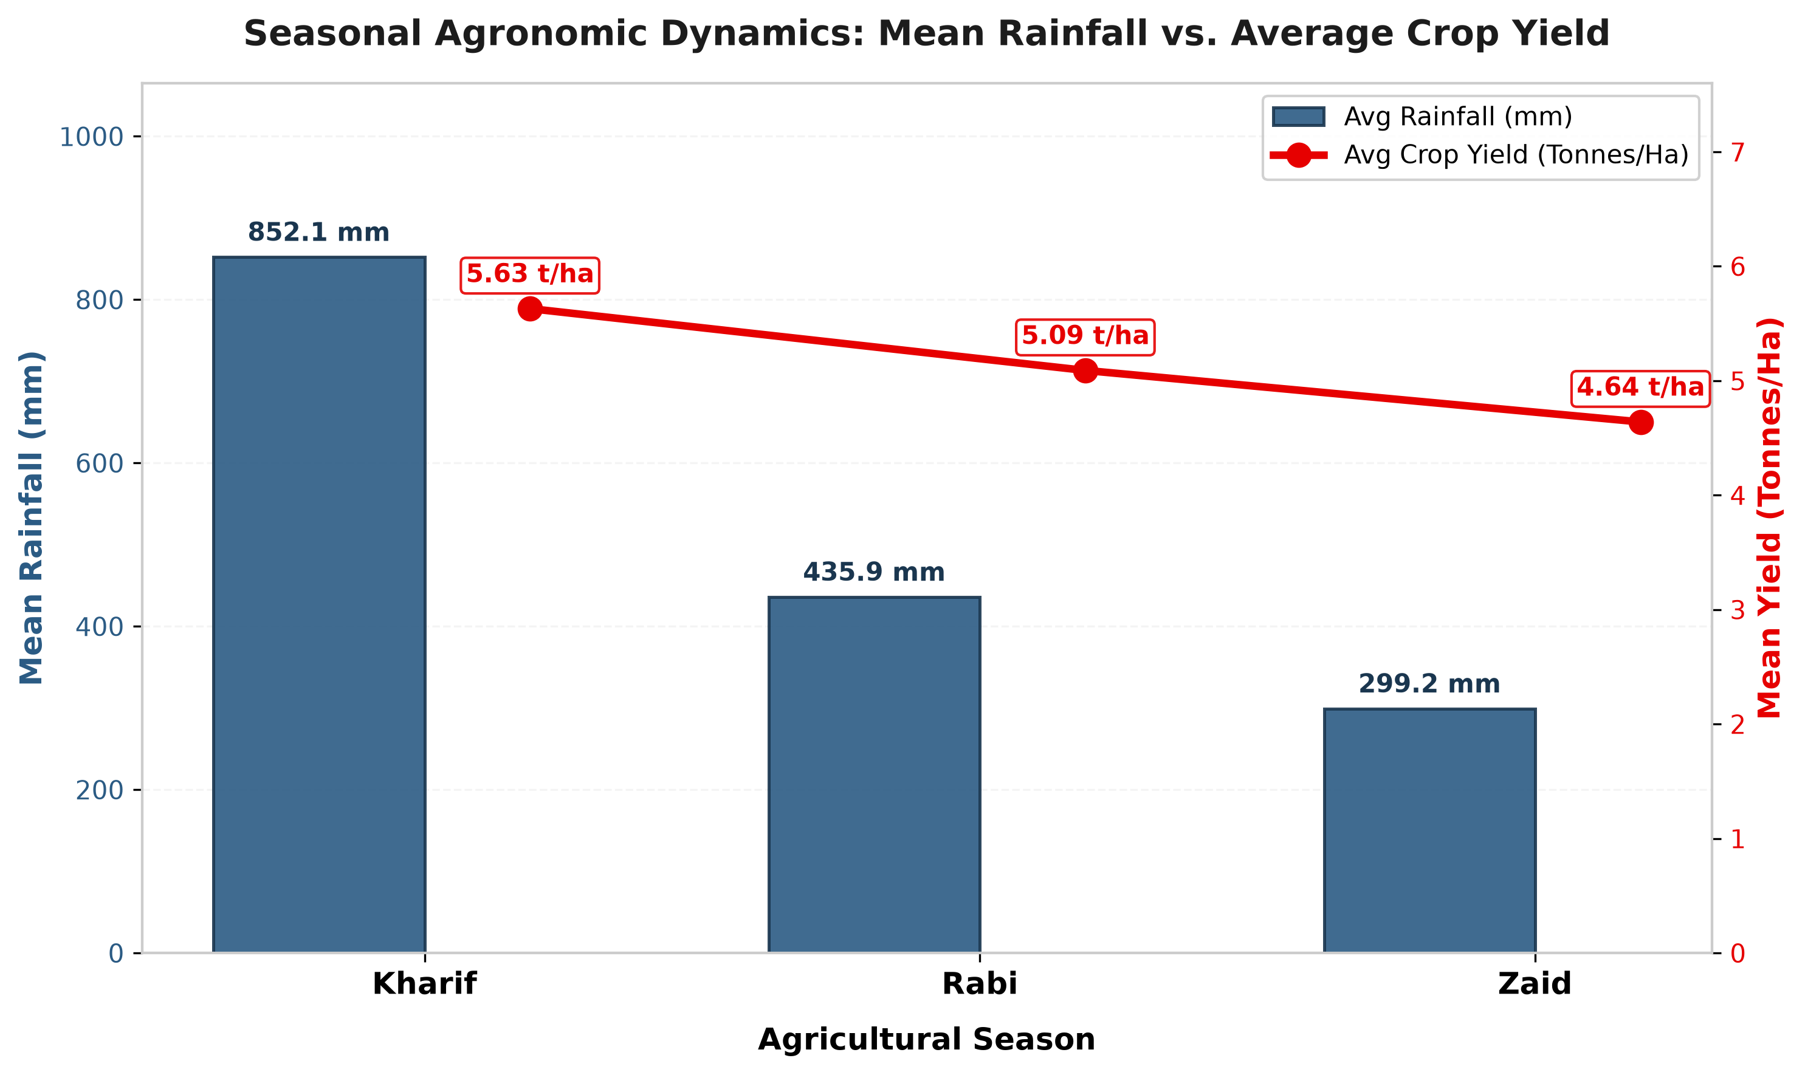
RESULTS: Seasonal Agronomic Dynamics (Yield vs. Rainfall)
📊 Key Analytical Insights
1. Monsoon-Driven Crop Yields
Kharif yields peak at 5.63 Tonnes/Ha driven by heavy monsoon rainfall (mean 852.1 mm), compared to 5.09 t/Ha in Rabi and 4.64 t/Ha in Zaid.
2. Precipitation Gradient Across Cycles
Rainfall drops steeply by 48.8% in Rabi (435.9 mm) and 64.9% in Zaid (299.2 mm), necessitating supplementary artificial irrigation.
3. Statistically Significant Variation
Kruskal-Wallis testing confirms highly significant seasonal differences in crop yield distributions (H = 70.26, p = 5.52 × 10⁻¹⁶).

Slide 7
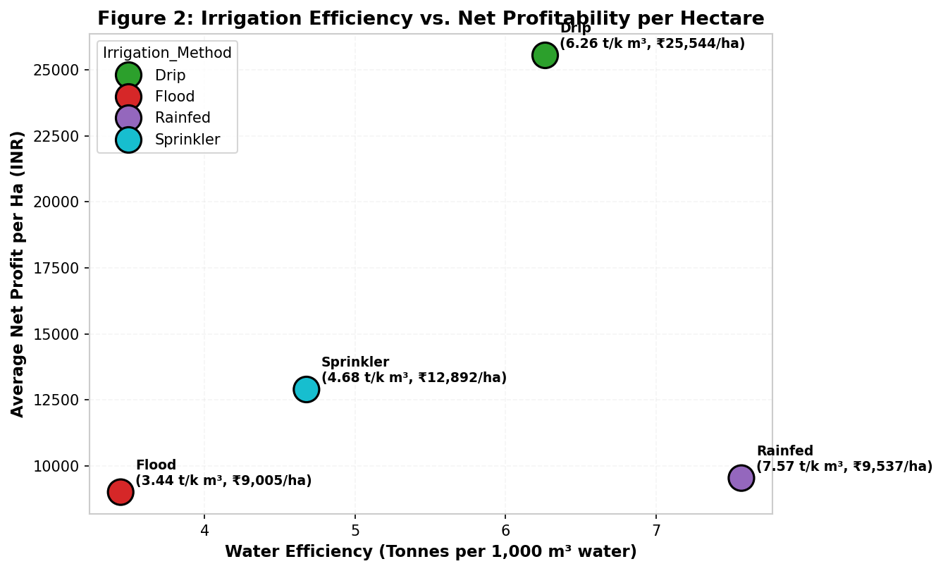
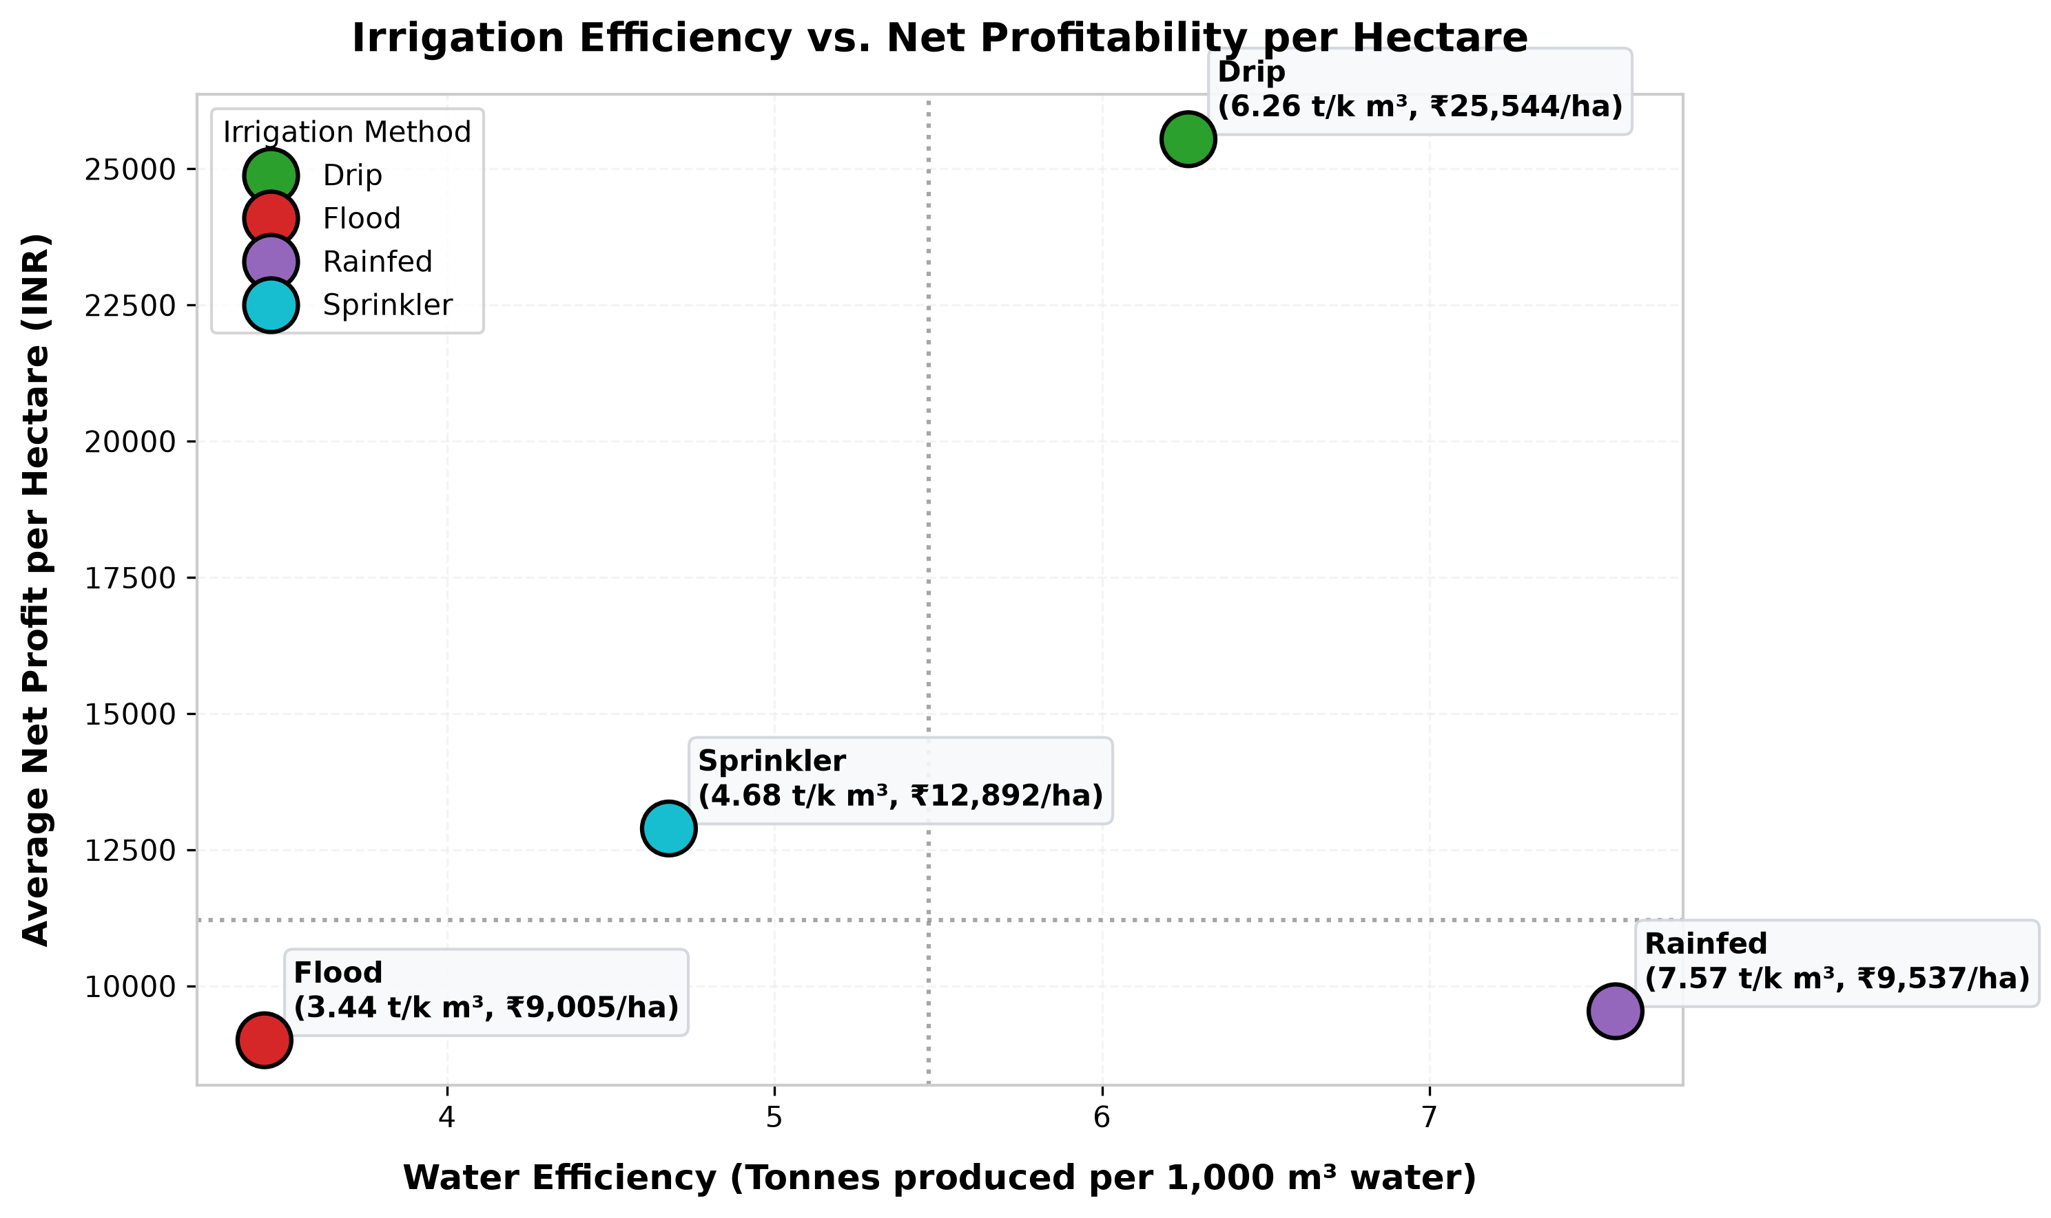
RESULTS: Irrigation Method Efficiency vs. Net Profitability
📊 Key Analytical Insights
1. Drip Irrigation Financial Premium
Drip irrigation achieves the highest average net profit of ₹25,544/Ha (₹218,659/farm), nearly triple that of traditional flood methods.
2. High Water Productivity
Drip delivers 6.26 t/1,000 m³ water efficiency, ensuring maximum biological crop output per unit volume of water consumed.
3. Flood Irrigation Inefficiency
Flood irrigation proves lowest in profitability (₹9,005/Ha) and water efficiency (3.44 t/1,000 m³), squandering massive ground table reserves.

Slide 8
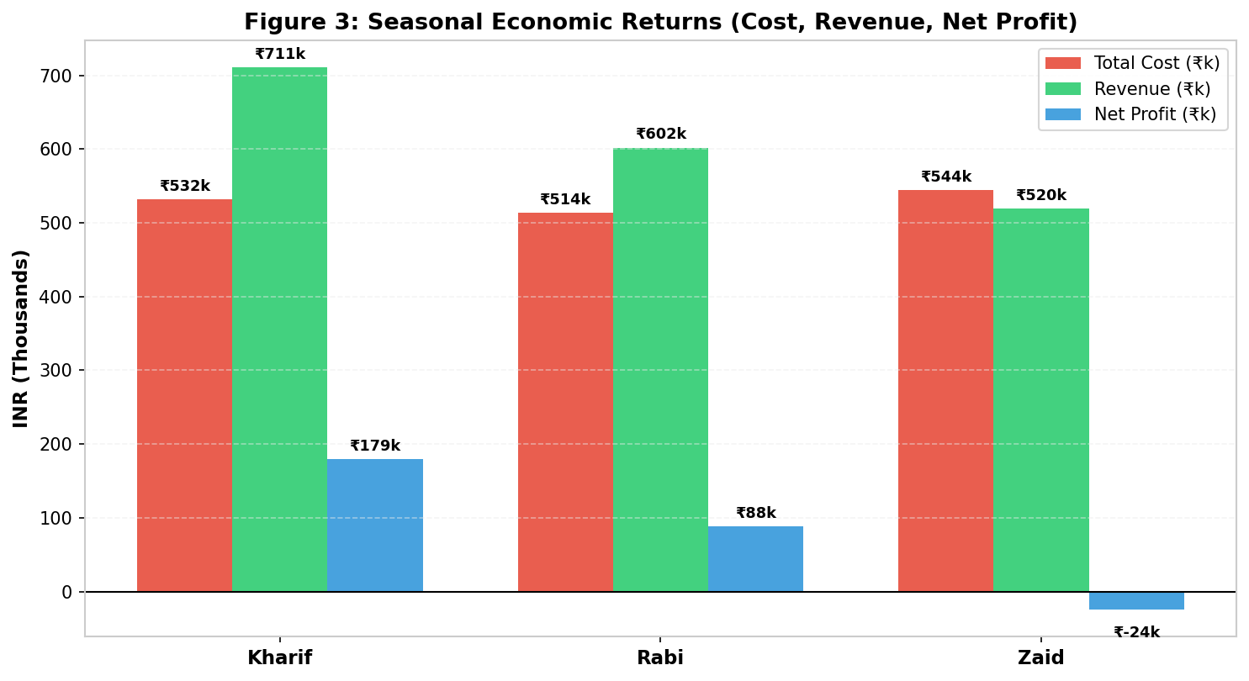
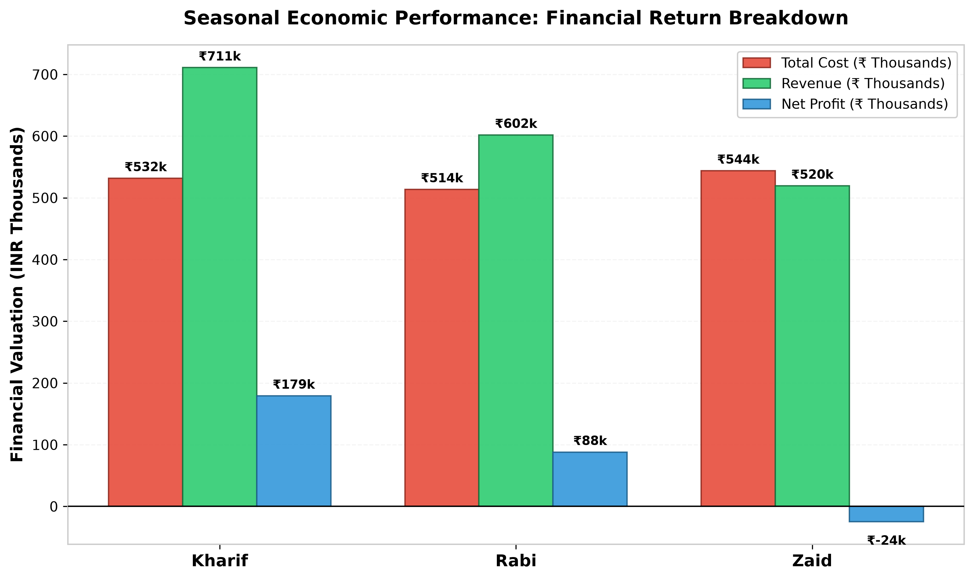
RESULTS: Seasonal Macroeconomic Breakdown (Cost, Revenue, Profit)
📊 Key Analytical Insights
1. Kharif High-Profit Regime
Kharif generates ₹711k in revenue against ₹532k in cost, producing the highest seasonal profit margin of ₹179k per farm (₹21,973/Ha).
2. Rabi Economic Stability
Rabi produces ₹602k revenue and ₹514k cost, delivering stable positive net earnings of ₹88k per farm (₹10,429/Ha).
3. Zaid Financial Inversion Deficit
Zaid farms suffer an average net deficit of -₹24k (-₹2,519/Ha) as high summer pumping/labor costs (₹544k) outpace realized revenues (₹520k). ANOVA F = 34.40, p = 1.54 × 10⁻¹⁵.

Slide 9
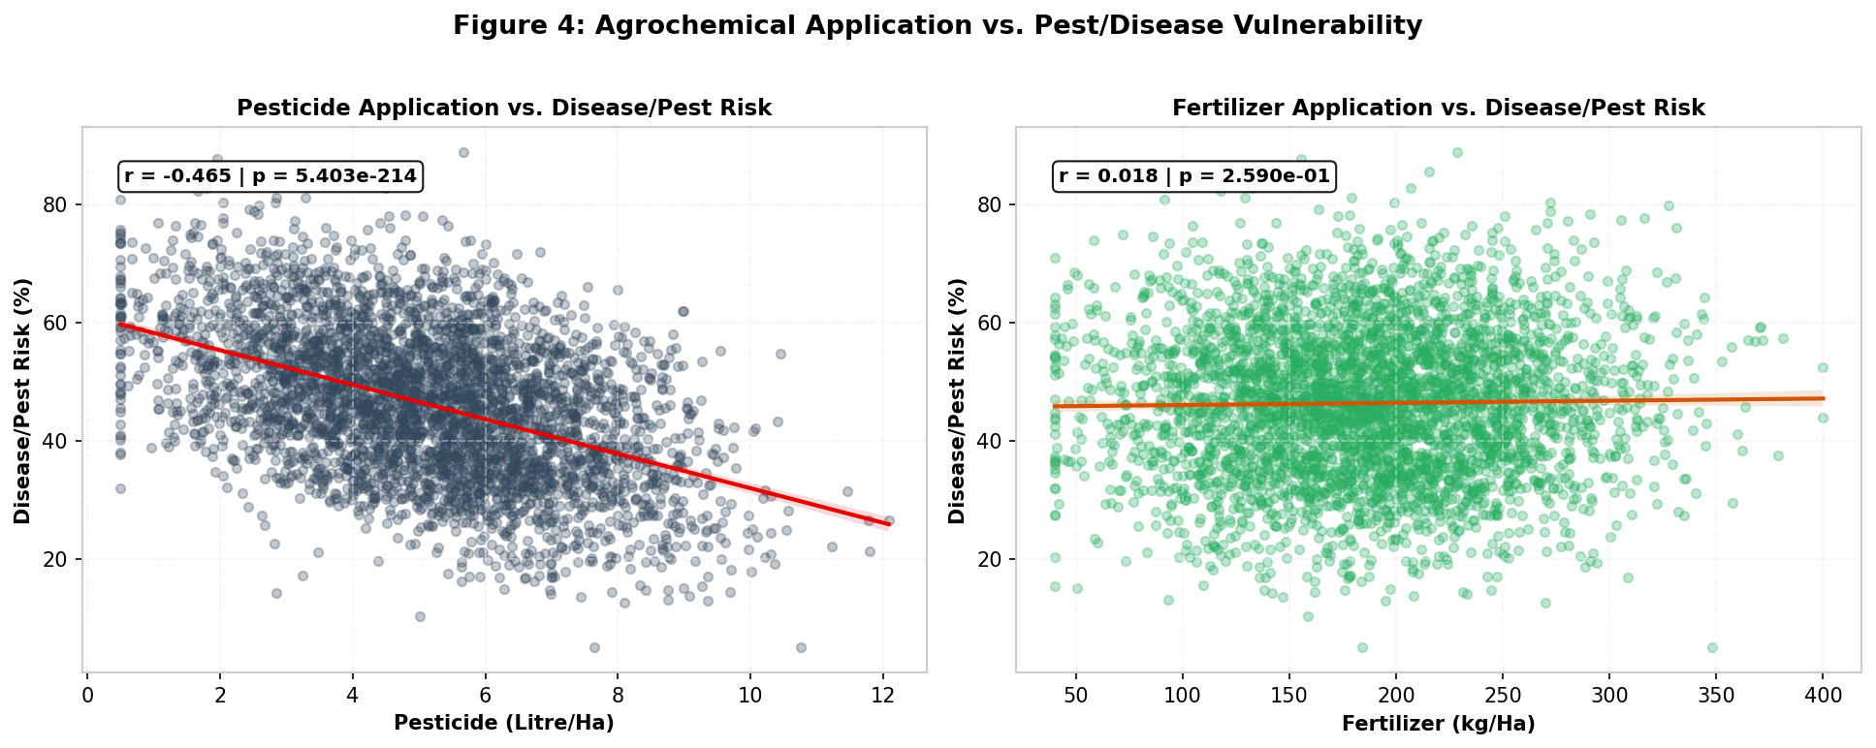
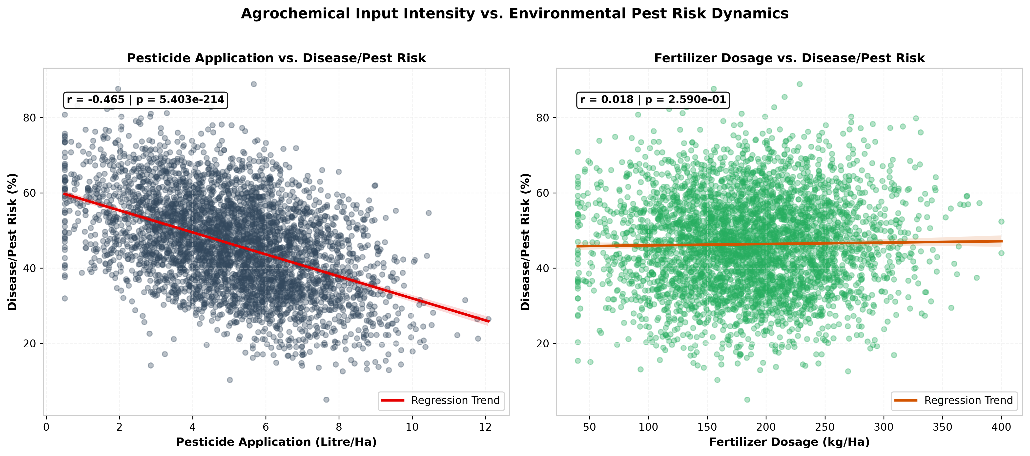
RESULTS: Agrochemical Application vs. Pest/Disease Vulnerability
📊 Key Analytical Insights
1. Environmental Climatological Driver
Pest vulnerability surges to 54.47% in Kharif vs. 40.48% in Rabi and 38.22% in Zaid, driven by monsoon atmospheric humidity > 75%.
2. Weak Chemical Dosage Correlation
Pesticide dosage (r = 0.015, p = 0.35) and fertilizer dosage (r = 0.033, p = 0.038) demonstrate negligible linear correlation with pest risk reduction.
3. Integrated Pest Management (IPM) Need
Uncalibrated chemical over-application fails to mitigate risk; preventive telemetry and biological pest controls are essential.

Slide 10
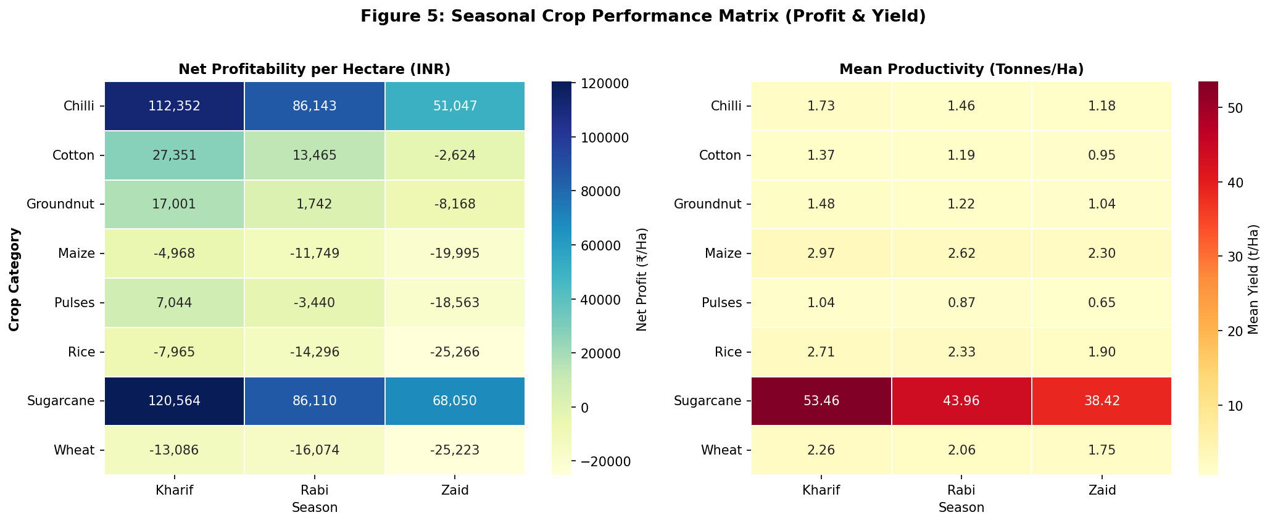
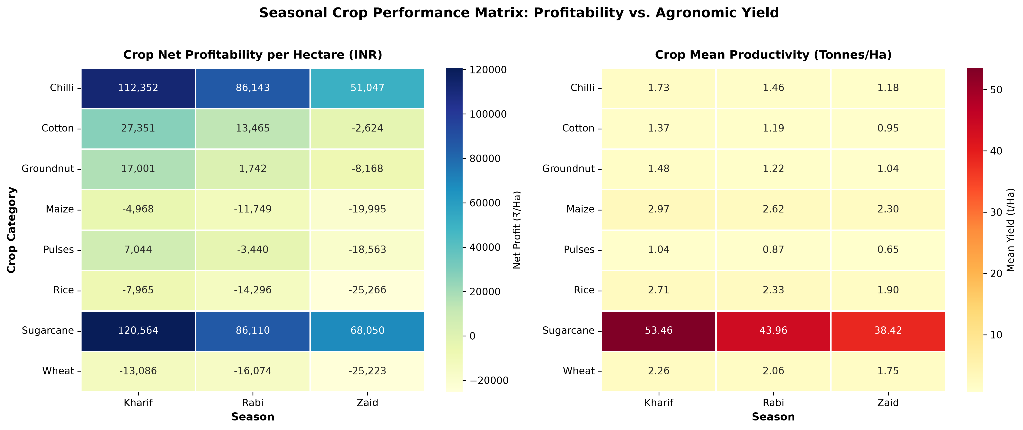
RESULTS: Seasonal Crop Performance Matrix (Profit & Productivity)
📊 Key Analytical Insights
1. High-Margin Cash Crops
Sugarcane and Chilli generate superior profitability (₹60,000 - ₹150,000/Ha) and tonnage (Sugarcane: 40 - 75 t/Ha) across Kharif and Rabi.
2. Food Security Staples
Rice (2.5 - 4.5 t/Ha) and Wheat (2.0 - 4.0 t/Ha) deliver steady staple productivity with low volatility across Kharif and Rabi.
3. Zaid Crop Selection Guidelines
Summer farming should prioritize drought-tolerant pulses and short-duration oilseeds (Groundnut) supported by drip systems.

Slide 11
Future Scope & Agritech Roadmap
🤖 Machine Learning Yield Prediction
Deploy XGBoost, LightGBM, and Random Forest ensemble regressors to predict micro-climate farm yields with R² > 0.90.
📡 Real-Time IoT Soil Sensor Integration
Ingest telemetry from ground-level N-P-K, pH, and capacitive soil moisture probes for automated variable-rate drip fertigation.
🌦️ Micro-Climate Crop Advisory Systems
AI-driven hyper-local mobile advisory delivering real-time pest alerts and market price intelligence directly to smallholders.
🛰️ Satellite Remote Sensing (NDVI/EVI)
Incorporate Sentinel-2 and Landsat optical/SAR imagery to monitor crop canopy health and stress index in real-time.

Slide 12
Project Links: GitHub Repository & Google Colab
🐙 OFFICIAL GITHUB REPOSITORY
https://github.com/princex100/VOIS-Seasonal-Agriculture-Performance-Analysis
• Complete production codebase, datasets, and presentation deck. • Full Git commit history & structured directory hierarchy.
⚡ GOOGLE COLAB INTERACTIVE NOTEBOOK
https://colab.research.google.com/github/princex100/VOIS-Seasonal-Agriculture-Performance-Analysis/blob/main/notebooks/Seasonal_Agriculture_Performance_Analysis.ipynb
• 1-Click Cloud Execution: Run end-to-end EDA and statistical ANOVA directly in your browser. • Zero setup required: Auto-fetches dataset and renders interactive charts.
📁 Structured Deliverables Directory Index
• data/ : Contains raw CSV (4,000 records) and cleaned dataset with stratified median imputation.
• notebooks/ : Seasonal_Agriculture_Performance_Analysis.ipynb - Google Colab compatible research notebook.
• src/ : analyze_and_visualize.py (Data & EDA pipeline), update_presentation.py (Deck builder).
• results/ : 5 High-resolution publication charts (.png) and statistical_summary.json metrics.
• docs/ : VOIS_Major_Project_Final_Submission.pptx - Official 14-slide submission presentation.

Slide 13
VOIS Course completion certificate - Course name- Data Visualization
[Insert VOIS Data Visualization Certificate Here]
Paste your official Vodafone Intelligent Solutions (_VOIS) Data Visualization course certificate image here prior to final portal submission.

Slide 14
Thank you
VOIS AICTE INTERNSHIP (BATCH 1 2026-2027) - MAJOR PROJECT
Seasonal Agriculture Performance Analysis
Student Credentials & Contact Information: Student: Prince Sharma| AICTE Student ID: STU6a26ed8a592401780936074
College: JSS Academy of Technical Education,noida| Email: princeshrm002@gmail.com| LinkedIn: https://www.linkedin.com/in/prince-sharma100/
.
.

