Slide 1
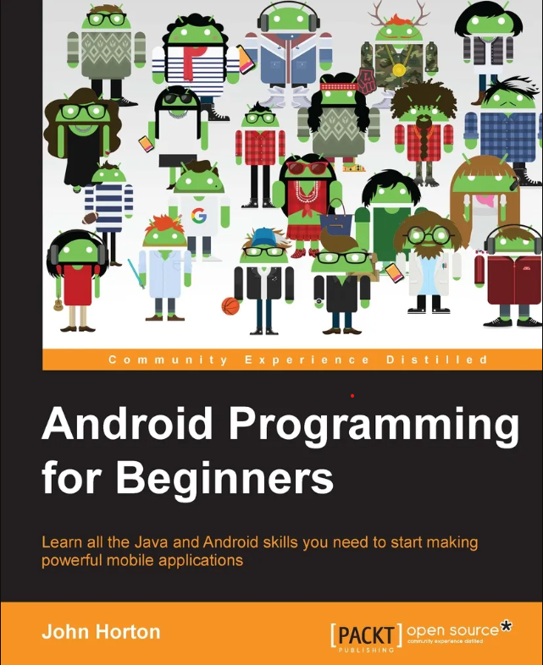
Android Programming for Beginners
John Horton

Slide 2



About:
Publication
ISBN no.
Edition
Cost
No. of Pages
PACKT PUBLISING
978-1-78588-326-2
First edition print:
December 2015
Rs.1599/-
660

Slide 3
With this book, you will:
Master the fundamentals of coding Java for Android.
Install and set up your Android development environment.
Build functional user interfaces with the Android Studio visual designer.
Add user interaction, data captures, sound, and animation to your apps.
Get a complete information about object oriented programming , encapsulation and inheritance.
Learn about Android intent and Persistence.
Learn how to Adding a Database and using SQLite Database in our apps
Designing Layouts, Real-World Layouts and many more.
Manage your apps' data using the built-in Android SQLite database
Find out about the design patterns used by professionals to make top-grade applications
Build, deploy, and publish real Android applications to the Google Play marketplace

Slide 4
Review:
Good book for beginners who don't know anything about Java or Android programming.
The book explains basic Java and android programming in good detail.
If you already know Java you may want a slightly more advanced book as you may end up skipping big chunks of the book like I did as I already know the material.
This book is helpful fro building the project and gathering resources and easy implementation.
From this book we get proper knowledge about design patterns, fragments and the real world.
Easy to learn database and how to implement and how to using the SQLite Database in our project or apps.
John Horton write a book in effective way to learn these types of programming languages. So this book is so Good.

Slide 5
Thank You
PRINCE YADAV

