Slide 1

END-TO-END DATA ANALYTICS PROJECT
Automotive Market & Sales Analysis
Pandas & Power BI Insights Across German Used Vehicle Listings (Currency: Euro € / EUR)
PY
Prince Yadav
Data Analyst

Slide 2
STRATEGY & OBJECTIVES
Project Overview & Scope
Dataset Scope
Tech Stack
Primary Objective
Comprehensive records analyzed across German used vehicle listings from market snapshots.
Python Pandas for data cleansing and Power BI for interactive visualization and DAX measures.
Uncover pricing correlations, transmission types, fuel specifications, and damage records.
Automotive Market Analysis • Slide 2

Slide 3
WORKSPACE OVERVIEW
Power BI Dashboard Telemetry (5 Core KPIs)
Count of index
Average of New_Price
Average of kilometer
Average of vehicle_age
Average of Car_Mileage
311.149K
€ 10.21K
125.61K
23.18
5.87
Automotive Market Analysis • Slide 3

Slide 4
MARKET VALUATION (CHART 1)
Average Price by Brand (€ EUR)
Porsche
€53,000
Land Rover
€19,000
Audi
€18,000
Jaguar
€15,000
Jeep
€14,000
Mercedes-Benz
€17,000
Mini
€11,000
BMW
€13,000
Automotive Market Analysis • Slide 4

Slide 5
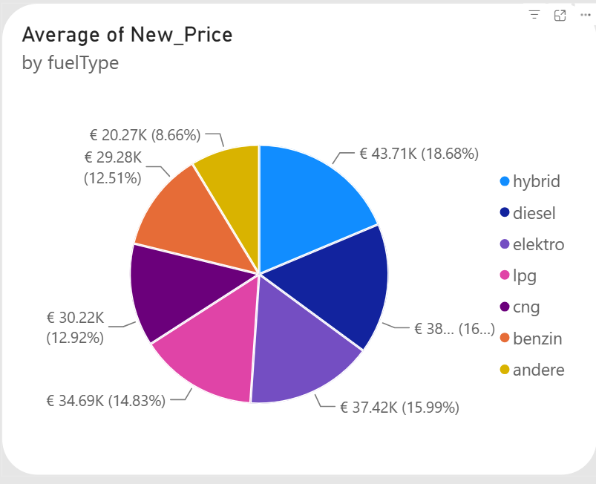
POWER BI VISUAL: FUEL TYPE
Average Price by Fuel Type
Fuel type vs. average new price
Hybrid is the highest at €16.01K (23.03%)
Lpg follows at €12.02K, then Diesel at €12K
Elektro €10.89K, Benzin €9.25K, Cng €5.72K, Andere €3.43K
Automotive Market Analysis • Slide 5

Slide 6
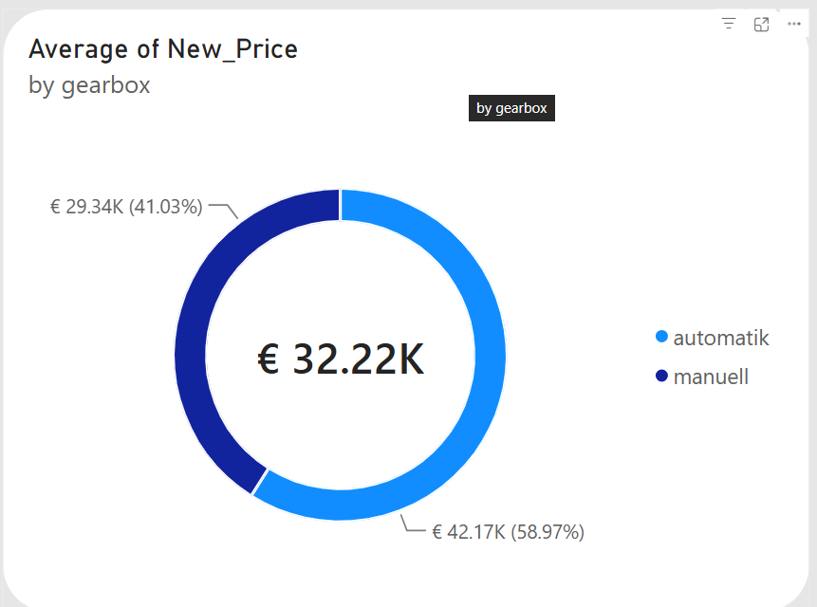
POWER BI VISUAL: GEARBOX
Average Price by Gearbox
Gearbox vs. average new price
Automatic averages €16.64K (66.61%)
Manual averages €8.34K (33.39%)
Overall average new price: €10.21K
€10.21K
Automotive Market Analysis • Slide 6

Slide 7
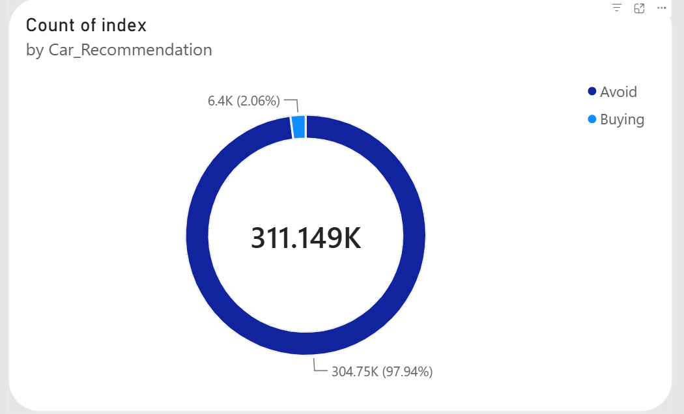
POWER BI VISUAL: RECOMMENDATION
Car Recommendation Share
Listings by Car_Recommendation
311.149K listings classified in total
Buying: 304.75K, 97.94%
Avoid: 6.4K, 2.06%
311.149K
Automotive Market Analysis • Slide 7

Slide 8
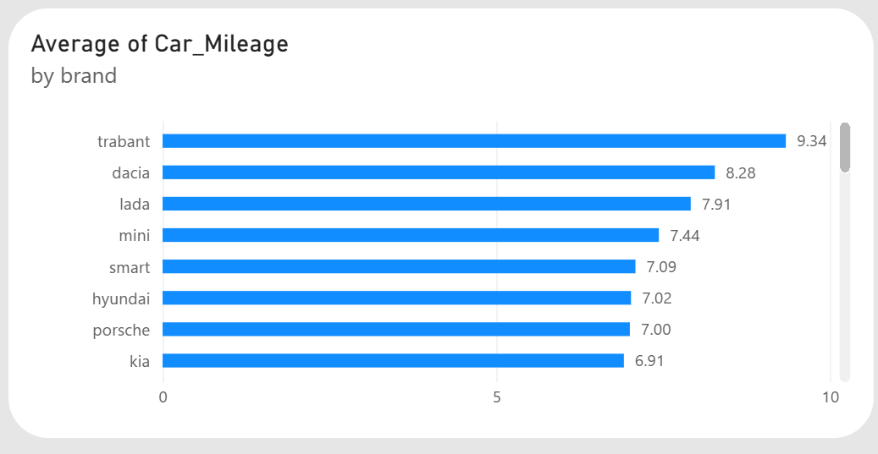
POWER BI VISUAL: MILEAGE
Average Car Mileage by Brand
Average of Car_Mileage by brand
Trabant leads at 9.34, then Dacia (8.28) and Lada (7.91)
Mini 7.44, Smart 7.09, Hyundai 7.02
Porsche 7.00 and Kia 6.91 close the top eight
Automotive Market Analysis • Slide 8

Slide 9
SPECIFICATION BREAKDOWN (CHART 2)
Fuel Type Average Price (€ EUR)
Average Price by Fuel Type
Gearbox Split
Hybrid (23.03%): €16.01K average new price
Automatic (Automatik - 66.61%): Highest average new price at €16.64K.
Diesel (17.53%): €12K average new price
Elektro (15.67%): €10.89K average new price
Manual (Manuell - 33.39%): Lower average new price at €8.34K.
Automotive Market Analysis • Slide 9

Slide 10
TRANSMISSION ANALYSIS (CHART 3)
Gearbox Average Price Split
Manual Transmission (33.39%)
Automatic Transmission (66.61%)
Price: €8.34K average new price
Price: €16.64K average new price
Share: 33.39% of the gearbox price split.
Share: 66.61% of the gearbox price split.
Automotive Market Analysis • Slide 10

Slide 11
SMART INTELLIGENCE (CHART 4)
Buying Suggestion Breakdown
Buying (97.94%)
Avoid (2.06%)
304.75K of 311.149K listings are flagged as recommended for purchase.
6.4K of 311.149K listings are flagged as Avoid.
Automotive Market Analysis • Slide 11

Slide 12
INVENTORY TRACKING (CHART 6)
Brand Inventory Volume Share
Volkswagen & BMW Lead
Niche & Import Brands
German domestic market shows massive listing volume dominance by Volkswagen, BMW, and Mercedes-Benz.
Specialized marques maintain lower inventory counts with high relative valuation averages.
Automotive Market Analysis • Slide 12

Slide 13
PERFORMANCE SLABS (CHART 5)
Top Brands by Car Mileage (kmpl)
9.34 kmpl: Trabant
7.00 - 8.28 kmpl
6.91 kmpl: Kia
Highest average Car_Mileage across all brands.
Dacia, Lada, Mini, Smart, Hyundai, Porsche.
Lowest of the top eight brands.
Automotive Market Analysis • Slide 13

Slide 14
Thank You
Open for questions regarding the Automotive Market & Sales Analysis project.
Prince Yadav • Data Analyst

