Slide 1


EvePaper: Campus-to-Career Bridge
EvePaper creates an integrated digital ecosystem that connects students with internships, mentors, employers, and career resources—aligning academic learning with professional opportunities and personalized career pathways to improve placement outcomes and long-term success.
Prince Yadav | Business Analytics Intern
Presenter

Slide 2
Empowering the Next Generation A New Delhi-based startup redefining student career pathways through skill development and networking.
Founded in 2021 by Yash Prasad with headquarters in New Delhi, India.
Operates as a digital platform connecting students, colleges, and corporate partners.
Focuses on providing access to internships, events, and career resources for fresh talent.
Prioritizes career growth and skill development to prepare students for the modern workforce.
About Us

Slide 3
Strategy Driving Professional Development
Our strategy centers on building a strong ecosystem that facilitates knowledge, skills, and long-term career success.

Slide 4

Comprehensive Service Portfolio
A one-stop platform offering diverse learning and employment services tailored for students and fresh graduates.
Internship Opportunities
Online Courses
Providing students and fresh graduates with hands-on professional experience across various sectors.
Facilitating continuous skill development through targeted and industry-relevant online learning modules.
Expert Webinars
Competitions & Events
Conducting workshops and webinars led by industry experts to provide professional insights and networking.
Encouraging student participation through competitive events that showcase talent to potential employers.

Slide 5

The Triple-Sided Marketplace
Synchronizing the needs of students, educational institutions, and corporate employers to create a thriving talent network.
Companies & Startups
Organizations searching young, motivated talent and interns to drive innovation and growth.
Colleges & Universities
Educational institutions aiming to provide their students with better corporate exposure and placement opportunities.
Ambitious Students
Individuals seeking internships, practical skills, and clear pathways to launch their professional careers.

Slide 6

The Eve Universe Ecosystem
Supporting students through every stage of their professional lifecycle, from initial learning to recruitment.
EvePaper
Eve Consultancy
The primary platform for discovering student opportunities and internships.
Offering business consulting services to complement the professional network.
Eve Learn
Eve Placement
The foundation focusing on skill development and comprehensive online courses.
Providing dedicated recruitment and hiring support for fresh graduates.

Slide 7
Business Model Revenue Streams & Value Creation
Generating sustainable growth through a mix of business-to-business marketing and professional training services.
Brand Promotions Generating revenue through companies that promote events and specific marketing campaigns to our large student audience. | Recruitment Services Fees associated with helping companies find and hire the right interns and fresh graduates for their teams. | Training Programs Monetizing skill development programs and industry-focused online courses for individual student growth. | Partnerships Collaborative revenue models with colleges and organizations to enhance their student opportunity portals.

Slide 8

Metrics Market Reach and Impact
10M+
500+
Establishing a massive nationwide presence to bridge the gap between education and industry across India.
Student Reach
Total student reach across various digital and on-campus channels in India.
College Collaborations
Partnerships established with educational institutions to provide student exposure.
5K+
Companies Connected
Organizations and startups utilizing the platform to find young talent.

Slide 9
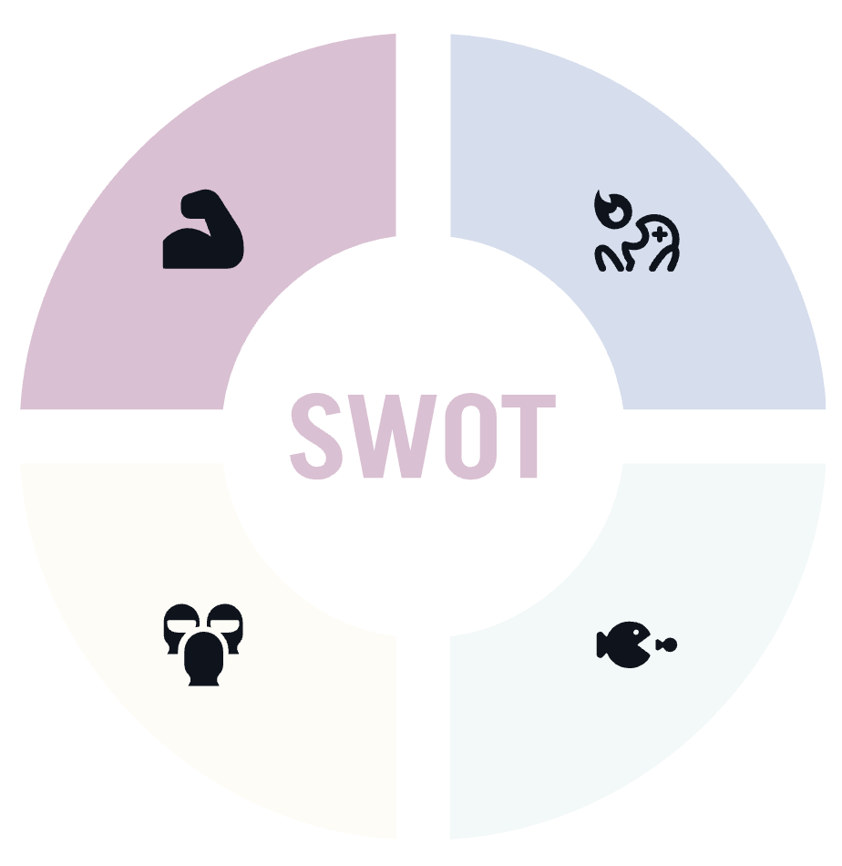
SWOT Analysis Analyzing internal strengths and external market dynamics to ensure long-term platform viability.
Strengths
Highly focused platform dedicated specifically to student opportunities and growth. Rapidly growing network of nationwide student communities and college partners. A comprehensive, multi-service platform that addresses various student career needs.
Weaknesses
Limited brand recognition when compared to established global professional platforms. Resource constraints typical of a growing startup seeking to scale operations rapidly. Need for deeper brand penetration in tier-2 and tier-3 city universities.
Threats
Direct competition from large
platforms like Internshala, LinkedIn, and major EdTech firms. Volatility and fast-paced changes within the global job and educational technology markets.
Opportunities
Growing national demand for digital career discovery and remote internship platforms. Expansion potential into more specialized industrial sectors and international universities. Developing advanced AI-driven tools for better student-opportunity matching.

Slide 10
Growth Future Growth Recommendations
Key strategic initiatives to enhance the platform and solidify our market position in the EdTech space.
1.
2.
3.
4.
5.
Aggressively increase digital marketing and student-focused social media engagement.
Deepen partnerships with a wider variety of tier-2 and tier-3 colleges for inclusivity.
Launch more industry-focused training programs and certifications for high-demand skills.
Improve platform discovery features to better match students with relevant opportunities.
Establish a robust student mentorship and career guidance system for long-term support.

