Slide 1

QUANTUM X-22
HACKATHON
“ MUTLI-DB ADAPTER ”
PRESENTED BY,
YUVARAJ K M
SHRIDHAR GAVADI
K HARSHITH
SURAJ ANTONY RAJ A

Slide 2
Agenda
Introduction
OUR APPROACH TO SOLVING THE PROBLEM
Objectives
Conclusion
SAMPLE OUTPUT

Slide 3
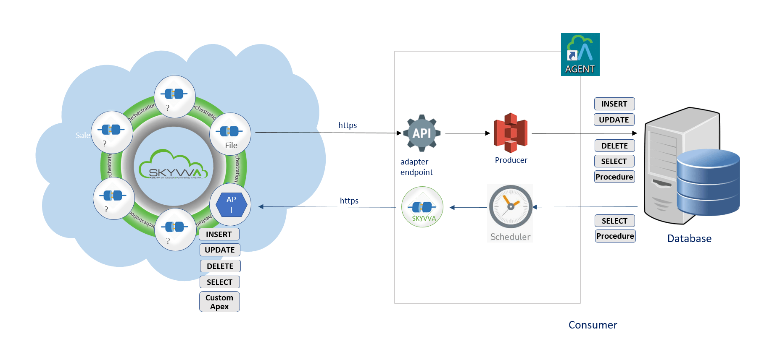
Introduction
A multi-DB adapter is a type of software that allows a single application to connect to and work with multiple databases. This allows the application to access data stored in different types of databases, such as MySQL, SQL Server, and Oracle, without having to be specifically designed to work with each individual database

Slide 4
OUR APPROACH TO SOLVING THE PROBLEM
using API we can solve the problem of creating a multi-DB adapter. This allows the application to use a single, consistent API to access data from multiple databases, without having to be specifically designed for each individual database. This can make it easier to develop and maintain the application, as it reduces the amount of database-specific code that needs to be written

Slide 5
Objectives
the main objectives of a multi-DB adapter is to increase the flexibility and versatility of the application, and to make it easier for developers to create applications that can work with multiple databases.
multi-DB adapter is to allow a single application to connect and work with multiple databases, without having to be specifically designed to work with each individual database.

Slide 6
Conclusion
The expected conclusion of using a multi-DB adapter is that it will allow a single application to connect to and work with multiple databases, without having to be specifically designed to work with each individual database.
This can help to make the application more versatile and flexible, and can make it easier for developers to create applications that can work with multiple databases.
In addition, using a multi-DB adapter can also help to reduce the amount of database-specific code that needs to be written, which can make it easier to develop and maintain the application over time.

Slide 7
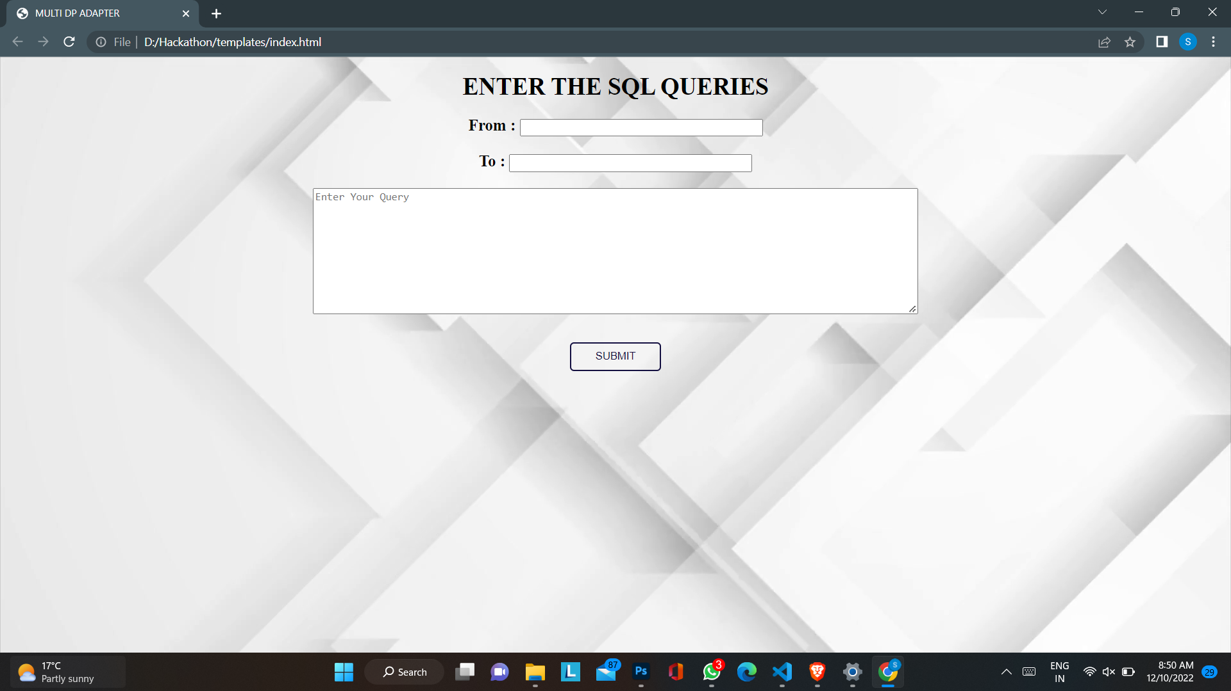
SAMPLE OUTPUT

Slide 8
THANK YOU

