Slide 1

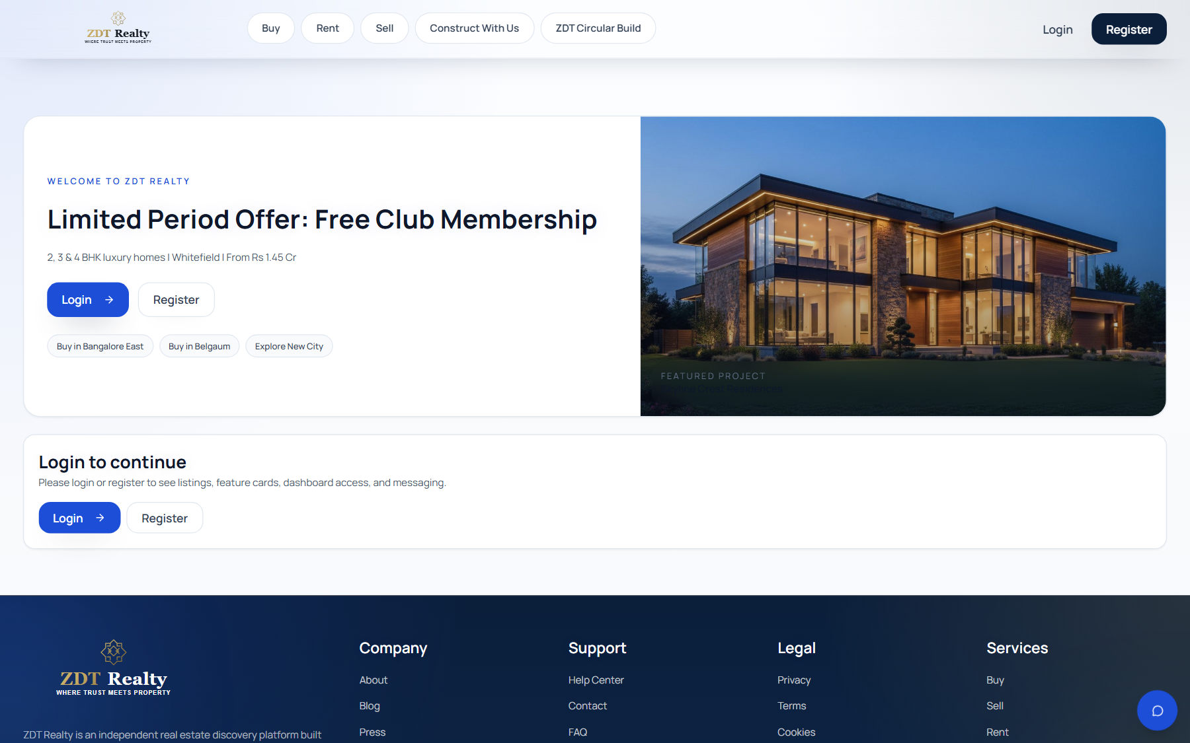
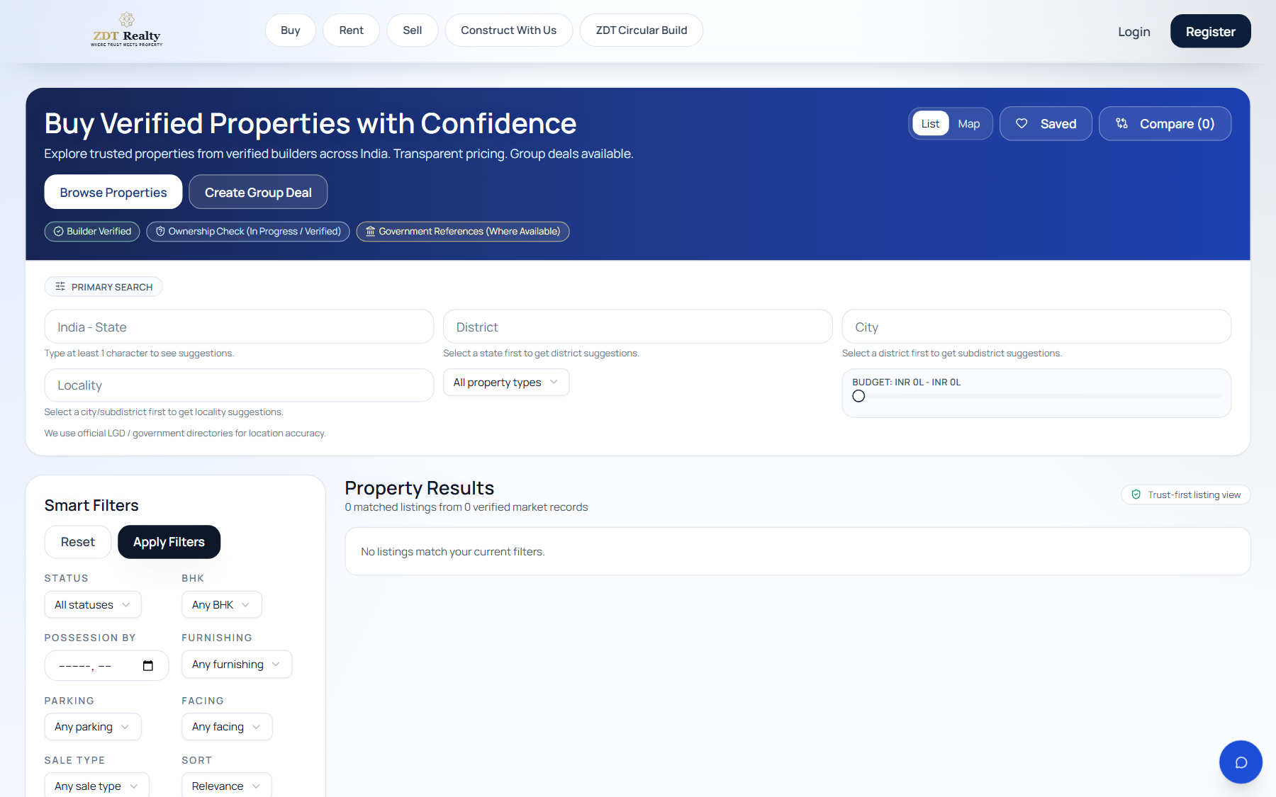
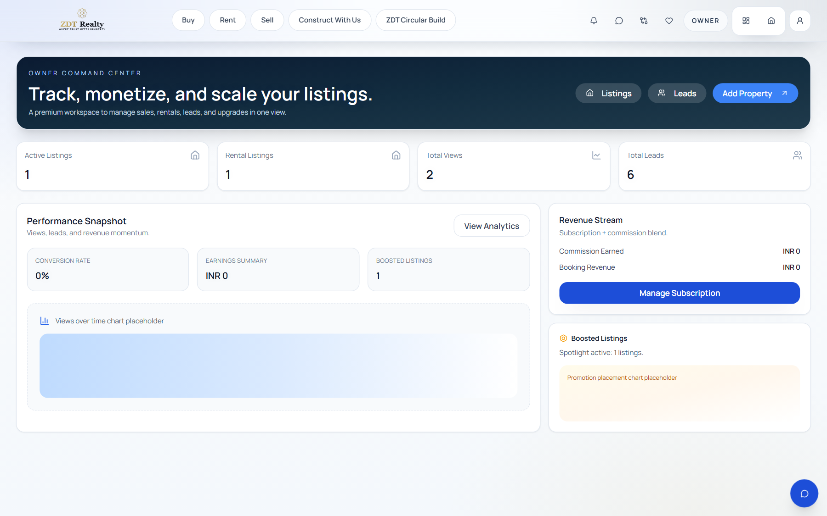
FOUNDING ROUND
LIVE
Product Surface
Trusted Real Estate Intelligence + Operations Platform
A multi-sided product for buyers, owners, builders, and operators. This deck uses live product screenshots so the pitch stays concrete and credible.
Homepage and feature navigation
BUY
OWNER
Marketplace
Intelligence
Operations
Consumer
Monetization
Search, compare, save, message, and convert buyer demand.
Market pricing, infra signals, and decision-support context.
Owner tools, builder workflows, approvals, and platform control.
Marketplace flow
Dashboard layer
ZDT Realty
Founding-round deck | live product screenshots

Slide 2
MARKET THESIS
Real estate discovery is fragmented. ZDT connects the whole workflow.
The product thesis is simple: users do not only need listings. They need decision support, trust, and operating tools around the listing.
Buyer problem
Owner / builder problem
What ZDT adds
Positioning
Users jump between property portals, infrastructure news, market trends, and trust checks before they feel confident enough to act.
Supply-side users need lead flow, analytics, promotions, approvals, and workspace tools after a listing is live.
Marketplace, intelligence, trust-led modules, owner monetization, builder tools, and admin governance in one platform.
Not another listing portal. A real-estate operating layer for India.
ZDT turns fragmented search, trust, and operations into one connected product stack.
ZDT Realty
Founding-round deck | live product screenshots

Slide 3
PLATFORM OVERVIEW
A modular surface that already looks like a platform, not a single-feature app.
The homepage acts as the product map across marketplace, intelligence, services, and operator workflows.
HOME
Multi-entry navigation
Platform Entry Point
Buy, rent, projects, insights, infrastructure, e-auctions, group deals, and operator modules are accessible from one product shell.
High-impact modules
The product already communicates clear strategic bets: intelligence, trust, B2B tooling, and monetization.
Demo-ready structure
For interviews and pitches, this gives you a strong story: broad capability with visible product depth.
Homepage: marketplace, intelligence, trust, and operator modules in one surface
ZDT Realty
Founding-round deck | live product screenshots

Slide 4
CONSUMER JOURNEY
The consumer side is built around conversion, not just browsing.
Buy and rent are structured as full marketplace journeys with decision and action layers.
What the user can do
BUY
Buy Marketplace
Search listings, filter inventory, save searches, compare properties, message directly, request callbacks, and schedule site visits.
Why it matters
This gives ZDT a stronger demand-side engagement and lead-conversion story than a static listing catalog.
Filters, listing cards, saved-search flow, and user conversion actions
ZDT Realty
Founding-round deck | live product screenshots

Slide 5
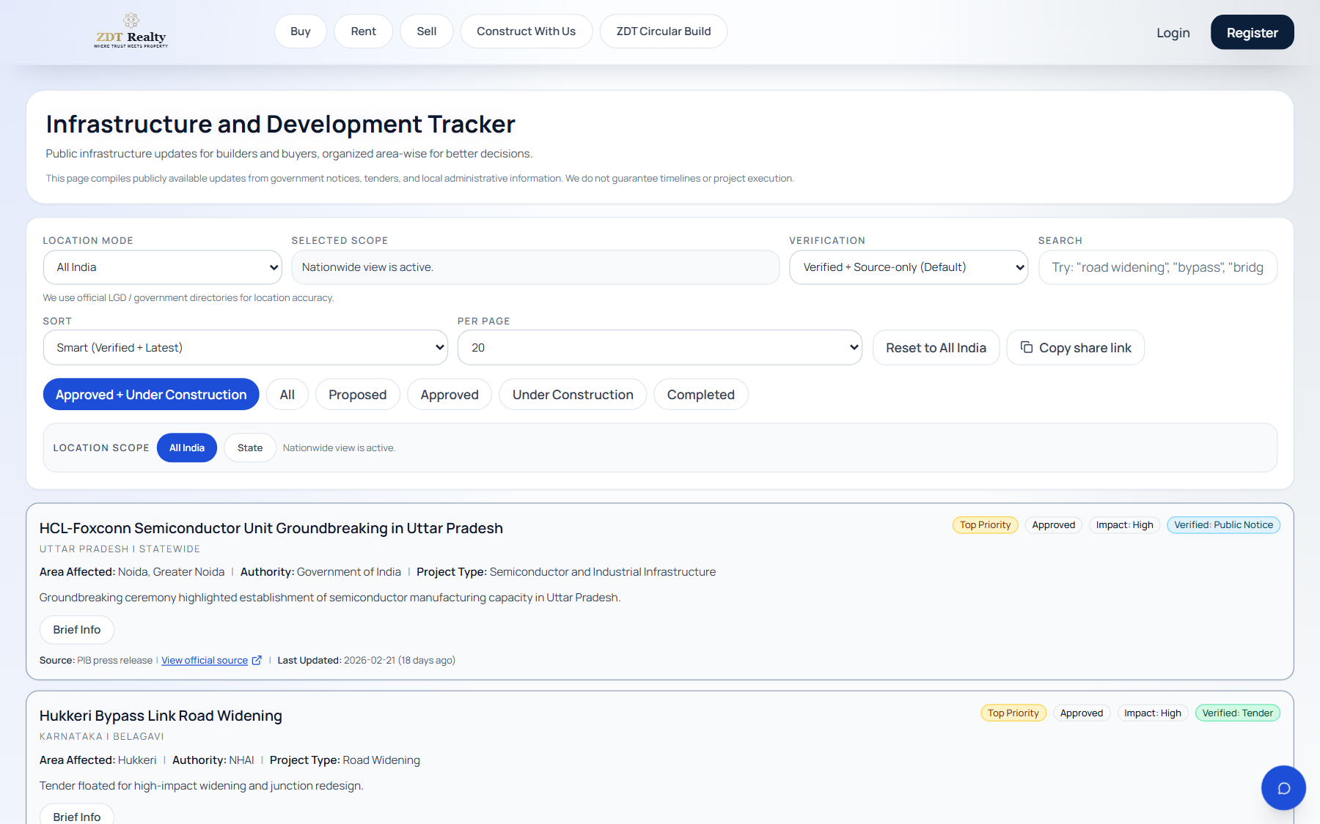
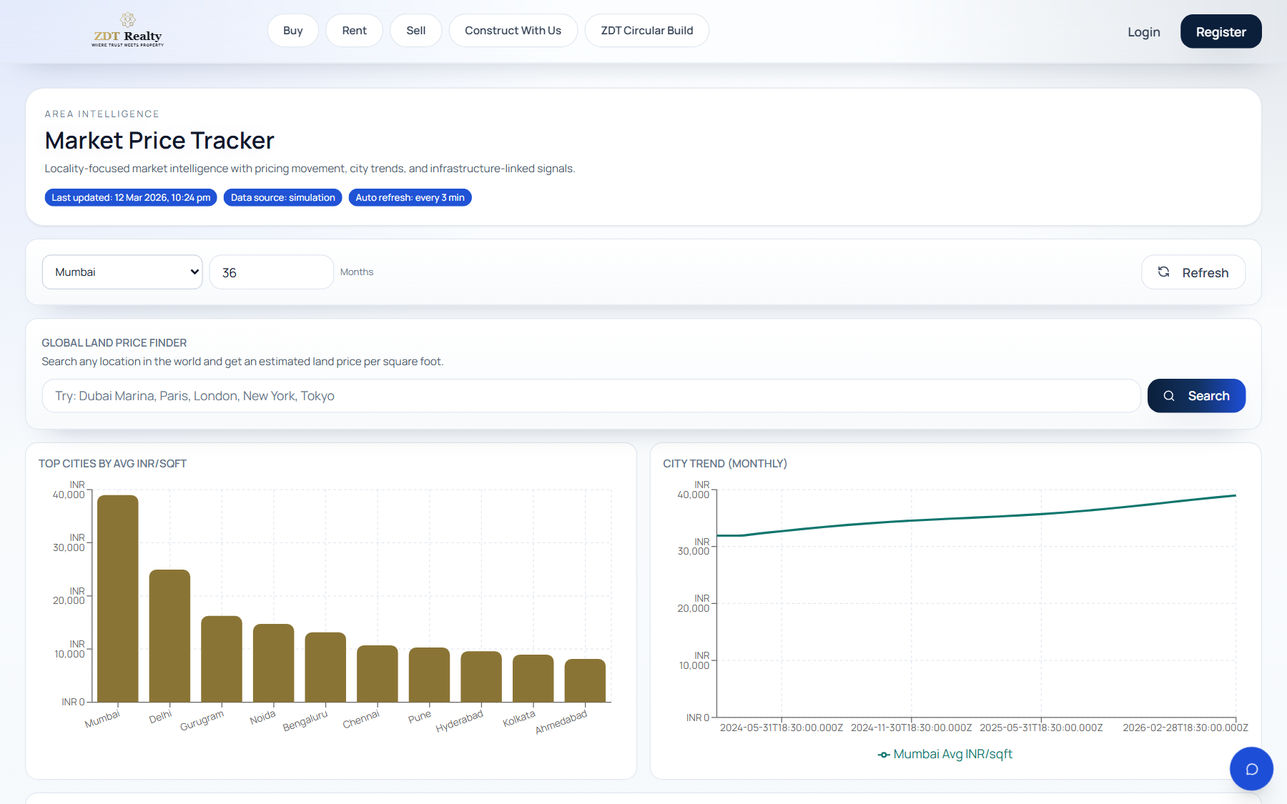
INTELLIGENCE LAYER
Decision support is one of the clearest product differentiators.
ZDT combines real-estate market data with infrastructure visibility so users do not have to leave the platform to evaluate context.
INFRA
MARKET
Infrastructure Tracker
Market Price Tracker
Geography, verification level, and alerting controls
Pricing movement, city comparison, and decision-support context
The moat is not only inventory. It is the intelligence layer around inventory.
ZDT Realty
Founding-round deck | live product screenshots

Slide 6
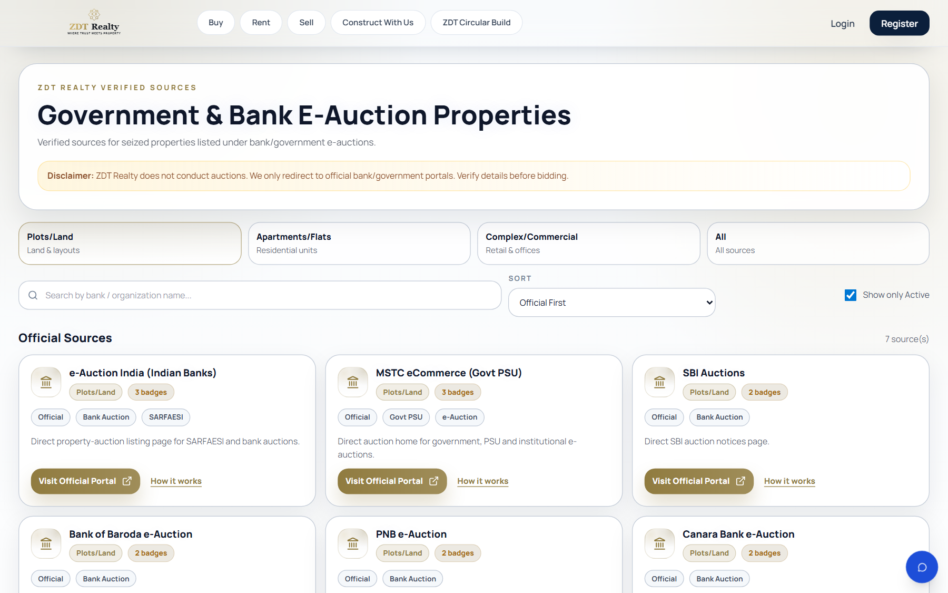
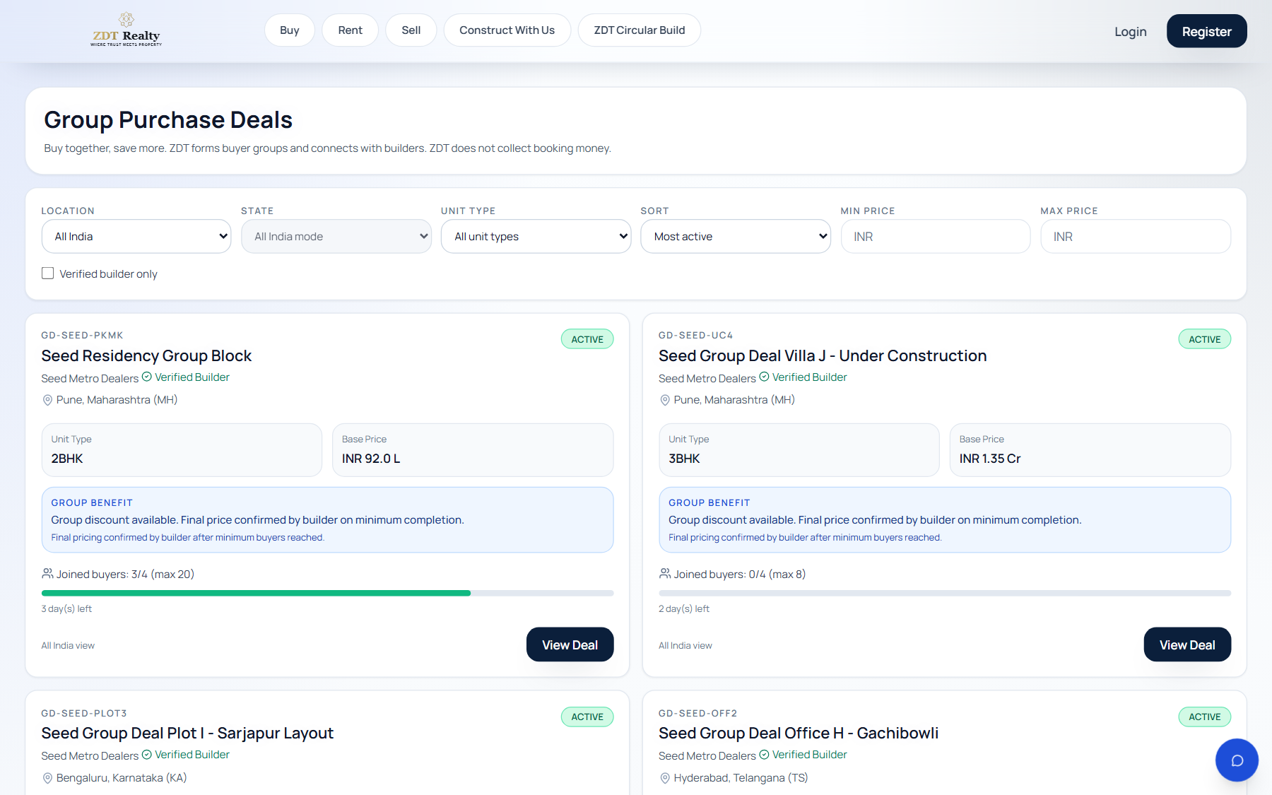
TRUST MODULES
ZDT stands out through trust-led discovery modules.
These modules are strong pitch points because they show differentiated product thinking, not just listing replication.
TRUST
DEMAND
Government & Bank E-Auctions
Group Purchase Deals
Official-source discovery for high-trust opportunity flows
Verified-builder filtering and demand aggregation
Compliance note
Compliance note
ZDT does not conduct auctions. It redirects users to official portals.
ZDT does not collect group booking money. It facilitates qualified buyer-builder connection.
ZDT Realty
Founding-round deck | live product screenshots

Slide 7
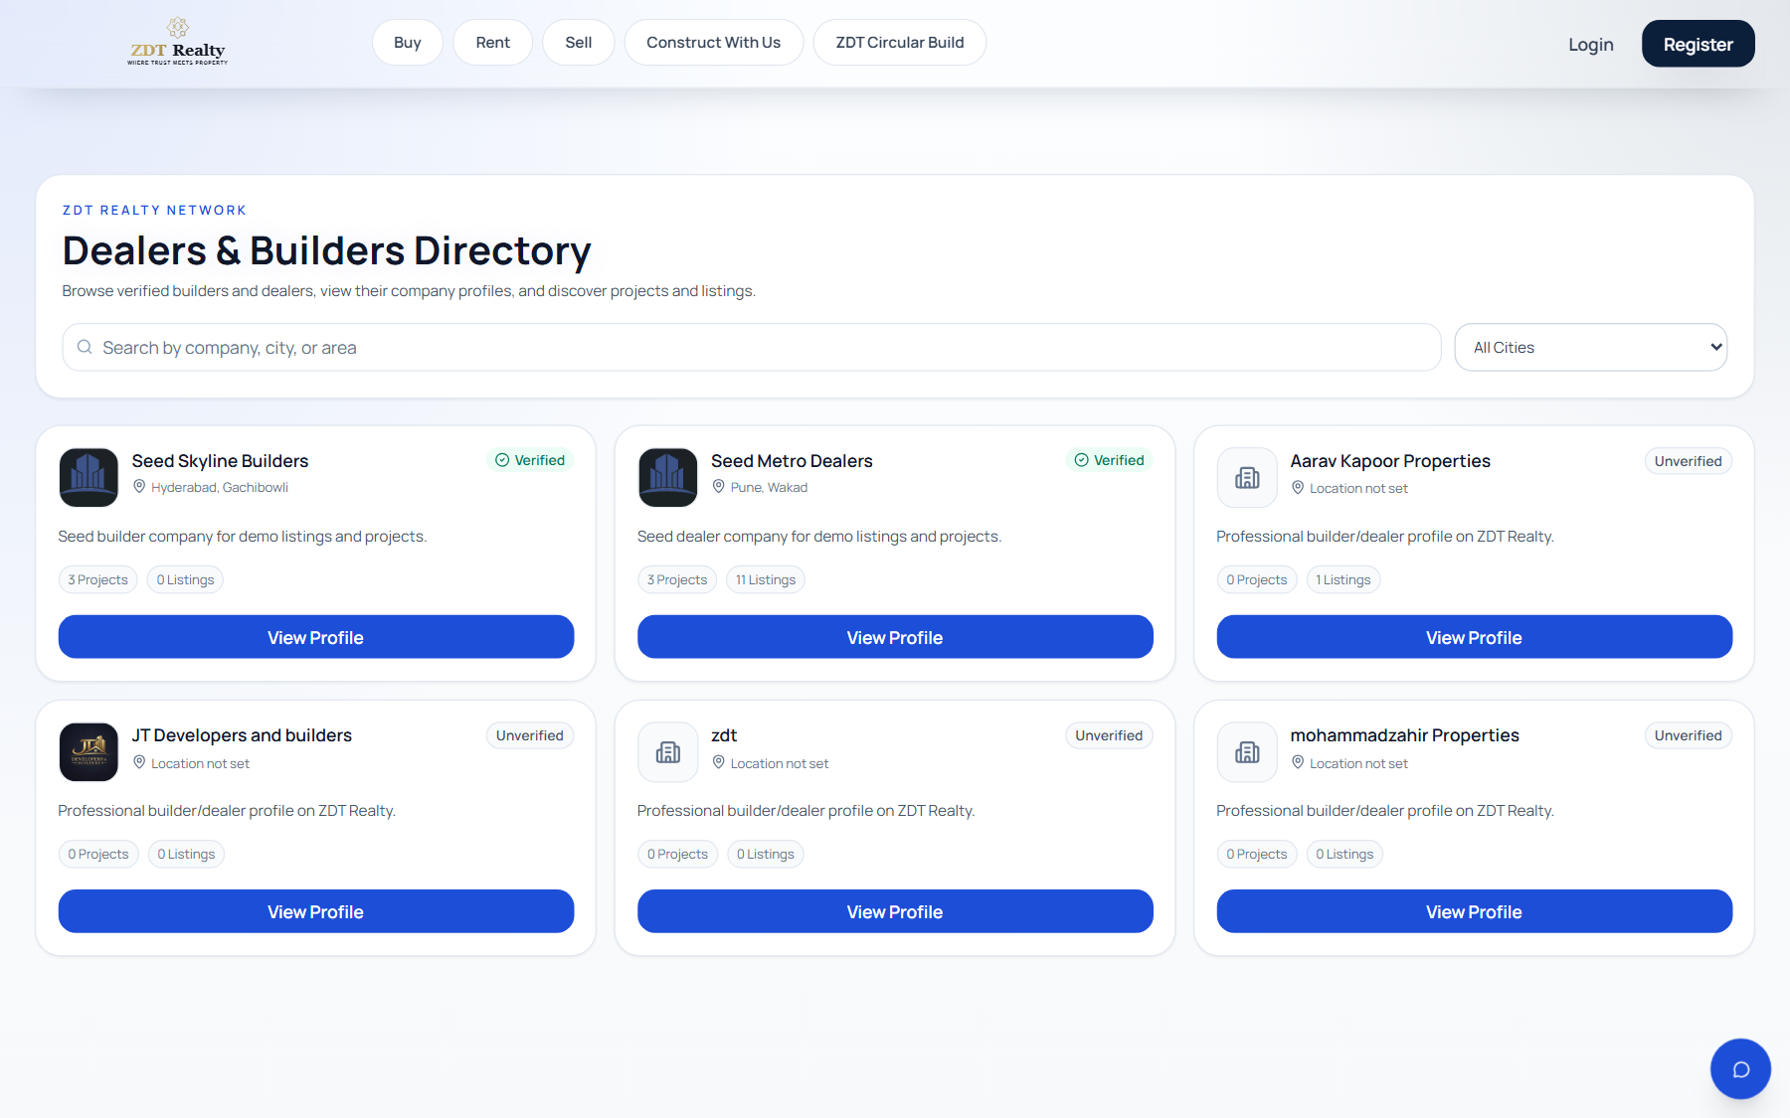
BUSINESS ENGINE
The business model works because the product serves both sides of the market.
ZDT is not only a consumer experience. It also acts as software for builders, dealers, and owners.
B2B
OWNER
Builder / Dealer Operating Layer
Owner Monetization Layer
Project tools, lead tools, promotions, team access, and trust structure
Listings, leads, views, conversion, subscriptions, and boosts
Builder revenue
Owner revenue
Platform upside
Company plans, promotions, and later enterprise tooling.
Subscriptions, boosts, and premium visibility.
Multi-sided monetization with stronger retention loops.
ZDT Realty
Founding-round deck | live product screenshots

Slide 8
CLOSING
A stronger way to say it in the interview
The product story is most compelling when it is framed as a trusted operating system, not only as a property portal.
Revenue layer 1
Owner subscriptions, boosts, and visibility products.
Closing line
ZDT Realty is evolving from a listing portal into a trusted real estate operating system for India.
Revenue layer 2
Builder and dealer plans, promotional inventory, and B2B workspace tools.
That phrasing is professional, credible, and strong for a founding-round or interview setting because it captures discovery, trust, intelligence, and operations in one sentence.
Revenue layer 3
Later enterprise upside through analytics, integrations, and workflow extensions.
Pitch angle: not another listing site. A multi-sided real-estate workflow platform.
ZDT Realty
Founding-round deck | live product screenshots

