Slide 1



Data Analysis and Recommendations
Prince Yadav |
12-02-2025
CHINOOK MUSIC STORE

Slide 2



INTRODUCTION
Founded in 1995: A trusted music store in North Central Washington.
Mission: Bringing the joy of music to all, from beginners to pros.
Adapting to Change: Embracing digital trends and evolving customer needs.
Community Focused: Supporting local musicians with products, lessons, and resources.
Strategic Emphasis: Chinook needs to examine its operations to identify crucial insights that will enhance decision-making.
Data-Driven Exploration: This presentation highlights patterns and trends uncovered through data analysis.
Driving Growth: Leveraging data to propel Chinook's growth and strengthen its position in the industry.

Slide 3
PROBLEM STATEMENT
Embracing Change in the Music Industry
The music industry is as dynamic as the melodies it produces.
For Chinook Music Store, the challenge lies in adapting to these shifts while maintaining the core values.
To remain a leader in the market, it is needed to
Adapt to the dynamic music industry while maintaining core values.
Understand customer purchasing habits and regional variations to optimize promotional strategies.
Explore untapped market segments through detailed analysis of sales trends and customer demographics.
Tailor offerings to meet the unique needs of each community.
Enhance market presence and deepen connections with music lovers through data-driven innovation.

Slide 4





OBJECTIVES
Objective nº 1
Objective nº 2
Objective nº 3
Objective nº 4
A comprehensive examination of sales patterns, enhancing the understanding of customer demographics, and recognizing potential market opportunities.
Analyzing seasonal fluctuations, product demand, and regional disparities to enhance Chinook's sales strategy.
Recognizing market opportunities to allow the company to venture into new segments and broaden its reach.
Gaining insights into customer demographics to address varied marketing requirements.

Slide 5
The data provided consists of 11 tables containing information regarding the past performance of Chinook music store
With 251 albums, 130 artists, 25 genres and 59 customers across 24 countries the data is quite vast.
The invoice table contains all the data of transactions by a customer.
Customer table contains the information regarding the customer base of Chinook.
DATA
OVERVIEW

Slide 6
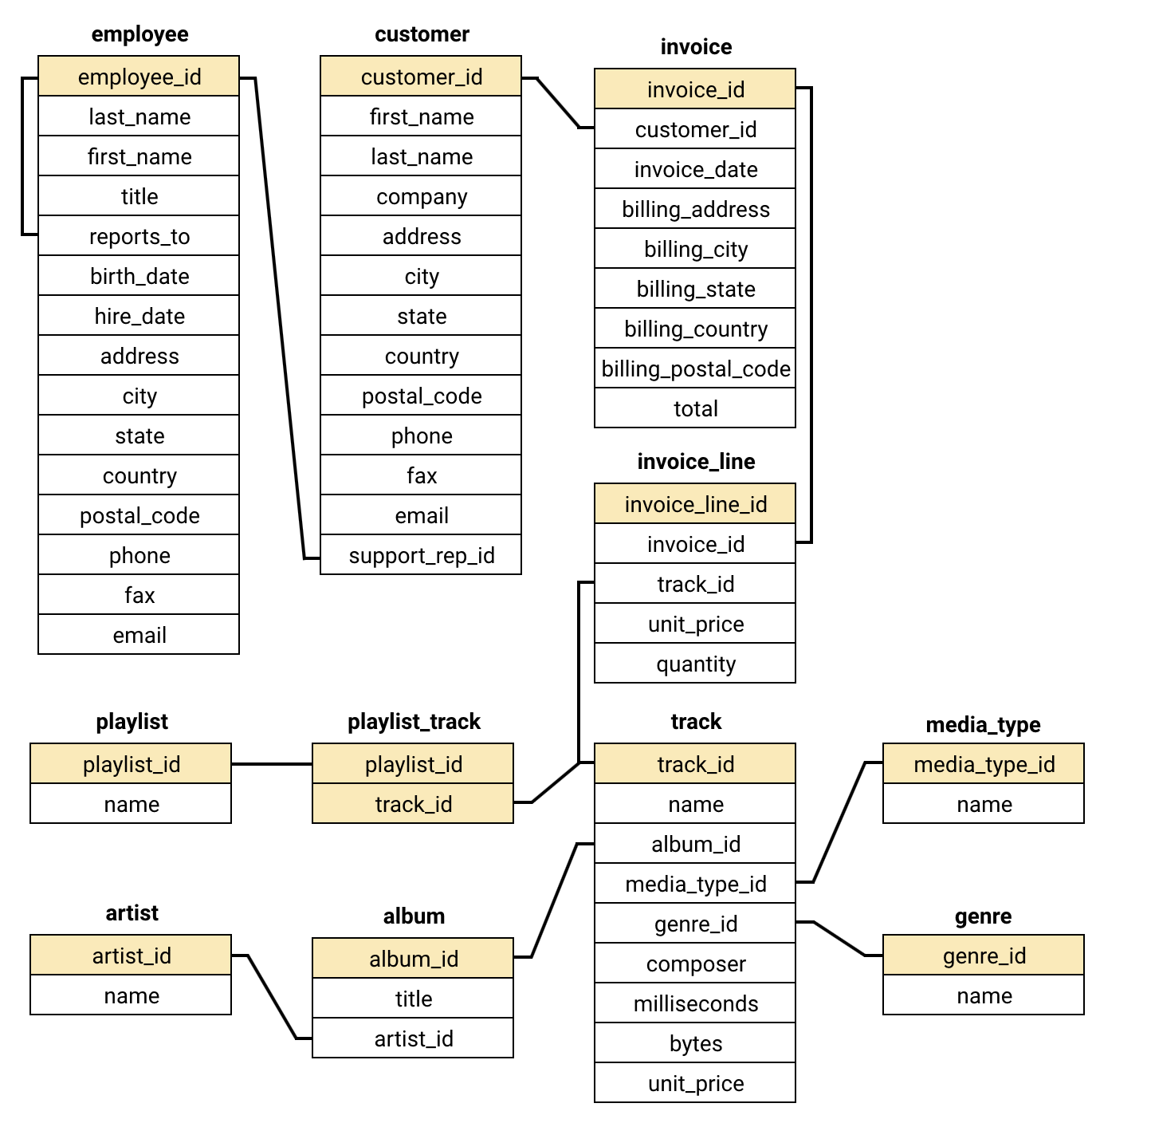

DATA SCHEMA

Slide 7
METHODOLOGICAL APPROACH
Step 2
Basic Queries: First Look
Used simple queries to explore the data.
Identified key areas for deeper analysis.
Step 1
Database Schema: The Blueprint:
We Understood the database structure (tables, relationships).
Essential for efficient data navigation.
METHODOLOY
Step 3
Data Cleaning: Ensuring Accuracy
Cleaned and prepped data (e.g., handled missing values with coalesce).
Ensured reliable analysis.
Step 4
Advanced Queries: Uncovering Insights
Used advanced queries to find hidden patterns (e.g., churn rate, customer segmentation).
Gained valuable business insights.

Slide 8
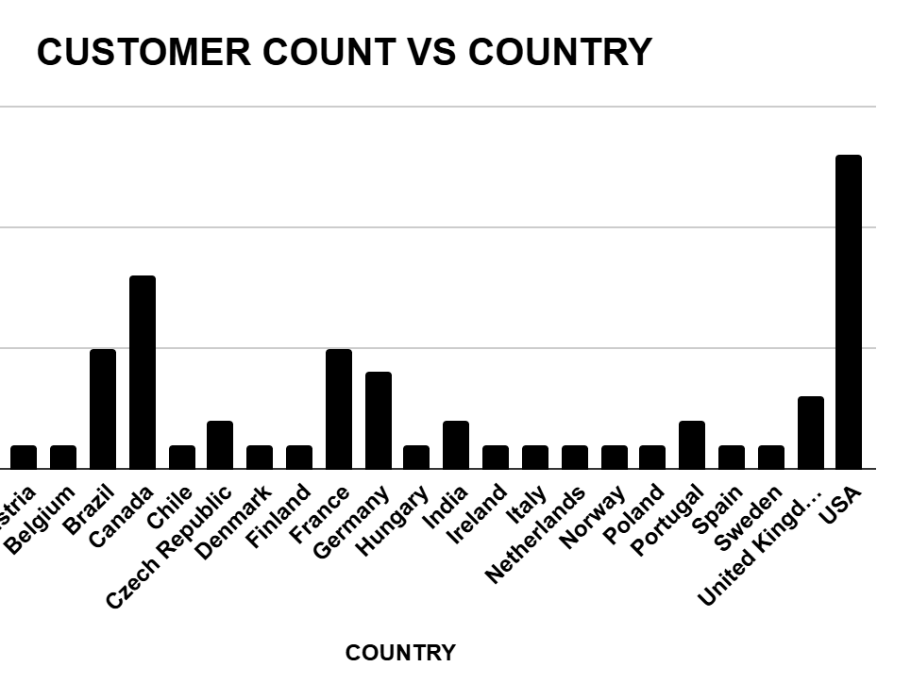
Demographics Analysis
1. North America: Core Market
Canada & USA = largest customer base.
Strong market penetration and success.
2. Europe & South America: Emerging Presence
Growing customer base in key countries (Brazil, France, Germany, UK).
3. Global Reach: Expansion Opportunities
Individual customers worldwide.
Potential for growth, but consider diverse market needs.

Slide 9
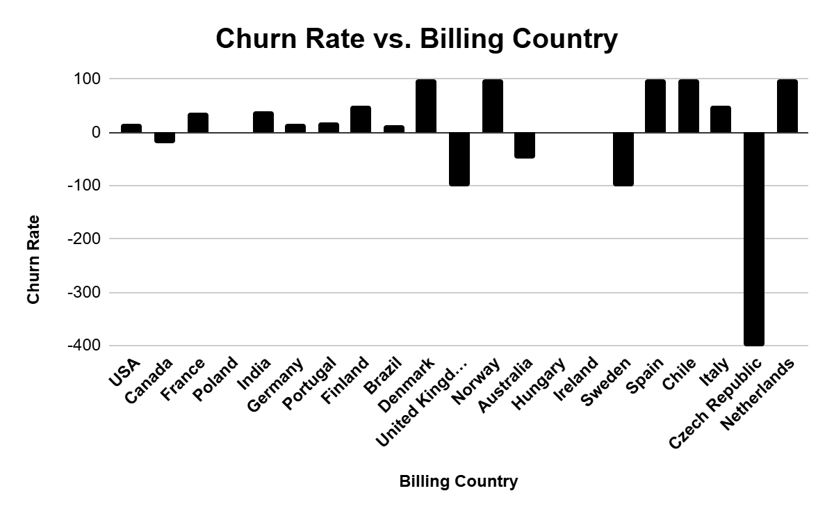
Churn Rate Analysis
Insights
Churn Rate: 40.82% attrition (2017 Q1–2020 Nov-Dec).
Customer Base Decline: 49 initial customers; 20 churned.
Recommendations
Retention Strategies: Loyalty programs, coupons, satisfaction surveys.
Engagement Initiatives: Targeted emails, promotions, campaigns.
Focus on At-Risk Customers: Early interventions for high-risk customers.
Improve Onboarding: Enhance customer satisfaction from the start.
Analyze Exit Reasons: Surveys to address and resolve churn causes.

Slide 10
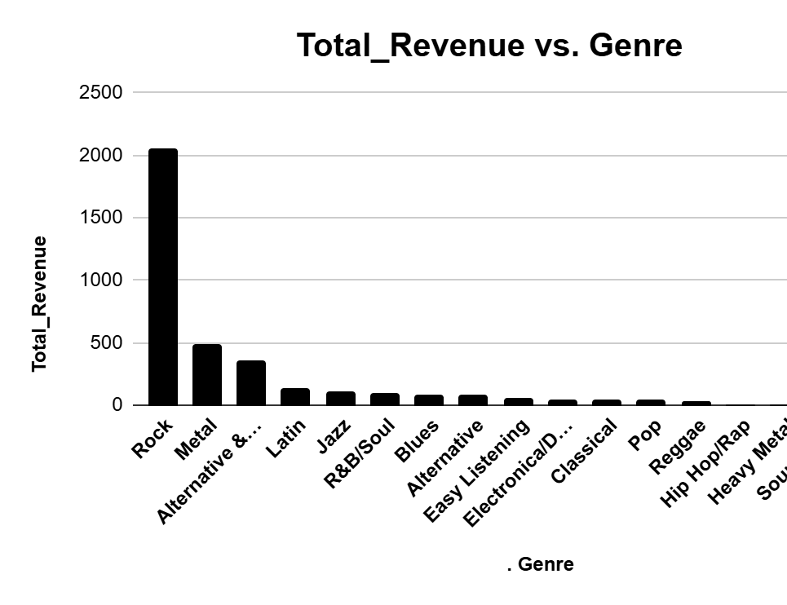
Genre Sales Analysis
1. Genre Popularity: Rock is King
Rock music dominates sales (50%+).
Alternative & Punk, Metal also show strong performance.
2. Business Recommendations
Prioritize Rock, Alternative & Punk, and Metal in inventory and marketing.
Implement genre-specific promotions to boost sales.

Slide 11
LongTerm v/s ShortTermCustomers
Insights:
1. Customer Lifetime Value
Long-term customers spend more and buy more items.
Customer retention is key!
2. Segmentation Opportunity
Tailor marketing based on customer "term" (e.g., new vs. long-term).
3. Business Recommendation: Focus on Retention
Prioritize strategies to keep customers coming back (loyalty programs, personalized recommendations, etc.).
Category | Total Spending | Items Bought | Customer Count
Long-term Customer | 28034.82 | 2762 | 32
Short-term Customer | 19468.35 | 1995 | 27
Recommendations:
Long-term customers spend more per order and purchase more tracks, indicating higher engagement, so try to increase duration.
New customers show potential for growth with targeted onboarding strategies.

Slide 12
Customer Risk Profiling
Understanding Customer Churn and Spending Behavior:
Inactivity Breeds Churn: Longer gaps between purchases increase the likelihood of customers churning.
Engagement Matters: Customers who buy more often are more likely to stay.
Spending is a Key Indicator: Low spenders may be on the verge of churning.
Demographics Play a Role: Age and gender can influence churn and spending, but more data and further analysis is required.

Slide 13
Recommendations
Focus on customer retention:
Optimize for high-value customers:
Tailor strategies to different markets:
Explore
acquisition channels:
Reward Loyalty: Implement loyalty programs.
Personalize: Targeted recommendations and marketing.
Excellent Service: Build strong customer relationships.
Identify & Nurture: Focus on high value and long-term customers.
Exclusive Benefits: Offer personalized experiences.
Regional Campaigns: Tailor marketing by location.
Cultural Sensitivity: Consider language and preferences.
Explore New Markets: Identify growth opportunities.
Localize: Consider partnerships and targeted marketing.

Slide 14
CONCLUSION
Composing Chinook Music Store’s Future
Boost Retention: Loyalty programs, personalized marketing.
Value High-Value Customers: Exclusive offers for long-term customers.
Data Quality: Ensure accurate data for reliable insights.
Targeted Strategies: Region-specific campaigns.
Gather More Data: Collect demographics for better targeting.
Closing Statement:
By acting on these insights, Chinook can optimize its operations, enhance customer engagement, and drive sustainable growth in a competitive market.

Slide 15
THANK YOU

