Slide 1
Generative AI Project
AI powered Clinical Trial Matching

Slide 2
Agenda
Abstract
Problem Statement & Objectives
Proposed Methodology
Novelty
Literature Survey
Architecture diagram

Slide 3
Abstract
Clinical trial matching remains a critical challenge due to unstructured eligibility criteria and the vast scale of trial data leading to trials taking many years to complete.
Traditional keyword-based search methods often fail to capture semantic relevance in patient-trial alignment.
We present a retrieval-augmented framework that combines ClinicalBERT-based dense retrieval with alightweight LLM for reasoning over top-ranked trials.
This setup enables interpretable, context-aware trial recommendations. Our approach demonstrates efficientsemantic retrieval and produces coherent justifications without requiring costly APIs.
Results indicate strong alignment between retrieved trials and query intent, showing the feasibility of low-resource clinical RAG systems.

Slide 4
Problem statement
The path from drug discovery to patient access is complicated, expensive, and time-consuming. Current methods rely heavily on manual processes, resulting in inefficiencies, high costs, and delays in recruitment.
Patients often struggle to find trials that fit their medical conditions, while sponsors face recruitment shortfalls that can jeopardize trial timelines and outcomes.
Generative AI has the potential to slow growing costs and transform the landscape of clinical development by accelerating tasks across the clinical life cycle.
An AI-powered solution for clinical trial matching could address these issues by automating and optimizing the process.
Such a system would analyze patient health data, medical history, and trial eligibility criteria to provide precise matches in real time. This approach aims to improve recruitment efficiency, enhance patient experiences, and accelerate the development of life-saving therapies.

Slide 5
Novelty
This project introduces an approach to leveraging generative AI (Gen AI) in clinical trials.
The system aims to integrates electronic health records (EHRs), patient feedback, and clinical trials, to create predictive models for trial success and patient outcomes. The system incorporates explainable AI mechanisms, ensuring that all trial matching and protocol optimization decisions are transparent and interpretable for stakeholders. By providing clear justifications for AI-driven decisions, this approach builds trust among researchers, patients, and regulators while addressing ethical concerns.
These innovations streamline trial processes, reduce redundancies, and ensure compliance with privacy standards, offering a robust framework for modernizing clinical trials.

Slide 6
Proposed methodology
1. Data Collection & Preprocessing
Collect structured and unstructured data from EHRs, clinical trial protocols, and public datasets.
Ensure compliance with differential privacy techniques.
Use Gen AI to generate synthetic patient records and eligibility criteria for data augmentation.
Convert unstructured text into structured formats.
2. Generative AI Model Development
Eligibility Extraction: Fine-tune LLMs to standardize trial criteria.
Patient Matching: Develop models for patient trial matching.
Explainability: Implement for interpretable AI-driven recommendations.
3. System Integration & Deployment
Clinical Trial Management Systems (CTMS) and EHRs integration using AI models.
4. Testing, Validation & Bias Mitigation
Validate using Gen AI-generated synthetic patients and real-world historical data.
Measure performance via various metrics.
5. Continuous Learning & Feedback
Use Human-in-the-Loop (HITL) validation with clinicians to refine recommendations.
Implement RLHF (Reinforcement Learning with Human Feedback) and federated learning for continuous model improvement.

Slide 7
Objectives
To develop an AI-powered platform that streamlines the clinical trial matching process by leveraging advanced generative AI techniques and ensuring trust through explainable AI.
The platform aims to:
Accurately match patients to suitable clinical trials by analyzing their medical history, health data, and trial eligibility criteria.
Reduce recruitment time and costs for sponsors while increasing the diversity and scale of participant pools.
Enhance the patient experience by providing personalized recommendations and simplifying the trial discovery process.
Accelerate clinical trial timelines, thereby contributing to faster development and availability of effective therapies.
Provide clear, interpretable explanations for each match, ensuring stakeholders understand how and why specific recommendations were made.

Slide 8
Expected Outcomes
Improved Efficiency: Significant reduction in the time required to match patients to clinical trials, potentially saving hours per patient.
Enhanced Trial Success Rates: Increased likelihood of recruiting eligible patients, leading to more successful and faster trials.
Reduced Costs: Lower administrative and operational expenses associated with trial design and patient matching.
Better Patient Access: Faster identification of suitable trials ensures timely access to new therapies for patients.
Scalable Framework: Develop a scalable and adaptable system that can be used across multiple therapeutic areas and geographies.

Slide 9
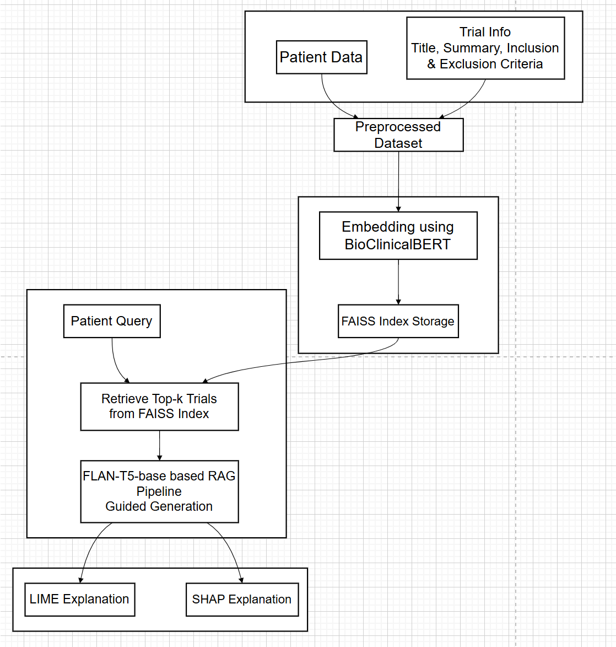
Architecture Diagram

Slide 10
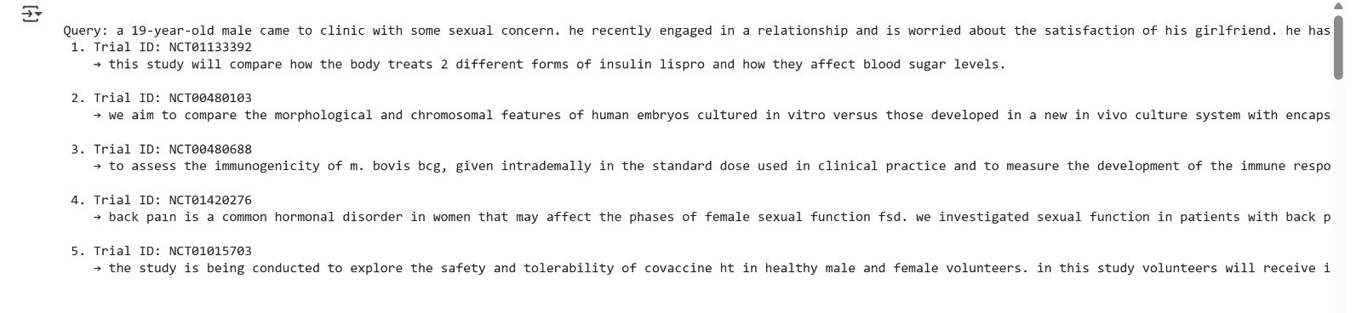
Results
The trials were matched successfully using the following :-
Bio clinical BERT for embeddings
faiss index
RAG pipeline with Flan-base model
Explainable ai using lime

Slide 11
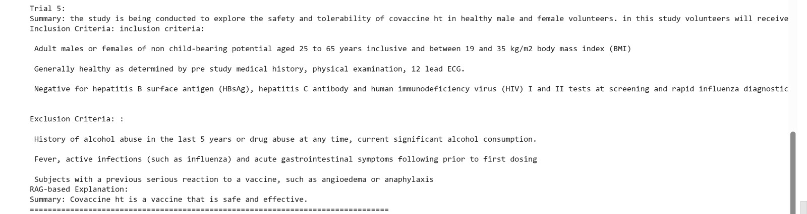
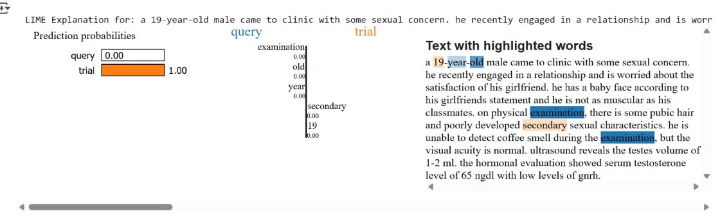
Results

Slide 12
References
[1] Wornow, M., Lozano, A., Dash, D., Jindal, J., Mahaffey, K.W., Shah, N.H. (2025). Zero-shot clinical trial patient matching with LLMs. NEJM AI, 2(1), AIcs2400360.
[2] Yim, D., Khuntia, J., Parameswaran, V., Meyers, A. (2024). Preliminary Evidence of the Use of Generative AI in Health Care Clinical Services: Systematic Narrative Review. JMIR Medical Informatics, 12, e52073. https://medinform.jmir.org/2024/1/e52073. DOI: 10.2196/52073
[3] Lee, K., Mai, Y., Liu, Z., et al. (2024). CriteriaMapper: Establishing the automatic identification of clinical trial cohorts from electronic health records by matching normalized eligibility criteria and patient clinical characteristics. Scientific Reports, 14, 25387.
[4] Jin, Q., Wang, Z., Floudas, C.S., et al. (2024). Matching patients to clinical trials with large language models. Nature Communications, 15, 9074.
[5] Nikolopoulos, A., Karalis, V.D. (2024). Implementation of a Generative AI Algorithm for Virtually Increasing the Sample Size of Clinical Studies. Applied Sciences, 14, 4570.

Slide 13
References
[6] Yuan, J., Tang, R., Jiang, X., Hu, X. (2024). Large Language Models for Healthcare Data Augmentation: An Example on Patient-Trial Matching. AMIA Annual Symposium Proceedings, 2023:1324–1333. PMID: 38222339; PMCID: PMC10785941.
[7] Wang, K., Cui, H., Zhu, Y., et al. (2024). Evaluation of an Artificial Intelligence-Based Clinical Trial Matching System in Chinese Patients with Hepatocellular Carcinoma: A Retrospective Study. BMC Cancer, 24, 246. https://doi.org/10.1186/s12885-024-11959-7
[8] Gupta, S., Basu, A., Nievas, M., et al. (2024). PRISM: Patient Records Interpretation for Semantic Clinical Trial Matching System Using Large Language Models. npj Digital Medicine, 7, 305. https://doi.org/10.1038/s41746-024-01274-7
[9] Beattie, J., Neufeld, S., Yang, D., Chukwuma, C., Gul, A., Desai, N., Jiang, S., Dohopolski, M. (2024). Utilizing Large Language Models for Enhanced Clinical Trial Matching: A Study on Automation in Patient Screening. Cureus, 16(5), e60044. DOI: 10.7759/cureus.60044. PMID: 38854210; PMCID: PMC11162699.

Slide 14
Thank You!!

