Slide 1
Virtual Memory
Partially Adapted from:
© 2004-2007 Ed Lazowska, Hank Levy, Andrea And Remzi Arpaci-Dussea, Michael Swift

Slide 2
A system with physical addressing
Main memory - An array of M contiguous byte-sized cells, each with a unique physical address
Physical addressing
Most natural way to access it – Addresses generated by the CPU correspond to bytes in it
Used in simple systems like early PCs and embedded microcontrollers (e.g. cars and elevators)
Main memory
Physical
address
(PA)
0:
1:
2:
CPU
3:
4
4:
5:
6:
7:
8:
...
M -1:
Data word
2
Notes:
2
Main memory is organized as an array of contiguous byte-sized cells, starting at address 0; given that, physical addressing is the most natural way for the CPU to use it.

Slide 3
Overcommitting Memory
Example:
Set of processes frequently referencing 33 important pages
Only 32 frames in physical memory
System repeats cycle
Reference page not in memory
Replace a page in memory with newly referenced page
Thrashing
System reading and writing pages instead of executing useful instructions
Average memory access time equals disk access time
Illusion breaks: Memory appears slow as disk rather than disks appearing fast as memory
Add more processes, thrashing gets worse

Slide 4
Virtual Memory
The basic abstraction that the OS provides for memory management is virtual memory (VM)
VM enables programs to execute without requiring their entire address space to be resident in physical memory
program can also execute on machines with less RAM than it “needs”
many programs don’t need all of their code or data at once (or ever)
e.g., branches they never take, or data they never read/write
no need to allocate memory for it, OS should adjust amount allocated based on its run-time behavior
virtual memory isolates processes from each other
one process cannot name addresses visible to others; each process has its own isolated address space
VM requires hardware and OS support
MMU’s, TLB’s, page tables, ...

Slide 5
Working Set
Many applications have a common memory access pattern
Accessed in a common order over a window of time
Tied closely to the idea of a computational kernel
The code that is the “heart” of an application
Executes for the majority of time
The Working Set
The memory itself accessed as part of the pattern
Working set is usually much smaller than all memory allocated
Ideally: A fixed region of memory of a certain size
Not so clean in the real world
Most of the time memory accesses will be to the working set
OS tries to make sure they are always available

Slide 6
Virtual Memory Features
Translation:
Ability to translate accesses from one address space (virtual to a different one (physical)
When translation exists, processor uses virtual addresses, physical memory uses physical addresses
Side effects:
Can be used to avoid overlap
Can be used to give uniform view of memory to programs
Protection:
Prevent access to private memory of other processes
Different pages of memory can be given special behavior (Read Only, Invisible to user programs, etc).
Kernel data protected from User programs
Programs protected from themselves

Slide 7
Hardware Support
Two operating modes
Privileged (protected, kernel) mode: OS context
Result of OS invocation (system call, interrupt, exception)
Allows execution of privileged instructions
Allows access to all of memory (sort of)
User Mode: Process context
Only access resources (memory) in its context (address space)

Slide 8
A system with virtual addressing
Modern processors use virtual addresses
CPU generates virtual address and address translation is done by dedicated hardware (memory management unit) via OS-managed lookup table
CPU chip
Main memory
Address
translation
0:
Virtual
address
(VA)
Physical
address
(PA)
1:
2:
CPU
MMU
3:
4100
4
4:
5:
6:
7:
...
M-1:
Data word
8
Notes:
8

Slide 9
Virtual Addresses
Virtual addresses are independent of location in physical memory (RAM) that referenced data lives
OS determines location in physical memory
instructions issued by CPU reference virtual addresses
e.g., pointers, arguments to load/store instruction, PC, ...
virtual addresses are translated by hardware into physical addresses (with some help from OS)
The set of virtual addresses a process can reference is its address space
many different possible mechanisms for translating virtual addresses to physical addresses
In reality, an address space is a data structure in the kernel
Typically called a Memory Map

Slide 10
Linux Memory Map
Each process has its own address space specified with a memory map
struct mm_struct;
Allocated regions of the address space are represented using a vm_area_struct (vma)
Recall: A process has a sparse address space
Includes:
Start address (virtual)
End address (first address after vma)
Memory regions are page aligned
Protection (read, write, execute, etc…)
Different page protections means new vma
Pointer to file (if one)
References to memory backing the region
Other bookkeeping

Slide 11
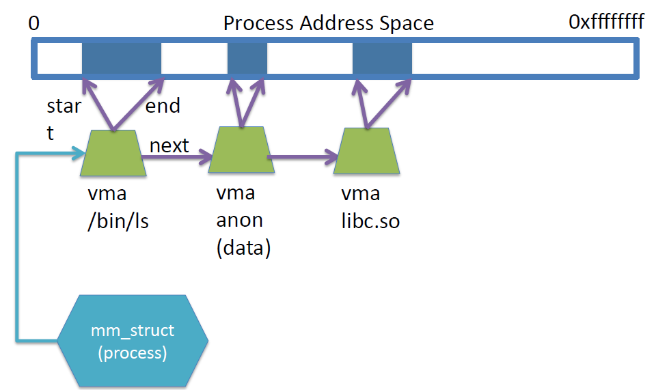
Memory map
Linked list of memory regions assigned to valid virtual addresses

Slide 12
Memory mapping
Each region has a specific use
Loaded executable segments
Stack
Heap
Memory mapped files
Modifying the memory map yourself
mmap(void *start, size_t length, int prot, int flags, int fd, off_t offset);
munmap(void *start, size_t length);

Slide 13
Instantiating the memory map
The OS must translate the memory map to a hardware configuration
Policy that the CPU can enforce
Two main hardware techniques for doing this
Segmentation
Each region is stored as a single entity
Paging
Regions are broken into fixed sized memory units (pages)

Slide 14
Segmentation
Segmentation partitions memory into logical units
stack, code, heap, ...
on a segmented machine, a VA is <segment #, offset>
segments are units of memory, from the user’s perspective
segmentation = many segments/process
Segments
Regions of contiguous memory
Defined by:
Base address – Physical Start address of the segment
Limit – Size of the segment (Maximum value of virtual address)
Hardware support:
multiple base/limit pairs, one per segment
stored in a segment table
segments named by segment #, used as index into table

Slide 15
Using Segments
Divide address space into logical segments
Each logical segment can be in separate part of physical memory
Separate base and limit for each segment (+ protection bits)
Read and write bits for each segment
How to designate segment?
Use part of logical address
Top bits of logical address select segment
Low bits of logical address select offset within segment
Implicitly by type of memory reference
Code vs. Data segments
Special registers

Slide 16
Segment lookups
Segment Table: Base and limit for every segment in process

Slide 17
x86 Segments
CS = Code Segment
DS = Data Segment
SS = Stack Segment
ES, FS, GS = Auxiliary segments
Explicit or implicitly specified by instructions
Accessed via special registers
16 bit “Selectors”
Identify the segment to the hardware MMU
Functionality depends on CPU operating mode

Slide 18
Protected Mode (32 bits)
Segment information stored as a table
GDT (Global Descriptor Table)
Where is the GDT?
Array of segment descriptions (base, limit, flags)
Segment registers now indicate array index
Segment registers select segment descriptor
E.g. CS points to Code Segment descriptor in GDT
Registers are 16 bits

Slide 19
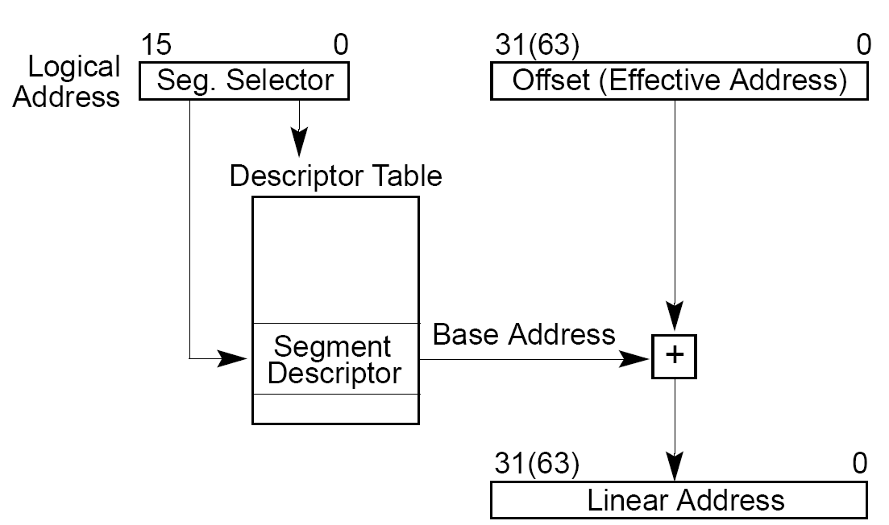
Linear address calculation

Slide 20
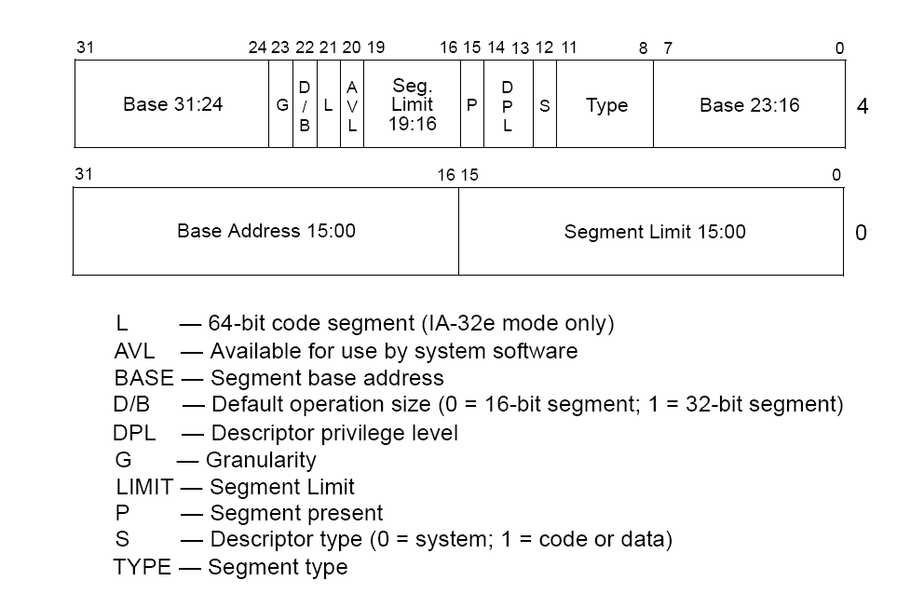
Segment descriptors

Slide 21
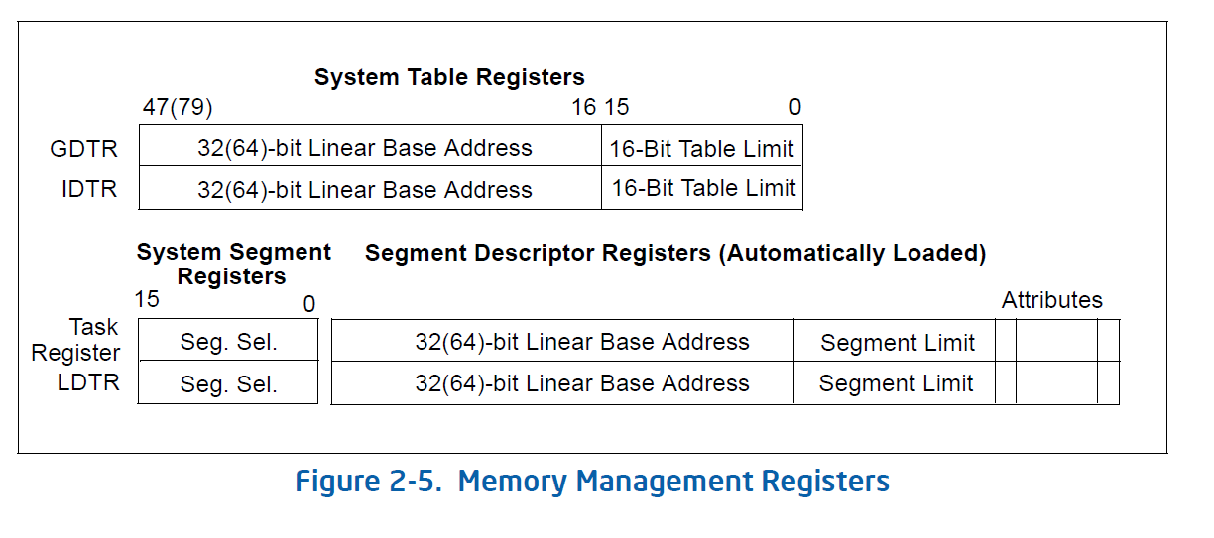
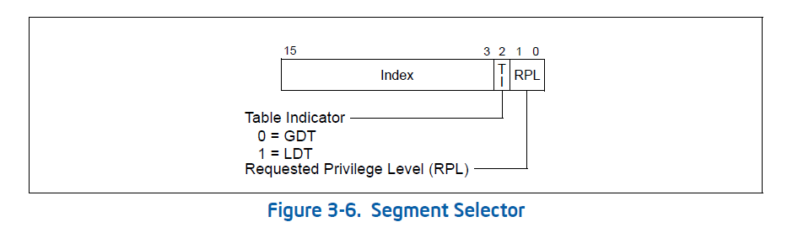
Segmentation Registers

Slide 22
Pros and Cons of Segmentation
Advantages
Supports dynamic relocation of address spaces
Supports protection across multiple address spaces
Cheap: Few registers and little logic
Fast: Add and Compare is easy
Disadvantages
Each process must be allocated contiguously in real memory
Fragmentation: Cannot allocate a new process
Must allocate memory that may not be used
No Sharing: Cannot share limited memory regions

Slide 23
Pages
Break memory up into fixed sized chunks
Fast to allocate and free
Easier to translate, less translations
Mostly 4KB, but not always
32 bit x86 supports 4KB and 4MB
64 bit x86 supports 4KB, 2MB and 1GB

Slide 24
Paging
Translating virtual addresses
a virtual address has two parts: virtual page number & offset
virtual page number (VPN) is index into a page table
page table entry contains page frame number (PFN)
physical address is PFN::offset
Page tables
managed by the OS
map virtual page number (VPN) to page frame number (PFN)
VPN is simply an index into the page table
one page table entry (PTE) per page in virtual address space
i.e., one PTE per VPN

Slide 25
Paging with Large Address Spaces
Mapping of logical addresses to physical memory
Page table for process
Base Address | CTRL bits
0 | 1 0
1 | 1 0
4 | 1 1
… skipped entries.. | 0 0
6 | 1 1
10 | 1 1
Free Page
Free Page
Physical Memory

Slide 26
Page tables
Memory resident
page table
(physical page
or disk address)‏
Virtual Page
Number
Physical Memory
Valid
1
1
0
1
1
1
0
1
0
Disk Storage
(swap file or
regular file system file)‏
1
26
Notes:
26

Slide 27
Page Translation
How are virtual addresses translated to physical addresses
Upper bits of address designate page number
20 Bits
12 Bits
Virtual
Address
Page Number
Page Offset
4K Pages
Page Table
Physical
Address
Page Base Address
Page Offset
No comparison or addition: Table lookup and bit substitution
1 page table per process: One entry per page in address space
Base address of each page in physical memory
Read/Write protection bits
How many entries in page table?

Slide 28
Paging Advantages
Easy to allocate physical memory
Just grab a page anywhere in memory that is available
Free pages are stored together in a linked list
To free a page, just put it back on the list
External fragmentation is not a problem
Large contiguous virtual address regions are easy to map
Don’t even need to map the entire region
Easy to “page out” chunks of programs
all chunks are the same size (page size)
use valid bit to detect references to “paged-out” pages
also, page sizes are usually chosen to be convenient multiples of disk block sizes

Slide 29
Paging Disadvantages
Can have internal fragmentation
process may not allocate memory in multiples of page size
Memory reference overhead
2 references per address lookup (page table, then memory)
Solution: use a hardware cache to absorb page table lookups
translation lookaside buffer (TLB) – next class
Page tables are stored in memory
need one page table entry per page in the virtual address space
32bit x86: 8KB page table required to map 4MB of address space
64bit x86: 16KB page table required to map 2MB of address space
Page tables can use a lot of memory

Slide 30
Combining Segmentation and Paging
x86 (32bit) architecture supports both segments and paging
Use segments to manage logically related units
stack, file, module, heap, …?
segment vary in size, but usually large (multiple pages)
Can manage policy at a single location
Use pages to partition segments into fixed chunks
Separates translation from protection
no external fragmentation
segments are “pageable”- don’t need entire segment in memory at same time
Linux:
1 kernel code segment, 1 kernel data segment
1 user code segment, 1 user data segment
1 task state segments (stores registers on context switch)
1 “local descriptor table” segment (not really used)
all of these segments are paged

Slide 31
Implementing Segmentation and Paging
IBM System 370
Segment #
(4 bits)
Page #
(8 bits)
Page Offset
(12 bits)
X86
Physical Memory
Physical
Address
Page Tables
(aka Virtual Address)

