Slide 1
实验报告务请按课程教学网站模板撰写！
5 WINDOWS REGISTRY
School of CS
Jicheng Hu
jichengwhu @ 163 . com
https://gitee.com/principlewindows/win-principle-2023

Slide 2
outlines
5.1 Introduction to Windows Registry
5.2 Registry Editor
5.3 Structure of the Registry
5.4 Backup and Restore
5.5 Registry Hives
5.1 Introduction to Windows Registry

Slide 3
概 述
The registry is a system-defined database in which applications and system components store and retrieve configuration data.
注册表是 Windows 的一个内部数据库，一个巨大的树状分层数据库。
容纳了应用程序和计算机系统的全部配置信息、系统和应用程序的初始化信息、应用程序和文档文件的关联关系、硬件设备的说明、状态和属性以及各种状态信息和数据。
注册表中存放着各种参数，直接控制着Windows的启动、硬件驱动程序的装载以及一些Windows应用程序的运行，从而在整个Windows系统中起着核心作用。
注册表在Windows 中起到中介的作用，负责系统同软件、硬件、用户之间的沟通

Slide 4
Window 使用注册表初衷：
一致性好：所有 Windows 应用程序采用一致的配置，相比 ini 等文本配置文件中自定义的各种配置结构（键值对、XML、Json）在MFC中能进行一致的访问
访问速度快：注册表以二进制树形结构存储，访问速度比文本解析快
保护版权：商业软件的验证信息隐藏在注册表中，二进制存储方式增加了破解难度，保护了版权
缺陷(Gnome 下 Dconf 有类似问题)：
迁移困难，造成对 Windows 上软件的迁移困难，重装系统导致软件也必须重装
备份麻烦，Linux 下只需备份 /etc 和 /home 基本解决问题
删除软件会有注册表遗留，要使用专门软件清理注册表
病毒攻击的对象之一，造成无法修复的损伤（“熊猫烧香”病毒）
Windows 平台下注册表发展趋势：
硬件等全局资源的放在注册表中方便管理
应用程序对注册表的依赖逐渐减弱，采用领域的社区习惯用法方便开放、迁移
新一代 VS 的配置文件夹 .vs/ 大量使用 .json，方便快速恢复用户工作区现场
C# 的 app.config 使用的是 XML
Registration-Free COM Interop：application and component manifests. A component manifest, created by a component developer, contains information otherwise located in the Windows registry.
Notes:
https://docs.microsoft.com/en-us/dotnet/framework/interop/registration-free-com-interop
https://docs.microsoft.com/en-us/windows/win32/sbscs/application-manifests
https://blogs.windows.com/windowsdeveloper/2019/04/30/enhancing-non-packaged-desktop-apps-using-windows-runtime-components/
https://docs.microsoft.com/en-us/dotnet/api/microsoft.win32.registryhive
http://www.winwin7.com/JC/5990.html

Slide 5
REGEDIT 概述总结
优点
不足
安全
特殊数据类型
Notes:
自己完善该 slide，以便应对考试

Slide 6
outlines
5.1 Introduction to Windows Registry
5.2 Registry Editor
5.3 Structure of the Registry
5.4 Backup and Restore
5.5 Registry Hives
5.2 Registry Editor

Slide 7
注册表的编辑
The registry in 64-bit versions of Windows is divided into 32-bit and 64-bit keys
Many of the 32-bit keys have the same names as their 64-bit counterparts, and vice versa
The default 64-bit version of Registry Editor (Regedit.exe) that is included with 64-bit versions of Windows displays both 64-bit keys and 32-bit keys
To open the 32-bit version of Registry Editor, follow these steps:
Click Start, and then click Run 或 <WIN> + r
In the Open box, type %systemroot%\syswow64\regedit, and then click OK.
Notes:
https://support.microsoft.com/en-us/help/305097/how-to-view-the-system-registry-by-using-64-bit-versions-of-windows
You must close the 64-bit version of Registry Editor before you can open the 32-bit version (and vice versa) unless you start the second instance of Registry Editor with the -m switch. For example, if the 64-bit version of Registry Editor is already running, type %systemroot%\syswow64\regedit -m in step 2 to start the 32-bit version of Registry Editor.

Slide 8
两个注册表编辑器的比较
To enable 64-bit/32-bit program interoperability through COM and other mechanisms, WOW64 uses a "Registry Reflector" that mirrors certain registry keys and values between the 64-bit and 32-bit registry views. The reflector is "intelligent", in that is only reflects COM activation data.
The WOW64 Registry reflector may modify the contents of keys and values during the reflection process to adjust path names, and so on. Because of this, the 32-bit and 64-bit contents may differ. For example, pathnames that contain the system32 registry entry are written as SysWOW64 in the 32-bit section of the registry. The following keys are reflected:
HKEY_LOCAL_MACHINE\Software\Classes
HKEY_LOCAL_MACHINE\Software\COM3
HKEY_LOCAL_MACHINE\Software\Ole
HKEY_LOCAL_MACHINE\Software\EventSystem
HKEY_LOCAL_MACHINE\Software\RPC

Slide 9
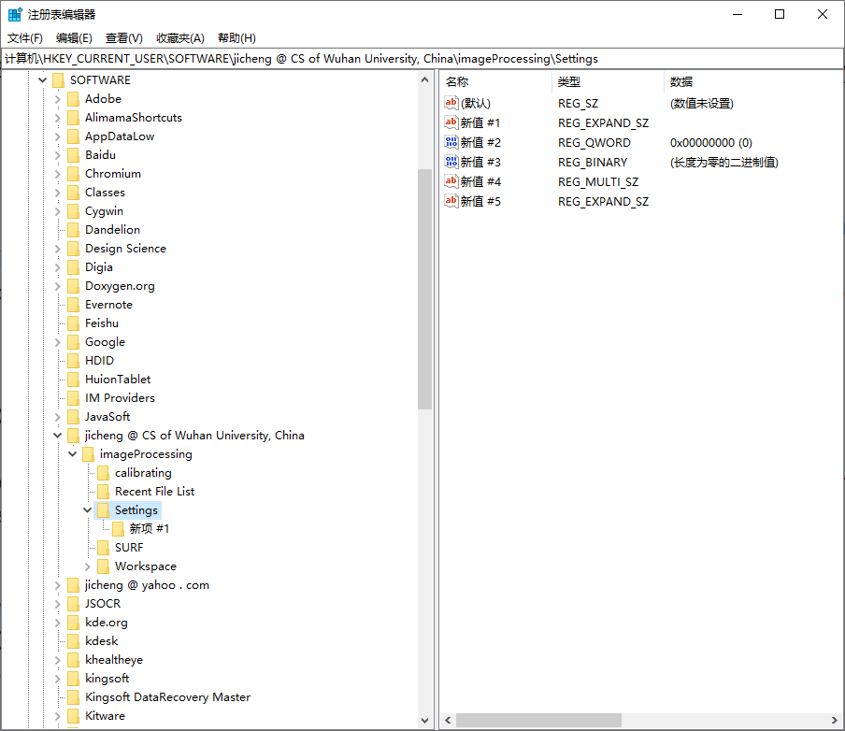
REGEDIT的图形模式

Slide 10
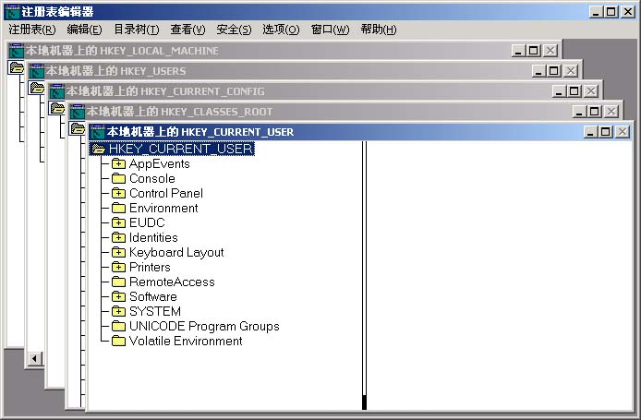
注册表编辑器REGEDT32
REGEDT32的窗口结构

Slide 11
REGEDT32与REGEDIT窗口的主要差别
不是一个单一的窗口，而是五个根键各有一个窗口
可以将五个独立窗口中的任意一个最大化，最小化，或重新调整大小，但不能单独关闭其中之一
没有“Favorites”菜单
在REGEDT32中见不到状态栏
REGEDT32不支持右击

Slide 12
REGEDT32用符号显示值类型
REG_SZ 表示“字符串(string)”。
REG_BINARY 表示“二进制(binary)”。
REG_DWORD 表示 “DWORD”。
REG_MULTI_SZ 表示“多字符串(multi-string)”。
REG_EXPAND_SZ 表示“可扩展字符串(expandable string)”，包含一个可扩展变量的 字符串。
Notes:
SZ: Zero Terminated String

Slide 13
Registry Element Size Limits
The following table identifies the size limits for the various registry elements.
REGISTRY ELEMENT SIZE LIMITS
Registry Element | Size Limit
Key name | 255 characters. The key name includes the absolute path of the key in the registry, always starting at a base key, for example, HKEY_LOCAL_MACHINE.
Value name | 16,383 characters Windows 2000: 260 ANSI characters or 16,383 Unicode characters.
Value | Available memory (latest format)1 MB (standard format)
Tree | A registry tree can be 512 levels deep. You can create up to 32 levels at a time through a single registry API call.
Long values (more than 2,048 bytes) should be stored in a file, and the location of the file should be stored in the registry. This helps the registry perform efficiently.
Notes:
https://docs.microsoft.com/en-us/windows/win32/sysinfo/registry-element-size-limits

Slide 14
outlines
5.1 Introduction to Windows Registry
5.2 Registry Editor
5.3 Structure of the Registry
5.4 Backup and Restore
5.5 Registry Hives
5.3 Structure of the Registry

Slide 15
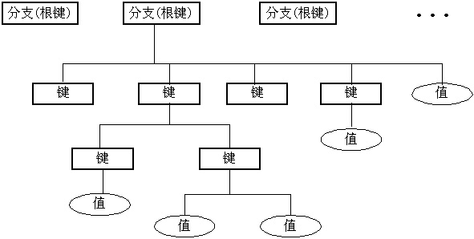
注册表的逻辑结构和内容
注册表的基本组织结构

Slide 16
注册表分支
分支名称
指向
缩写
HKEY_LOCAL_MACHINE
HKLM
HKEY_CURRENT_CONFIG
HKLM\SYSTEM\CurrentControlSet\
Hardware Profiles\Current
HKCC
HKEY_CLASSES_ROOT
HKLM\SOFTWARE\Classes＋HKCU\SOFTWARE\Classes
HKCR
HKEY_USER
HKU
HKEY_CURRENT_USER
HKU\<Security ID>
HKCU

Slide 17
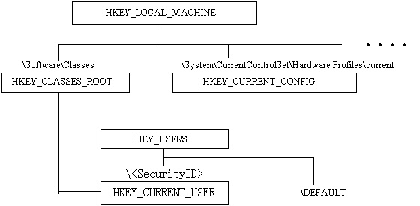
注册表分支结构的详细关系图

Slide 18
注册表中的值
Windows 2000注册表使用三种类型的值：字符串、二进制及DWORD(双字)
在注册表编辑器里，值类型是使用前缀REG的“匈牙利语式”符号，例如REG_BINARY

Slide 19
注册表中的值
字符串REG_SZ
扩展字符串 REG_EXPAND_SZ，允许用户创建含有一个系统变量的字符串
多重字符串，REG_MULTI_SZ，是字符串类型的另一个变体，是注册表把几个字符串集合成为一个值
二进制 REG_BINARY
DWORD值 REG_DWORD ，是一种特殊的二进制值，即四个字节的二进制值

Slide 20
HKEY_LOCAL_MACHINE
HKEY_LOCAL_MACHINE(HKLM)
子目录树中的设置内容是关于本地计算机系统的信息，包括硬件和操作系统数据，如总线类型、系统内存、设备驱动程序和启动控制数据。这些信息只与本地的用户有关，而与其他用户无关。
包含五个子项。注意不能使用注册表编辑器修改HKEY_LOCAL_MACHINE子目录树中的SAM子项和SECURITY子项，这些子项对应的是“计算机管理器”等系统功能。

Slide 21
HKEY_LOCAL_MACHINE
HKEY_LOCAL_MACHINE\HARDWARE
保存了Windows 2000 系统中的所有硬件信息，系统和应用程序都是通过该项的设置与具体的硬件进行沟通。
HEKY_LOCAL_MACHINE\SOFTWARE
包含系统中软件的设置信息。由于用户安装的软件不同，该项中的设置信息也会不同。
HEKY_LOCAL_MACHINE\SYSTEM
包含系统启动需要的详细信息，包含设备的驱动程序及其配置信息、控制数据、系统分区及其他驱动器的设置信息，以及系统不能启动时，如何恢复正确配置信息。

Slide 22
HKEY_CURRENT_CONFIG
HKEY_CURRENT_CONFIG子目录树是用来控制系统硬件配置信息的，它包含系统不同的硬件配置信息之间的差异。如果在系统中设置了多个不同的正确的配置文件，则系统在启动时会让用户选择要使用的配置文件。HKEY_CURRENT_CONFIG控制项代表的就是用户或用户选择的硬件配置文件，但是它只列出用户选择的配置文件与其它配置文件不同的地方。

Slide 23
HKEY_CLASSES_ROOT
为了加强对系统数据类型的管理，Windows 在注册表中组织了HKEY_CLASSES_ROOT子目录树，它包含了对数据文件类型的定义；每一种在系统中注册过的文件类型，都会在此建立一个子项。在每一个子项中定义的数据文档的扩展名、扩展名的说明性文字、在文件列表窗口中显示的图标以及与数据文档关联的应用程序和应用程序对数据文档的操作方式。如果用户要动手注册新的数据文档，可以在HKEY_CLASSES_ROOT中创建相应的子项。

Slide 24
HKEY_USERS
HKEY_USERS子目录树是用来控制用户配置文件的，它包含所有用户的配置文件的内容。每个用户都会在HKEY_USERS项中有一个子项，该子项的内容和HKEY_CURRENT_USER项的内容相似，具体功能也相同，只是使用子项的用户不同。

Slide 25
HKEY_CURRENT_USER
HKEY_CURRENT_USER子目录树是Windows 注册表最重要的部分之一，它包含Windows 系统、系统的集成部分以及应用软件的配置信息，主要是针对系统的声音、时间、控制面板的功能（如桌面、鼠标、配色方案、屏幕保护程序）、键盘等建立的配置信息以及安装软件时由安装程序建立的项和值

Slide 26
HKEY_CURRENT_USER常用项
HKEY_CURRENT_USER\AppEvents
HKEY_CURRENT_USER\Console
HKEY_CURRENT_USER\Control Panel
HKEY_CURRENT_USER\Environment
HKEY_CURRENT_USER\Printers
HKEY_CURRENT_USER\Keyboard Layout
HKEY_CURRENT_USER\software

Slide 27
outlines
5.1 Introduction to Windows Registry
5.2 Registry Editor
5.3 Structure of the Registry
5.4 Backup and Restore
5.5 Registry Hives
5.4 Backup and Restore

Slide 28
注册表的备份与恢复
备份方法
通过REGEDIT菜单工具进行备份。
通过reg.exe工具备份。export
利用磁盘管理工具备份。
恢复方法
通过REGEDIT菜单工具进行恢复。
通过reg.exe工具恢复。import
利用磁盘管理工具恢复。

Slide 29
注册表的备份
Back up the registry manually
From the Start menu, type regedit.exe in the search box, and then press Enter. If you are prompted for an administrator password or for confirmation, type the password or provide confirmation.
In Registry Editor, locate and click the registry key or subkey that you want to back up.
Click File > Export.
In the Export Registry File dialog box, select the location to which you want to save the backup copy, and then type a name for the backup file in the File name field.
Click Save.
Create a system restore point
From the Start menu, type create a restore point.
Select Create a restore point from the search results.
Choose Create, and then follow the steps to create a restore point.
Notes:
https://support.microsoft.com/en-us/help/322756/how-to-back-up-and-restore-the-registry-in-windows

Slide 30
注册表的恢复
Restore a manual back up
From the Start menu, type regedit.exe, and then press Enter. If you are prompted for an administrator password or for confirmation, type the password or provide confirmation.
In Registry Editor, click File > Import.
In the Import Registry File dialog box, select the location to which you saved the backup copy, select the backup file, and then click Open.
Restore from a restore point
From Start, type create a restore point.
Select Create a restore point from the search results.
Choose System Restore.

Slide 31
outlines
5.1 Introduction to Windows Registry
5.2 Registry Editor
5.3 Structure of the Registry
5.4 Backup and Restore
5.5 Registry Hives
5.5 Registry Hives

Slide 32
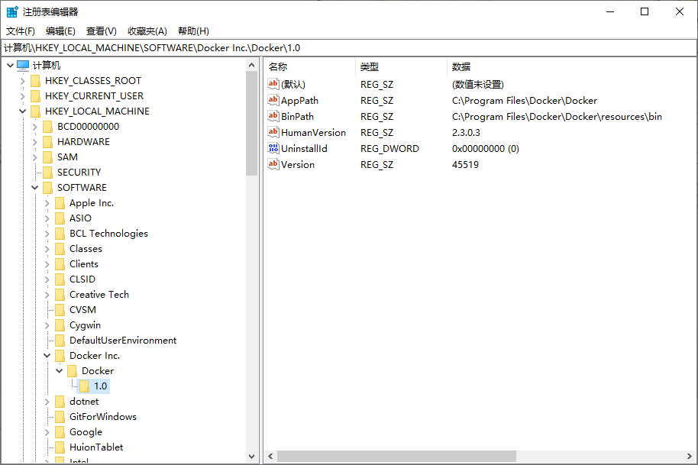
A hive is a logical group of keys, subkeys, and values in the registry that has a set of supporting files loaded into memory when the operating system is started or a user logs in.
配置单元
Hives
Left pane
values
一些人将 hives 称作 root keys
Right pane
Keys & subkeys
Notes:
Most of the supporting files for the hives are in the %SystemRoot%\System32\Config directory.
These files are updated each time a user logs on

Slide 33
注册表文件组成
大多数注册表文件都存放在%SystemRoot%\System32\Config 文件夹
*.LOG文件，日志文件，保存运行时更新信息。
Default文件，登录网络前所用缺省用户配置文件。
Sam (Security Account Manager,安全帐目管理器)
Security文件，含有与安全有关的内容。
Software文件，安装软件内容。
System文件，包含的主要是硬件配置的信息。
Documents and Settings\UserName\NTUSER.DAT
Notes:
Most of the supporting files for the hives are in the %SystemRoot%\System32\Config directory.
These files are updated each time a user logs on

Slide 34
User Profile Hive
Each time a new user logs on to a computer, a new registry hive is created for that user with a separate file for the user profile. This is called the user profile hive.
A user's hive contains specific registry information pertaining to the user's application settings, desktop, environment, network connections, and printers
User profile hives are located under the HKEY_USERS key.
Notes:
https://docs.microsoft.com/en-us/windows/win32/sysinfo/registry
A hive is a logical group of keys, subkeys, and values in the registry that has a set of supporting files loaded into memory when the operating system is started or a user logs in.

Slide 35
注册表文件组成
The following table lists extensions along with a description of the data in the file
Extension | Description
none | A complete copy of the hive data.
.alt | A backup copy of the critical HKEY_LOCAL_MACHINE\System hive. Only the System key has an .alt file.
.log | A transaction log of changes to the keys and value entries in the hive.
.sav | A backup copy of a hive. Windows Server 2003 and Windows XP/2000: Copies of the hive files as they looked at the end of the text-mode stage in Setup. Setup has two stages: text mode and graphics mode. The hive is copied to a .sav file after the text-mode stage of setup to protect it from errors that might occur if the graphics-mode stage of setup fails. If setup fails during the graphics-mode stage, only the graphics-mode stage is repeated when the computer is restarted; the .sav file is used to restore the hive data.
Notes:
Most of the supporting files for the hives are in the %SystemRoot%\System32\Config directory.
These files are updated each time a user logs on

Slide 36
注册表文件组成
The following table lists the standard hives and their supporting files
Registry hive | Supporting files
HKEY_CURRENT_CONFIG | System, System.alt, System.log, System.sav
HKEY_CURRENT_USER | Ntuser.dat, Ntuser.dat.log
HKEY_LOCAL_MACHINE\SAM | Sam, Sam.log, Sam.sav
HKEY_LOCAL_MACHINE\Security | Security, Security.log, Security.sav
HKEY_LOCAL_MACHINE\Software | Software, Software.log, Software.sav
HKEY_LOCAL_MACHINE\System | System, System.alt, System.log, System.sav
HKEY_USERS\.DEFAULT | Default, Default.log, Default.sav
Notes:
Most of the supporting files for the hives are in the %SystemRoot%\System32\Config directory.
These files are updated each time a user logs on

Slide 37
THANK YOU !

Slide 38
上机练习
使用windows API实现对注册表的操作
创建键与子健
删除键
修改键值
读取键值

