Slide 1
WINDOWS编程实战进阶
School of CS
Jicheng Hu
jichengwhu @ 163 . com
https://gitee.com/principlewindows/

Slide 2
Windows Coding Skills
APPROACHING TO ADVANCED LEVEL
surf in the programming ocean
seek the endless technique waves
the shimmering spoondrift forms a coding life

Slide 3
内容提要
x.1 RAII
x.2 PowerToys
x.3 coding style
x.4 XAML Islands / PWA
x.5 Fibers / Coroutine

Slide 4
x.1 RAII
Resource Acquisition Is Initialization
一种利用对象生命周期来管理资源的技术
内存、文件句柄、网络连接、互斥量……
该技术使得资源的获取只需初始化
对象构造时获取资源
管理对资源的访问，使其在对象生命周期内保持有效
在对象析构的时候负责释放资源
资源获取即初始化
https://en.cppreference.com/w/cpp/language/raii

Slide 5
x.1 RAII
x.1 RAII
Resource Acquisition Is Initialization
一种利用对象生命周期来管理资源的技术
内存、文件句柄、网络连接、互斥量……
该技术使得资源的获取只需初始化
对象构造时获取资源
管理对资源的访问，使其在对象生命周期内保持有效
在对象析构的时候负责释放资源
资源获取即初始化
https://en.cppreference.com/w/cpp/language/raii

Slide 6
RAII 例子
将所请求资源的生命周期绑定到一个对象的生存期
std::mutex m;
void bad()
{
m.lock(); // acquire the mutex
f(); // if f() throws an exception, the mutex is never released
if(!everything_ok()) return; // early return, the mutex is never released
m.unlock(); // if bad() reaches this statement, the mutex is released
}
void good()
{
std::lock_guard<std::mutex> lk(m); // RAII class: mutex acquisition is initialization
f(); // if f() throws an exception, the mutex is released
if(!everything_ok()) return; // early return, the mutex is released
} // if good() returns normally, the mutex is released
参考网页 https://en.cppreference.com/w/cpp/language/raii

Slide 7
使用RAII的好处:
不需要显式地释放资源
对象所需的资源在其生命期内始终保持有效
RAII,java & C#: https://blog.csdn.net/u014053368/article/details/22595289

Slide 8
RAII SUMMARIZATION:
encapsulate each resource into a class, where
the constructor acquires the resource and establishes all class invariants or throws an exception if that cannot be done
the destructor releases the resource and never throws exceptions
always use the resource via an instance of a RAII-class that either
has automatic storage duration or temporary lifetime itself, or
has lifetime that is bounded by the lifetime of an automatic or temporary object
Another name for such technique is Scope-Bound Resource Management (SBRM)
Notes:
Scope-Bound Resource Management: 作用域界定资源管理

Slide 9
RAII resource wrappers
VS2022 Community 使用微软的 RAII 实现
打开项目的NuGet管理器
右击需要安装的项目
选择manage NuGet packages …
安装WIL
在NuGet管理器中搜索Microsoft.Windows.ImplementationLibrary
安装最新版本的WIL(Latest stable 1.0.220914.1, Thursday, September 15, 2022)
在需要使用的地方添加头文件 #include <wil/resource.h>
https://github.com/Microsoft/wil/wiki/RAII-resource-wrappers
Smart pointers and auto-releasing resource wrappers to let you manage Windows API HANDLEs, HWNDs, and other resources and resource handles with RAII semantics.
参考网页 https://en.cppreference.com/w/cpp/language/raii

Slide 10
RAII resource wrappers
The resource wrappers library is usable by any user-mode C++ code through relative inclusion of Resource.h
Note that Resource.h defines wrappers only for types that have been defined prior to the inclusion of Resource.h.
It is safe to include Resource.h multiple times. Each time will define wrappers for any new types defined after the previous inclusion of Resource.h.
#include <wil/Resource.h>
#include <WinINet.h>
#include <wil/Resource.h>
参考网页 https://github.com/Microsoft/wil/wiki/RAII-resource-wrappers

Slide 11
RAII resource wrappers
// Construct a new pointer with a resource
wil::unique_handle ptr( handle );
// Retrieve the resource
auto resource = ptr.get( );
// Check validity of the resource
if ( ptr )
{
// resource is assigned
}
// Same as previous
if ( ptr.is_valid( ) )
{
// resource is assigned
}
// Free the resource
ptr.reset ( );
// Free and replace the resource
ptr.reset ( handle );
// Detach resource from the pointer without freeing
auto resource = ptr.release( );
// Return the address of the internal resource for out parameter use
// Note: Also frees any currently-held resource
WindowsApiCall ( &ptr );
// Same as previous
WindowsApiCall ( ptr.put( ) );
// Return the address of the internal resource for in-out parameter use
WindowsApiCall ( ptr.addressof ( ) );
// Swap resources between smart pointers
ptr.swap ( ptr2 );
参考网页 https://github.com/Microsoft/wil/wiki/RAII-resource-wrappers

Slide 12
RAII resource wrappers
wil::unique_hwnd m_hMainWnd = nullptr;
HWND GetHandle ( ) const
{
return m_hMainWnd.get ( );
}
static void OnNCCreate ( HWND const window, LPARAM const lparam ) noexcept
{
auto cs = reinterpret_cast<CREATESTRUCT*>(lparam);
auto that = static_cast<DesktopWindow*>(cs->lpCreateParams);
WINRT_ASSERT ( that );
WINRT_ASSERT ( !that->GetHandle ( ) );
that->m_hMainWnd = wil::unique_hwnd ( window );
SetWindowLongPtr ( window, GWLP_USERDATA,
reinterpret_cast<LONG_PTR>(that) );
}

Slide 13
x.2 PowerToys
a set of utilities for power users to tune and streamline their Windows experience for greater productivity
PowerToys是一组由微软首先在Windows 95中引入的实用型程序
Windows XP发布后推出了PowerToys第二版，但自那之后便不再更新
17年之后，微软正在考虑向Windows 10用户推出PowerToys 3
PowerToys 3工具是开源的
工具1：FancyZones
工具2：Windows key shortcut guide
参考网页 https://github.com/microsoft/PowerToys

Slide 14
x.2 PowerToys
x.2 PowerToys
a set of utilities for power users to tune and streamline their Windows experience for greater productivity
PowerToys是一组由微软首先在Windows 95中引入的实用型程序
Windows XP发布后推出了PowerToys第二版，但自那之后便不再更新
17年之后，微软正在考虑向Windows 10用户推出PowerToys 3
PowerToys 3工具是开源的
工具1：FancyZones
工具2：Windows key shortcut guide
Prerequisites to Build the Installer
Install the WiX Toolset Visual Studio 2019 Extension.
Install the WiX Toolset build tools from https://wixtoolset.org/releases/
参考网页 https://github.com/microsoft/PowerToys

Slide 15
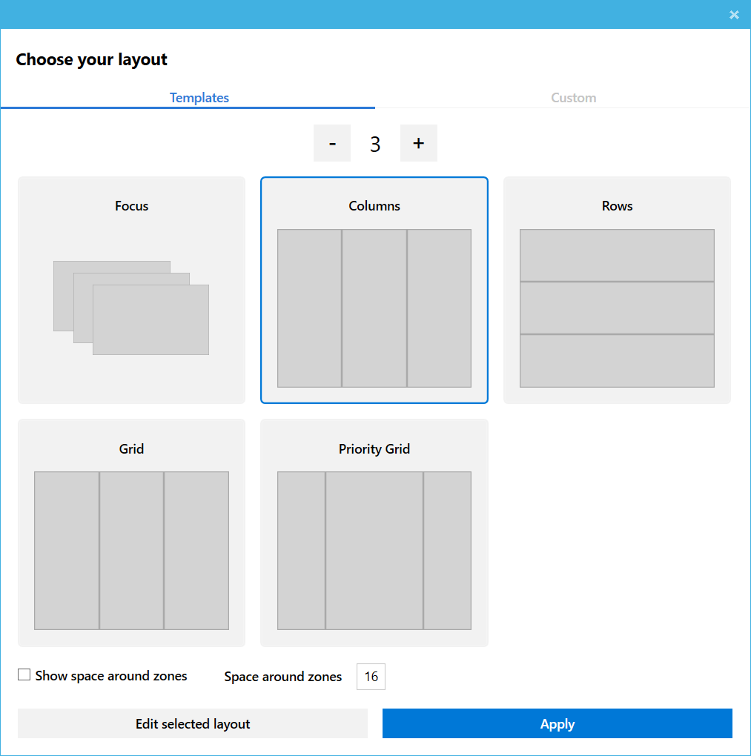
FancyZones的功能
在显示桌面上用户自定义布局
将应用程序窗口对齐到定义好的布局
拖动窗口时使用shift键

Slide 16
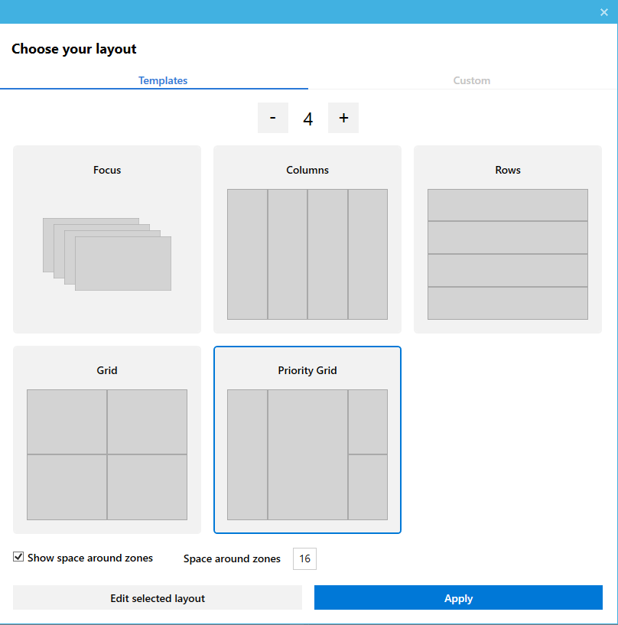
FancyZones的功能
在显示桌面上用户自定义布局
将应用程序窗口对齐到定义好的布局
拖动窗口时使用shift键

Slide 17
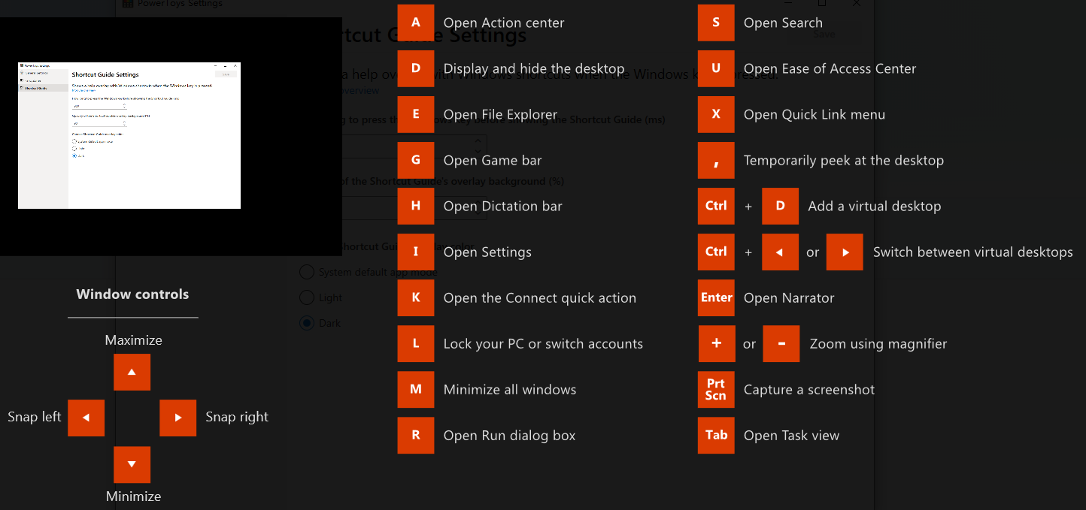
Windows key shortcut guide的功能
Windows键长按900ms

Slide 18
x.3 coding style
You are defined by your character
Your character is defined by your coding style
Not best-practices or requirements
deleting arrays with delete[]……
typography
TextFileProcessor ::
TextFileProcessor( class ConstStringFinder& theConstStringFinder )
: TextFileProcessor_Base( theConstStringFinder )
, m_ThreadHandle ( NULL )
, m_startNLSearch ( 0 )
, m_endNLSearch ( 0 )
, m_LineEndGetIdx ( 0 )
, m_LineEndPutIdx ( 0 )
, m_LineEnds ( new const void*[ sc_LineEndSize ] )
{
;
}

Slide 19
x.3 coding style
x.3 coding style
You are defined by your character
Your character is defined by your coding style
Not best-practices or requirements
deleting arrays with delete[]……
typography
TextFileProcessor ::
TextFileProcessor( class ConstStringFinder& theConstStringFinder )
: TextFileProcessor_Base( theConstStringFinder )
, m_ThreadHandle ( NULL )
, m_startNLSearch ( 0 )
, m_endNLSearch ( 0 )
, m_LineEndGetIdx ( 0 )
, m_LineEndPutIdx ( 0 )
, m_LineEnds ( new const void*[ sc_LineEndSize ] )
{
;
}

Slide 20
Codes formatted in columns
seems to be a lot easier for us to read...
int myVar = 1; // comment 1
int myLongerVar = 200; // comment 2
MyStruct arrayOfMyStruct[] =
{
// Name, timeout, valid
{"A string", 1000, true }, // Comment 1
{"Another string", 2000, false }, // Comment 2
{"Yet another string", 11111000, false }, // Comment 3
{NULL, 5, true }, // Comment 4
};

Slide 21
enumeration
scoped enumeration
// obsolete in C++11
namespace EntityType {
enum Enum {
Ground = 0,
Human,
Aerial,
Total
};
}
void foo(EntityType::Enum entityType)
{
if (entityType == EntityType::Ground) {
/*code*/
}
}
// Scoped enumeration (declared with enum class or enum struct)
enum class EntityType
{
Ground = 0,
Human,
Aerial,
Total
};
void foo ( EntityType entityType )
{
if (entityType == EntityType::Ground )
{
/*code*/
}
}

Slide 22
Curiously Recurring Template Pattern
// pass a class as a template parameter to its base class
template<class Derived>
struct BaseCRTP { };
struct Example : BaseCRTP<Example> { };
// Within the base class, it can get ahold of the derived instance,
// complete with the derived type, simply by casting
// (either static_cast or dynamic_cast work)
template<class Derived>
struct BaseCRTP {
void call_foo() {
Derived& self = *static_cast<Derived*>(this);
self.foo();
}
};
struct Example : BaseCRTP<Example> {
void foo() { cout << "foo()\n"; }
};
In effect, call_foo has been injected into the derived class with full access to the derived class's members.

Slide 23
Pointer-to-Implementation
The implementation of foo is decoupled from its public interface, so that
it can use members and types from other headers without requiring these dependencies to be present when the class is used, and
the implementation can be modified without forcing a recompile of the code that uses the class.
Users of the class simply include the header, which contains nothing specific about the implementation of the class. All implementation details are contained inside foo.cpp.
Someone called it "Handle Body"
// foo.cpp
#include whichever header defines the types T and U
// define the private implementation class
class private_foo {
public:
void bar() { /*...*/ }
private:
T member1;
U member2;
};
// fill in the public interface function definitions:
foo::foo() : pImpl(new private_foo()) {}
foo::~foo() { delete pImpl; }
void foo::bar() { pImpl->bar(); }
// a forward declaration a pointer may be used
class private_foo;
// foo.h
class foo {
public:
foo();
~foo();
void bar();
private:
private_foo* pImpl;
};

Slide 24
Compile-time polymorphism
contrast to runtime polymorphism
The implementation of foo is decoupled from its public interface, so that
it can use members and types from other headers without requiring these dependencies to be present when the class is used, and
the implementation can be modified without forcing a recompile of the code that uses the class.
Users of the class simply include the header, which contains nothing specific about the implementation of the class. All implementation details are contained inside foo.cpp.
Someone called it "Handle Body"
// foo.cpp
#include whichever header defines the types T and U
// define the private implementation class
class private_foo {
public:
void bar() { /*...*/ }
private:
T member1;
U member2;
};
// fill in the public interface function definitions:
foo::foo() : pImpl(new private_foo()) {}
foo::~foo() { delete pImpl; }
void foo::bar() { pImpl->bar(); }
XAML Islands.
XAML Islands.
// a forward declaration a pointer may be used
class private_foo;
// foo.h
class foo {
public:
foo();
~foo();
void bar();
private:
private_foo* pImpl;
};

Slide 25
x.4 XAML Islands
UWP XAML hosting API
Starting in Windows 10, version 1903, non-UWP desktop apps (including C++ Win32, WPF, and Windows Forms apps) can use the UWP XAML hosting API to host UWP controls in any UI element that is associated with a window handle (HWND)
enables non-UWP desktop apps to use the UI features that are only available via UWP controls
host UWP controls that use the Fluent Design System
support Windows Ink
参考网页 https://docs.microsoft.com/en-us/windows/apps/desktop/modernize/using-the-xaml-hosting-api

Slide 26
x.4 XAML Islands
x.4 XAML Islands
UWP XAML hosting API
Starting in Windows 10, version 1903, non-UWP desktop apps (including C++ Win32, WPF, and Windows Forms apps) can use the UWP XAML hosting API to host UWP controls in any UI element that is associated with a window handle (HWND)
enables non-UWP desktop apps to use the UI features that are only available via UWP controls
host UWP controls that use the Fluent Design System
support Windows Ink
参考网页 https://docs.microsoft.com/en-us/windows/apps/desktop/modernize/using-the-xaml-hosting-api

Slide 27
1. Prerequisites
XAML Islands require Windows 10, version 1903 (or later) and the corresponding build of the Windows SDK. To use XAML Islands in your C++ Win32 app, you must first set up your project.
Support for C++/WinRT
install the Microsoft.Windows.CppWinRT NuGet package in the project
Configure your project for app deployment
Install the Microsoft.Toolkit.Win32.UI.SDK package
Additional requirements for custom UWP controls
for a custom UWP control, additional instructions will be discussed later

Slide 28
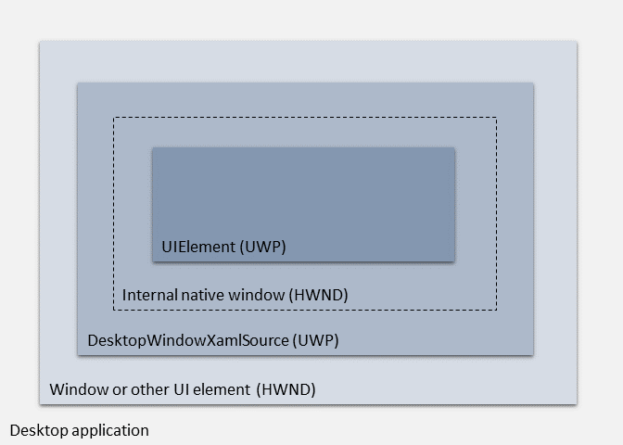
2. Architecture of the API
At the base level is the UI element in your app where you want to host the XAML Island
must have a window handle (HWND)
At the 2nd is a DesktopWindowXamlSource object
provides the infrastructure for hosting the XAML Island
Your code is responsible for creating this object and attaching it to the parent UI element
the DesktopWindowXamlSource object automatically creates a native child window to host your UWP control
you can access its handle (HWND) if necessary
at the top level is the hosted UWP control
any UWP control provided by the Windows SDK as well as custom user controls

Slide 29
3. Host a standard UWP control
Windows 10, version 1903 SDK (version 10.0.18362) or a later
Retarget solution, select the 10.0.18362.0 or later
Install the Microsoft.Windows.CppWinRT NuGet package
Install the Microsoft.Toolkit.Win32.UI.SDK NuGet package
In the NuGet Package Manager window, make sure that Include prerelease is selected
install version v6.0.0-preview7 (or later)

Slide 30
4. Host a custom UWP control
what you need:
configure the project to meet the prerequisites for hosting XAML Islands
add reference to the project of custom control
access to an instance of the Microsoft.Toolkit.Win32.UI.XamlHost.XamlApplication class

Slide 31
4. Host a custom UWP control
general steps:
add a Blank UWP project
in the solution that contains C++ Win32 desktop project
add the project that contains the source code for the custom UWP XAML control
typically a UWP class library project
In the UWP app project, add a reference to the UWP class library project
In your C++ Win32 project, add a reference to the UWP app project and the UWP class library project
Assign an instance of the custom control to host to the Content property of the DesktopWindowXamlSource object in your code
https://github.com/marb2000/XamlIslands/tree/master/1903_Samples/CppWinRT_Win32_App

Slide 32
内容提要
x.1 RAII
x.2 PowerToys
x.3 coding style
x.4 XAML Islands / PWA
x.5 Fibers / Coroutine

Slide 33
x.5 Fibers / Coroutine
参考网页 https://docs.microsoft.com/en-us/windows/win32/procthread/using-fibers
纤程 / 协程
A fiber is a unit of execution that must be manually scheduled by the application. Fibers run in the context of the threads that schedule them. Each thread can schedule multiple fibers.
assumes the ID of the thread that runs it
state info maintained for a fiber:
stack
a subset of its register – typically preserved across func call
fiber data – provided during fiber creation
not preemptively scheduled: system schedules threads
switching to it from another fiber
Be4 scheduling the first fiber, call ConvertThreadToFiber to create an area in which to save fiber state info
Notes:
In general, fibers do not provide advantages over a well-designed multithreaded application. However, using fibers can make it easier to port applications that were designed to schedule their own threads.

Slide 34
5.1 Fiber functions
CreateFiber:
stack size
starting address – fiber function(takes fiber data as para and does not return a value)
the fiber data
SwitchToFiber:
execute fiber created with CreateFiber
the address maybe created by a diff thread
must use proper synchronization
GetFiberData: retrieve the fiber data
GetCurrentFiber: retrieve the fiber address

Slide 35
5.2 FLS (Fiber Local Storage)
A fiber can use FLS to create one for each:
If no fiber switching occurs, FLS acts exactly the same as thread local storage
FLS functions(FlsAlloc, FlsFree, FlsGetValue, and FlsSetValue) manipulate the FLS associated with the current thread
FLS switched if the fiber switched
DeleteFiber:
clean up data associated with a fiber (the stack, a subset of registers, and the fiber data)
its thread calls ExitThread and terminates
if selected fiber of a thread is deleted by a fiber running in another thread, the thread with the deleted fiber is likely to terminated abnormally because the fiber stack has been freed

Slide 36
5.3 Coroutine
functions that can invoke each other but do not share a stack:
flexibly suspend their execution at any point to enter a different coroutine
Coroutines are the base for cooperative tasks, event loops, infinite data streams, or pipelines:
https://lewissbaker.github.io/
no internal scheduler
https://www.scs.stanford.edu/~dm/blog/c++-coroutines.html
Kenny Kerr: From Algorithms to Coroutines in C++
https://docs.microsoft.com/en-us/archive/msdn-magazine/2017/october/c-from-algorithms-to-coroutines-in-c
Kenny Kerr: Effective Async with Coroutines and C++/WinRT
https://docs.microsoft.com/en-us/archive/msdn-magazine/2018/june/c-effective-async-with-coroutines-and-c-winrt
Notes:
The coroutine TS is the base of the cppcoro library from Lewis Baker. TS stands for technical specifications and is the preliminary version of the coroutines framework we get with C++20. Lewis ported the cppcoro library from the coroutines TS framework to the coroutines framework we get with C++20.
fibers are switched by an internal scheduler while coroutines use no internal scheduler
In the book Linux System Programming, 2nd Edition, the difference between coroutines and fiber is explained as follows:
Coroutines and fibers provide a unit of execution even lighter in weight than the thread (with the former being their name when they are a programming language construct, and the latter when they are a system construct).

Slide 37
A coroutine is a suspendable (a.k.a. resumable) function
remember where it was suspended
later be resumed at that point
A currently executed coroutine might figure that it needs to wait for something to be available
用户态“线程”
没有上下文切换
能够被阻塞
Coroutine 是可以中断并恢复执行的 subroutine
Notes:
https://www.cnblogs.com/pointer-smq/p/8780895.html

Slide 38
THANK YOU !

