Slide 1
PRINCIPLES OF DATA SCIENCE — 7144
Exploratory Data Analysis
Online Retail II Dataset | Dec 2010 – Dec 2011
333K
£4.3M
37
4,300+
Transactions
Total Revenue
Countries
Customers
Coventry University — NIBM Campus

Slide 2
EDA Structure
Descriptive Statistics
Revenue Trends
Product Analysis
01
Central tendency, spread, skew & kurtosis
02
Monthly & seasonal time-series patterns
03
Top products by revenue & units sold
Customer Analysis
Geographic Analysis
Correlation & Anomalies
04
RFM framework & purchase frequency
05
UK dominance & international markets
06
Feature relationships & outlier detection

Slide 3
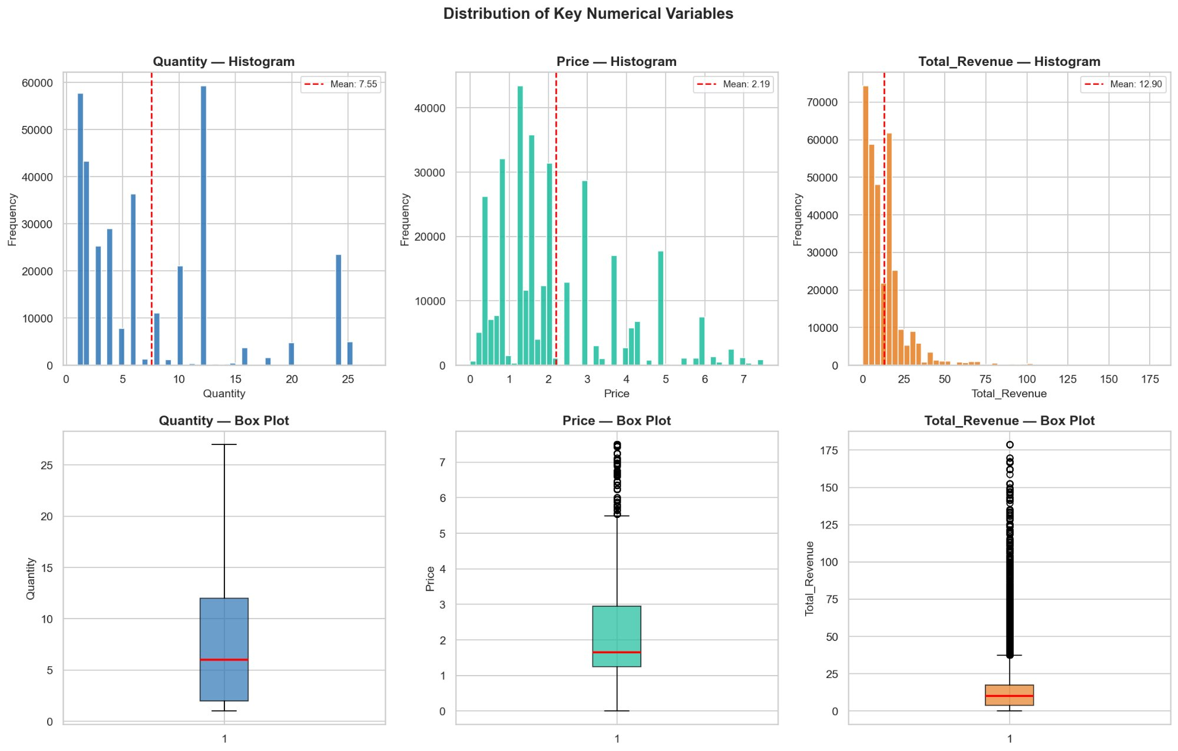
Section 2 — Descriptive Statistics
7.55 units
Mean Quantity
£2.19
Mean Price
£12.90
Mean Revenue/Txn
All 3 variables
Histograms show right-skewed distributions — most transactions are small value with few high-value outliers.
Right Skew

Slide 4
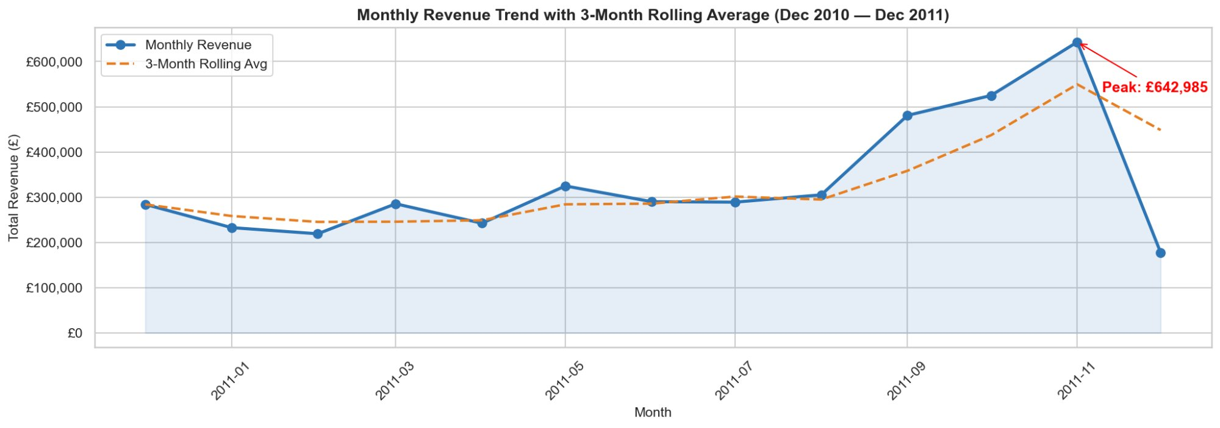
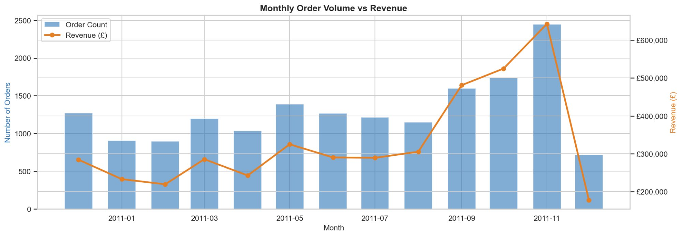
Section 3 — Revenue Trends
Peak: £642,985 in November 2011 | 3-Month Rolling Average confirms sustained Q4 growth

Slide 5
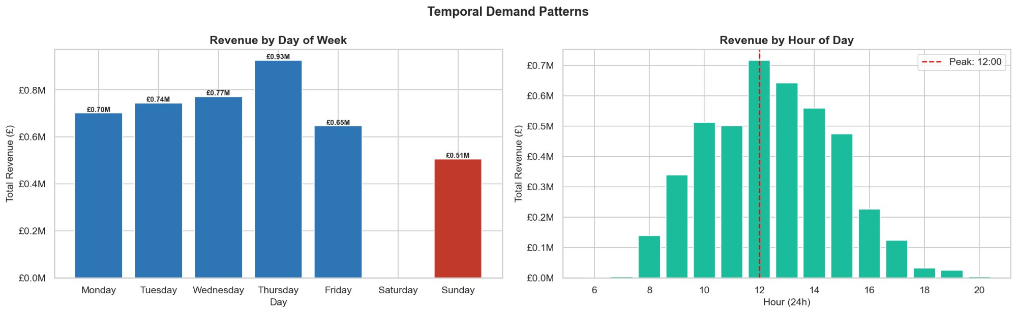
Temporal Demand Patterns
📅 Thursday is peak revenue day — £0.93M
⏰ Peak hour: 12:00 noon
📉 Saturday shows zero — B2B wholesale pattern

Slide 6
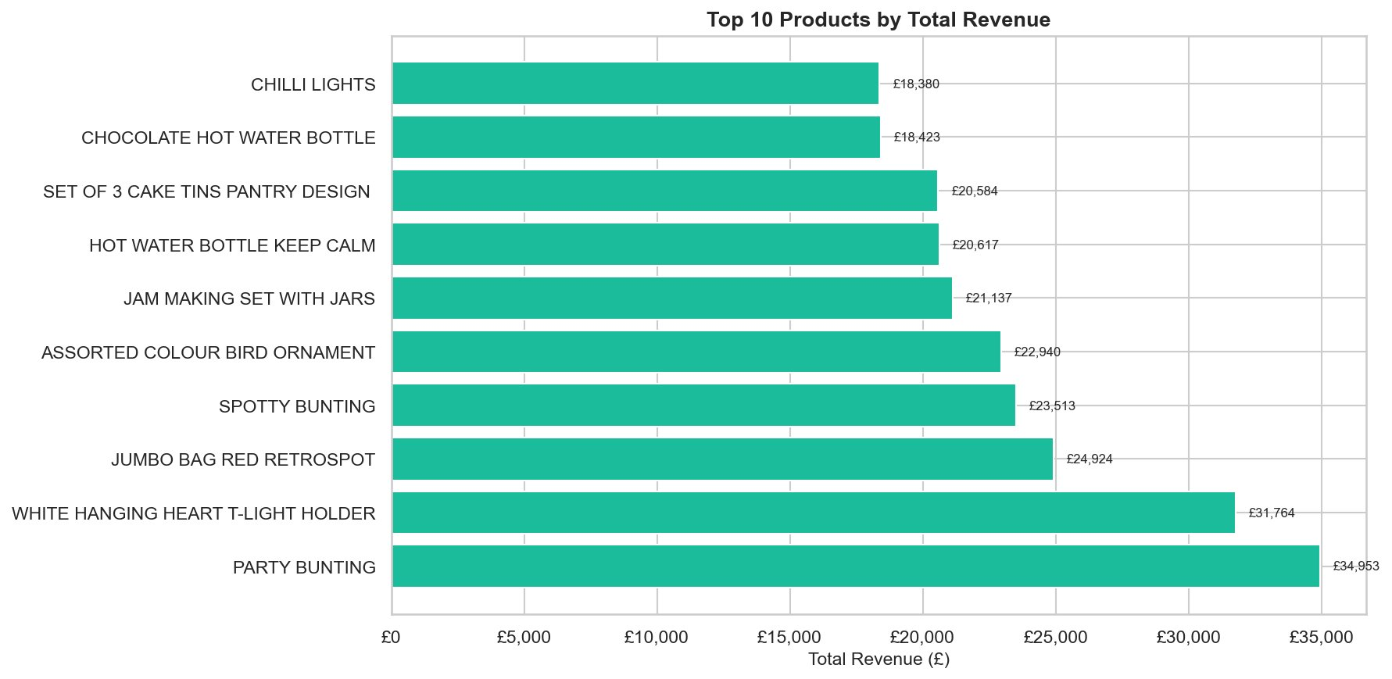
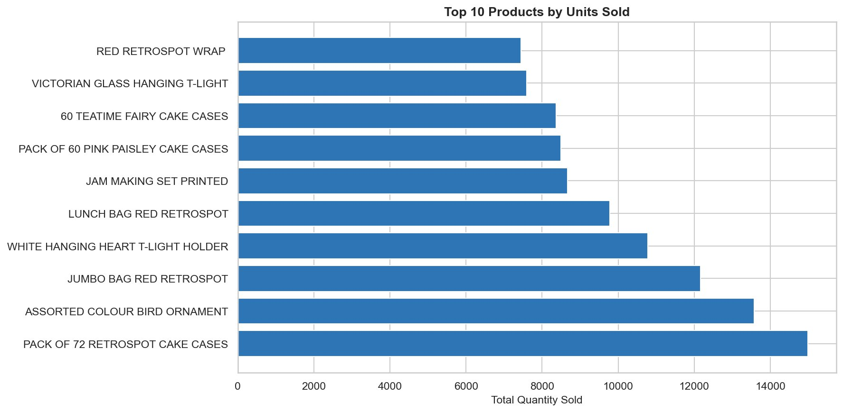
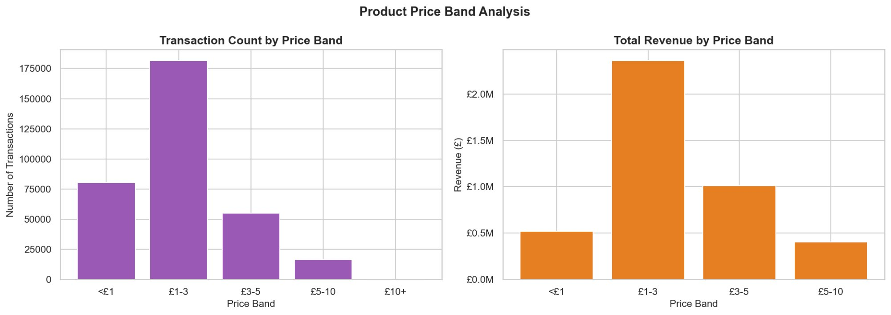
Section 4 — Product Analysis
By Revenue
By Units Sold
PARTY BUNTING tops revenue (£34,953) | PACK OF 72 RETROSPOT CAKE CASES leads by units | £1–3 band drives highest volume

Slide 7
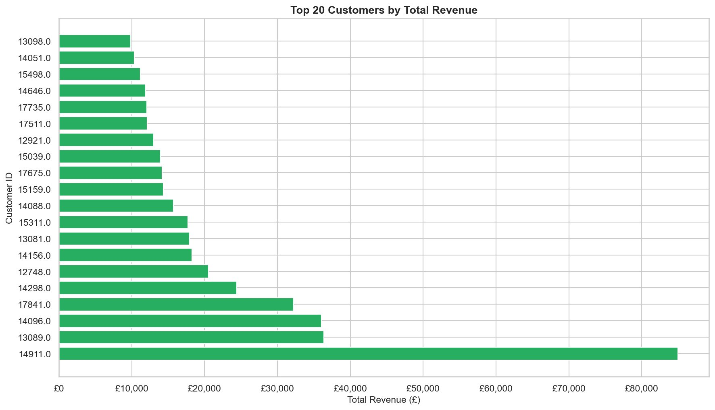
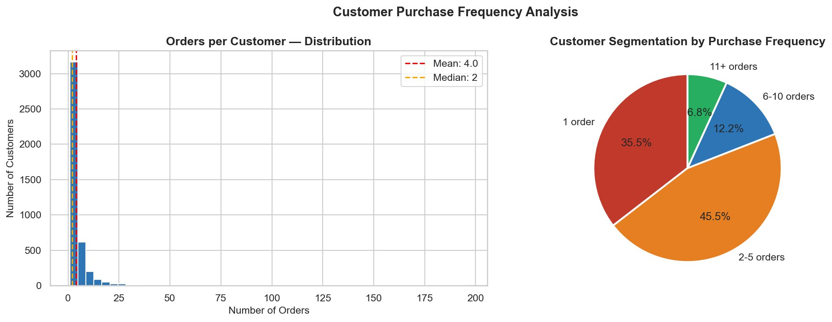
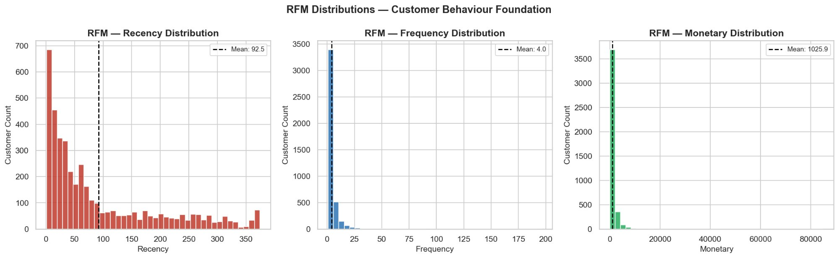
Section 5 — Customer Analysis
Customer 14911 alone generates £85K+ | 45% of customers place 2–5 orders | Mean Recency: 93 days

Slide 8
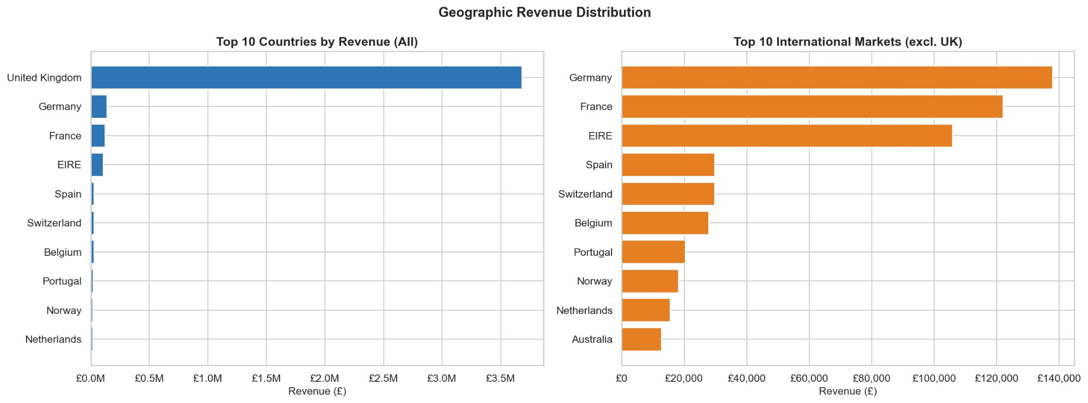
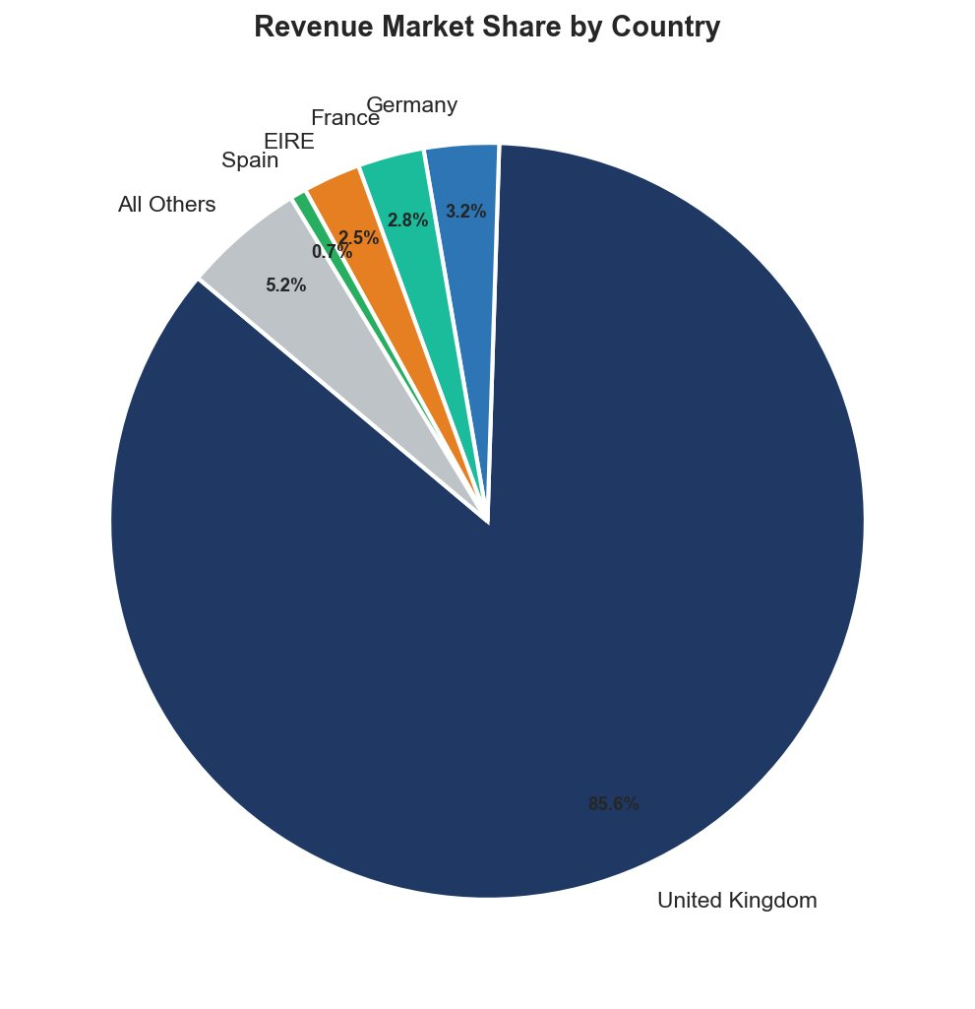
Section 6 — Geographic Analysis
85.6%
Germany
37
UK Revenue Share
Top Intl Market
Total Countries
UK dominates at 85.6% — Germany, France & EIRE are the key international growth markets.

Slide 9
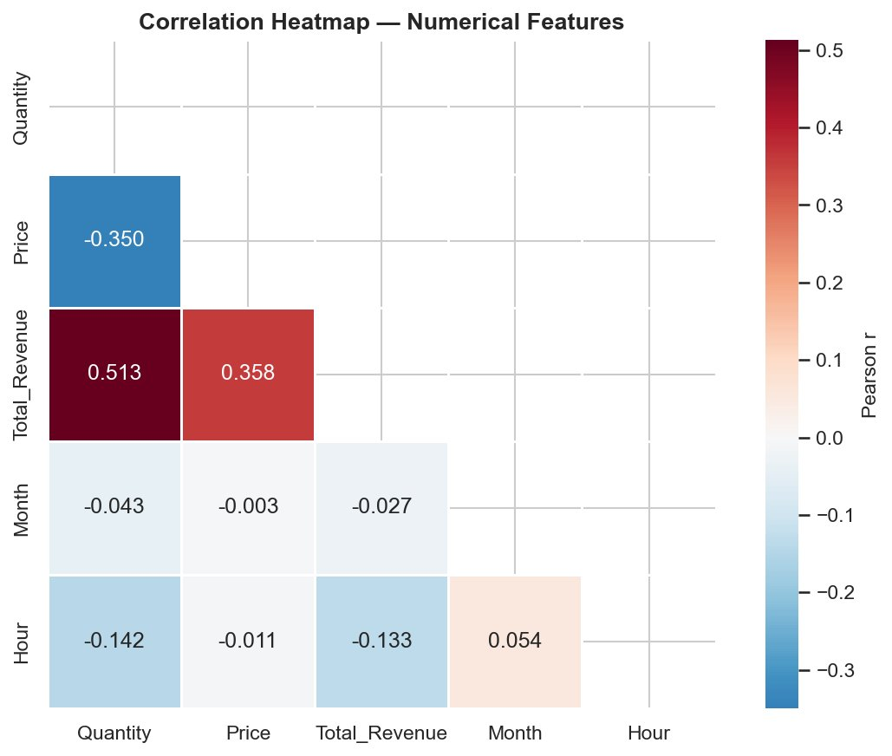
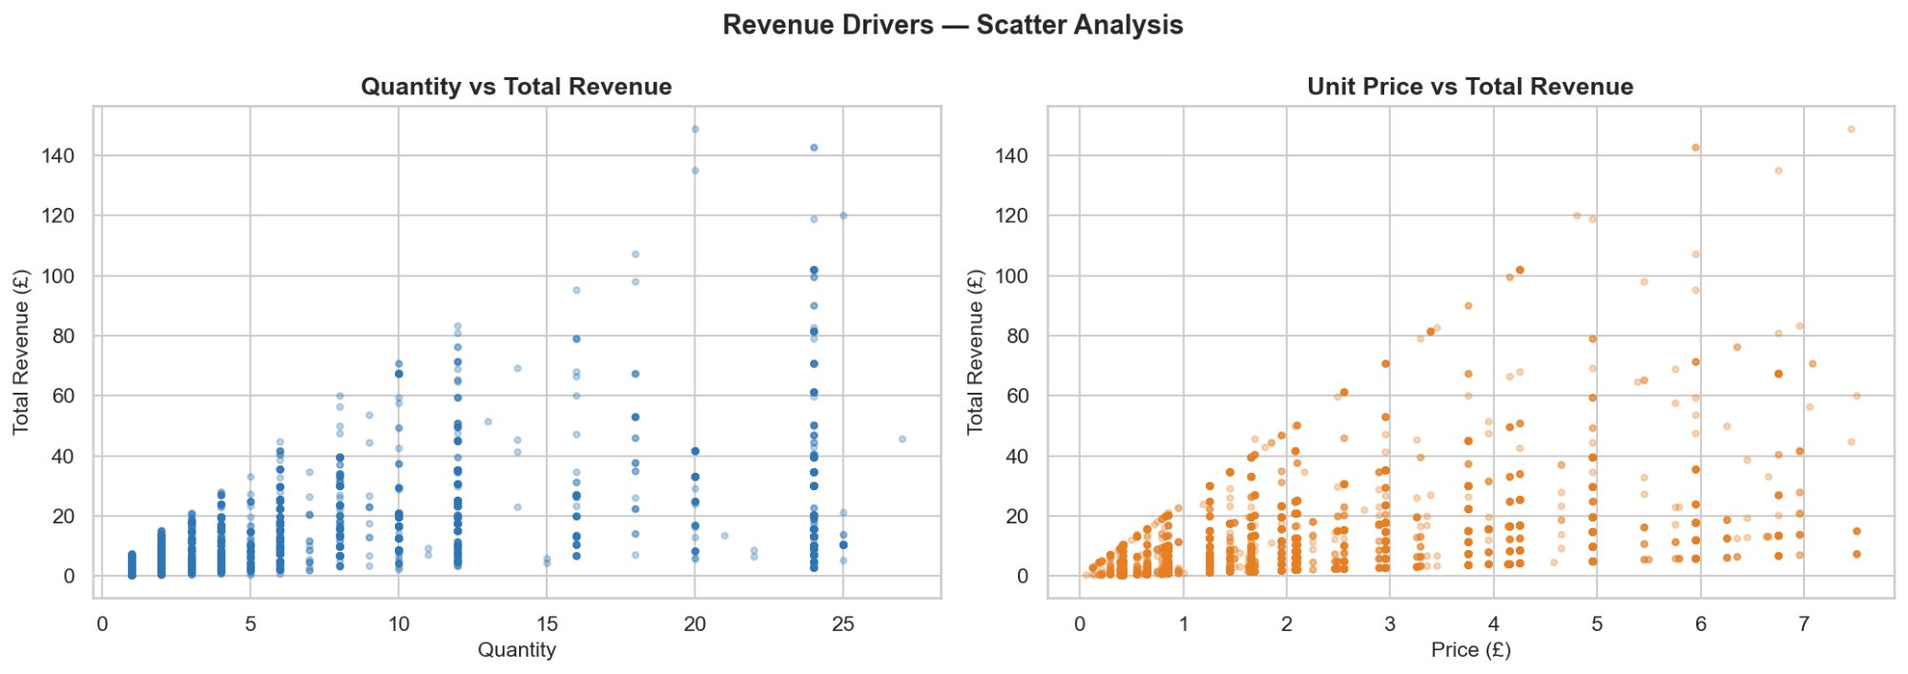
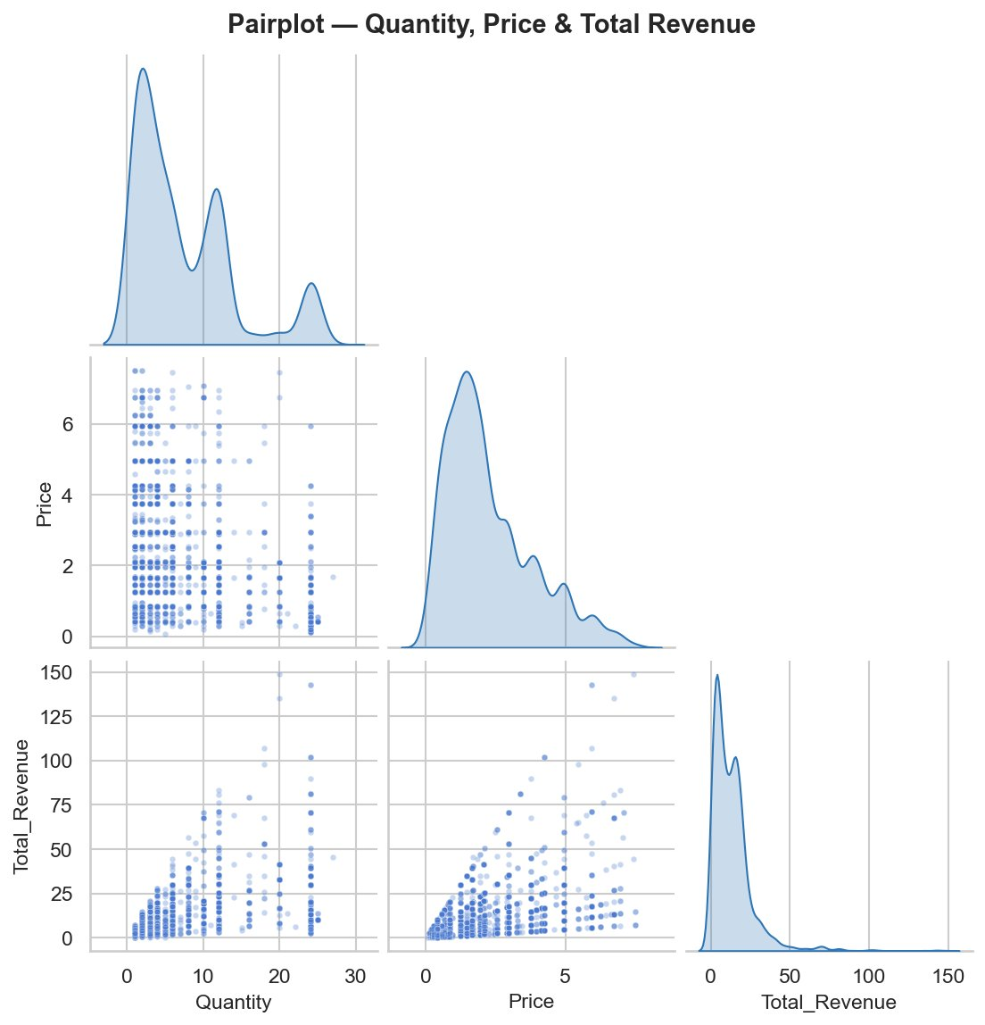
Section 7 — Correlation Analysis
Qty ↔ Revenue
0.513
Price ↔ Revenue
0.358
Month ↔ Revenue
-0.027

Slide 10
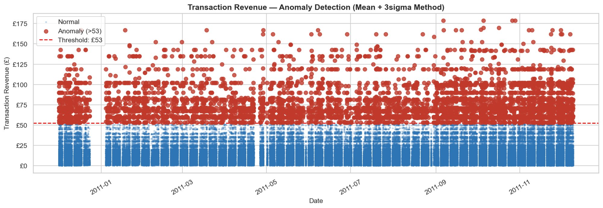
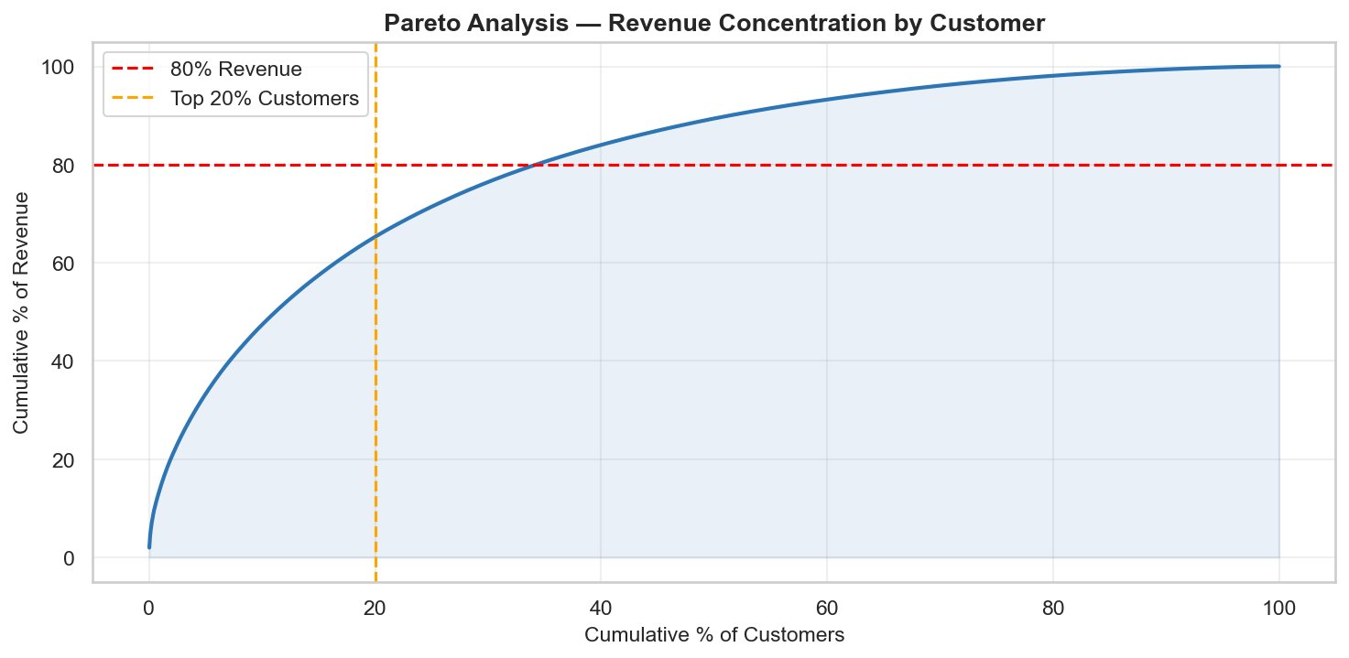
Section 8 — Anomaly Detection & Pareto Analysis
Threshold: Mean + 3σ = £53 | Pareto: Top 20% customers → ~65% of revenue

Slide 11
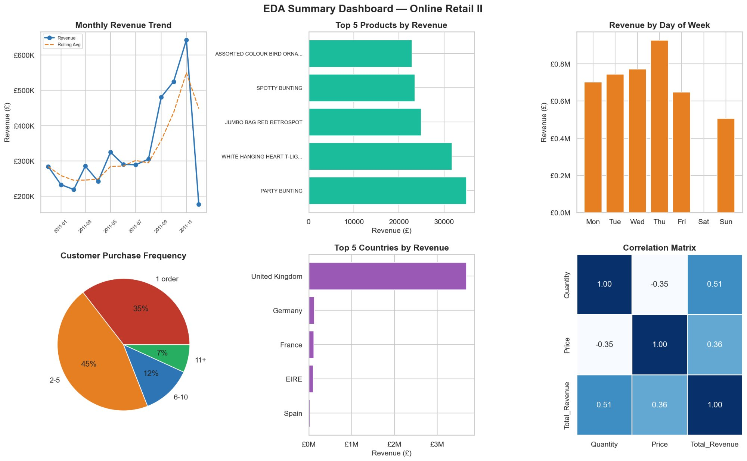
EDA Summary Dashboard
All 6 key dimensions captured: Revenue Trend | Top Products | Day Pattern | Customer Frequency | Geography | Correlation

Slide 12
Key Insights & Business Recommendations
📈 Q4 Peak Demand
👑 Pareto Customer Base
Revenue spikes in Oct–Nov. Focus marketing budget on this window for maximum ROI.
Top 20% customers generate ~65% of revenue. Prioritise VIP retention programs.
🌍 UK Dominance
⏰ Peak Hours & Days
UK = 85.6% of revenue. Germany, France & EIRE are highest-potential intl. markets.
Thursday 12pm is peak. Schedule promotions & emails around this window.
📦 Mid-Range Price Sweet Spot
🔍 Anomaly Investigation
£1–3 items drive volume. PARTY BUNTING leads revenue — stock & promote heavily.
Q4 bulk orders (>£53 threshold) may indicate B2B segment — worth separate analysis.

Slide 13
Thank You!

