Slide 1
GROUP ASSIGNMENT — PRINCIPLES OF DATA SCIENCE 7144
Online Retail II
Data Analysis & Operations Improvement Pipeline
MODULE
Principles of Data Science (7144)
INSTITUTION
Coventry University — NIBM Campus
DATASET
Online Retail II | Kaggle | Dec 2010 – Dec 2011
541,910
333,234
£4.3M
4,191
37
Raw Records
Clean Records
Total Revenue
Customers
Countries

Slide 2
GROUP MEMBERS & WORK DIVISION
Principles of Data Science 7144 | Group Assignment | MSc Data Science 2025 | Coventry University — NIBM
Task 1 — ETL Pipeline
Name
Pasindu Ashan
01
Student ID
COMScDS251P-001
Branch
feature-pasindu-ETL
Task 2 — Exploratory Data Analysis
Name
Anuradha Dhananjanee
02
Student ID
COMScDS252P-005
Branch
feature-anuradha-EDA
Task 3 — Clustering Analysis
Name
(
Chamika Subashinie
03
Student ID
COMScDS252P-001
Branch
(to be added)
feature-chamika-cluster-analysis
Task 4 — Forecasting Model
Name
Madushika Pramod Senevirathna
04
Student ID
COMScDS252P-002
Branch
feature-madushika-forecasting-model
github.com/principles-of-data-science-cw-2/group-assignment | 4 members · 4 tasks · Equal contribution · Feature branches per member

Slide 3
PROJECT OVERVIEW
Project Structure
Four analytical tasks covering the full data science lifecycle
ETL Pipeline
KEY OUTCOMES
01
Extract → Validate → Transform → Load
6-step cleaning | 98.4% quality score
✓
541,910 raw records cleaned to 333,234 (98.4% quality)
✓
4 RFM customer segments identified (ARI = 0.762)
Exploratory Data Analysis
✓
3 product demand tiers for inventory strategy
02
Revenue trends | Customer behaviour
Geographic | Correlation | Anomalies
✓
3 market performance tiers across 37 countries
✓
GB model: RMSE £5,987 vs Naive £8,048 on revenue
Clustering Analysis
✓
30-day forecast: £540K revenue, 2,090 orders
03
K-Means + Hierarchical | RFM segments
Customers · Products · Countries | ARI validated
→
VIP loyalty for Loyal cluster (£4,158 avg spend)
→
Q4 marketing: Nov peaks £642K in a single month
Forecasting Model
→
Thursday 12pm: schedule promotions for peak ROI
04
Seasonal Naive vs Gradient Boosting
30-day revenue & order volume forecast

Slide 4
TASK 1 — ETL | DATASET OVERVIEW
Dataset Overview
Online Retail II — Source, Scope & Data Dictionary
Source
Kaggle — mathchi/online-retail-ii-data-set-from-ml-repository
DATA DICTIONARY
Time Period
December 2010 – December 2011 (12 months)
Invoice
ID — 'C' = cancellation
Geography
United Kingdom (primary) — 37 countries total
StockCode
Product code
Business Type
Non-store B2C & B2B online retail (giftware)
Description
Product name (nullable)
Quantity
Raw Records
541,910 invoice-line records
Units — negatives=returns
InvoiceDate
Columns
8 original features
String → datetime64
Price
Download
kagglehub.dataset_download() — automatic v3
Unit price (GBP £)
Customer ID
24.93% missing — CRITICAL
Licence
CC BY 4.0 — Open for academic use
Country
37 unique countries

Slide 5
TASK 1 — ETL | PIPELINE ARCHITECTURE
ETL Pipeline Architecture
End-to-end data flow: raw Kaggle CSV → clean analytical dataset ready for EDA, Clustering & Forecasting
01
02
03
04
05
EXTRACT
VALIDATE
CLEAN
ENGINEER
LOAD
Kaggle kagglehub
541,910 rows
8 columns
CSV ISO-8859-1
Null census
Consistency audit
Duplicate check
4 dimensions
6-step pipeline
Remove/filter/drop
IQR outliers
All justified
Total_Revenue
Year/Month
DayOfWeek
Hour
333,234 rows
13 columns
UTF-8 CSV
✓ Validated
541,910
38.5%
333,234
13 cols
98.4%
Raw Records
Records Cleaned
Clean Records
Final Features
Data Quality

Slide 6
TASK 1 — ETL | TRANSFORM PIPELINE
Transform — 6-Step Cleaning Pipeline
Each step independently justified, coded, and tracked for quantified impact
Remove Cancellations
Filter Invalid Qty/Price
3.1
Invoices prefixed 'C' are reversals — not real sales
3.4
Zero/negative values produce nonsensical revenue
Removed: 9,288 rows
Removed: 40 rows
Remove Duplicates
IQR Outlier Removal
3.2
System logging errors inflate transaction counts
3.5
Tukey (1977) fence: removes B2B wholesale anomalies
Removed: 5,231 rows
Removed: 59,459 rows
Drop Null Customer ID
Feature Engineering
3.3
Primary key for clustering — imputation invalid
3.6
Year, Month, DayOfWeek, Hour, Total_Revenue added
Removed: 134,658 rows
Removed: 0 (adds cols) rows

Slide 7
TASK 1 — ETL | QUALITY SCORECARD & PIPELINE IMPACT
Pipeline Impact & Data Quality Scorecard
Before-and-after quantified impact across every step | Quality dimensions: Completeness · Validity · Uniqueness · Consistency
Step
Before
After
Removed
% Impact
QUALITY SCORECARD
3.1 Remove Cancellations
541,910
532,622
9,288
1.71%
Completeness
75.1% → 100%
3.2 Remove Duplicates
532,622
527,391
5,231
0.98%
Validity
3.3 Drop Null Customer ID
527,391
392,733
134,658
25.5%
91.4% → 100%
3.4 Filter Qty/Price
392,733
392,693
40
0.01%
Uniqueness
99.0% → 100%
3.5 IQR Outlier Removal
392,693
333,234
59,459
15.1%
Consistency
3.6 Feature Engineering
333,234
333,234
0
0%
96.3% → 100%
TOTAL
541,910
333,234
208,676
38.5%
OVERALL: 72.1% → 98.4%

Slide 8
TASK 2 — EXPLORATORY DATA ANALYSIS | OVERVIEW & STATISTICS
Exploratory Data Analysis
Descriptive statistics across 333,234 clean transactions
333,234
16,826
4,191
Total Transactions
Unique Invoices
Unique Customers
3,392
37
£4.3M
Unique Products
Countries
Total Revenue
Metric
Quantity
Price (£)
Total Revenue (£)
Skewness
Kurtosis
Mean
7.55
£2.19
£12.90
—
—
Std Dev
6.78
£1.55
£13.22
—
—
Min / Max
1 – 27
£0.001 – £7.50
£0.001 – £202.50
Right-skewed
Leptokurtic
25% / 75%
2 – 12
£1.25 – £3.75
£3.90 – £17.50
All 3 variables
High outlier ratio

Slide 9
TASK 2 — EDA | REVENUE TRENDS & TEMPORAL PATTERNS
Revenue Trends & Temporal Patterns
Monthly time series | Day-of-week | Peak hour analysis
MONTHLY REVENUE TREND
📅 Peak Day
Thursday
£927K total revenue
⏰ Peak Hour
12:00 Noon
Most orders placed mid-day
📉 Saturday
Zero Revenue
D10
J
F
M
A
M
J
J
A
S
O
N
D11
B2B wholesale pattern — no weekend ops
Peak: £642,985 in November 2011
3-month rolling average confirms sustained Q4 seasonal growth
📈 Q4 Growth
Oct – Nov
Pre-Christmas demand surge every year

Slide 10
TASK 2 — EDA | PRODUCT & CUSTOMER ANALYSIS
Product & Customer Analysis
Top products · Price bands · RFM framework · Customer frequency
TOP PRODUCTS BY REVENUE
PRICE BAND DISTRIBUTION
52%
PARTY BUNTING
£34,953
24%
8%
12%
4%
WHITE HANGING HEART T-LIGHT
£31,764
<£1
£1–£3
£3–£5
£5–£10
£10+
JUMBO BAG RED RETROSPOT
£24,924
£1–£3 band drives 52% of all transaction volume
RFM SUMMARY STATISTICS
SPOTTY BUNTING
£23,513
ASSORTED BIRD ORNAMENT
£22,940
Recency (avg)
93 days since last purchase
Frequency (avg)
4.0 orders per customer
JAM MAKING SET WITH JARS
£21,137
Monetary (avg)
£1,026 lifetime spend
KEY CUSTOMER INSIGHTS
35.5%
4.0
45%
Top 20%
£85K+
One-time customers
Avg orders/customer
2–5 order customers
Generate ~65% revenue
Customer 14911 alone
Retention opportunity
Repeat buyer base
Core loyal segment
Pareto principle
VIP segment exists

Slide 11
TASK 2 — EDA | GEOGRAPHIC ANALYSIS & CORRELATION
Geographic Analysis & Correlation
UK dominance · International markets · Feature relationships · Anomaly detection
REVENUE BY COUNTRY (TOP 8)
CORRELATION MATRIX
United Kingdom
85.6%
£3,680,989
Qty
Price
Revenue
Month
Hour
Netherlands
3.1%
£133,418
Quantity
1.000
-0.350
0.513
-0.043
-0.142
EIRE
2.8%
£120,362
Price
-0.350
1.000
0.358
-0.003
-0.011
Germany
2.7%
£116,116
Revenue
0.513
0.358
1.000
-0.027
-0.133
France
2.4%
£103,255
Month
-0.043
-0.003
-0.027
1.000
0.054
Australia
0.9%
£38,702
Hour
-0.142
-0.011
-0.133
0.054
1.000
UK = 85.6% revenue | Germany, France & EIRE = key intl growth markets | 37 countries served
Key: Qty ↔ Revenue = 0.513 | Price ↔ Revenue = 0.358 | Month/Hour weak
ANOMALY DETECTION & PARETO ANALYSIS
Method
Mean + 3σ threshold = £52.55
Top 20% customers = ~65% revenue
Finding
6,320 anomalous transactions (1.90%)
34.3% customers generate 80% revenue
Pattern
Concentrated in Nov 2011 — Q4 bulk orders
Classic Pareto principle confirmed
Action
Investigate B2B segment separately
Prioritise VIP retention strategy

Slide 12
TASK 2 — EDA | KEY INSIGHTS & RECOMMENDATIONS
EDA Key Insights & Business Recommendations
Six actionable insights directly informing operational and strategic decisions
📈 Q4 Peak Demand
👑 Pareto Customer Base
🌍 UK Market Dominance
Revenue spikes in Oct–Nov every year. November 2011 hit £642,985. Focus marketing and stock replenishment budget on this window for maximum ROI.
Top 20% of customers generate ~65% of revenue. Customer 14911 alone accounts for £85K+. These VIPs must be protected and nurtured.
UK = 85.6% of total revenue. Germany, France & EIRE are the highest-potential international markets showing consistent order patterns.
Action: Pre-position inventory by September
Action: Launch VIP loyalty programme immediately
Action: Localise product listings for DE/FR/IE
⏰ Peak Trading Window
📦 Price Sweet Spot
🔍 Anomaly Investigation
Thursday generates £927K — the highest of any day. Orders peak at 12:00 noon. Saturday shows zero activity — clear B2B operating pattern.
£1–£3 items drive 52% of all transaction volume. PARTY BUNTING leads revenue at £34,953. Mid-range giftware is the core product category.
1.90% of transactions exceed Mean+3σ threshold (£52.55), concentrated in Q4. These likely represent B2B bulk orders worth separate analysis.
Action: Schedule promotions for Thu 10am–2pm
Action: Expand £1–£3 product range
Action: Create dedicated B2B customer segment

Slide 13
TASK 3 — CLUSTERING ANALYSIS | OVERVIEW
Clustering Analysis — Overview
K-Means + Hierarchical across 3 analytical dimensions | ARI cross-validation
01
Customer Segmentation
02
Demand Pattern Analysis
03
Service Performance
RFM-based K-Means & Hierarchical
4,124 customers (after outlier removal)
4 clusters: Loyal · Active · Occasional · Lapsed
ARI = 0.762 — strong method agreement
Product-Level RFM Clustering
3,575 products clustered into 3 tiers
Fast-moving · Steady · Slow-moving
Word analysis confirms product archetypes
Country-Level K-Means & Hierarchical
37 countries across 3 performance tiers
Core · Growth · Developing markets
ARI = 0.795 — strong method agreement
Optimal k: k = 4
Optimal k: k = 3
Optimal k: k = 3
K-Means + Hierarchical (Ward)
StandardScaler · PCA · Silhouette · ARI
K-Means + Hierarchical (Ward)
StandardScaler · PCA · Silhouette · ARI
K-Means + Hierarchical (Ward)
StandardScaler · PCA · Silhouette · ARI
METHOD VALIDATION — Adjusted Rand Index (ARI):
Customer ARI = 0.762 ✓
Country ARI = 0.795 ✓
Threshold > 0.7 ✓

Slide 14
TASK 3 — CLUSTERING | PART 1: CUSTOMER SEGMENTATION (RFM)
Part 1 — Customer Segmentation (RFM K-Means k=4)
4,124 customers · RFM features · StandardScaler · ARI = 0.762
Loyal High-Value
Active Regular
Occasional Buyers
Lapsed / At-Risk
R
12.7d
R
31.5d
R
50.0d
R
250.8d
F
14.5
F
6.6
F
2.2
F
1.4
M
£4,158
M
£1,813
M
£457
M
£285
n = 309 customers
n = 669 customers
n = 2,082 customers
n = 1,064 customers
Most valuable segment. Recent, frequent, high spend. Priority for VIP programme and exclusive offers.
Healthy engagement. Consistent buyers with moderate spend. Upselling opportunity to move to Loyal tier.
Largest segment. Infrequent buyers with low monetary value. High churn risk without re-engagement.
Longest recency. Nearly dormant. Win-back campaigns may recover a portion if acted on quickly.
→ VIP loyalty rewards + personal account manager
→ Upsell campaigns + product bundle offers
→ Re-engagement emails + discount incentives
→ Win-back campaign + last-chance discount

Slide 15
TASK 3 — CLUSTERING | PART 2 & 3: DEMAND PATTERNS + SERVICE PERFORMANCE
Demand Pattern Analysis (Products) + Service Performance (Countries)
3,575 products in 3 demand tiers | 37 countries in 3 market performance tiers | ARI validated
PART 2 — Product Demand Tiers (k=3)
PART 3 — Market Performance Tiers (k=3)
High-Demand / Fast-Moving
Core Market
7.5%
R:2.3d | F:475.8 | M:£7,698 — BAG · JUMBO · LUNCH · RETROSPOT
→ Maintain stock; negotiate priority supplier allocation
United Kingdom
Rev: £3,680,989 | Orders: 15,144 | Cust: 3,784
Steady / Mid-Tier
→ Protect & grow — dominant revenue source
17.7%
R:14.7d | F:72.0 | M:£799 — HOLDER · DECORATION · VINTAGE · CANDLE
Growth Markets
→ Monitor; bundle with fast-movers to boost volume
26 countries incl. DE, FR, EIRE
Slow-Moving
Rev: £21,653 avg | Orders: 61.7 avg | Cust: 14 avg
74.8%
R:234.7d | F:13.5 | M:£157 — GLASS · BRACELET · EASTER · GARDEN
→ Increase basket size; localise product fit
→ Review for markdown or discontinuation
Developing Markets
10 countries incl. USA, CH, BR
Rev: £5,550 avg | Orders: 7.9 avg | Cust: 4.5 avg
Country Clustering ARI = 0.795 ✓ Both methods agree
→ Investigate shipping & localisation barriers

Slide 16
TASK 3 — CLUSTERING | VALIDATION & STRATEGIC RECOMMENDATIONS
Method Validation & Strategic Recommendations
Silhouette · ARI · Optimal k selection · Business actions
OPTIMAL k SELECTION SUMMARY
STRATEGIC RECOMMENDATIONS
Analysis
Sil. Peak
Sil. Score
Chosen k
Rationale
CUSTOMERS
Customer Segmentation
k = 2
0.518
k = 4
4 actionable CRM segments
→ VIP loyalty programme → Cluster 2 (£4,158 avg spend)
→ Win-back campaign → Cluster 1 (>250 day recency)
Demand Patterns
k = 2
0.648
k = 3
3 inventory management tiers
INVENTORY
Service Performance
k = 2
0.852
k = 3
3 regional strategy tiers
→ Priority supplier → Cluster 1 fast-movers (BAG, JUMBO)
ADJUSTED RAND INDEX VALIDATION
→ Reduce Cluster 2 slow-movers → free working capital
Customer Segmentation
ARI = 0.762
✓ Strong agreement
MARKETS
Service Performance (Countries)
ARI = 0.795
✓ Strong agreement
→ Basket-size campaigns → 26 Cluster 2 growth countries
Threshold for 'strong'
ARI = > 0.7
Both analyses pass
→ Investigate barriers → Cluster 0 developing markets

Slide 17
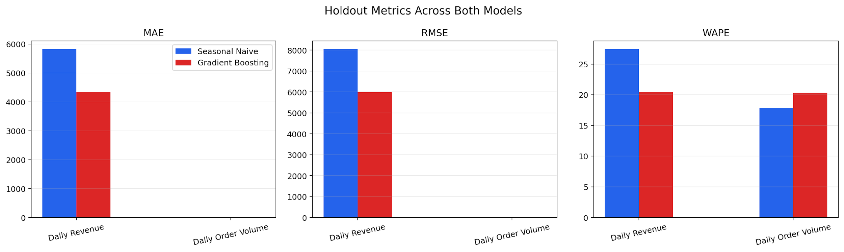
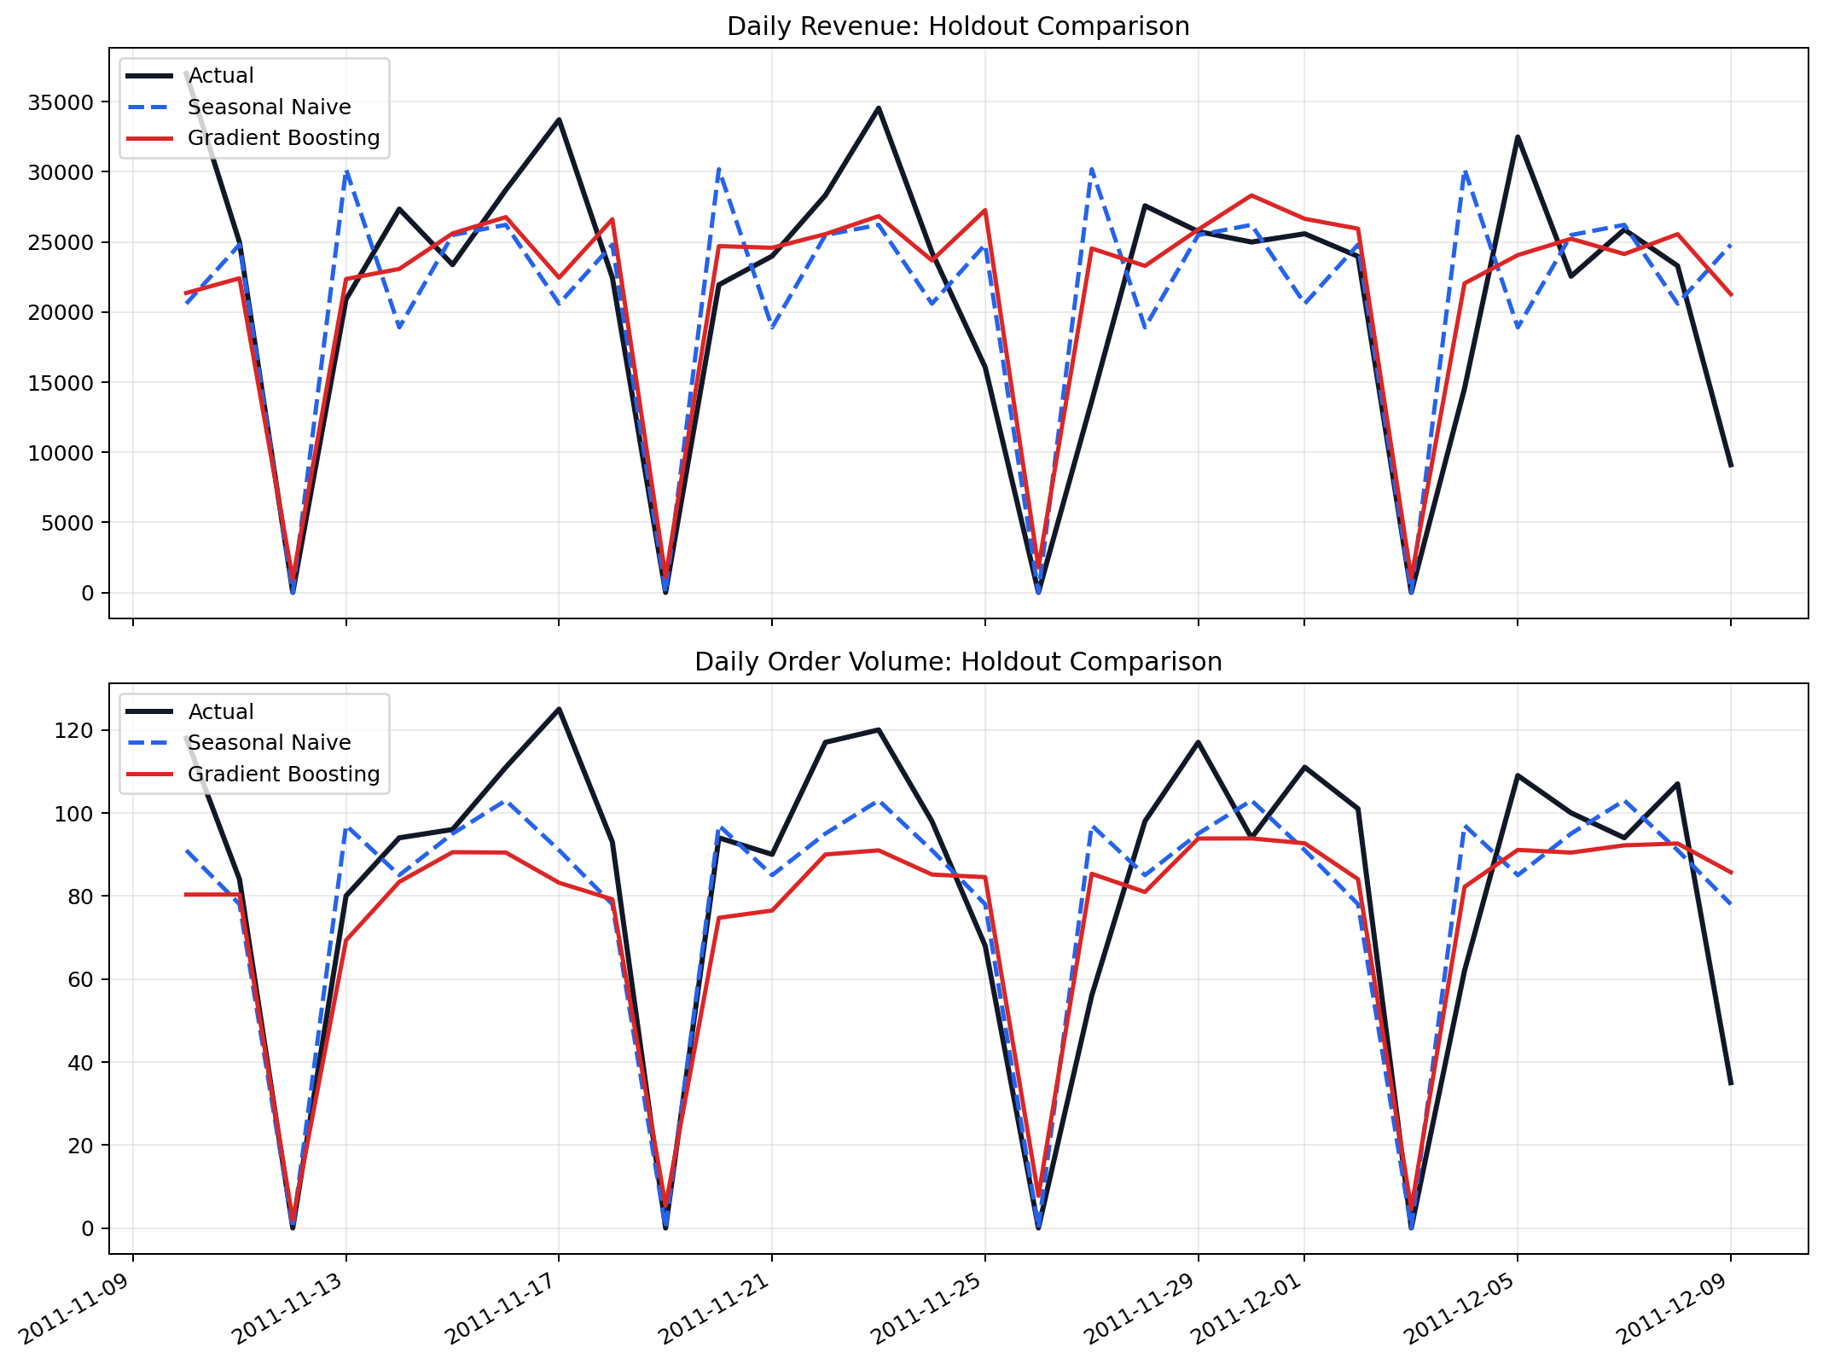
TASK 4 — FORECASTING MODEL | OBJECTIVE & MODEL COMPARISON
Forecasting — Objective & Model Comparison
Forecasting Overview
We evaluated two distinct prediction models over a strict 30-day holdout testing window, focusing on our two critical operational targets: Daily Revenue and Daily Order Volume.
Seasonal Naive Model
BASELINE
Gradient Boosting Model
ADVANCED
Insight: Gradient Boosting strongly outperforms the baseline for daily revenue, as it is highly dependent on our enriched features (like product mix, geography, and basket value changes). Gradient Boosting captures those nuances far better than just repeating the previous week.
Predict daily_revenue and daily_order_volume for the next 30 days | 374 daily calendar records (2010-12-01 → 2011-12-09) | Train: 344 days | Holdout: 30 days
Insight: The basic Seasonal Naive model outperforms for raw order volume, as it is heavily driven by a strict and stable weekly rhythm rather than complex features. Simply repeating the trend from the prior week (especially accounting for our zero-order Saturdays) yielded the most accurate order counts.
Target
MAE (Mean Absolute Error)
RMSE (Root Mean Squared Error)
WAPE (Weighted Average Percentage Error)
Target
MAE (Mean Absolute Error)
RMSE (Root Mean Squared Error)
WAPE (Weighted Average Percentage Error)
Revenue
5,822.61
8,048.46
27.42%
Revenue
4,348.53
5,986.90
20.48%
Orders
14.70
19.06
17.84%
Orders
16.73
20.53
20.30%
SELECTION RULE: Lowest RMSE per target (MAE as tiebreaker) | GB → daily_revenue | Seasonal Naive → daily_order_volume

Slide 18
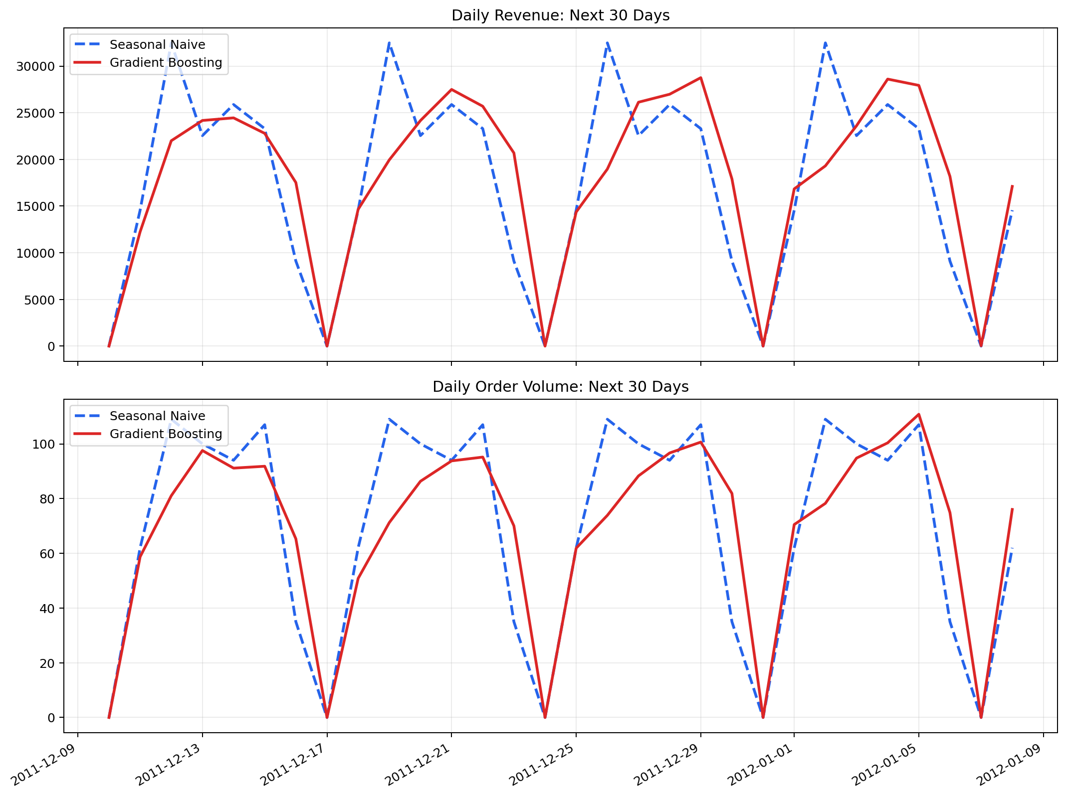
TASK 4 — FORECASTING | 30-DAY FORWARD FORECAST & BUSINESS IMPACT
30-Day Forward Forecast & Business Impact
Gradient Boosting → daily_revenue | Seasonal Naive → daily_order_volume | Horizon: Dec 10 – Jan 09, 2012
£540,563
£18,019
£28,758
30-Day Revenue Forecast
Average Daily Revenue
Peak Day Revenue
Gradient Boosting
Per forecast day
Best forecast day
2,090
69.67
109
30-Day Order Volume
Average Daily Orders
Peak Day Orders
Seasonal Naive
Per forecast day
Highest forecast day
OVERALL BUSINESS TAKEAWAY:
We cannot use a "one-size-fits-all" model. By allowing Seasonal Naive to handle stable flow (Orders) and Gradient Boosting to handle complex variance (Revenue), we optimize our tactical accuracy which directly allows for better weekly staff planning and near-term cash-flow analysis.
Business Use: Revenue forecasts → purchasing & cash-flow planning | Order volume → staffing & logistics planning | Tactical guidance for next 30 days

Slide 19
LIMITATIONS & FUTURE IMPROVEMENTS
Limitations & Future Improvements
Honest assessment of current constraints and the roadmap for enhanced analysis
Area
Current Limitation
Future Improvement
ETL
38.5% of records excluded — may under-represent new/guest customers
Probabilistic identity matching via StockCode + Country + date proximity
→
ETL
IQR removes wholesale B2B orders — B2B patterns lost
Segment B2C/B2B prior to cleaning; maintain separate analytical pipelines
→
EDA
No external data: promotions, holidays, macro factors not included
Enrich with UK retail calendar, Bank Holidays, promotional event flags
→
Clustering
Silhouette peak at k=2 overridden for business interpretability
Use gap statistic and business stakeholder validation for k selection
→
Clustering
Static snapshot — clusters may drift over time
Rolling RFM recalculation + customer migration tracking month-over-month
→
Forecasting
Only 374 calendar days — recursive GB errors accumulate over 30 days
Rolling-origin or expanding-window cross-validation for robust evaluation
→
Forecasting
Single 30-day holdout; no uncertainty bands or prediction intervals
Add SARIMAX, Prophet, LSTM alternatives; add confidence intervals
→
Pipeline
Static CSV extraction — not suitable for real-time or incremental loads
Migrate to Apache Airflow or AWS Glue for scheduled delta ETL loading
→

Slide 20
OPERATIONAL RECOMMENDATIONS — INTEGRATED INSIGHTS FROM ALL 4 TASKS
Operational Recommendations
Data-driven actions synthesising ETL quality, EDA insights, clustering segments, and forecast results
👑 Customer Strategy
📦 Inventory & Supply Chain
→ Launch VIP loyalty programme for Loyal cluster (£4,158 avg spend, n=309) immediately
→ Negotiate priority supplier allocation for top fast-moving products (BAG, JUMBO, LUNCH, RETROSPOT)
→ Execute win-back email campaigns for Lapsed segment (>250 day recency, n=1,064)
→ Reduce Slow-Moving cluster stock (74.8% of products, £157 avg) to free working capital
→ Use RFM scores monthly to detect customers migrating toward at-risk status
→ Pre-position all inventory by end of September to meet November peak (£642,985 historical)
⏰ Marketing & Timing
📈 Forecasting & Operations
→ Schedule all email campaigns and promotions for Thursday 10am–2pm (peak revenue window)
→ Use 30-day revenue forecast (£540K projected) for cash-flow and purchasing decisions
→ Focus marketing budget on Q4 October–November: historical 40%+ revenue concentration
→ Use the 30-day order-volume forecast to plan staffing, warehouse capacity, and logistics, Projected demand: ~2,090 orders (~69.7 per day)
→ Test UK-localised product listings for Germany, France & EIRE — highest international ROI
→Align operations to the observed demand rhythm
Highest activity on Thursday; zero activity on Saturday

Slide 21
CONCLUSION
Project
Complete
98.4%
0.762
Data Quality
Clustering ARI
Online Retail II — Full Data Analysis & Operations Improvement Pipeline
£540K
4
ETL
541,910 → 333,234 clean records | 98.4% quality | 6-step pipeline
30-Day Forecast
Actionable Segments
EDA
£4.3M revenue | Q4 peak | Thursday 12pm | Pareto customer base
Clustering
4 customer segments | 3 product tiers | 3 market tiers | ARI validated
Forecasting
£540K 30-day forecast | GB outperforms on revenue | Naive on orders
Principles of Data Science 7144 | Coventry University — NIBM Campus | MSc Data Science 2025

