Slide 1
User authentication and CRUD
Waqar Saleem

Slide 2
Execution Instructions
Install Docker and Docker Compose:
Make sure Docker and Docker Compose are installed on your system.
Download the Project:
Download the project structure above in a zip folder and extract it to your working directory.
Run Docker Compose:
Open a terminal and navigate to the project directory.
Run docker-compose up --build to build and start all the services.
Access the Application:
Backend: http://localhost:8000
Frontend: http://localhost:8501
Kong: http://localhost:8000

Slide 3
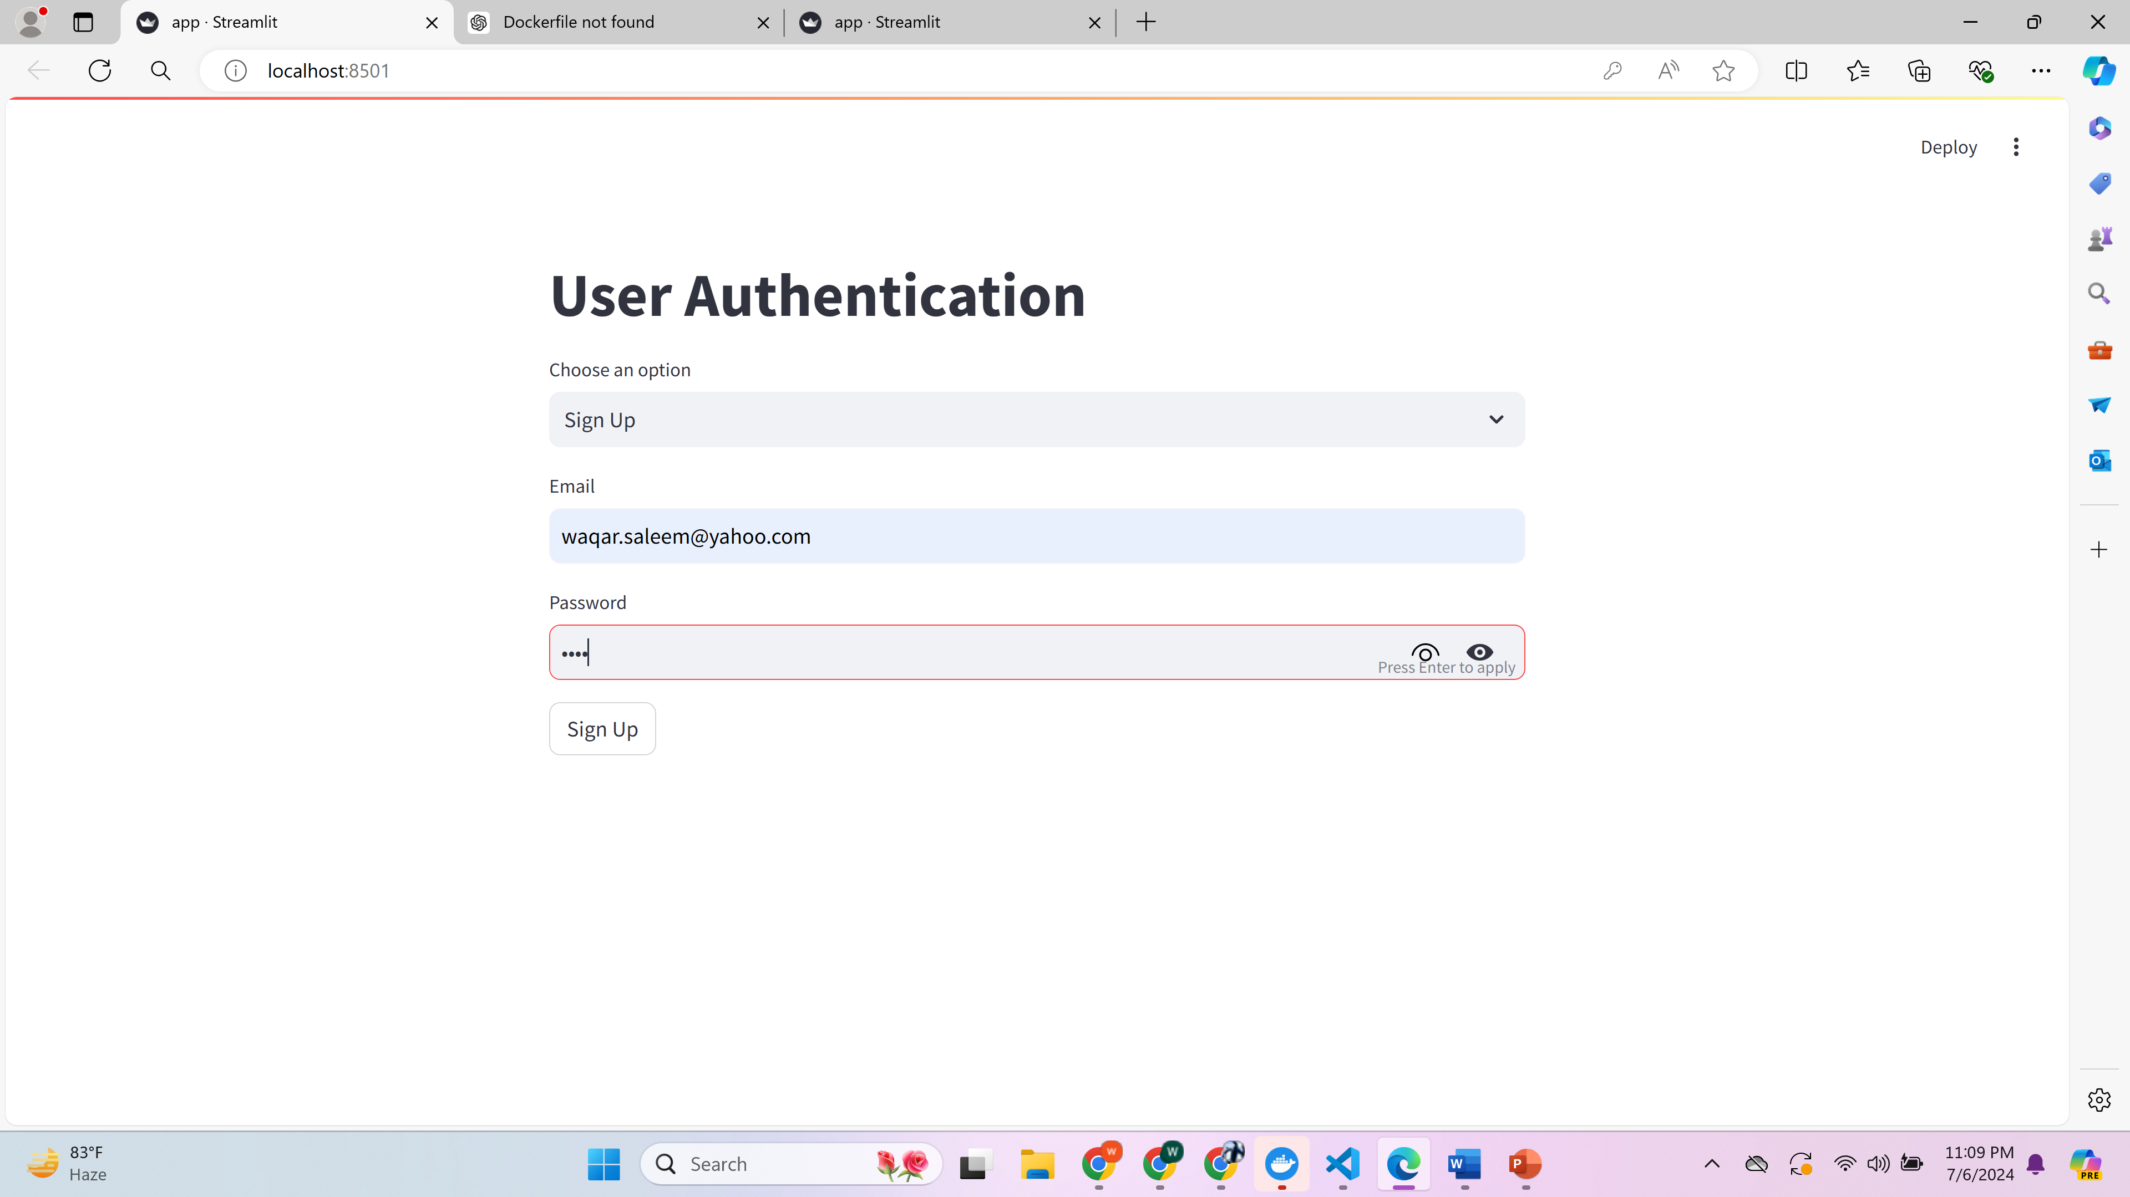
Sign UP

Slide 4
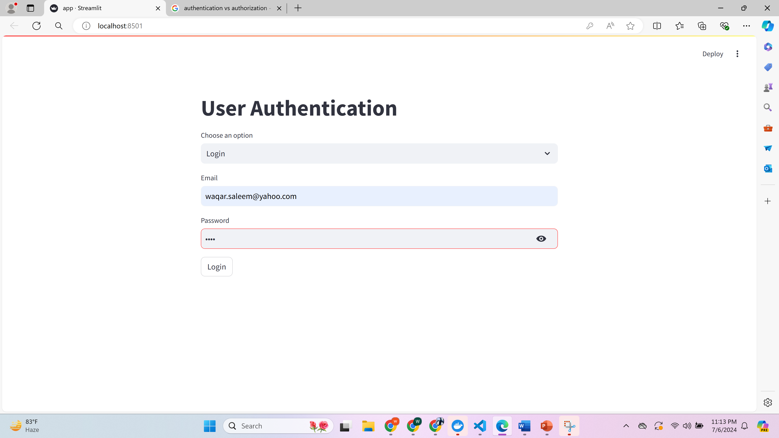
Loin

Slide 5
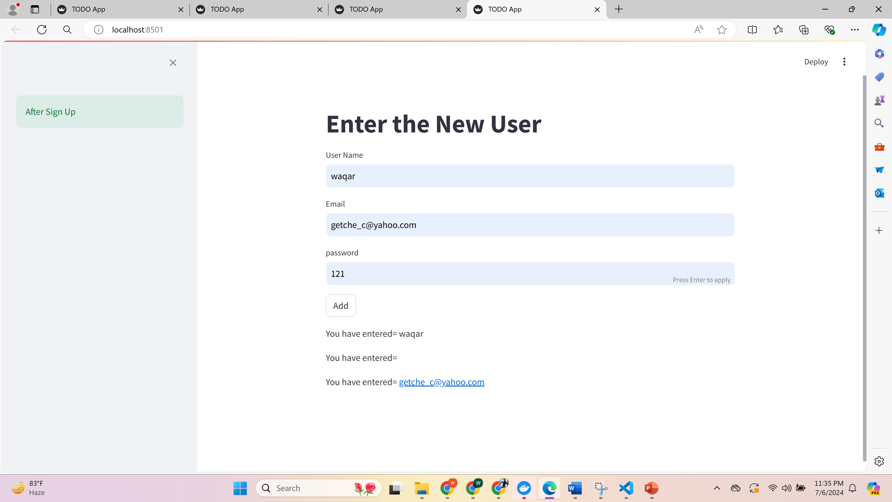
TO DO -ADD

Slide 6
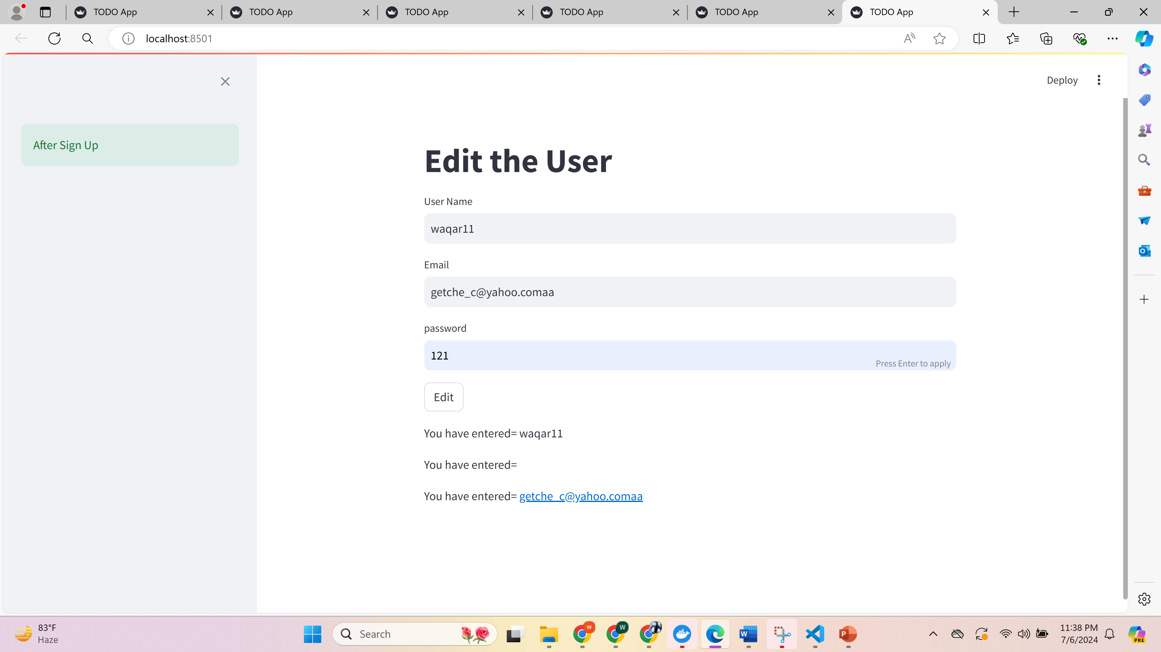
EDIT

Slide 7
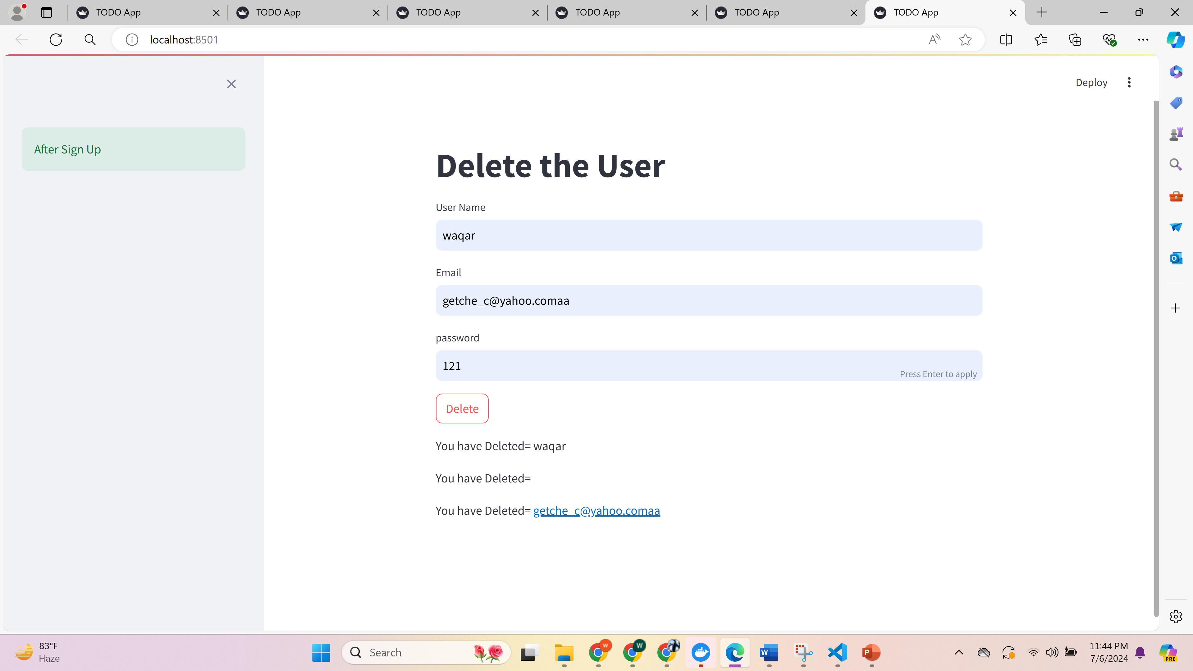
Delete

