Slide 1
Chronic Kidney
Disease Progression
Predict
Princy Pappachan Iakov

Slide 2
TABLE OF CONTENTS
01
03
02
Data Insights
Evaluation of Model
Models explored and its performance

Slide 3
01
Data Insights
Let us see what story our data beholds

Slide 4
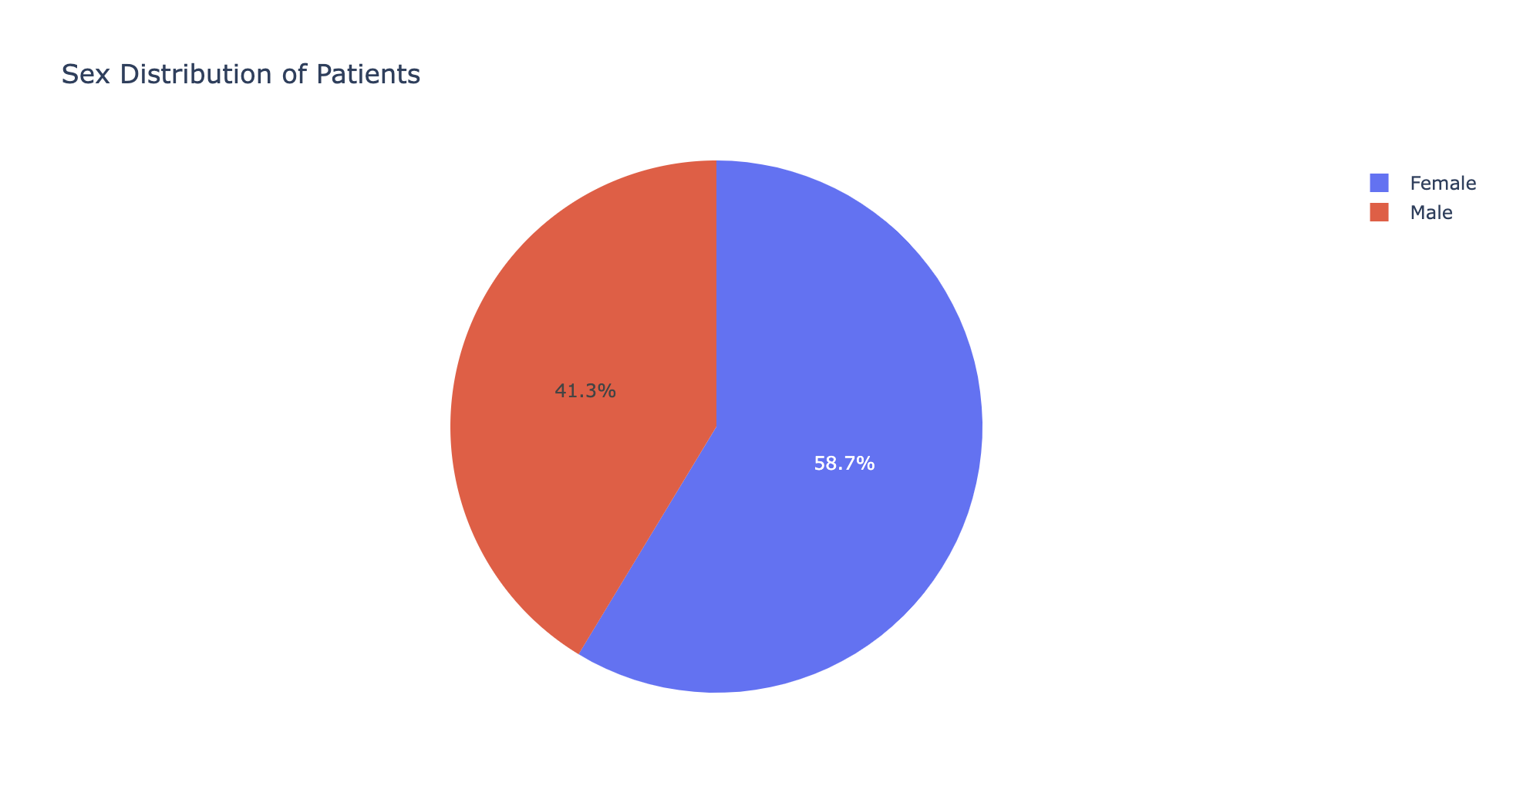
Patients’
Sex
Major portion of our patients are female
Female
59% of our patients are Female
Male
41% of our patients are Male

Slide 5
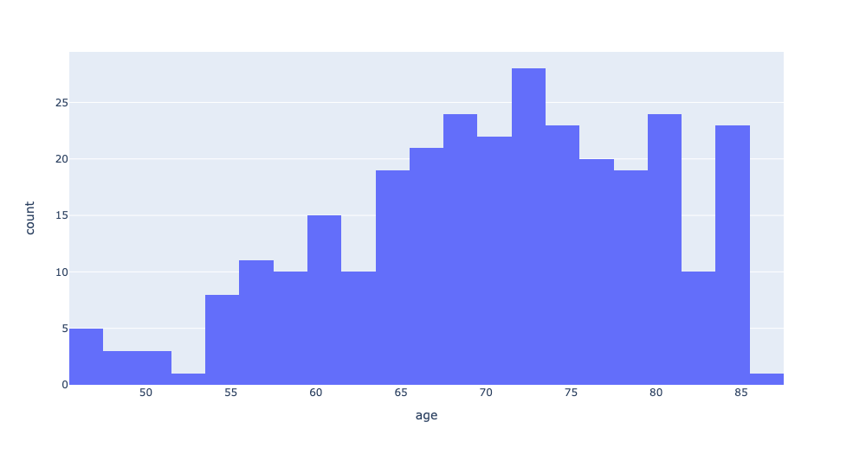
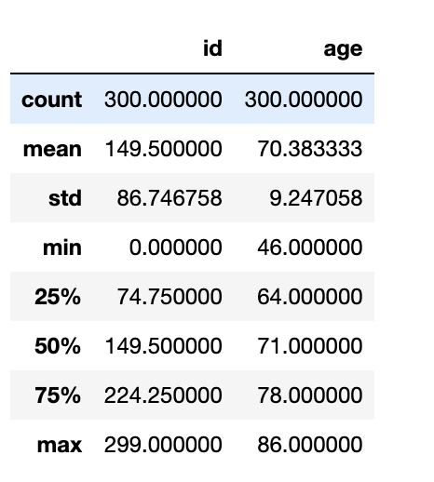
Age Range of Patients
The participants of our study range between the age of 46 to 86 years
50% of our patients are 71 years or younger
Average age of the patients is 70 years.

Slide 6
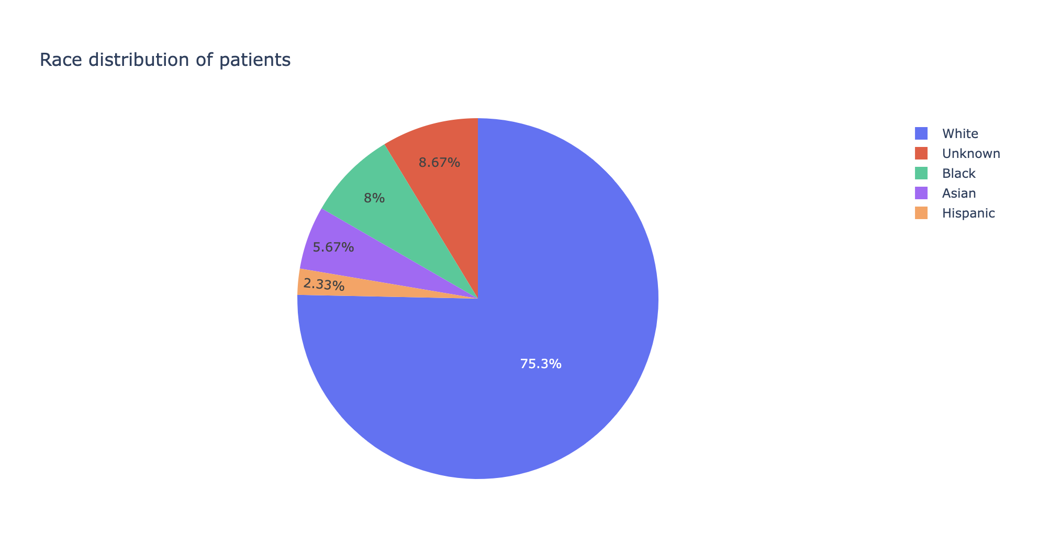
Patients’ Race
The participants of our study are predominantly of one race
White
75% of our patients are white
Hispanic
Only 2% of our patients are Hispanic

Slide 7
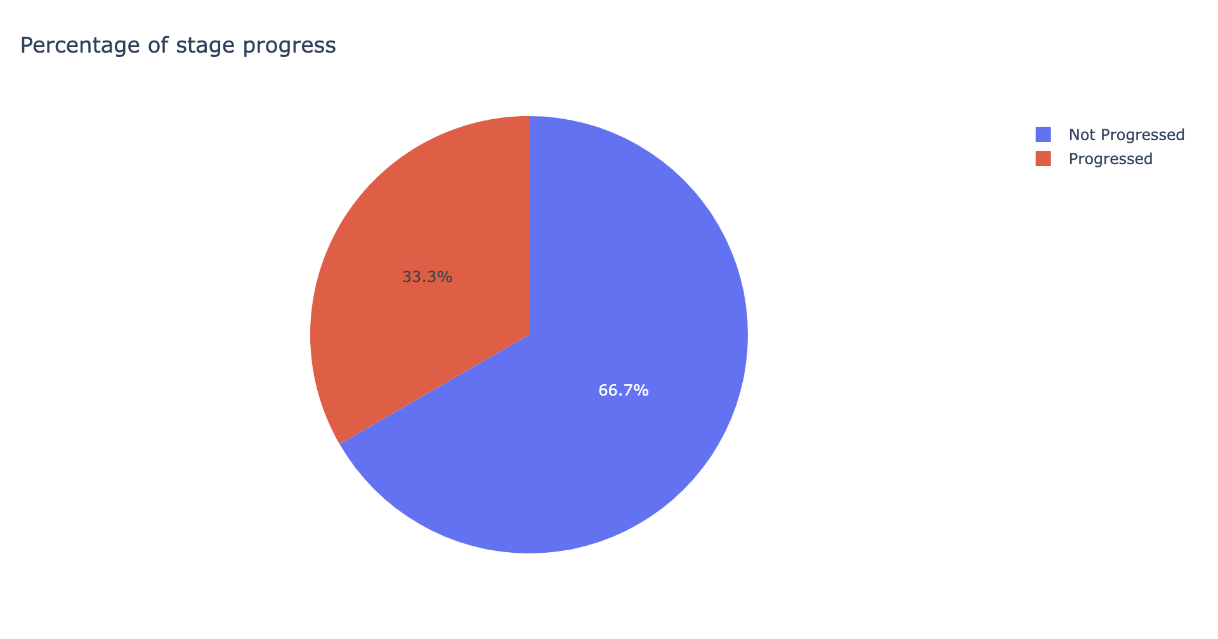
Status Progress
Most of have patients have regressed
Not Progressed
67% of our patients have not progressed
Progressed
Only 33% of our patients have progressed

Slide 8
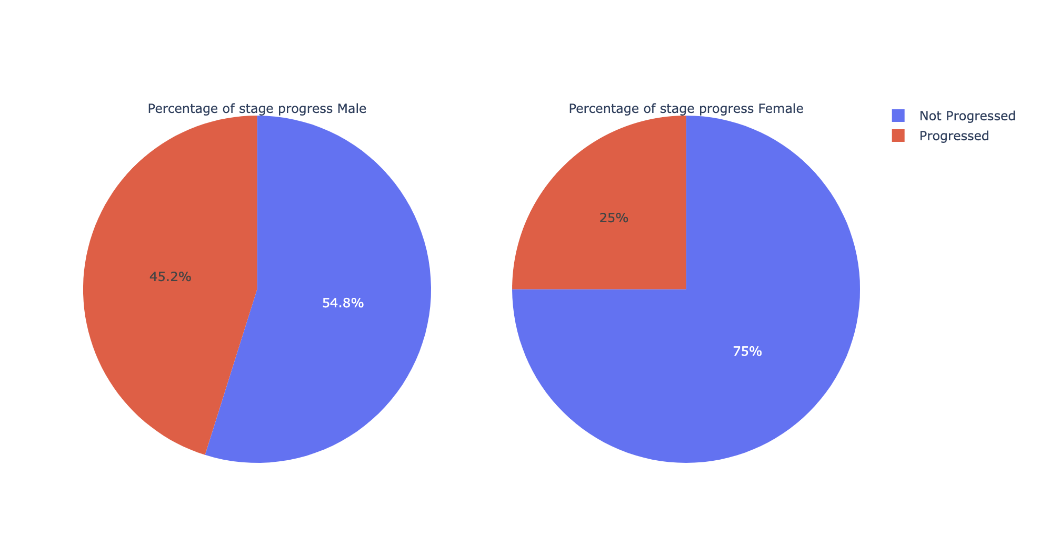
Status Progress
Male VS Female
More males have progressed as compared to females
Not Progressed
75% Females compared to 55% Males
Progressed
45% Males compared to 25% Females

Slide 9
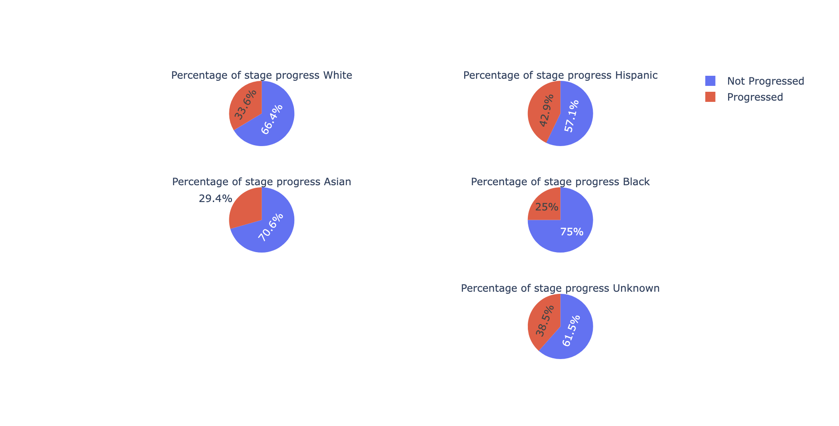
Status Progress
Races
Not Progressed
75% blacks have not progressed as compared to others
Progressed
43% Hispanics have progressed as compared to others

Slide 10
02
Models Explored
A quick summary of all the models explored

Slide 11
Machine Learning Model
Random Forest
XGBoost
Accuracy: 0.6555555555555556
F1 Score: 0.47457627118644063
Accuracy: 0.7111111111111111
F1 Score: 0.5806451612903225
Linear Regression
KNN
Accuracy: 0.6222222222222222
F1 Score: 0.5405405405405405
Accuracy: 0.6555555555555556
F1 Score: 0.5507246376811593

Slide 12
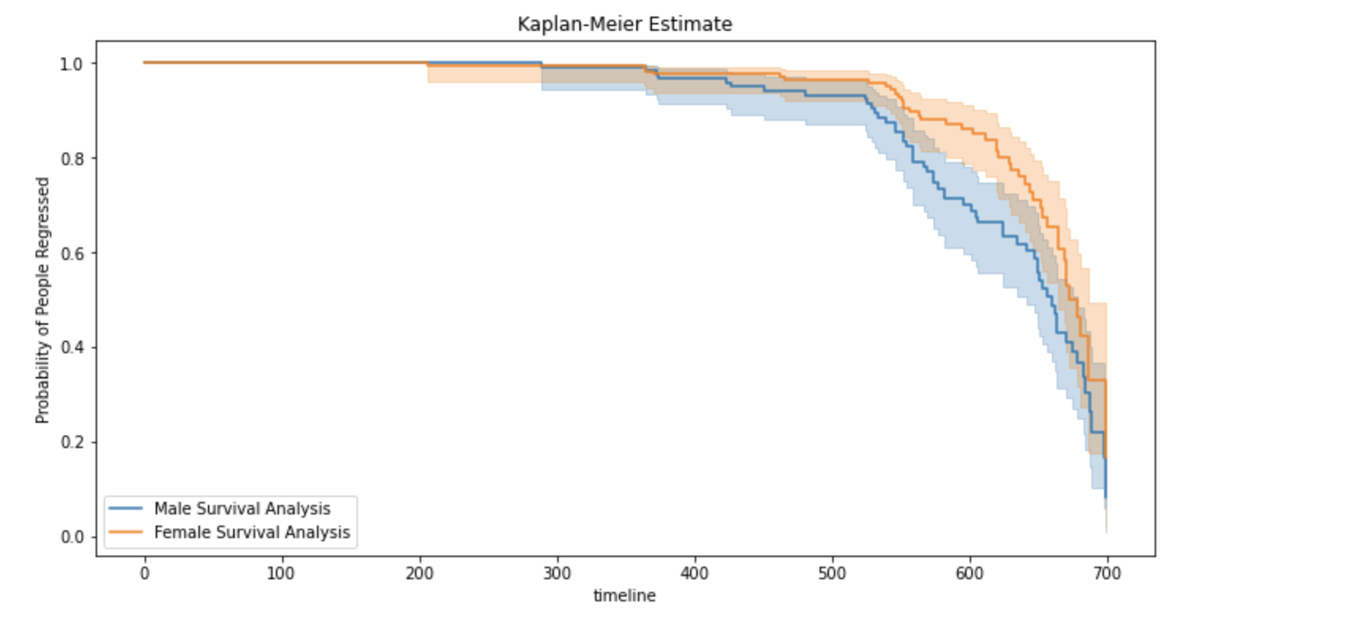
Kaplan-Meier Estimate
Insights for gender
Female vs Male
Males have higher possibility to progress compared to female

Slide 13
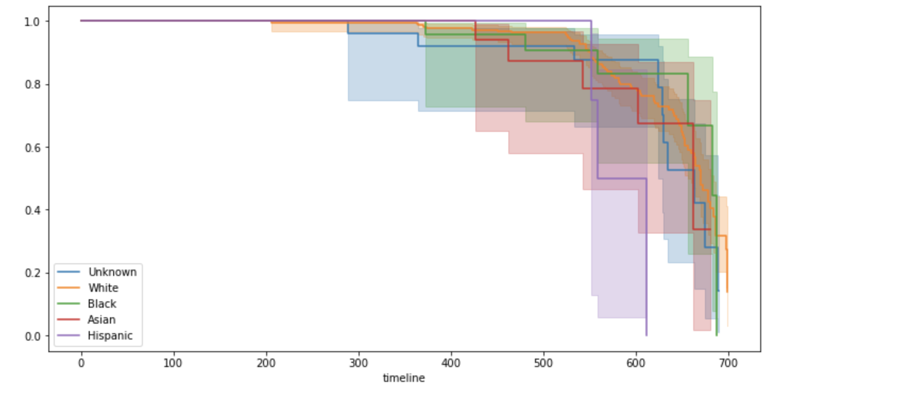
Kaplan-Meier Estimate
Insights for Race
Hispanics have the highest possibility of progressing

Slide 14
COX MODEL SUMMARY
RACE
CREATINE & GLUCOSE
Hispanics have 734% higher chances of progression
Higher creatine and glucose leads to 7% and 8% increased risk respectively
Gender
BP & HGB
Males have 59% higher chances of progression
Higher systolic BP leads to 2% higher risk of progression while higher HGB reduces the risk by 3%

Slide 15
03
Model
Evaluation
How did I evaluate model?

Slide 16
Giskard for inspection of data
To explore how model reacts to real time data modification

Slide 17
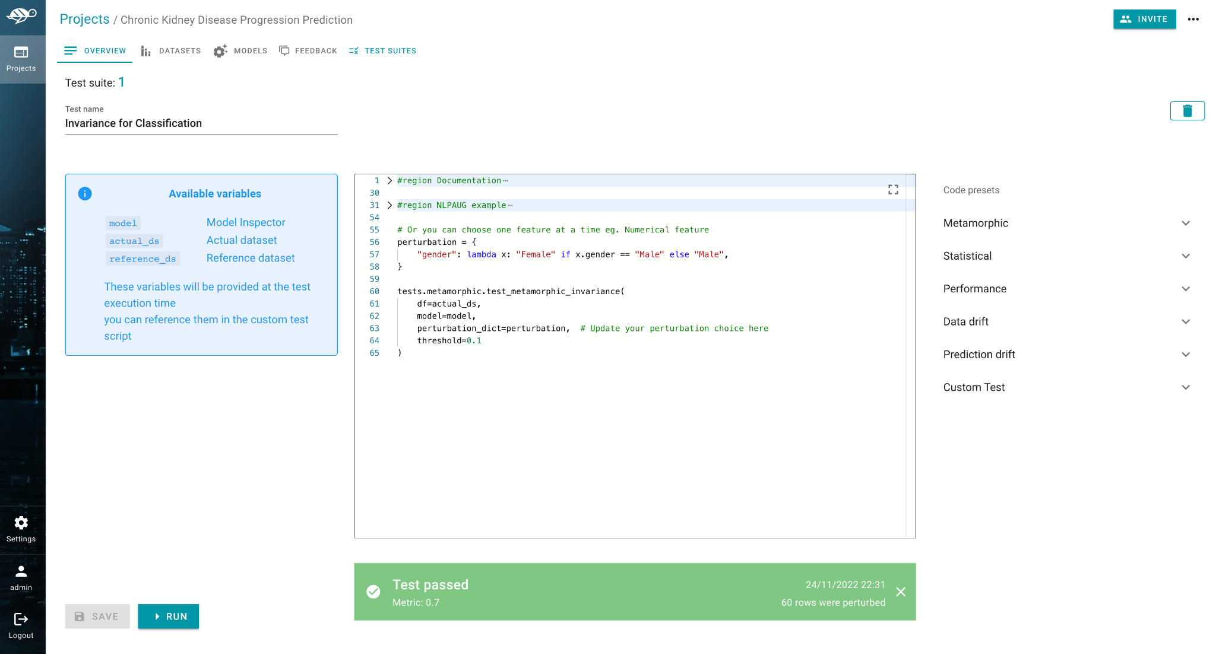
Giskard for testing by changing the values on the whole dataset. Example : Replace female with male and evaluate how much deviation we have in prediction probability

Slide 18
Link to the repo for detailed version
https://github.com/princyiakov/chronic_kidney_disease_progression

Slide 19
THANK YOU!
Do you have any questions?
princy.iakov@gmail.com
+65 81099121

