Slide 1
System Call Demonstration and Monitoring System
Section _ | Team _
Roll Number | Student Name
2520030499 | G.Sahithi
2520030557 | B.Jasmitha

Slide 2
Abstract
A Linux-based Operating Systems project showing how application programs request services from the kernel through system calls.
A C program creates and manipulates files, creates processes and runs other programs. A web dashboard and strace show each call crossing from user space into the kernel.
Implemented in C using open(), read(), write(), close(), fork(), exec(), waitpid() and errno.
Key OS concepts
System calls
User mode vs kernel mode
File I/O
Process creation
Program execution (exec)
Synchronization (wait)
Error handling (errno)
Tracing with strace

Slide 3
Problem Statement
The problem
Our approach
Programs need kernel services such as files and processes, but students cannot see how the request reaches the kernel.
System calls happen silently, so errors and return values are hard to understand.
Result: weak understanding of the user space to kernel transition.
A C program performs real system calls for files, processes and synchronization.
Every return value is checked and errors are handled with errno.
strace and a web dashboard show each call and the kernel response.

Slide 4
Objectives
Create and manipulate files using system calls
Use open(), read(), write() and close()
1
2
Create processes using fork()
Execute another program using exec()
3
4
Synchronize processes with wait() or waitpid()
Check and handle system-call return values
5
6
Handle errors using errno
Trace calls with strace and identify the user-kernel transition
7
8

Slide 5
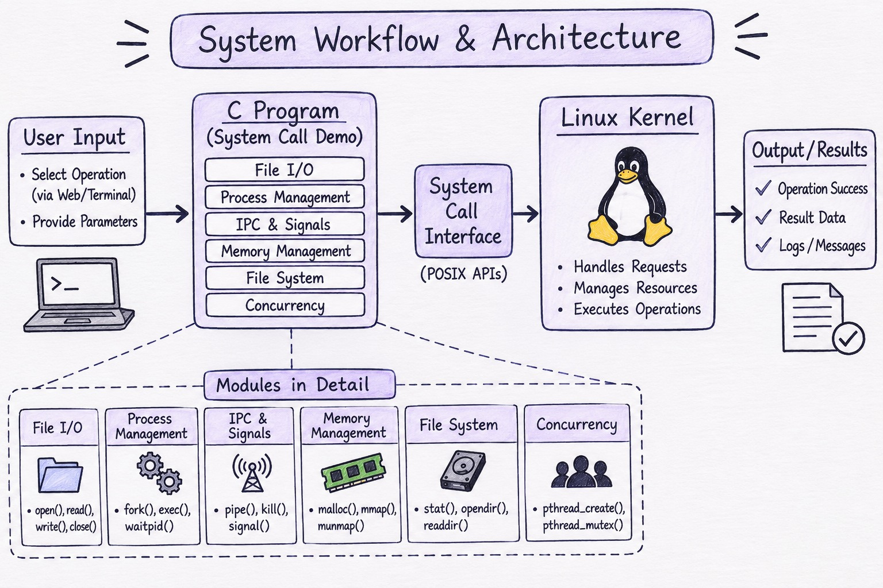
System Architecture
Kernel boundary: system call interface · Linux kernel · strace trace · web dashboard

Slide 6
Execution Flow
1
Select Operation
2
Identify Operation
3
Invoke System Call
4
Kernel Processes
›
›
›
5
Return Result or Error
6
Display Result
7
Trace with strace
8
Analyze Trace
›
›
›
Testing: run the program in an Ubuntu terminal, trace it with strace -f, and verify file I/O, process creation, exec, waitpid and error handling.

Slide 7
Proposed Methodology
Phase | What happens
1. Operation selection | User picks a file, process or error operation from the menu
2. File I/O | open() creates a file, write() saves data, read() reads it, close() releases it
3. Process creation | fork() creates a child process
4. Program execution | Child calls exec() to run another program such as ls
5. Synchronization | Parent uses waitpid() to wait for the child and reap it
6. Error handling | Return values are checked; errno and strerror() report failures
7. Tracing | strace -f records every system call made
8. Visualization | Web dashboard shows each call crossing into the kernel

Slide 8
OS Concepts / Linux APIs Used
Concept / API | Purpose in the project
File access – open() | Creates or opens a file (appears as openat in strace)
Writing – write() | Writes data to a file descriptor
Reading – read() | Reads data from a file descriptor
Closing – close() | Releases the file descriptor
Process creation – fork() | Creates a child process (appears as clone)
Execution – exec() | Replaces the child with another program (execve)
Synchronization – waitpid() | Parent waits for the child to finish (wait4)
Error handling – errno | Identifies why a system call failed
Tracing – strace | Shows the system calls made by the program

Slide 9
Tools / Platforms / Software
Tool | Purpose
Linux / Ubuntu | Operating environment for development and execution
C language | Implements the system-call demonstration program
GCC | Compiles the C source code
strace | Traces the system calls made by the program
Python server | Compiles and runs the program, returns output and trace
HTML / JavaScript dashboard | Shows the operation flow, trace analysis and errors

Slide 10
Expected Outcome
Create
Files created and written using system calls
Read
Saved data read back and closed correctly
Fork
Child processes created using fork()
Exec
Another program executed using exec()
Wait
Parent synchronized using waitpid()
Handle
Return values and errno checked
Trace
strace lists every system call
Observe
User to kernel transition clearly shown

Slide 11
Thank You

