Slide 1
PID – 496 Pay & Park Facility Locator Developed By : Princy Patel Branch – Cyber Security Batch – CS13 Enrollment No. – CS37

Slide 2
Problem Statement
SMC has created multilevel and open parking facilities. It is required to have a mobile app which enables citizens to locate nearest parking location. For the multilevel parking, the parking slots for the four wheelers are fixed and the entry and exit is under controlled environment, for such MLP slots, a back end app can be designed for the operator which will enable to mark entry and exit of four wheeler. This information will help the citizen to check the parking space availability as well.

Slide 3
What are the problems ?
The first problem is to help the citizen to check the parking space availability and send them the location address for park their four wheeler.
Many citizens like elders in Surat are not aware / don’t know utilization of this facility.
Some old folks not able to use this because they should not know English.
Some times this parking facility requires more free, then some people avoid this facility and park their vehicle anywhere.

Slide 4

What steps will become helpful in this problem ?
At first, we should create a web-site for this parking facility which will find the nearest parking for citizens.
The owner of this web-site should spread awareness about this facility.
Developers should put a option in this web-site to choose language which will help elder peers.
In addition, it is also mandatory to set it’s fees in limit.

Slide 5
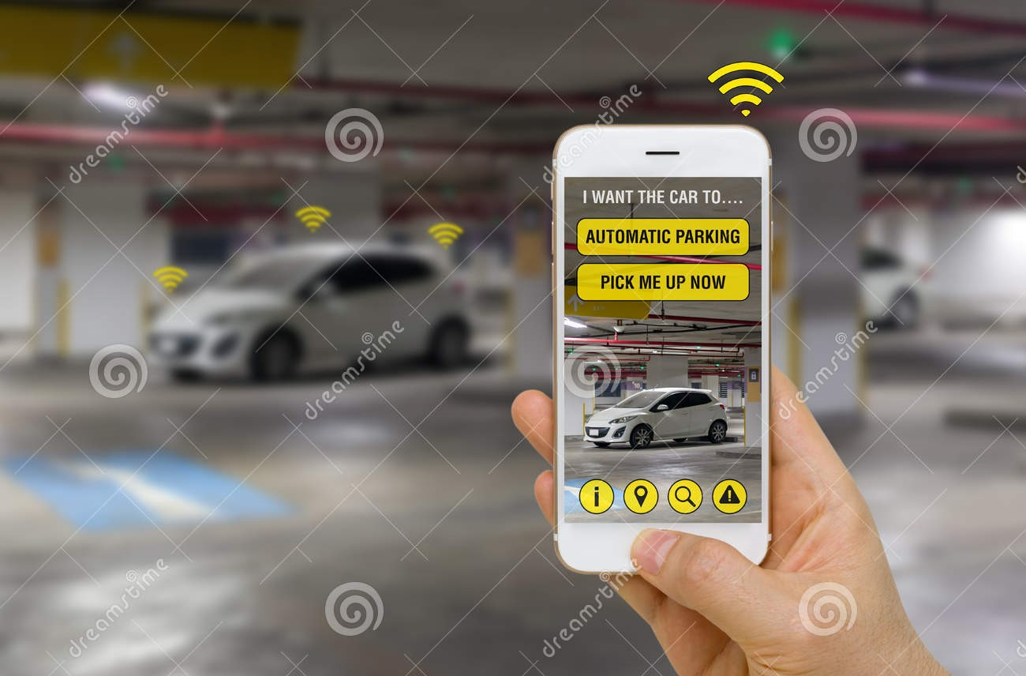
What is my help in this project ?
I can create a web-site which will help to find nearest car parking and all the data of user and it will not be costly for the citizen that everyone can use it. This small step can be solve the problem of traffic.

