Slide 1


INSTITUTE FOR ADVANCED COMPUTING AND SOFTWARE DEVELOPMENT AKURDI, PUNE
Documentation On:-
“Analysis of import export and production of fertilizer in various countries and prediction for upcoming year”
PGDBDA MAR2022
Submitted By:
Group No: 25
Princy Singh 223341
Shubham Govindwar 223353
Mr. Prashant Karhale Mr. Akshay Tilekar
Centre Coordinator Project Guide

Slide 2
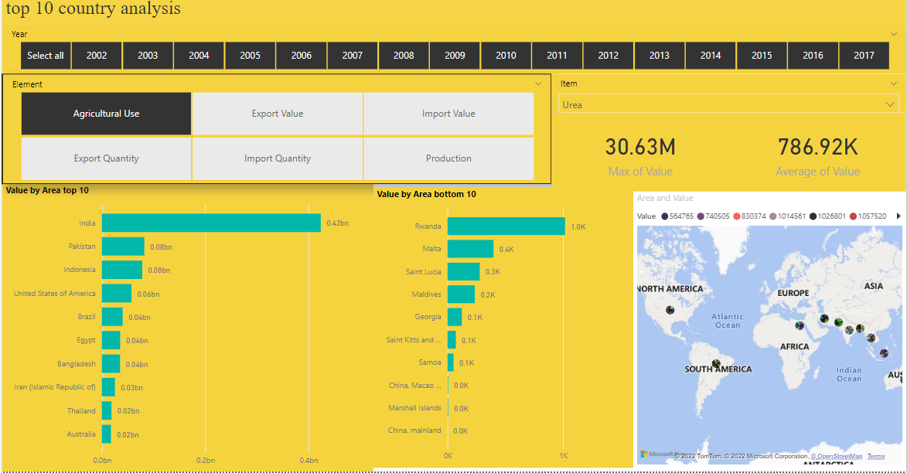
HOW MUCH FERTILIZER IMPORTED BY ANY COUNTRY?

Slide 3
BASIC ANALYSIS OF THE DATA WE HAVE:-
We have data of 146550 rows of data
Which includes 146 countries , with 16 years of data ,in six type of elements like('Import Quantity', 'Import Value', 'Export Quantity', 'Export Value', 'Agricultural Use', 'Production’)
This all data is indicated to 23 types of fertilizer and row materials
By using the dash board we can filtered all that data as per we want
The upper dashboard we seen that gives you top 10 or bottom 10 countries for that filtration

Slide 4
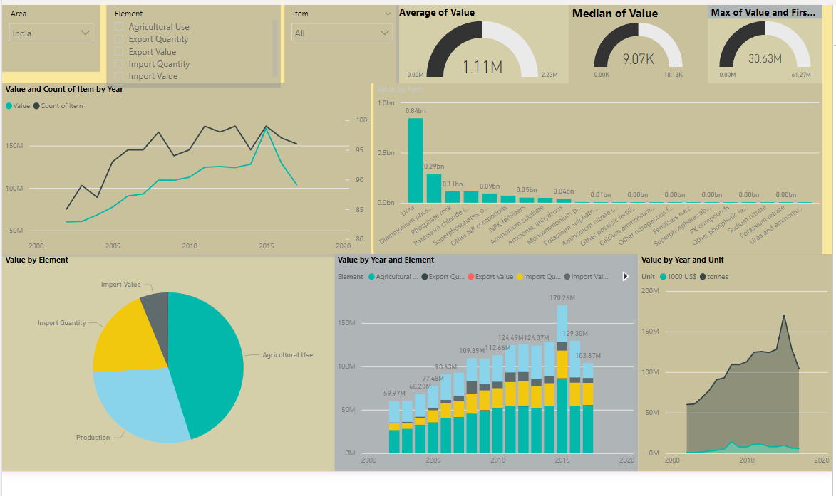
ANALYSING THE DATA FOR INDIA FOR EVERY FERTILIZER

Slide 5
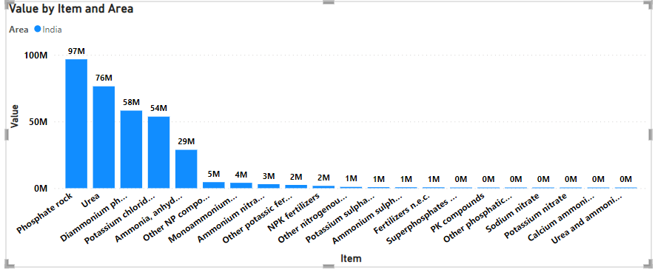
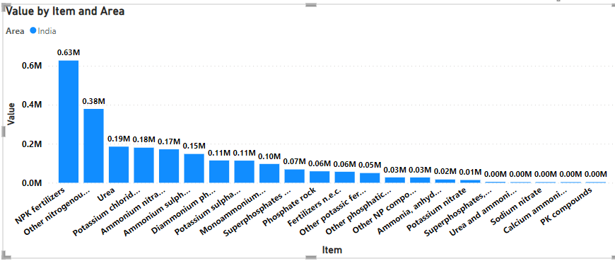
Analysis Of the data:- Import and Export in India:-

Slide 6
ANALYSIS OF DATA :(basic analysis using powerbi)
India deals with 22 fertilizers of the 23 fertilizers used worldwide.
The sum of total of imports of fertilizers is much more than exports over the years, hence India is dependent on imported fertilizers.
NPK Fertilizers, Nitrogeneous fertilizers are the most exported fertilizers.
Imports of fertilizers have decreased consistently in last 5 years.
'Diammonium phosphate (DAP)', 'Urea' are the most imported Fertilizers in India.
Use of fertilizers have been constant around the last decade except in 2015.
Urea remains the most produced fertilizer in India.
'Urea' and 'Diammonium phosphate (DAP)' are the most fertilizers in India.
India is also steadily increasing production of 'Diammonium phosphate (DAP)' given its high use and import value.

Slide 7
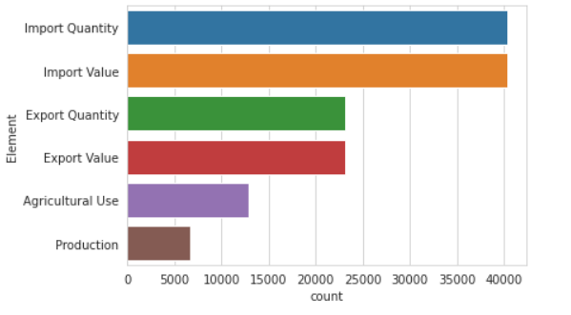
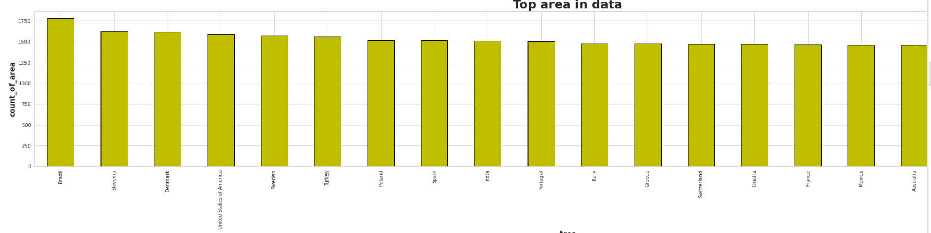

Slide 8
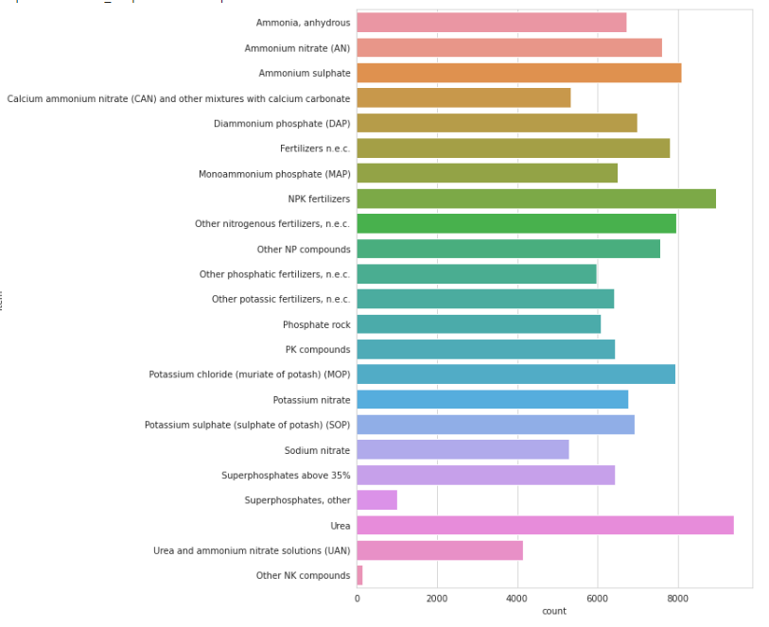
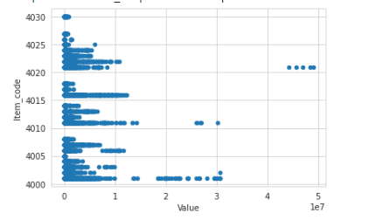

Slide 9
PREDICTING THE VALUES BY USING ML ALGORITHMS
Basically we have to use regression algorithms
1)gridSearch randomforest regresser
2)gridSearch Xgboost regresser
3)Linear regression
4)Randomforest regresser
5)Decission tree regresser
6)Neural network for regression

Slide 10
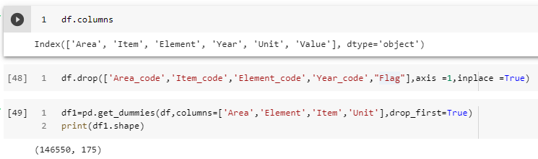
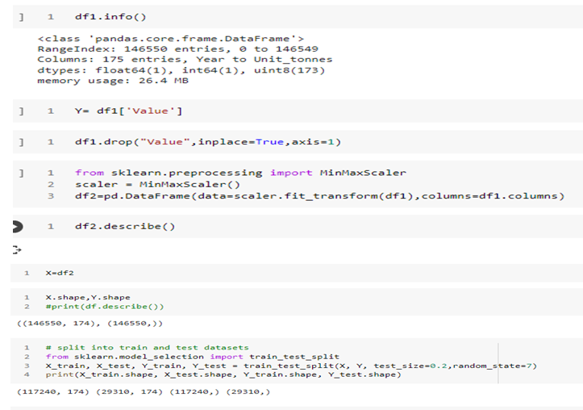
Preprocessing:-

Slide 11
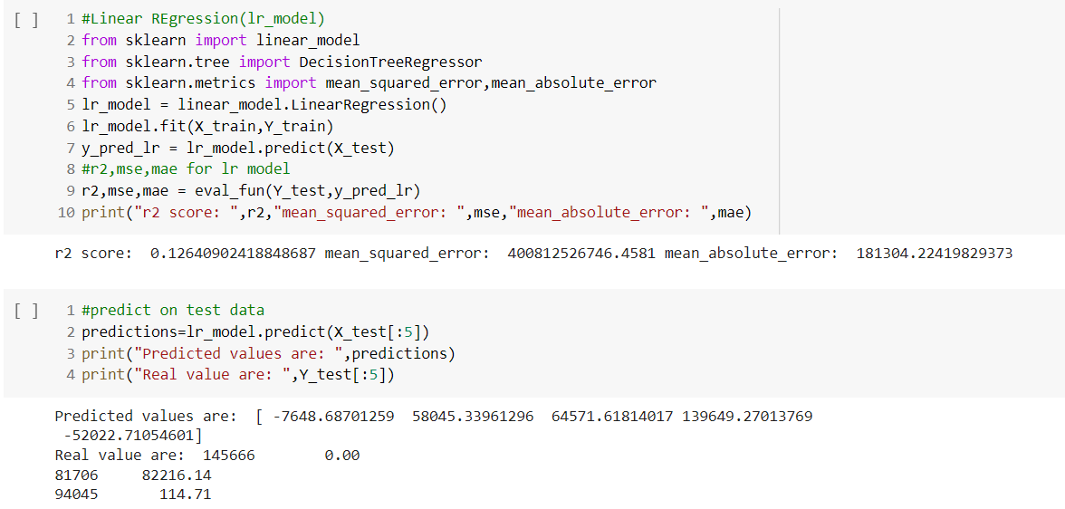
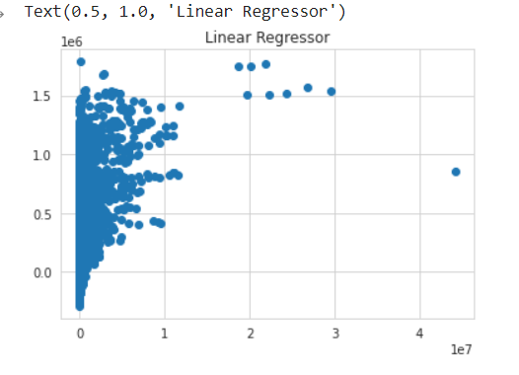
1)Linear regression
.

Slide 12
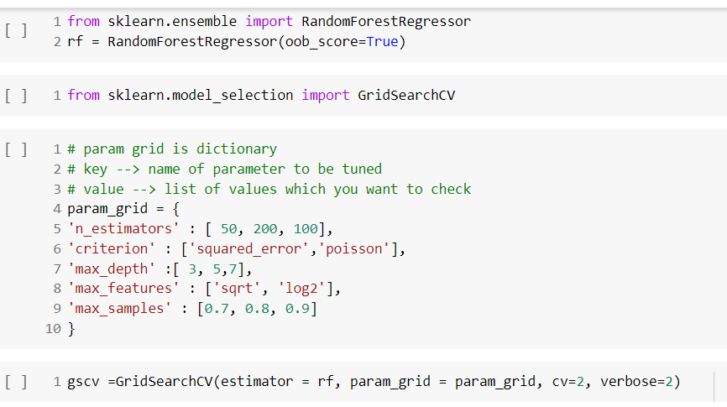
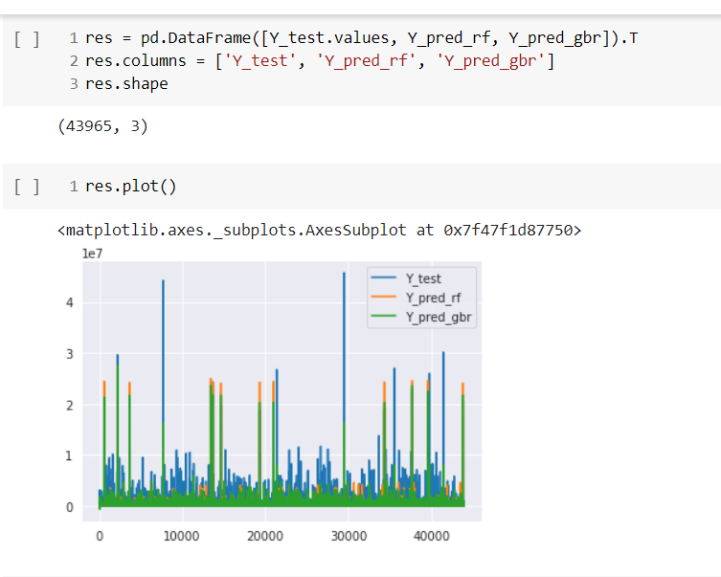
2)gridSearch randomforest regresser

Slide 13
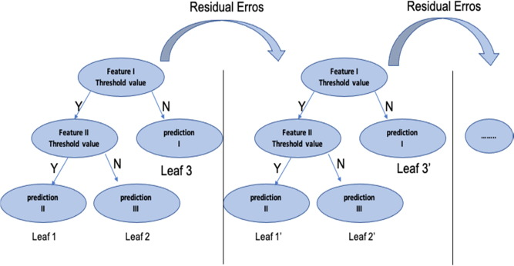
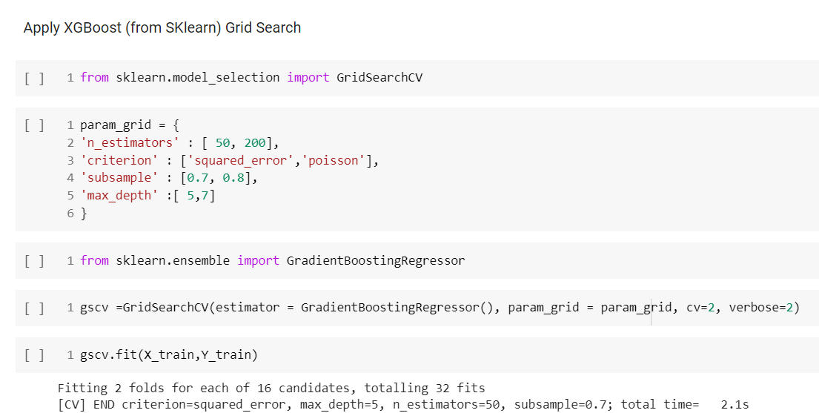
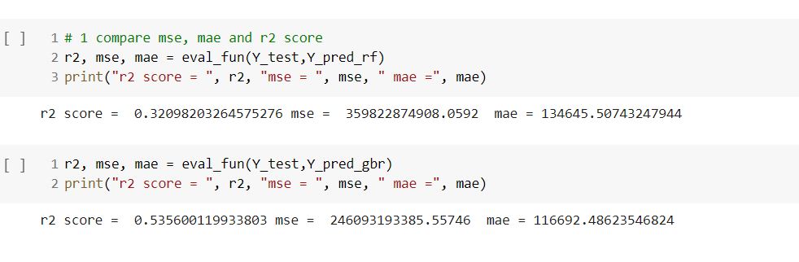
3)gridSearch Xgboost regresser

Slide 14
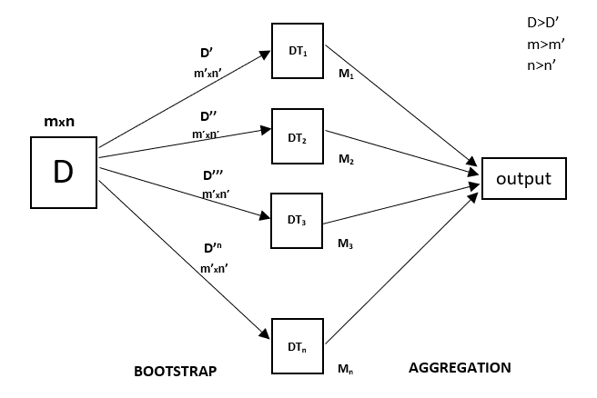
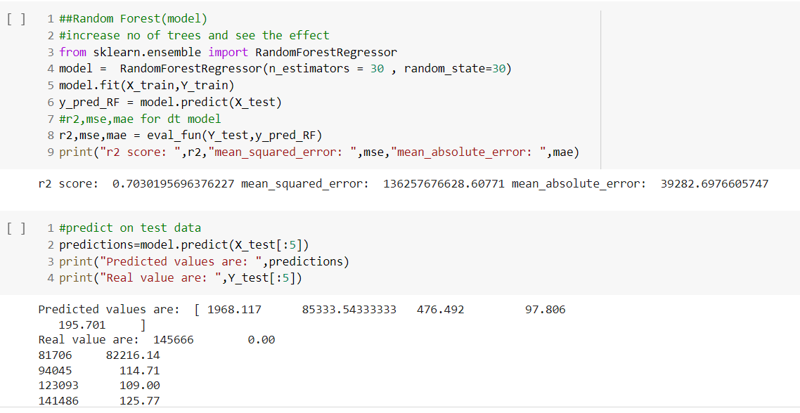
4)Randomforest regresser
Random Forest is an ensemble technique capable of performing both regression and classification tasks with the use of multiple decision trees and a technique called Bootstrap and Aggregation

Slide 15
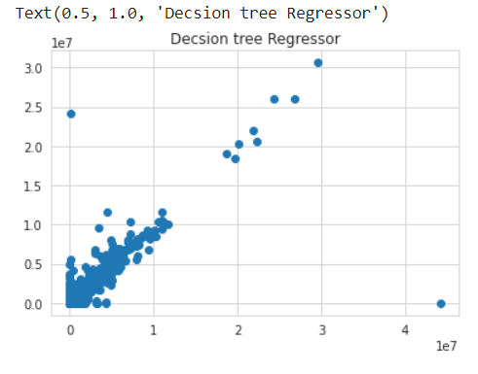
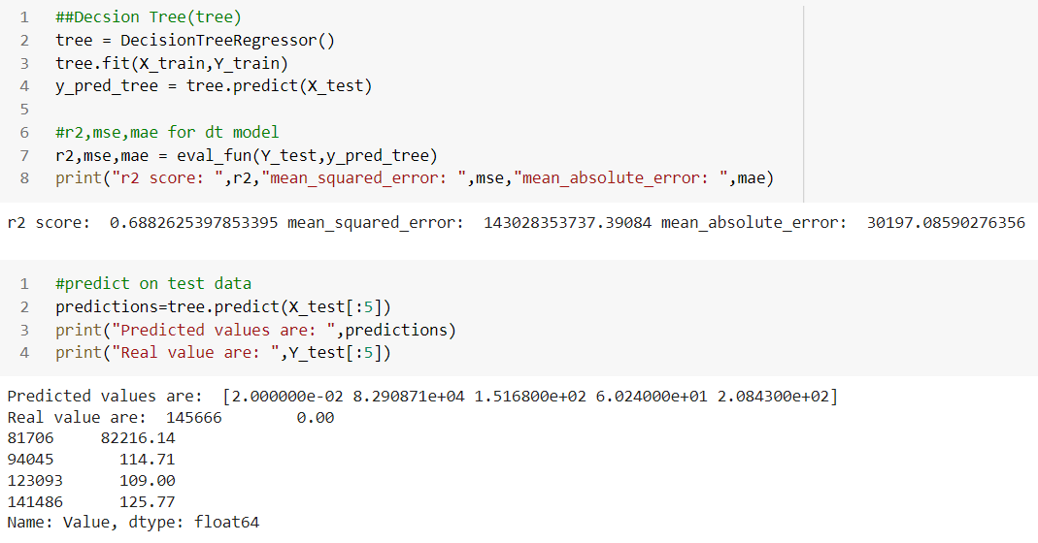
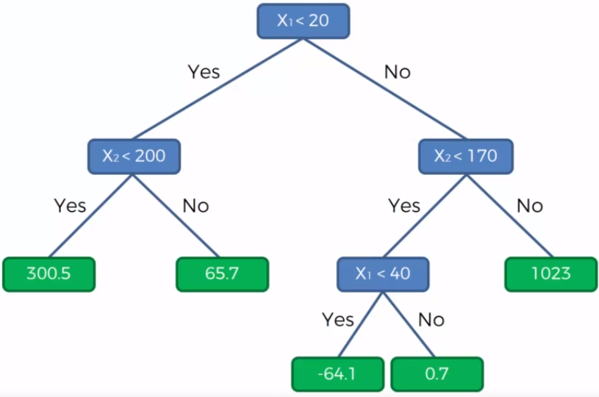
5)Decission tree regresser

Slide 16
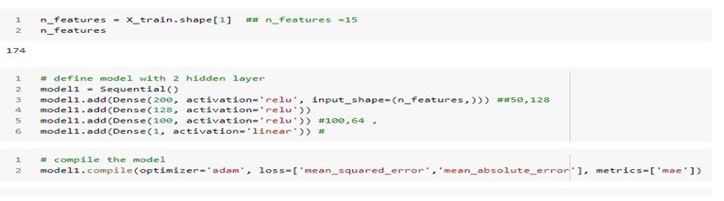
6)Neural network for regression
*Activation in Output:- Linear for regression because not want to include non-linearity in function .
*Activation in hidden :- Relu (Rectified Linear Unit. )
*Optimizer:- Adam(Adaptive momentum)

Slide 17
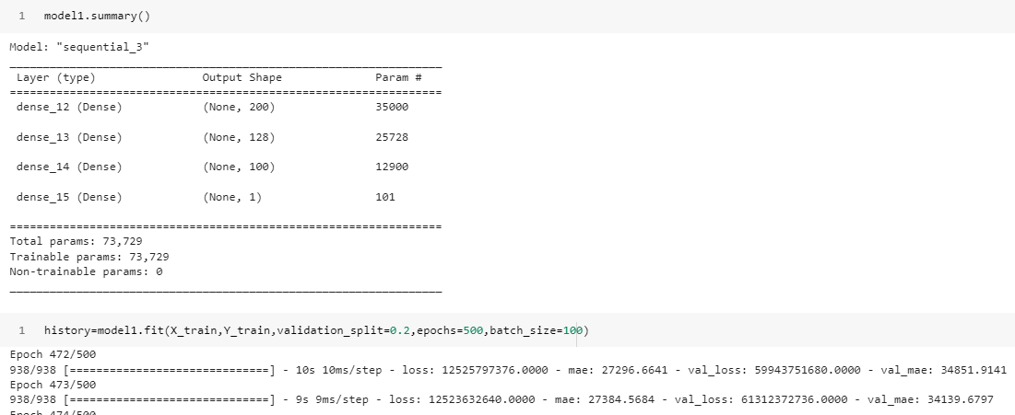

Slide 18
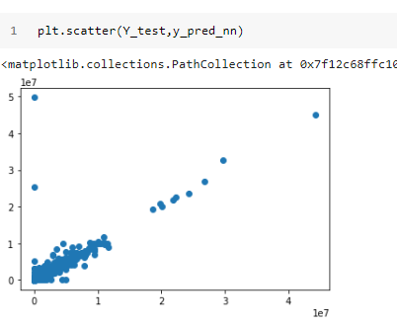

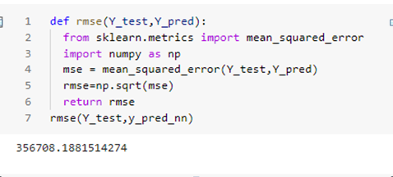
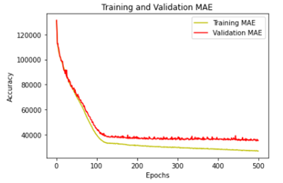
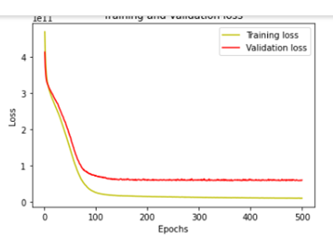

Slide 19
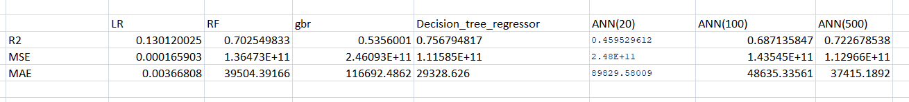
Result:-
For Import of fertilizer have created different-2 and for that best model for this which give R2 square value is approx 75.67% which comes by using of Decision Tree regressor model.

