Slide 1
Database Strategies In Data Mining
Scott Sonnleitner

Slide 2
1. Many Combinations of Variables from a Simple Operator
Alexander Hinneburg, Dirk Habich, and Wolfgang Lehner. Combi-Operator – Database Support for Data Mining Applications. Proceedings of the 29th VLDB Conference, Berlin, Germany, 2003.
Useful takeaways?
Watch out for permutations and combinations in algorithms because they are potentially very large (factorial)

Slide 3
The Problem
Comparing a few attributes at a time from a data set that has a large number of attributes creates a very large number of combinations, which means a very large volume of data.
The large volume of data is problematic (main memory is not infinite)

Slide 4
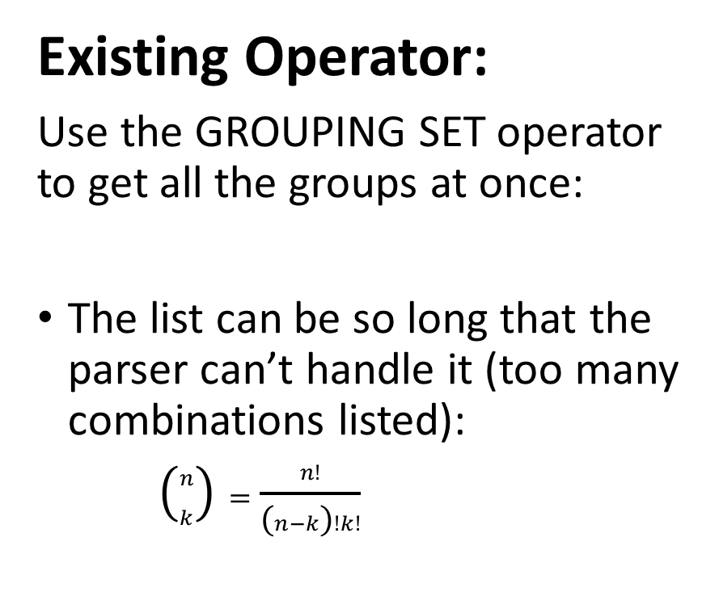
Limitations
Naïve Approach:
A single SQL statement for each group you want to see:
Traverses the data multiple times in secondary storage
Existing Operator:
Use the GROUPING SET operator to get all the groups at once:
The list can be so long that the parser can’t handle it (too many combinations listed):
$\left({n \atop k}\right)=\frac{n!}{\left(n−k\right)!k!}$

Slide 5
Strategy
Multiple Passes of the Database
Long Syntax
Minimize the number of scans by using main memory efficiently on each pass
Two algorithms:
1) Process the data in subsets and maximize the size of those subsets (limited by main memory)
2) Process the data in an orderly manner and output results as soon as possible to free main memory
New operator with much shorter syntax

Slide 6
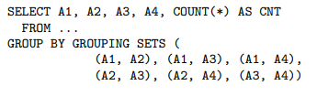
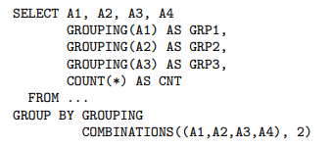



Shorter Syntax (“Avoiding enumeration”)
Previously:
Proposed Operator:

Slide 7
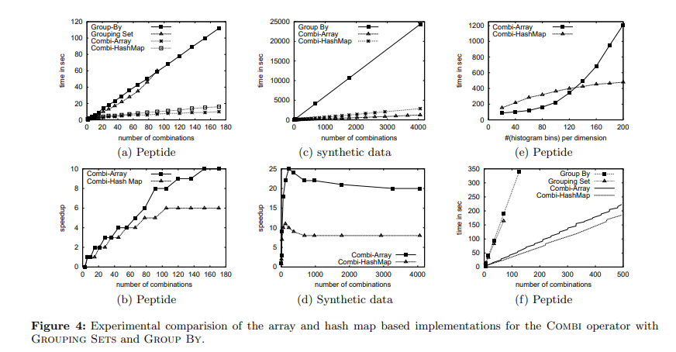

Results and Methodology
Tests and Results
Algorithm 1 (Process in subsets):
Generally…
Array > Hash-map > GROUPING SET > Naïve
But if you increase the number of attributes in each group…
Hash-map > Array
Algorithm 2 (): Only the theoretical analysis…
Lower main memory requirements
More passes over the data

Slide 8
2. Sum, Count, etc. in Better Organized Tables
Carlos Ordonez. Horizontal Aggregations for Building Tabular Data Sets. DMKD’04 June 13, Paris, France, 2004.
Useful takeaways?
Sometimes you can write a paper about what you build at work…
…and then use it as an excuse to travel ? (This guy went to Paris?)

Slide 9
The Problem
Databases in “Normal Form” require a lot of work to format the data into an easily useable layout for data mining
This is because the data is spread out over multiple tables, so it has to be joined and aggregated (sum, count, etc.)
Tables can be transposed by many existing OLAP tools, but it may be better to just address the problem using SQL

Slide 10
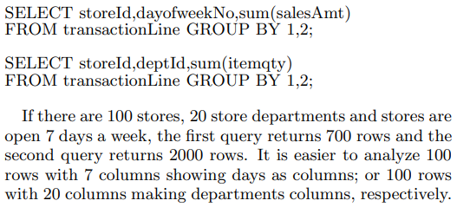
The Problem
Example:

Slide 11
Limitations
Other improvements to data mining through better use of SQL are not applicable to as many cases as their proposal
The particular idea here hasn’t been studied before

Slide 12
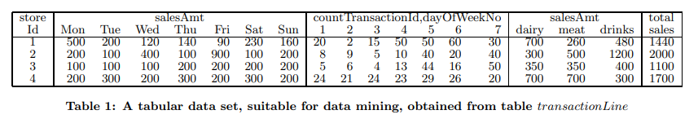
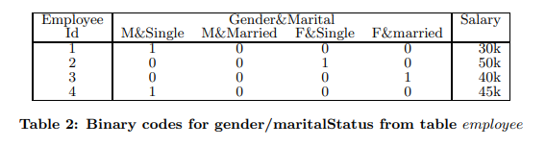
Strategy
A new aggregation function to extend SQL:
“horizontal” results, grouped by user-specified attribute:

Slide 13

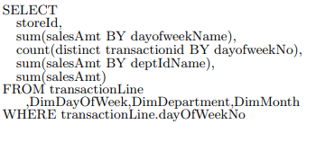
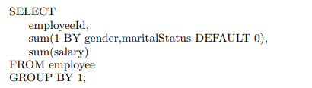

Syntax

Slide 14
Strategy
Two implementation strategies:
Relational operations (Select, Project, Join; “SPJ”):
Create the “usual” tables for each column and then join them
2) SQL case construct (the binary table):
An adaptation to return binary values (uses the case statement)
Two sub-strategies (for each):
1) Direct aggregation to table 2) Indirect aggregation using a temporary table

Slide 15
Results and Methodology
The relational operations strategy was slower than the case construct strategy (faster to create the binary tables)
It wasn’t clear which sub-strategy was best for making the binary tables
The cardinality of the user-specified grouping attribute had a major impact

Slide 16
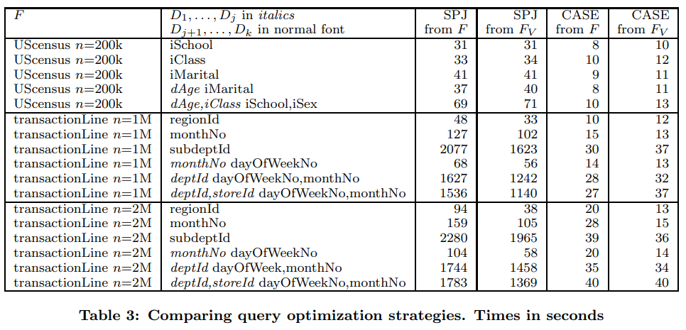
Sub-strategies: F = Direct aggregation to table Fv = Indirect aggregation using a temporary table

Slide 17
3. Uncertain + Constrained Frequent Itemset Search
Carson Kai-Sang Leung, Dale A. Brajczuk. Mining Uncertain Data for Constrained Frequent Sets. IDEAS ’09, September 16–18. Cetraro, Calabria, Italy, 2009.
Useful takeaways?
Can combine previously accomplished and separate tasks to do something publishable

Slide 18
The Problem
Need to do frequent set mining on uncertain (probabilistic) data sets with constraints, so that unnecessary operations are avoided

Slide 19
Limitations
Previous studies have been done using either constrained frequent set “searches” or uncertain (probabilistic) data, but not both at once
Sometimes we want both

Slide 20
Strategy
uncertain Constrained Frequent Set (“uCFS”) system
Use the properties of succinct constraints to reduce the cost
A tree-based system
Depth-First Search for frequent sets
Avoid checking every possible candidate by applying the user’s constraints

Slide 21
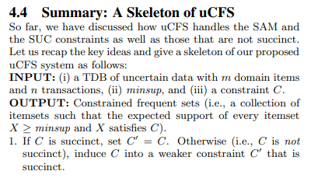

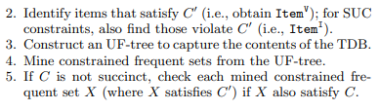
SUC = succinct non-anti-monotone

Slide 22
Results and Methodology
The system was satisfactory for succinct anti-monotone and succinct non-anti-monotone constraints
Non-succinct constraints were handled by converting them to succinct constraints
More selective constraints gave better execution times (graph a)
Linear as database size increased (graph c)

Slide 23
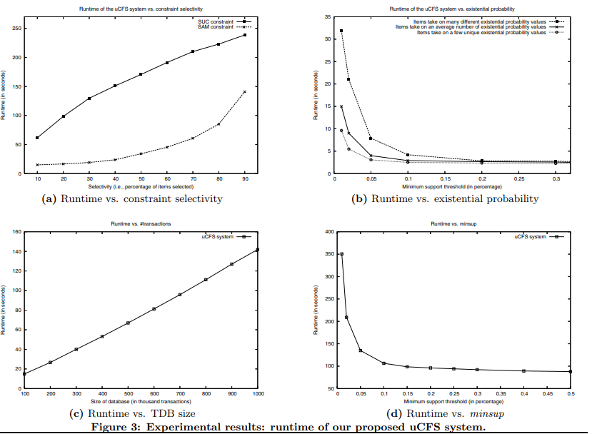

Slide 24
4. String Analysis for Finding Database Structure
Tamraparni Dasu, Theodore Johnson, S. Muthukrishnan, Vladislav Shkapenyuk. Mining Database Structure; Or, How to Build a Data Quality Browser. AT&T Labs-Research, ACM SIGMOD '2002 June 4-6, Madison, Wisconsin, USA, 2002.
Useful takeaways?
Jargon is infinite (“q-gram” = “string of length q”)

Slide 25
The Problem
Databases must be cleaned before they can be used for data mining, i.e. equivalent attributes in different databases discovered
In order to do this, the structure of the database must be understood (schema mapping)
Large, complex databases make this a major obstacle

Slide 26
Limitations
Previous work has generally focused on identifying specific relationships within tables or between fields (attributes)
These authors want to find the structure of the whole database as well

Slide 27
Strategy
Developed a data quality browser for examining the structure of the database:
Use summaries of the database
Query the browser about those summaries (faster than using the actual database)
They examine the more complicated profiles they use in this paper
i) Finding related fields using small summaries
ii) Checking the effect of different summary sizes
iii) New algorithms for determining database structure

Slide 28
Results and Methodology
They have used different measures of resemblance between sets and multisets (“signature”, “multisignature”)
They also used substring resemblance to evaluate how similar attribute names were to each other, using a smaller representation of the string in question (“sketches”)
Quantitative Results: the signatures and sketches provided good estimates, overall
Qualitative Results: They thought their browser was pretty useful

Slide 29
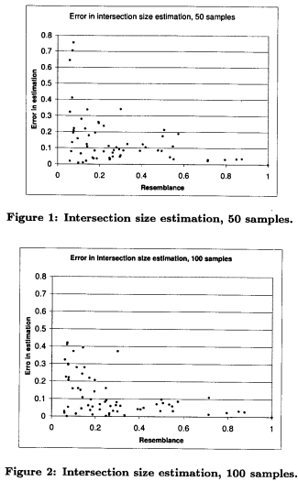
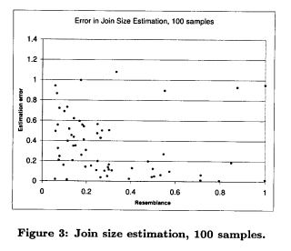
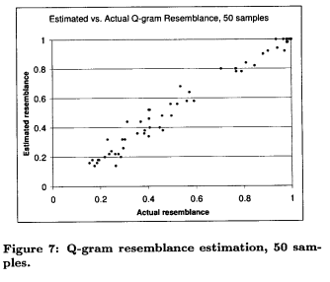

Slide 30
5. DFS Frequent Itemset Finding
Xuequn Shang, Kai Uwe Sattler. Depth-First Frequent Itemset Mining in Relational Databases. AC’05, March 13-17, Santa Fe, New Mexico, USA, 2005.
Useful takeaways?
Look for something better than the standard algorithm and maybe you’ll find something?

Slide 31
The Problem
Data mining algorithms implemented in SQL are performing worse than algorithms implemented outside of the database system because the non-SQL algorithms are designed to minimize the number of scans of the database (whereas the SQL-based algorithms are not).

Slide 32
Limitations
Other SQL-based approaches did not perform well on large data sets
Other algorithms used an A Priori-like approach, which generates large candidate sets

Slide 33
Strategy
An algorithm for mining frequent itemsets that avoids making multiple passes over the original data and also avoids complex joins between tables
A divide and conquer approach
Their plan:
Use frequent 1-itemsets to scan for other items that are also frequent with the 1-itemset
Build a new table of frequent 2-itemsets
Repeat
This forms the largest possible table for each item before moving to the next item, hence “Depth-First” in the title
This avoids costs associated with a breadth-first approach (creating/dropping tables)

Slide 34
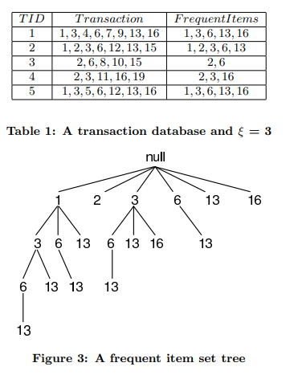
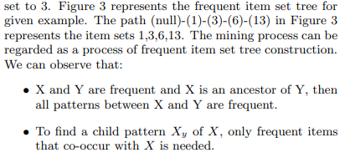

Slide 35
Results and Methodology
Better results than other algorithms when used on large data sets
Better results when the minimum support was low (lots of candidates generated by other algorithms)
A few nuances/special situations arose with their different optimized and hybrid versions

Slide 36
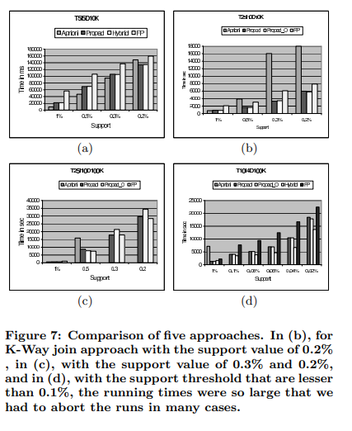
Propad = Their algorithm
“Projection Pattern Discovery”

Slide 37
6. Improved Machine Learning
Zhen Guo, Zhongfei (Mark) Zhang, Eric P. Xing, Christos Faloutsos. Enhanced Max Margin Learning on Multimodal Data Mining in a Multimedia Database. DD’07, August 12–15, San Jose, California, USA, 2007.
Useful takeaways?
Do it well enough and you can patent it, apparently:
https://patents.google.com/patent/US8463053B1/en

Slide 38
The Problem
The relationship between different data sources of different types must be learned by the machine learning model before those relationships can be used for predictions
Example:
Images and text descriptions:
The relationship must be learned by the machine learning
model before using it for predicting text/images

Slide 39
Limitations
Potentially exponential numbers of structures in their structured output variables
Limited reduction in the number of constraints when using a dual problem approach
Computing the most violated constraint was expensive

Slide 40
Strategy
A new enhanced max margin learning framework
Finds a small set of active constraints (compared to regular max margin learning)
Arbitrarily select a constraint that violates the optimality condition rather than computing one

Slide 41
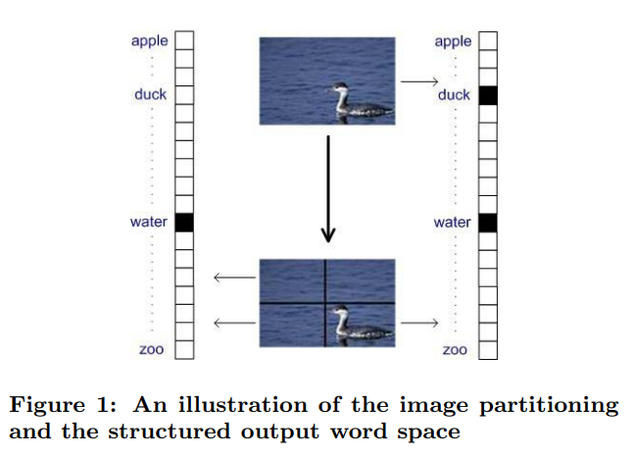

Slide 42



Results and Methodology
Faster convergence rate than other max margin learning implementations (10 minutes vs 14 hours)
Highly scalable: The response time was independent of the database size (constant)

