Slide 1
Solar Panel Predictive Maintenance Recommendation
Team Members
Priyanka Vijaybaskar 3122 21 5002 081
Purushothaman P 3122 21 5002 082
Rahul V 3122 21 5002 084

Slide 2
Problem Statement
In the field of solar energy production, selecting the most efficient photovoltaic (PV) technology for maintenance is crucial for optimizing energy output. The goal of this project is to leverage statistical inference and data analytics techniques to predict the efficiency of PV technologies based on geographical parameters. The project will analyze a dataset comprising geographical information, meteorological data for different PV technologies.
All the geographical locations configured are for locations in Tamil Nadu.

Slide 3
Data Collection
Usage of Selenium. Beautiful Soup, and requests to parse and retrieve data from a simulation website that can give us geographical data of irradiation and solar energy output at particular coordinates.
Selenium is used to automate the browser for interaction with the PVGIS website.
Requests is used to make an HTTP request to the PVGIS website to retrieve HTML content and the corresponding JSON data.
BeautifulSoup is used to parse the HTML content obtained from the website.

Slide 4
Data Preparation
All the data is organized into JSON files of 12 instances each
Each file is individually processed and combined into a single csv such that there are no null or missing values
The distribution of data is gaussian and with limited overall outliers and is thus not removed for that

Slide 5
Data before Processing
{"inputs": {"location": {"latitude": 10.653, "longitude": 76.956, "elevation": 237.0}, "meteo_data": {"radiation_db": "PVGIS-SARAH", "meteo_db": "ERA5", "year_min": 2005, "year_max": 2016, "use_horizon": true, "horizon_db": "DEM-calculated"}, "mounting_system": {"fixed": {"slope": {"value": 50, "optimal": false}, "azimuth": {"value": 68, "optimal": false}, "type": "free-standing"}}, "pv_module": {"technology": "CIS", "peak_power": 7.34, "system_loss": 10.0}, "economic_data": {"system_cost": 35.43, "interest": 8.0, "lifetime": 15}}, "outputs": {"monthly": {"fixed": [{"month": 1, "E_d": 31.57, "E_m": 978.78, "H(i)_d": 5.59, "H(i)_m": 173.41, "SD_m": 56.63}, {"month": 2, "E_d": 33.04, "E_m": 925.02, "H(i)_d": 6.0, "H(i)_m": 168.09, "SD_m": 41.48}, {"month": 3, "E_d": 30.64, "E_m": 949.99, "H(i)_d": 5.69, "H(i)_m": 176.35, "SD_m": 71.11}, {"month": 4, "E_d": 26.71, "E_m": 801.27, "H(i)_d": 5.02, "H(i)_m": 150.57, "SD_m": 70.79}, {"month": 5, "E_d": 24.99, "E_m": 774.55, "H(i)_d": 4.6, "H(i)_m": 142.46, "SD_m": 105.71}, {"month": 6, "E_d": 20.14, "E_m": 604.16, "H(i)_d": 3.66, "H(i)_m": 109.71, "SD_m": 125.13}, {"month": 7, "E_d": 19.73, "E_m": 611.75, "H(i)_d": 3.56, "H(i)_m": 110.4, "SD_m": 118.89}, {"month": 8, "E_d": 22.74, "E_m": 704.98, "H(i)_d": 4.09, "H(i)_m": 126.75, "SD_m": 134.98}, {"month": 9, "E_d": 24.45, "E_m": 733.62, "H(i)_d": 4.4, "H(i)_m": 131.94, "SD_m": 161.68}, {"month": 10, "E_d": 24.54, "E_m": 760.84, "H(i)_d": 4.44, "H(i)_m": 137.66, "SD_m": 127.74}, {"month": 11, "E_d": 24.39, "E_m": 731.74, "H(i)_d": 4.36, "H(i)_m": 130.8, "SD_m": 110.03}, {"month": 12, "E_d": 27.53, "E_m": 853.45, "H(i)_d": 4.85, "H(i)_m": 150.25, "SD_m": 69.58}]}, "totals": {"fixed": {"E_d": 25.84, "E_m": 785.85, "E_y": 9430.15, "H(i)_d": 4.68, "H(i)_m": 142.37, "H(i)_y": 1708.39, "SD_m": 76.77, "SD_y": 921.22, "l_aoi": -3.25, "l_spec": "?(0)", "l_tg": -13.63, "l_total": -24.8, "LCOE_pv": 0.0}}}, "meta": {"inputs": {"location": {"description": "Selected location", "variables": {"latitude": {"description": "Latitude", "units": "decimal degree"}, "longitude": {"description": "Longitude", "units": "decimal degree"}, "elevation": {"description": "Elevation", "units": "m"}}}, "meteo_data": {"description": "Sources of meteorological data", "variables": {"radiation_db": {"description": "Solar radiation database"}, "meteo_db": {"description": "Database used for meteorological variables other than solar radiation"}, "year_min": {"description": "First year of the calculations"}, "year_max": {"description": "Last year of the calculations"}, "use_horizon": {"description": "Include horizon shadows"}, "horizon_db": {"description": "Source of horizon data"}}}, "mounting_system": {"description": "Mounting system", "choices": "fixed, vertical_axis, inclined_axis, two_axis", "fields": {"slope": {"description": "Inclination angle from the horizontal plane", "units": "degree"}, "azimuth": {"description": "Orientation (azimuth) angle of the (fixed) PV system (0 = S, 90 = W, -90 = E)", "units": "degree"}}}, "pv_module": {"description": "PV module parameters", "variables": {"technology": {"description": "PV technology"}, "peak_power": {"description": "Nominal (peak) power of the PV module", "units": "kW"}, "system_loss": {"description": "Sum of system losses", "units": "%"}}}, "economic_data": {"description": "Economic inputs", "variables": {"system_cost": {"description": "Total cost of the PV system", "units": "user-defined currency"}, "interest": {"description": "Annual interest", "units": "%/y"}, "lifetime": {"description": "Expected lifetime of the PV system", "units": "y"}}}}, "outputs": {"monthly": {"type": "time series", "timestamp": "monthly averages", "variables": {"E_d": {"description": "Average daily energy production from the given system", "units": "kWh/d"}, "E_m": {"description": "Average monthly energy production from the given system", "units": "kWh/mo"}, "H(i)_d": {"description": "Average daily sum of global irradiation per square meter received by the modules of the given system", "units": "kWh/m2/d"}, "H(i)_m": {"description": "Average monthly sum of global irradiation per square meter received by the modules of the given system", "units": "kWh/m2/mo"}, "SD_m": {"description": "Standard deviation of the monthly energy production due to year-to-year variation", "units": "kWh"}}}, "totals": {"type": "time series totals", "variables": {"E_d": {"description": "Average daily energy production from the given system", "units": "kWh/d"}, "E_m": {"description": "Average monthly energy production from the given system", "units": "kWh/mo"}, "E_y": {"description": "Average annual energy production from the given system", "units": "kWh/y"}, "H(i)_d": {"description": "Average daily sum of global irradiation per square meter received by the modules of the given system", "units": "kWh/m2/d"}, "H(i)_m": {"description": "Average monthly sum of global irradiation per square meter received by the modules of the given system", "units": "kWh/m2/mo"}, "H(i)_y": {"description": "Average annual sum of global irradiation per square meter received by the modules of the given system", "units": "kWh/m2/y"}, "SD_m": {"description": "Standard deviation of the monthly energy production due to year-to-year variation", "units": "kWh"}, "SD_y": {"description": "Standard deviation of the annual energy production due to year-to-year variation", "units": "kWh"}, "l_aoi": {"description": "Angle of incidence loss", "units": "%"}, "l_spec": {"description": "Spectral loss", "units": "%"}, "l_tg": {"description": "Temperature and irradiance loss", "units": "%"}, "l_total": {"description": "Total loss", "units": "%"}, "LCOE_pv": {"description": "Levelized cost of the PV electricity", "units": "system_cost_currency/kWh"}}}}}}
This was the type of data before processing. About 31 such JSON Files existed to be processed.

Slide 6
Data After Structuring
Economic Data:
System cost: 35.43 (currency units)
Annual interest: 8.0%
Lifetime: 15 years
Monthly Data:
Energy production,
global irradiation, and
standard deviation for each month.
Totals:
Total energy production, global irradiation, and standard deviation for the entire period.
Various losses such as angle of incidence, spectral, temperature and irradiance, and total loss.
Levelized cost of electricity (LCOE) for the PV system.
Meta Information:
Detailed descriptions of input and output variables, including units of measurement.
Information on the structure of the mounting system, PV module, economic data, and the time series nature of the output data.
Location:
Latitude: 10.653
Longitude: 76.956
Elevation: 237.0 meters
Meteorological Data:
Radiation database: PVGIS-SARAH
Meteorological database: ERA5
Years for calculations: 2005 to 2016
Use horizon shadows: True
Horizon database: DEM-calculated
Mounting System:
Fixed system with specified slope and azimuth angles
PV Module:
Technology: CIS, CdTe, C-Si
Peak power: 7.34 kW
System loss: 10.0%

Slide 7
Data Processing and Analysis
The data itself comprises of 26 fields, of which about 19 of them are of interest.
Fields of interest are [ ‘latitude', 'longitude', 'elevation', 'radiation_db', 'meteo_db', 'year_min', 'year_max', 'use_horizon', 'horizon_db', 'slope_value', 'slope_optimal', 'azimuth_value', 'azimuth_optimal', 'type', 'technology', 'peak_power', 'system_loss', 'system_cost', 'interest', 'lifetime', 'month', 'E_d', 'E_m', 'H(i)_d', 'H(i)_m', 'SD_m']

Slide 8
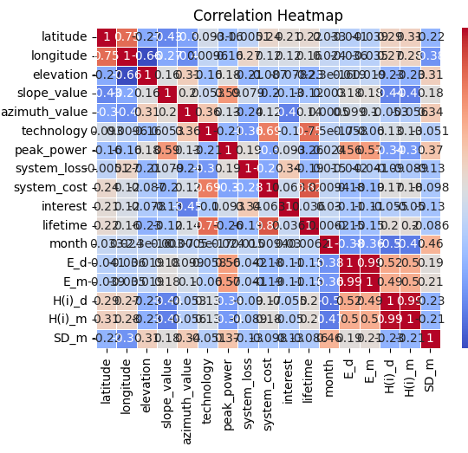
Graphical Analysis - Correlation
The heat map is shows that there exists a weak relationship between longitude and energy output and irradiation which are the points of our interest.

Slide 9
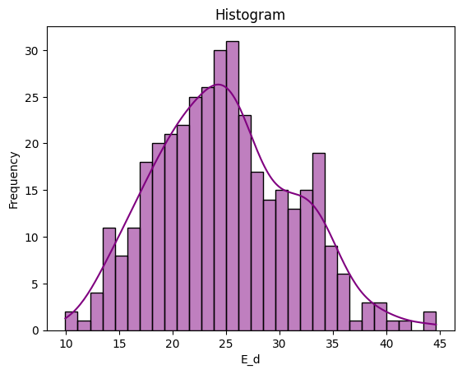
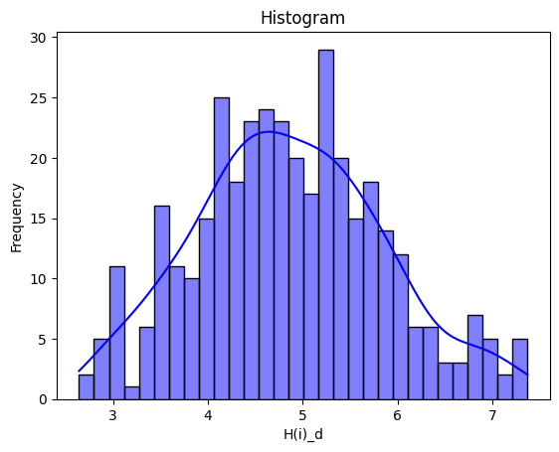
Graphical Analysis

Slide 10
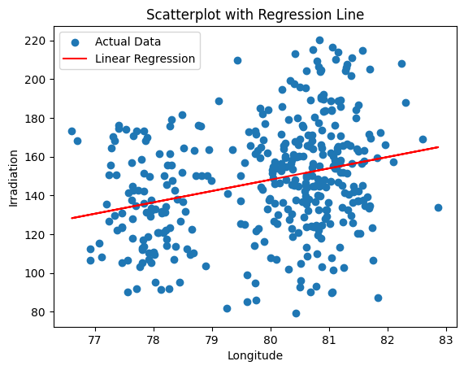
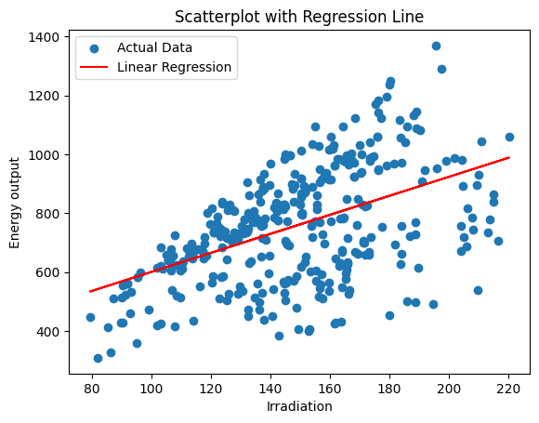
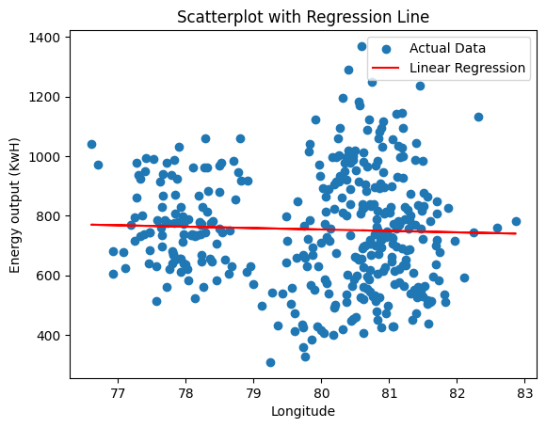
Regression Analysis
We perform regression between longitude and irradiation and energy output. This helps us find any linear relationship if they are present.

Slide 11
Regression Analysis
While it is noticed that we can fit a regression line to the above features, we must note that the relationship between those variables is not linear in nature. However there is a positive correlation between longitude and irradiation. There also exists a seemingly negative correlation between the longitude and Energy output, however the scatterplot and box plots show positive correlation that may not be linear

Slide 12
Hypothesis Testing.
### Hypothesis 1 : Coastal regions have worse solar output than interior regions
To frame the above hypothesis, we can assume a sample of data that corresponds to locations that are closer to the coastal regions, and compute the mean of the monthly energy output of those regions. If this mean is lower than the population mean, then the hypothesis is rejected.
H0 : sample mean = population mean
H1 : sample mean < population mean
in order to decide the above, we have to classify the sample population. Thus we take a sample population of all the data points that are at a longitude greater than 80.1 degrees. Using that as the sample and the whole as the complete population, we can move forward with testing the hypothesis.

Slide 13
Conclusion 1
Sample Mean: 707.6472916666667
Z-Score: -1.774500843473621
Critical Z-Value: -1.6448536269514729
Reject Null Hypothesis. Sample mean < population mean
Our null hypothesis states that the population mean and the sample mean are the same. Since it is rejected, we can state that coastal regions have lower energy outputs at a 95% confidence level

Slide 14
Hypothesis Testing.
### Hypothesis 2 : Higher irradiation leads to higher energy output
As with the previous testing we shall perform a similar test to note if as we have higher irradiation values, the energy output improves.
H0 : Population mean = sample mean
H1 : sample mean > population mean
Just as before we find the data points that have a irradiation greater than a certain value and test the energy sample for that.

Slide 15
Conclusion 2
Sample Mean: 28.7894
Z-Score: 3.892374559786816
Critical Z-Value: 1.6448536269514722
Reject Null hypothesis. sample mean > population mean
As our null hypothesis state that population mean = sample mean, we reject that. We accept that the population mean is lesser than the sample mean.

Slide 16
Hypothesis testing
Hypothesis 3 : F test for checking variance as per energy and irradiation for coastal regions
Clearly, since there is not any change in the variance of the energy output of irradiation of with respect to longitude. We can conclude that all the samples takes are from the same population. Thus the differing of the means is of higher significance since they do so with the same variance.

Slide 17
Hypothesis testing
Hypothesis 4 : ANOVA For technology Vs Energy Output
Test Statistic (F-statistic): 13.273168281178283
P-Value: 2.713003954548856e-06
Reject the null hypothesis: Means are not equal across categories.
As per the conclusion, the performance of different PV technology is different.

Slide 18
Hypothesis testing
Hypothesis 5 : Crystalline Silicon is preferred for higher energy output.
While framing this hypothesis it is important we take into consideration that it has already been proven that the different PV technologies show different behaviours in terms of energy. This further test is to show that for efficient energy use, Crystalline Silicon is preferred.
H0 : The means of crystalline silicon is the same as the general population
H1 : The mean of crystalline silicon is greater than the general population
This call for a one tailed z-test.

Slide 19
Conclusion 3
Sample Mean: E_m 773.076526
Z-Score: 36.79990620248375
Critical Z-Value: 1.6448536269514722
Reject the null hypothesis.
Thus since we are rejecting the null hypothesis, we can say that Crystalline Silicon has a higher energy output.

Slide 20
Final Conclusions
From the above hypothesis testing, we draw the following conclusions
Coastal regions have worse energy output
Irradiation improves energy output
There is a distinct change in mean performance in coastal and interior regions, without affecting their variance
PV technology influences the Energy output
Crystalline Silicon has the best energy output.

Slide 21
Final Conclusions
These conclusions are helpful for predictive maintenance as, Crystalline Silicon has an average lifetime of about 23-25 years, and CdTe of about 10-15 years.
For regions based in the coast, the average irradiation and energy output are not as high as those in interior regions. This goes to show that weather is a major player in energy output of solar panels.
Thus, geographically speaking, it is advised for interior regions of tamil nadu to opt for Crystalline silicon or CIS technology for their solar panels, whereas coastal regions should prefer the CdTe technology which more cost efficient in cases of frequent replacements.
However, as the regression models showed, the data is not conducive for a linear model to fit the data properly.
Possibly a logistic regression model mapping the latitude to the technology may be optimal.

Slide 22
References
Webscraping link - https://re.jrc.ec.europa.eu/pvg_tools/en/
https://www.codecademy.com/article/caupolicandiaz/web-scrape-with-selenium-and-beautiful-soup
https://leanpub.com/LittleInferenceBook/read
]

