Slide 1
TECHNICAL PROJECT SHOWCASE
3D Text Counter & Deep Text Analytics
A Local-First, High-Performance Linguistic Intelligence Dashboard
Featuring Real-Time Extruded 3D Typography & Longitudinal Rhythms
Author: Prince Patel | GitHub: @prinspatel8055 | Tech: Python, FastAPI, SQLite, Three.js | MIT License

Slide 2
PROBLEM CONTEXT
The Problem: Why Traditional Online Counters Fail
1. Privacy Exposure
• Online counters upload text to external servers.
• Confidential drafts, code snippets, and private thoughts are exposed to ad trackers.
• Zero privacy guarantees or data sovereignty.
2. Superficial Metrics
• Most web tools only count characters and words.
• No syllable counting or lexical diversity (TTR).
• No Flesch readability grade classification.
• No reading or speaking duration estimation.
3. Zero Memory & Flat UX
• Session data disappears completely on page reload.
• No historical archive or habit tracking.
• Cannot measure daily writing velocity or circadian peak hours.
• Static, dull interfaces with zero kinetic feedback.

Slide 3
CORE VALUE PROPOSITION
The Solution: Local-First Text Intelligence with 3D Visuals
🔒 100% Local-First Privacy
• Runs entirely on localhost (127.0.0.1).
• Zero external API dependencies, telemetry, or analytics tracking.
• Embedded SQLite storage stays strictly on the author's device.
🔤 Real Extruded 3D Typography
• Dynamic WebGL stage powered by Three.js.
• Every typed letter generates extruded, bevelled 3D polygon geometry.
• Dynamic character mesh diffing with smooth kinetic animations.
📊 20+ Deep Linguistic Metrics
• Raw counts (characters, words, sentences, syllables).
• Character composition breakdown (letters, digits, emojis, vowels).
• Flesch Reading Ease algorithm & complexity classification band.
📈 Longitudinal Habit Analytics
• Day-wise velocity tracking over 7, 30, or 90 days.
• 24-Hour circadian rhythm heatmap for any chosen calendar date.
• Multi-criteria search, sorting, and CSV/JSON data exports.

Slide 4
ENGINEERING DESIGN
System Architecture: Decoupled 3-Tier Design
1. Presentation Tier
• templates/index.html
• Three.js WebGL Stage
• Vanilla JS Engine
• CSS3 Grid Layout
• Real-time keystroke listener
• Dynamic lighting & materials
• Zero front-end frameworks needed
2. API Controller Tier
• app.py
• FastAPI + Uvicorn
• Pydantic Validation
• Dynamic port auto-selection
• Auto-browser launcher
• CSV/JSON streaming exports
• Interactive /docs Swagger
3. Analytics Engine
• analytics.py
• Pure functional Python
• Zero database dependencies
• Tokenization regex
• Syllable acoustic heuristic
• Flesch readability score
• Stop-word elimination
4. Persistence Tier
• database.py
• SQLite3 with WAL mode
• Auto-migrating schema
• Window aggregation queries
• Temporal zero-filling
• ACID transaction safety
• Local counter.db file

Slide 5
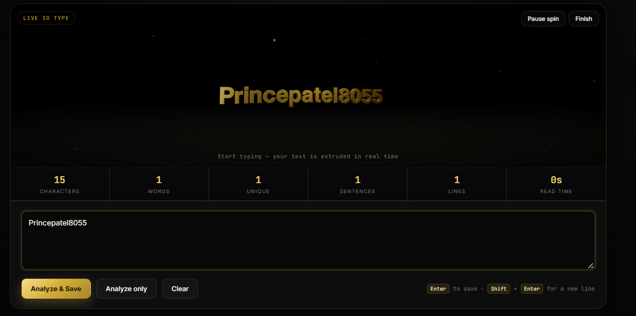
VISUAL INNOVATION
Real-Time 3D Typography: WebGL Mesh Generation
Technical Highlights
• True Geometry: Loaded from JSON typeface glyphs with bevels & extrusion depth.
• Incremental Diffing: Only adds/removes meshes that changed, preserving kinetic fluidity.
• Physically Based Shading: Key, rim, and ambient lights bounce off metallic shaders.
• 4 Material Finishes: Polished Gold, Brushed Brass, Champagne, Antique Bronze.
• Graceful Fallback: Seamlessly falls back to polygonal slabs if WebGL is unavailable.

Slide 6
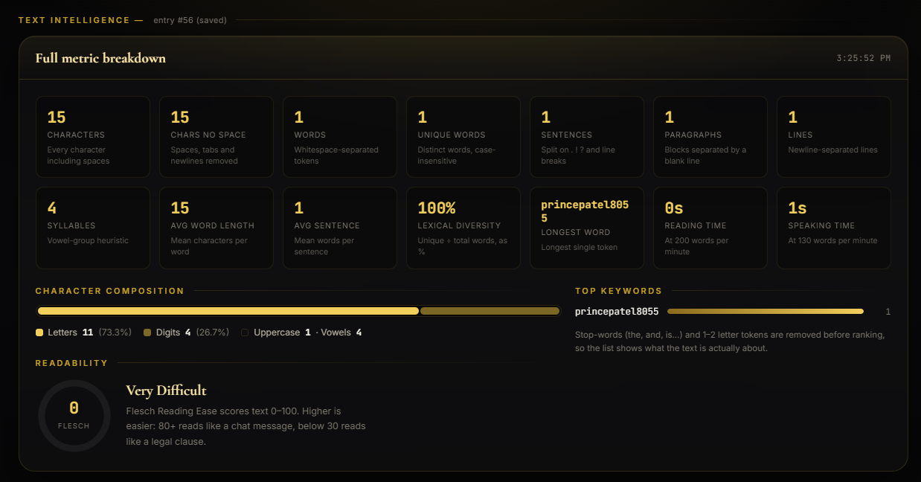
COMPUTATIONAL LINGUISTICS
Linguistic Intelligence & Readability Formulas
Algorithmic Blueprint
• Flesch Reading Ease:
206.835 - 1.015(words/sent) - 84.6(syllables/word)
• Complexity Bands:
Very Easy (90+) to Very Difficult (<30)
• Acoustic Syllables:
Consecutive vowel clustering + suffix rules
• Lexical Diversity:
Type-Token Ratio (TTR %)
• Reading/Speaking Time:
Calibrated at 200 WPM / 130 WPM
• Keyword Extraction:
130-word English stoplist removal

Slide 7
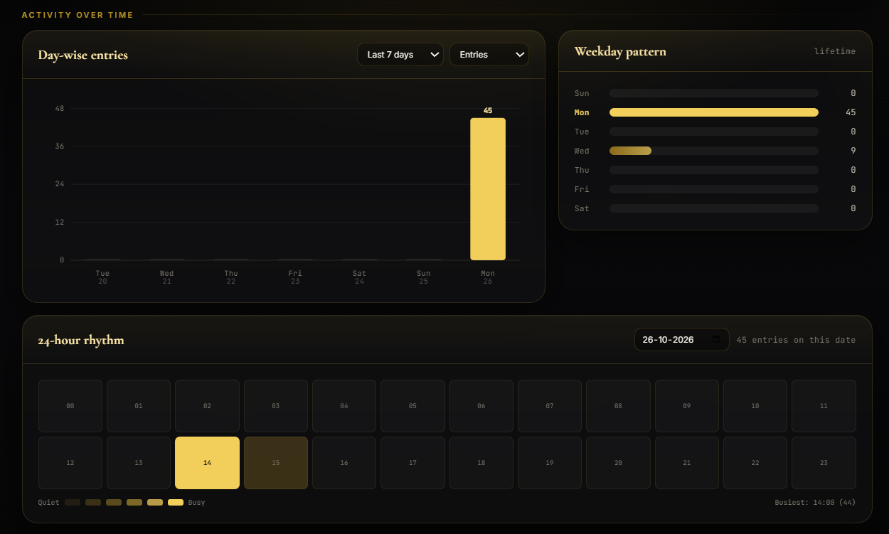
TEMPORAL BEHAVIOR
Longitudinal Writing Analytics & Rhythms
Longitudinal Features
• Day-Wise Velocity: Visualizes writing output over 7, 30, or 90 days with zero-fill accuracy.
• 24-Hour Rhythm Heatmap: Pinpoints exact hours of peak productivity for any selected date.
• Weekday Pattern: Identifies creative momentum across days of the week.
• Top Keywords: Tracks cumulative vocabulary trends across all historical submissions.
• High Performance: Pure SQL aggregations executed locally in <5 milliseconds.

Slide 8
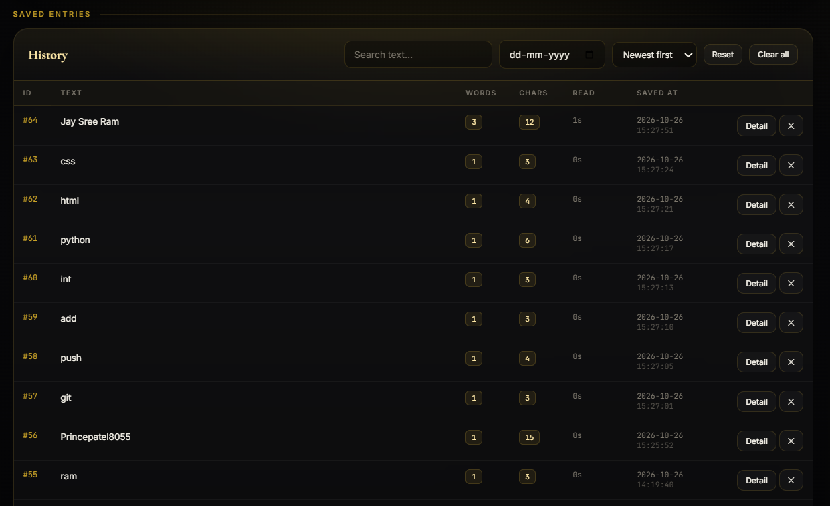
DATA MANAGEMENT
Searchable History & Data Ownership
Data Sovereignty
• Full-Text Search: Query across all saved entries in real time.
• Multi-Criteria Sort: Sort by newest, oldest, longest text, or word count.
• Date Filtering: Isolate entries written on specific dates.
• CSV & JSON Export: One-click download of all data for external data science workflows.
• Self-Migrating DB: Schema upgrades automatically without data loss.

Slide 9
RUNNING THE PROJECT
Installation, Portability & One-Click Launch
🪟 Windows Execution
• Simply double-click run.bat
• Auto-detects Python 3.10+
• Initializes virtual environment
• Installs requirements.txt
• Launches Uvicorn server
• Opens default browser automatically
🍎 macOS / 🐧 Linux
• Run ./run.sh
• Configures environment permissions
• Activates isolated .venv
• Resolves open local port
• Starts FastAPI backend
• Zero external configuration required
⌨️ Ergonomics & APIs
• Enter: Instantly analyzes and saves text.
• Shift + Enter: Inserts multiline newline.
• REST Endpoints: Full programmatic access via /api/texts and /api/stats.
• Interactive Swagger: Live API testing available at /docs.

Slide 10
CONCLUSION
Roadmap, Open Source Community & GitHub Star
🚀 Future Engineering Roadmap
• v1.1: Multilingual linguistic support & language detection models.
• v1.2: Native Dark/Light theme switching & customizable stage lighting controls.
• v1.3: Comprehensive automated unit test suite with 100% branch coverage.
• v2.0: Optional multi-user authentication for shared classroom/team environments.
⭐ Star the Project on GitHub!
• GitHub Repository: https://github.com/prinspatel8055/python-text-counter
• Author: Prince Patel (@prinspatel8055)
• License: MIT Open Source License
• Why Star? Every star increases project visibility in the open-source ecosystem!
• Contributions: Pull requests and feature suggestions are warmly welcomed.

