Slide 1
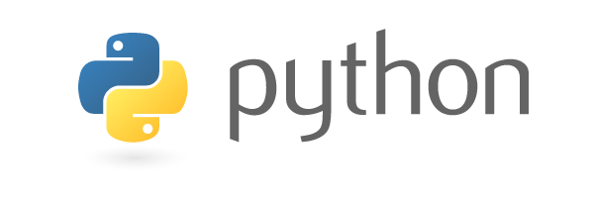

INTRODUCTION TO python

Slide 2
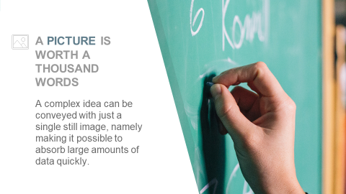
The Index
What’s python
Roots of python
Aims of python
Python’s impressions
Compiling and interpreting
Why we go for python

Slide 3
1.
WHAT IS PYTHON

Slide 4
Python is a general-purpose interpreted, interactive, high level, object-oriented scripting language.

Slide 5
Python laid its foundation in the late 1980s.
Created by Guido van Rossum and first released in 1991.

Slide 6
Fully dynamic type system and automatic memory management.
Python is designed to be highly readable. It uses English keywords frequently.
Open Source : Support all OS like (Windows, Linux, Mac,.)
It can be used as a scripting language or can be compiled to byte-code for building large applications.

Slide 7
2.
Roots of python

Slide 8
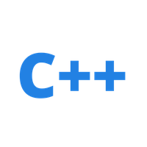

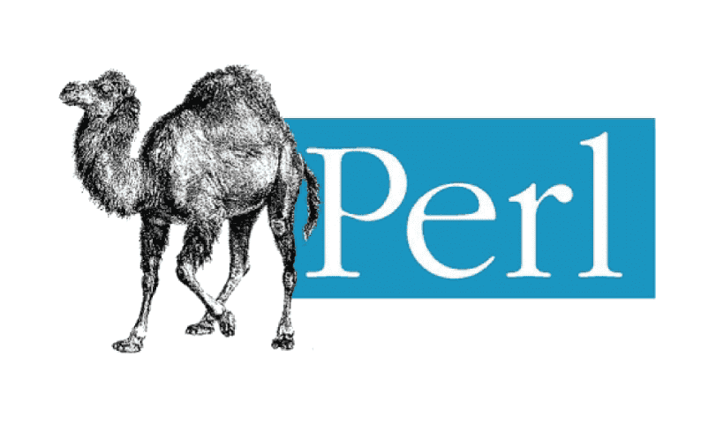
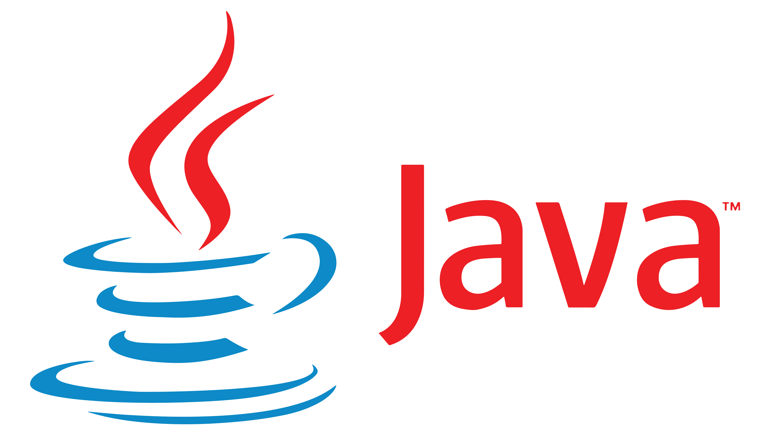
Roots of python
Simplicity
Lambda and Math
Interpreter Lang
Object Oriented

Slide 9
3.
Aims of python

Slide 10
AIMS OF PYTHON
Minimal code
Easy to learn
Clarity & Consistency

Slide 11
4.
Python’s impressions

Slide 12
Automatic Type Inference
No Worry about Memory Allocation
Minimal and Clear Syntax
Full Support OO
Interface with Existing Lang
a=10
No New and Delete
No need {} for Block of Code
Multiple Inheritance
C++ ,java

Slide 13
5.
Compiling and interpreting

Slide 14


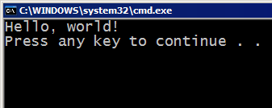
Compiling Most of the languages require you to compile (translate) your program into a form that the machine understands
Source code
Compile
Byte code
Execute
Output

Slide 15
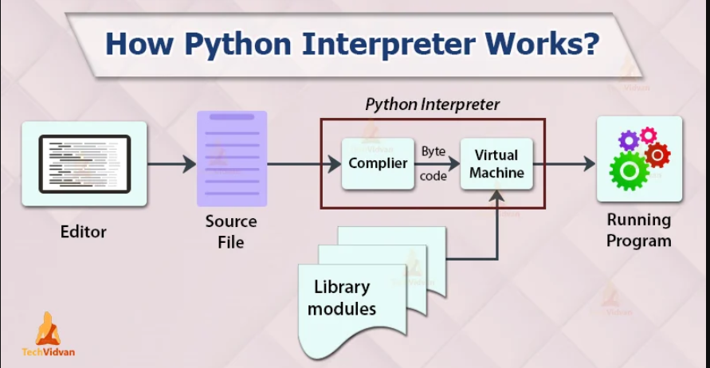

Slide 16

Interpreting Python instead directly interpreted into machine instructions.
Source code
Interpret
Output

Slide 17

6. Why we go for python

Slide 18
Python, as a high level programming language, allows you to focus on core functionality of the application by taking care of common programming tasks.

