Slide 1
卸土車運輸物品探測
Lee Ka Ho
Wong Lai Kei
Lai Tsz Fung

Slide 2
Agenda
Send Alert message
01
Function update
02
template(video) / template(image)
Send alert message(email) to stakeholder/safety officer
Further Planning
03
04
Requirements
project future planning
some required of the project

Slide 3
Function update
01

Slide 4
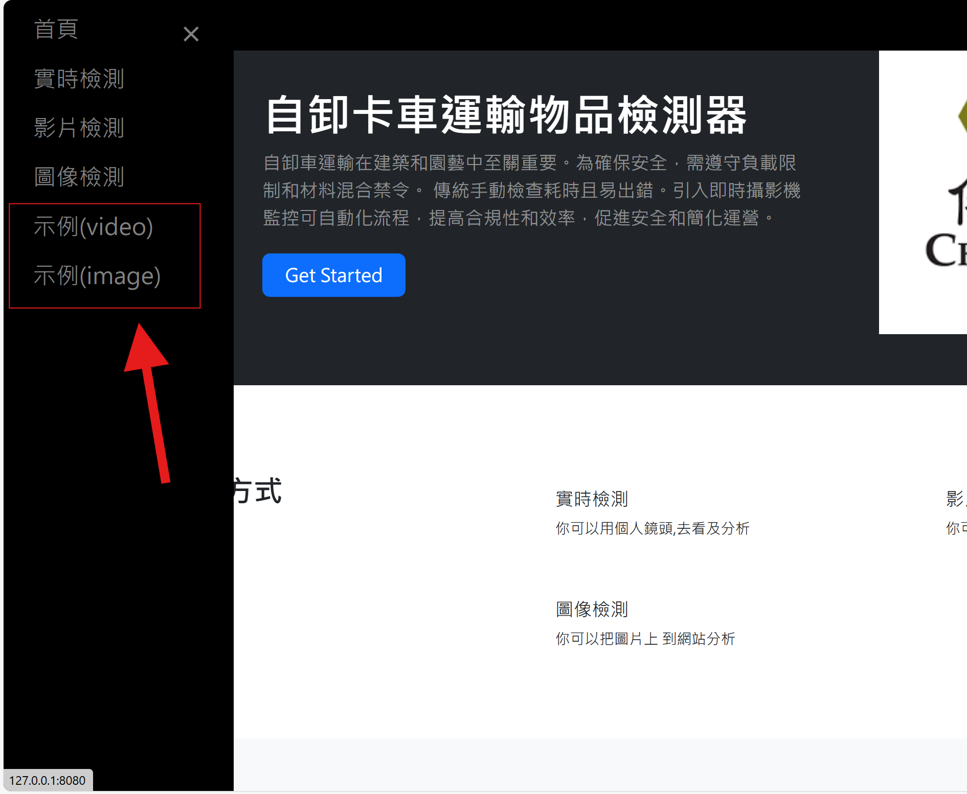
Object Detection Templates
Two template:
Video
Image
Users view detection results

Slide 5
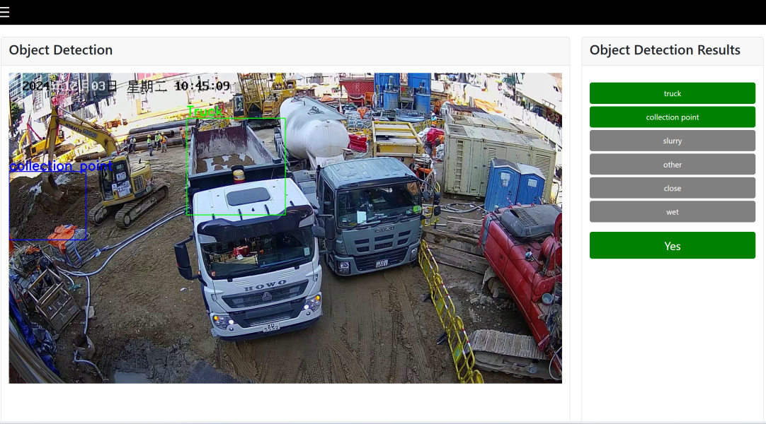
Video Detection Templates
This page will randomly detect video as an example
Total Examples Analyzed: 8

Slide 6
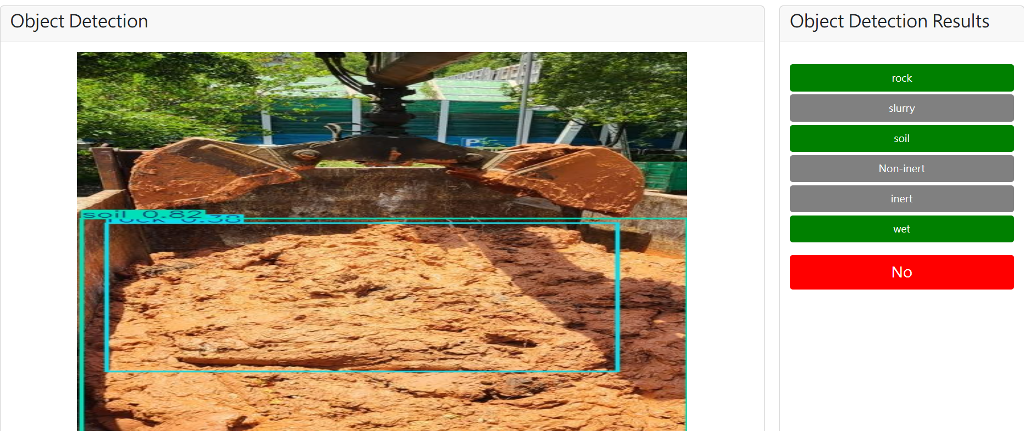
Image Detection Templates
This page will randomly detect images as an example
Total Examples Analyzed: 37
Examples for "Yes": 20
Examples for "No": 17

Slide 7
Send Alert message
02

Slide 8
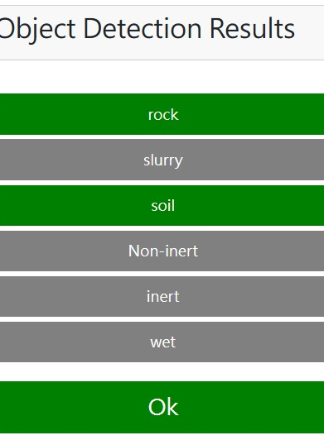
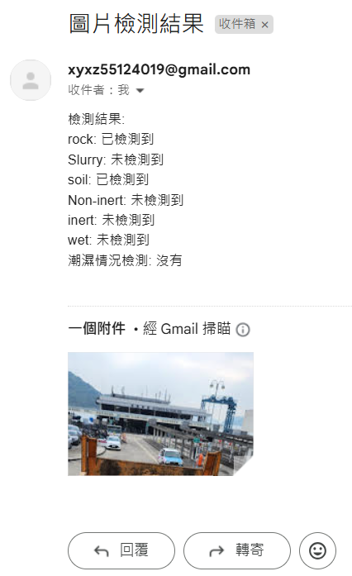
Object Detection Templates
Automated Notifications: When specific items or conditions are detected, the system automatically generates and sends an email to a designated recipient, providing immediate detection results.
Result Reporting: The email content includes the status of detected items and whether there is any wet condition, helping users quickly understand the situation.
Image Attachments: If relevant detection images are available, they can be sent as attachments with the email, enhancing the clarity of the information.
User Feedback: After sending the email, the system displays a success message, improving user experience.

Slide 9
Further Planning
03

Slide 10
Plan
Function update:
Add specified conditions for sending alert messages(Image Detection)
Add Send Alert message function In Video & Live Detection
Update detect model

Slide 11
Requirements
04

Slide 12
Requirements

Slide 13
Our require
We need better live camera angles.
The driver should try to stop under the camera
We need more inert and non-inert data source:
video
image
For inspection, the truck body needs to be opened.

Slide 14

Thanks!
Does anyone have any questions?

