Slide 1
卸土車運輸物品探測
Lee Ka Ho
Wong Lai Kei
Lai Tsz Fung

Slide 2
Agenda
Send Alert message
01
Function update
02
template(video) / template(image)
Send alert message(email) to stakeholder/safety officer
Further Planning
03
04
Requirements
project future planning
some required of the project

Slide 3
Function update
01

Slide 4
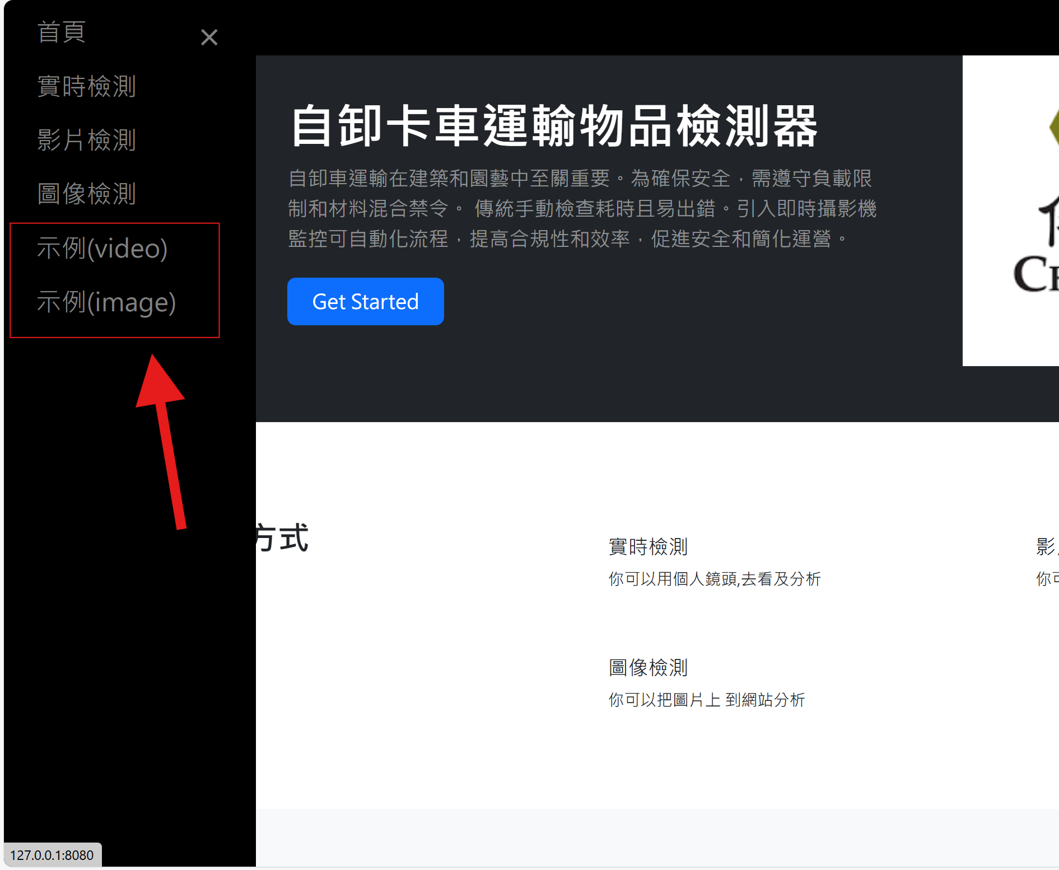
Object Detection Templates
Two template:
Video
Image
Users view detection results

Slide 5
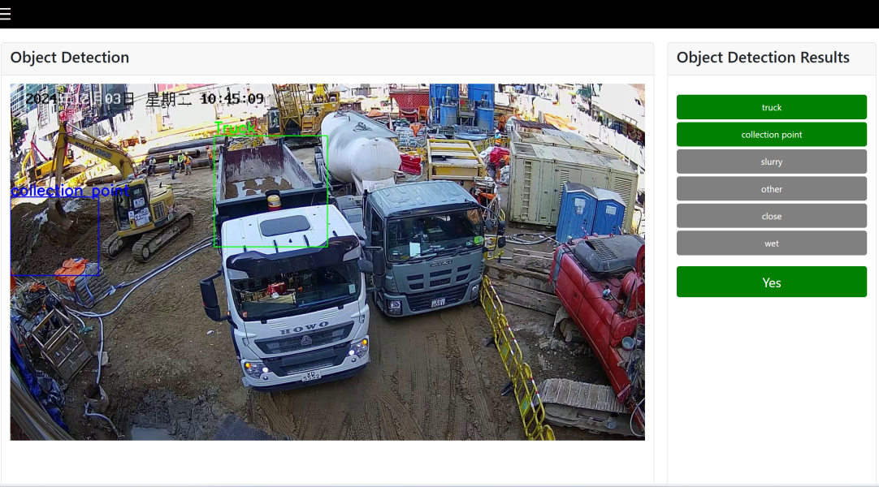
Video Detection Templates
This page will randomly detect video as an example
Total Examples Analyzed: 8

Slide 6
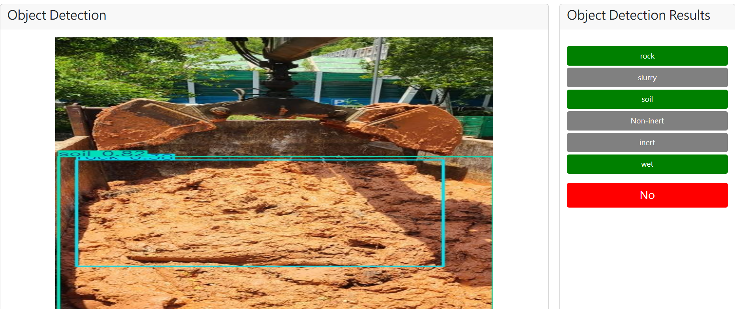
Image Detection Templates
This page will randomly detect images as an example
Total Examples Analyzed: 37
Examples for "Yes": 20
Examples for "No": 17

Slide 7
Send Alert message
02

Slide 8
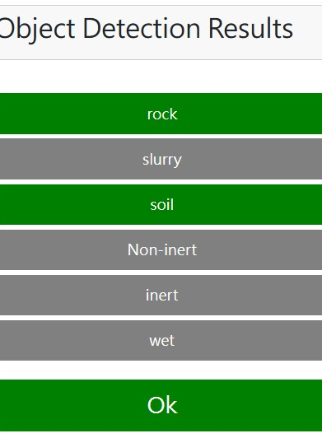
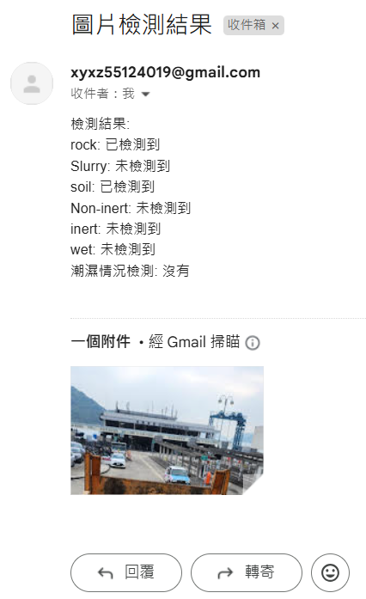
Object Detection Templates
Automated Notifications: When specific items or conditions are detected, the system automatically generates and sends an email to a designated recipient, providing immediate detection results.
Result Reporting: The email content includes the status of detected items and whether there is any wet condition, helping users quickly understand the situation.
Image Attachments: If relevant detection images are available, they can be sent as attachments with the email, enhancing the clarity of the information.
User Feedback: After sending the email, the system displays a success message, improving user experience.

Slide 9
Further Planning
03

Slide 10
Plan
Function update:
Add specified conditions for sending alert messages(Image Detection)
Add Send Alert message function In Video & Live Detection
Update detect model

Slide 11
Requirements
04

Slide 12
Requirements

Slide 13
Our require
We need better live camera angles.
We need more inert and non-inert data source:
image
Video

Slide 14

Thanks!
Does anyone have any questions?

