Slide 1
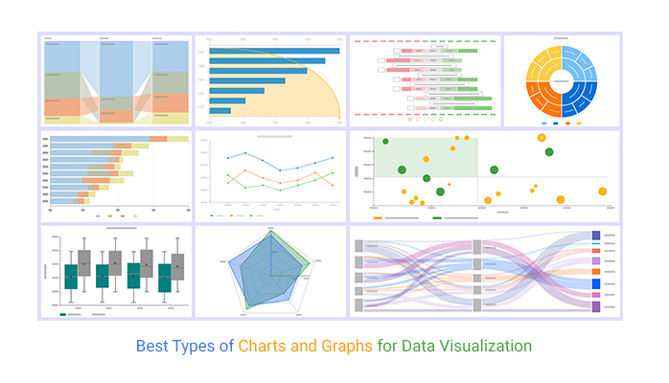
Module 3
Data Organization and Presentation
through Graphs and Charts

Slide 2
What are different types of graphs which can be used to describe data?
Bar Graph – used for categorical; nominal or ordinal data
Histograms – used for continuous numerical data
Line Chart – used for discrete or continuous numerical data.
Pie Chart – used for percentage data

Slide 3
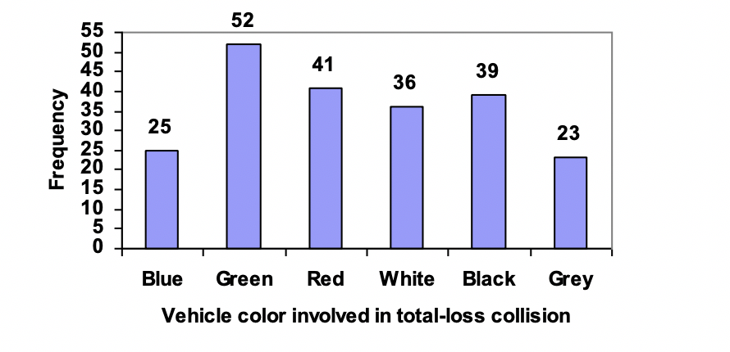
Bar Graph
– used for nominal data such as color

Slide 4
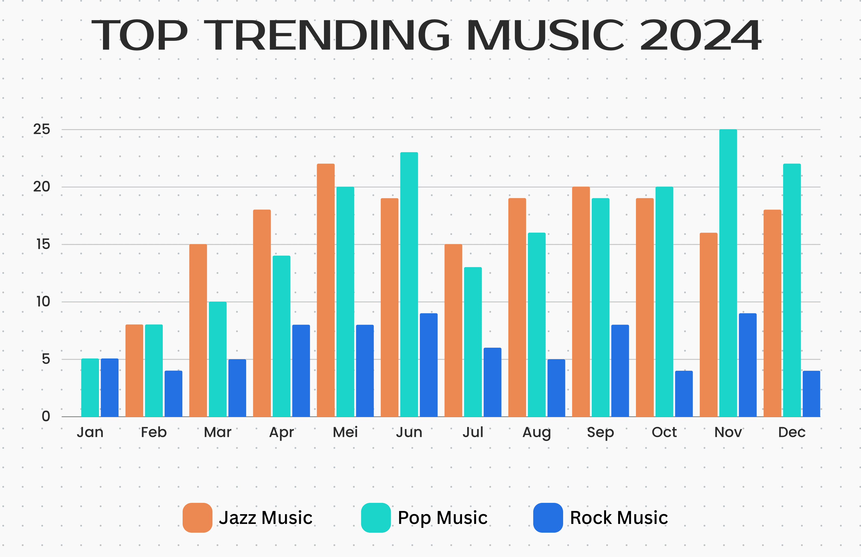
Bar Graph
– used for nominal data such music genre

Slide 5
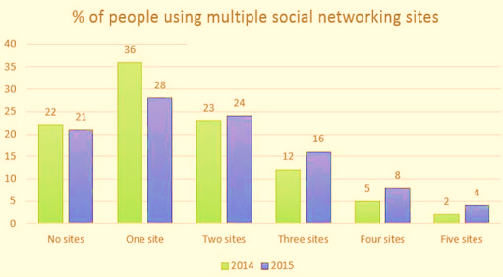
Bar Graph
– used for categorical data such as count

Slide 6
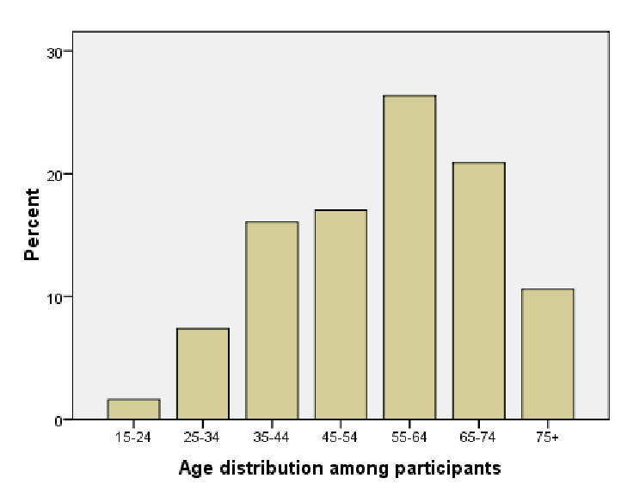
Bar Graph
– used for categorical data such as age bracket

Slide 7
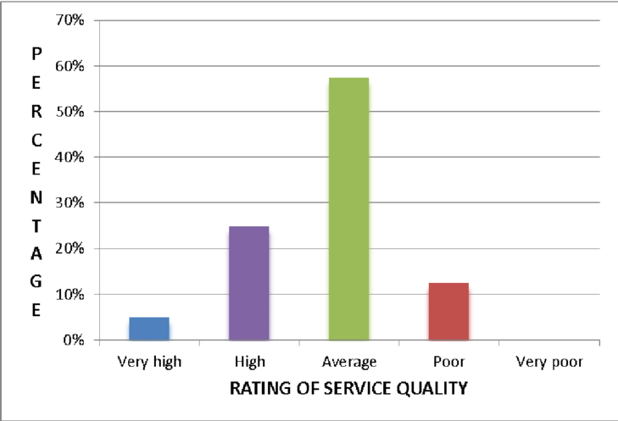
Bar Graph
– used for ordinal data such a Likert scale

Slide 8
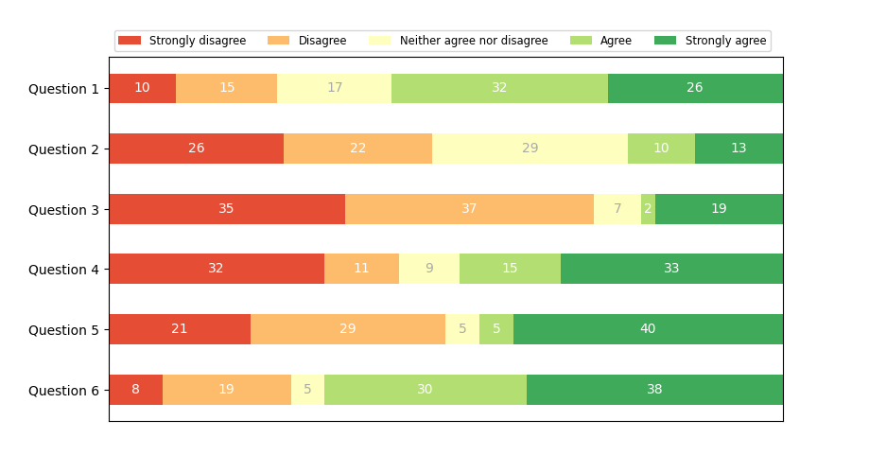
Bar Graph
– used for ordinal data such a Likert scale

Slide 9
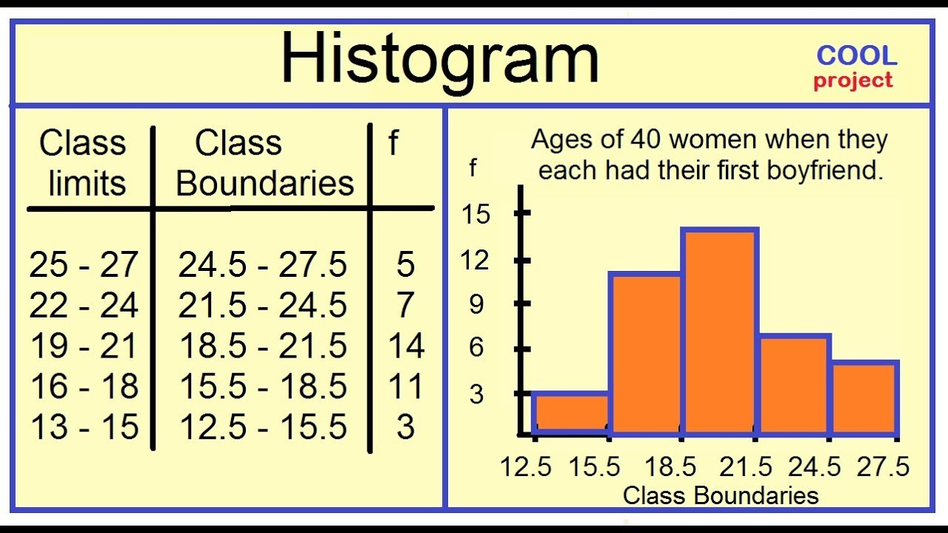
Histogram
– used for continuous data such as age

Slide 10
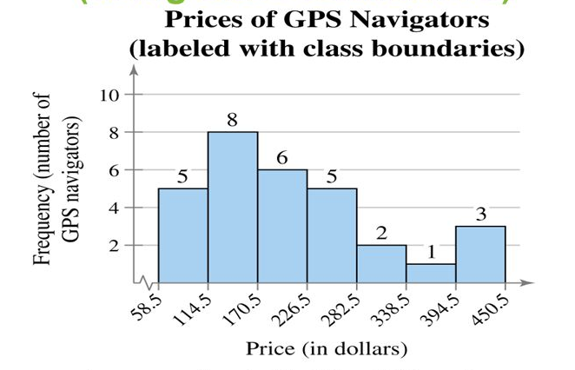
Histogram
– used for continuous data such as price

Slide 11
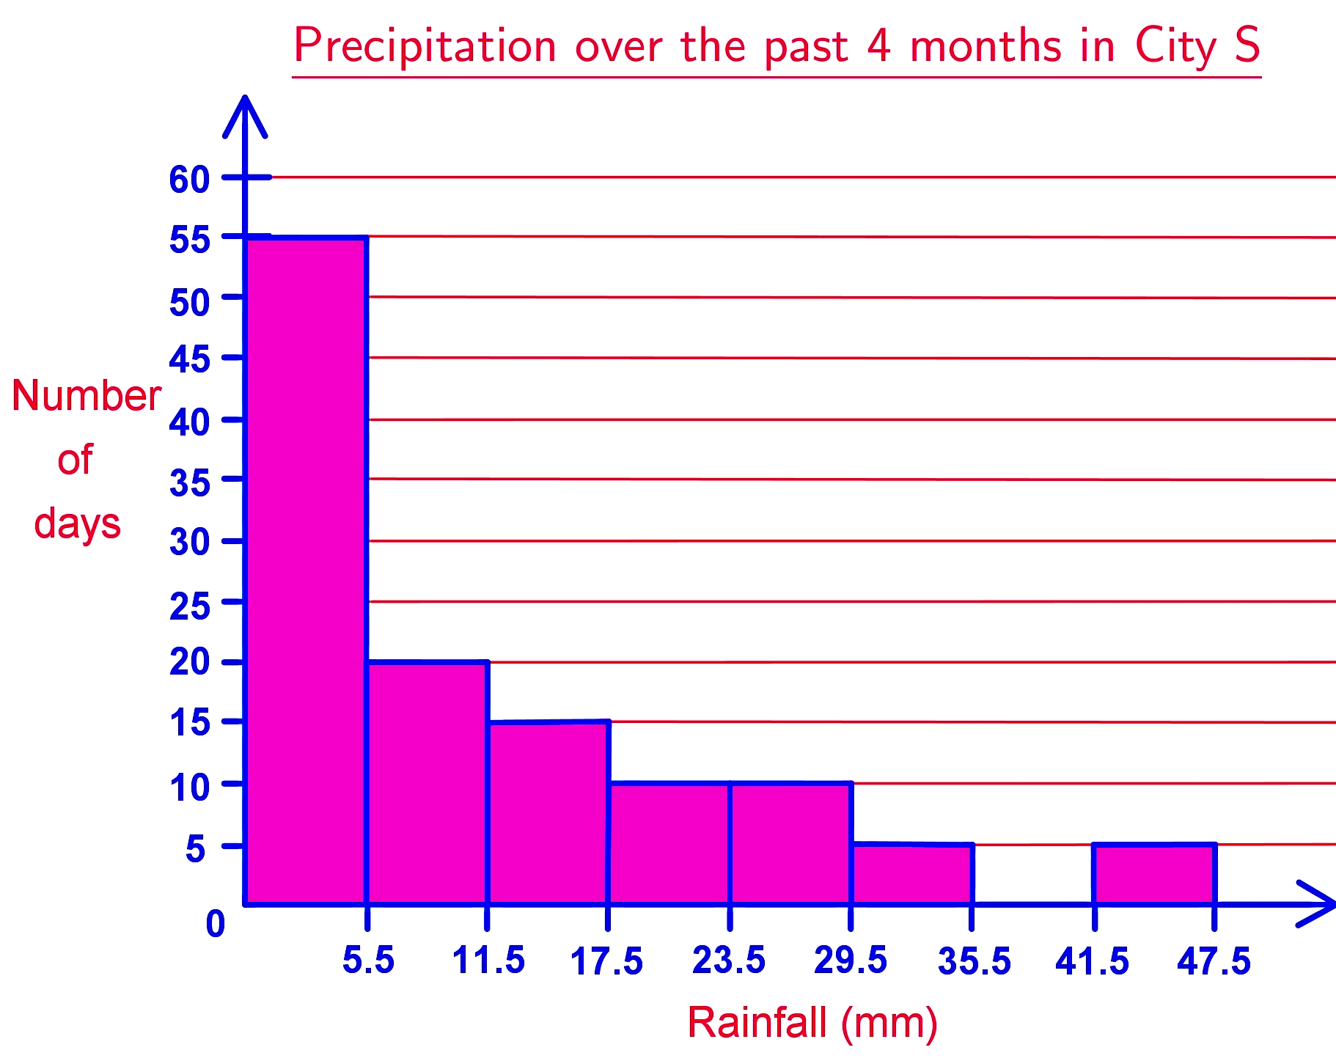
Histogram
– used for continuous data such as measurement

Slide 12
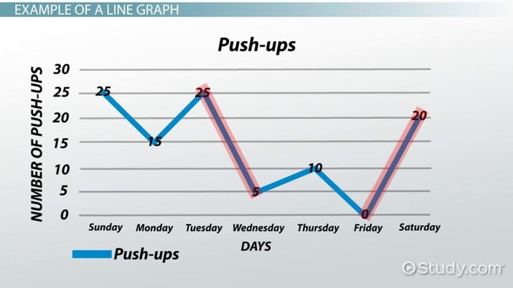
Line Chart
– used for discrete data such as number of times

Slide 13
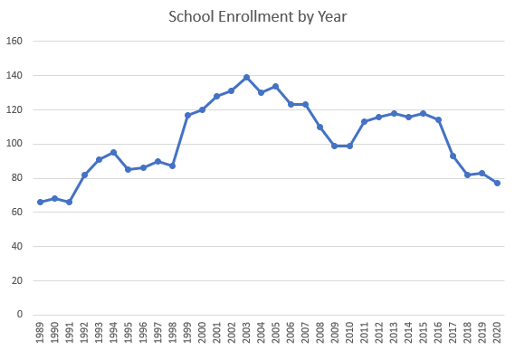
Line Chart
– used for discrete data such as enrollment

Slide 14

Line Chart
– used for comparing discrete data.

Slide 15
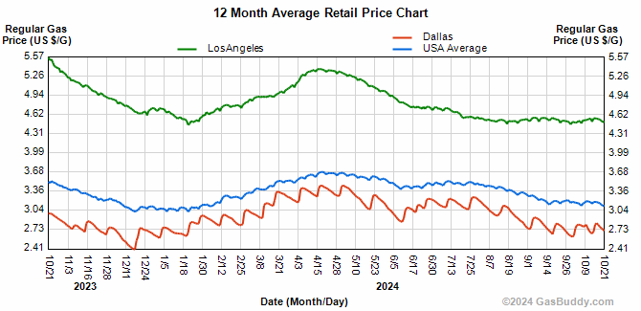
Line Chart
– used for comparing continuous data.

Slide 16
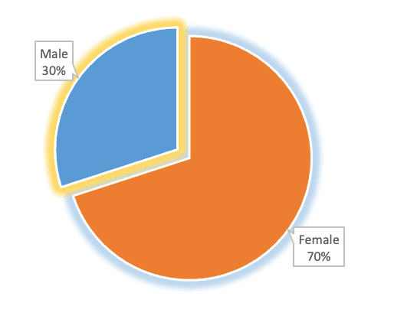
Pie Chart
– used for percentage data such as sex

Slide 17
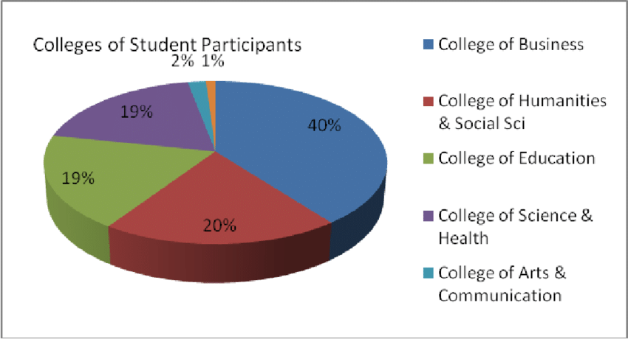
Pie Chart
– for percentage data of college participants

Slide 18
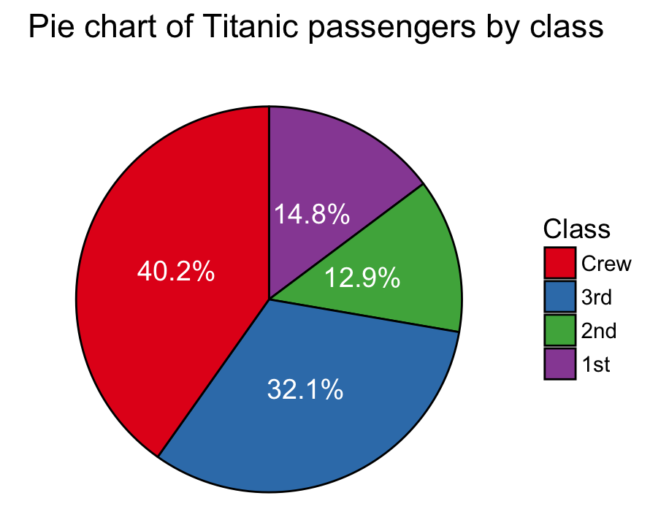
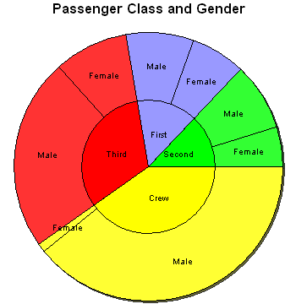
Pie Chart
– used for percentage data such as class/type

Slide 19
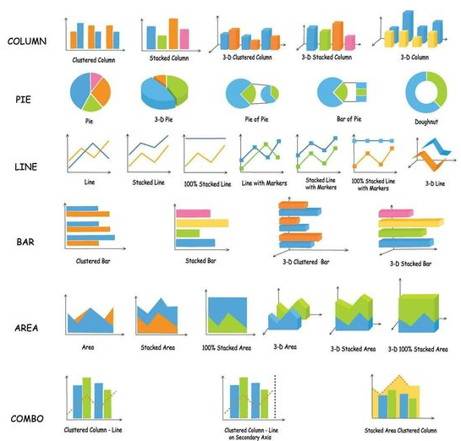

Slide 20
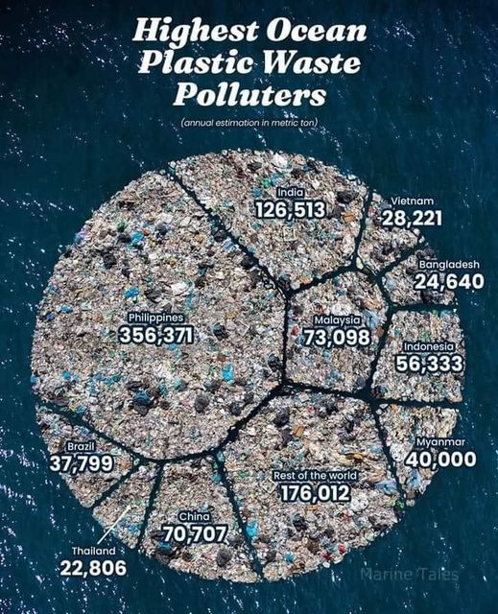

Slide 21
Generating Graphs and Charts Using Excel
Based on the raw data you had entered in a column, construct the frequency distribution table for which you wish to create a graph or chart.
Highlight the cells containing the data you want to be shown in your graph. Include the data labels.
Click on Insert tab and click the chart type button in the Charts group. A list of sub-types would appear (bar, pie, line,...).
Click the desired chart type. Excel creates the chart and the Chart Tools Context tabs would appear (Layout Options, Chart Elements, Chart Styles, and Chart Filters). You can use these context tabs to customize your chart.
To export your chart onto a Word doc, Click on the chart, click copy, and then paste onto the Word doc.

Slide 22
Once in Word, you can still edit your chart.
  Click on the chart (outer) and the Chart Tools Context tabs will appear at the right side.
  Click on the chart area (inner), you can also resize or reposition your chart.
  Right click on the chart area and the Format Plot Area will appear in the pull-down through which you can change the fill and border.
  Right click on an element in the chart and the Format Data Labels and Format Data Series will appear in the pull down through which you can edit the labels, fills, borders, rotation, effects, and series options where you can resize the gap width.
  Double clicking on the labels will allow you to change their font style, font size, and color.

