Slide 1
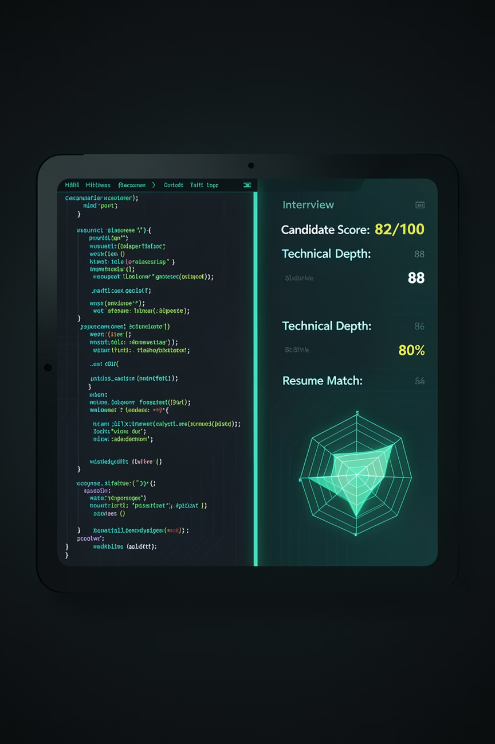
HACKATHON SUBMISSION · V1.0
THEME: PRODUCTIVITY PLATFORMS
CATEGORY: AI AGENT — INTERVIEW INTELLIGENCE
GhostCue
Your unfair advantage in every hire.
A multi-interface AI agent — run it in your terminal or talk to it via Telegram, WhatsApp, and more. █

Slide 2
Interviews Are Broken
Unprepared Interviewers
Uneven Topic Coverage
Dropped Follow-ups
0–10 minutes reviewing resumes. Generic questions. Skill mismatches undetected.
35+ minutes on one topic. System design and behavioral signals never touched.
Shallow answers accepted. Nobody probes scope, impact, or failures.
Biased Post-call Notes
Undetected Contradictions
Reports written from memory 10–30 minutes after. Two interviewers, two different assessments.
Candidates contradict themselves mid-session. Nobody tracks the full thread in real time.
Every one of these problems costs companies bad hires. GhostCue solves all five.

Slide 3



GhostCue — Your Silent AI Interview Agent
One agent. Three phases. Every interface.
BEFORE — Prepare in Seconds
DURING — Silent Real-Time Coach
AFTER — Report, Score, Decide
Upload CV via Terminal, Telegram, or WhatsApp. GhostCue parses skills, experience, and tech stack — then generates custom questions and a competency checklist in under 30 seconds.
Listens via system audio capture. Whisper transcribes with diarization. OpenClaw Agent processes against Cognitive RAM. Live nudges — "Ask about scope" or "Contradiction detected" — arrive silently on your device.
HEARTBEAT.md triggers post-session pipeline. Structured report + Candidate Integrity Score (0–100) with Radar Chart in under 2 minutes. Human review gate required. Export as PDF or Markdown.

Slide 4
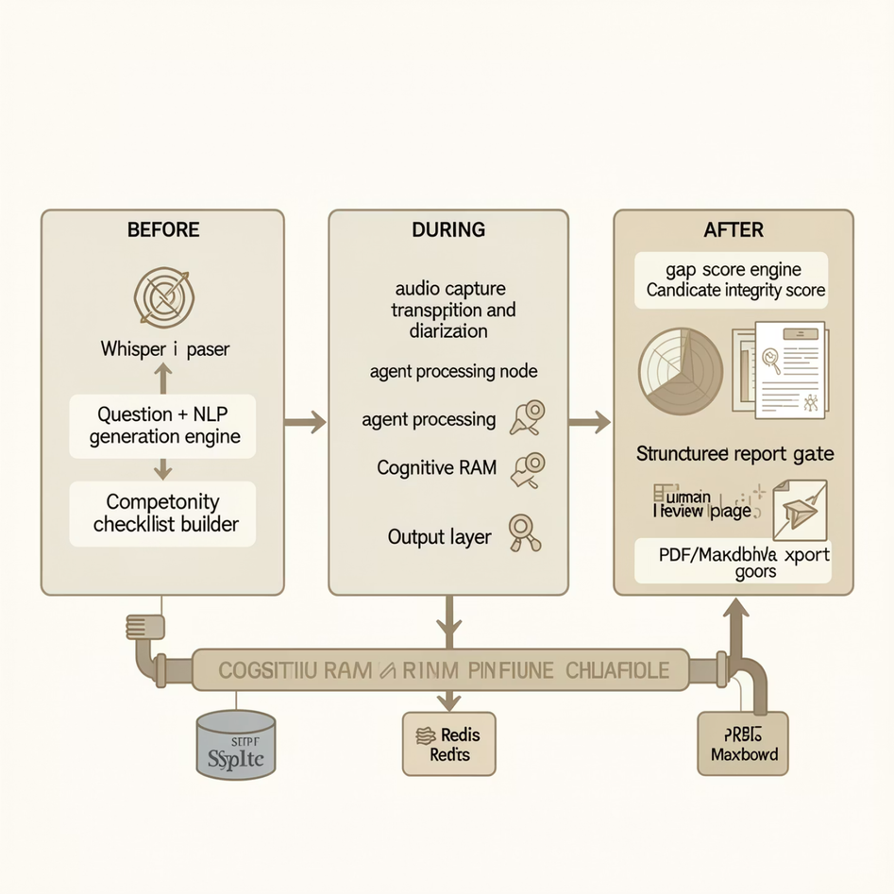

Under the Hood — GhostCue's Architecture
Cognitive RAM — The Persistent Memory Layer
SQLite and Redis power a stateful memory layer that persists the full candidate profile, live transcript, and cross-session history across all three phases — enabling real-time contradiction detection, competency tracking, and post-session scoring.
SOUL.md defines the agent's coaching persona and behavioral rules. HEARTBEAT.md triggers pre/post session lifecycle hooks automatically.

Slide 5
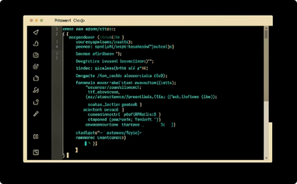
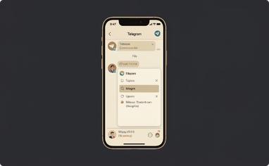
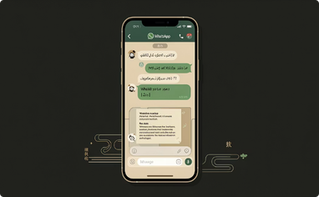
One Agent, Every Interface
Same backend. Same intelligence. Your choice of how to talk to it.
💻 Terminal Interface
📱 Telegram Bot Interface
💬 WhatsApp Bot Interface
ghostcue start in any CLI. Upload CV, stream live nudges, run ghostcue compare. Reports saved as PDF + Markdown locally.
Send CV as file to GhostCue bot. Instant questions, real-time nudges, and full structured PDF report delivered post-interview.
Send CV via WhatsApp Business. Questions, nudges, and full PDF report in chat. Powered by Twilio WhatsApp API.
NON-TECHNICAL RECRUITERS · CAMPUS HIRING · MOBILE-FIRST
DEVELOPERS · TECH INTERVIEWERS · POWER USERS
HR TEAMS · RECRUITERS · HIRING MANAGERS
All three interfaces are powered by the exact same OpenClaw + Whisper + Cognitive RAM backend.

Slide 6
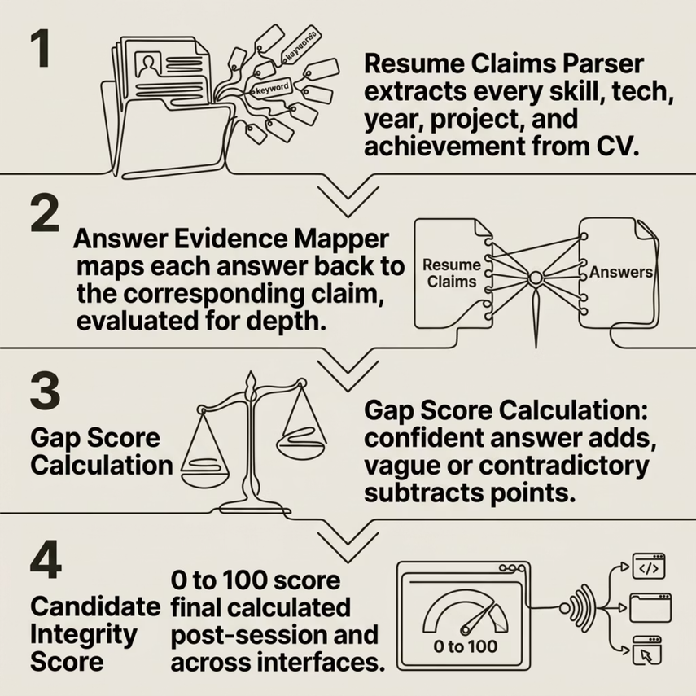

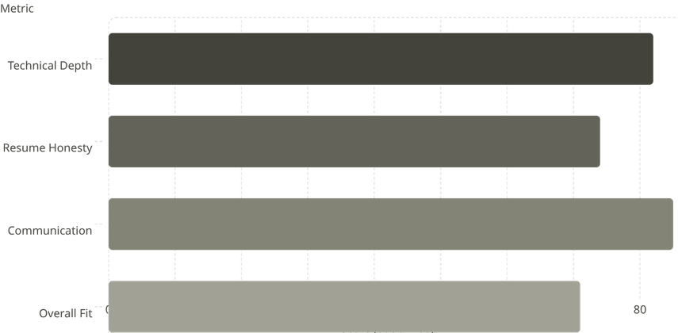
Does Their Resume Actually Match Their Answers?
GhostCue's Gap Detector catches the difference between what candidates claim and what they actually know.
78 / 100 — Candidate Integrity Score calculated post-session and delivered across all interfaces.

Slide 7
Who's the Better Hire? Let the Data Decide.
After interviewing two candidates for the same role, GhostCue builds an instant comparison report.
Trigger Commands
AI Verdict: Candidate A demonstrates stronger system design depth and resume accuracy; Candidate B shows better communication fluency and culture signals. Recommend Candidate A for the senior backend role.
Terminal:
ghostcue compare candidate_1 candidate_2
Telegram / WhatsApp:
compare [Candidate A] vs [Candidate B]
Full comparison report exported as PDF — delivered via Terminal, Telegram, or WhatsApp. Human approval required before any decision is shared.
Comparison Table
Metric
Candidate A
Candidate B
Overall Integrity Score
82 ✅
71
Technical Depth
88 ✅
70
Resume Honesty
80 ✅
65
Communication
79
88 ✅
Red Flags Detected
1
3

Slide 8
Built for Every Hiring Role
👤 Hiring Manager
👤 Tech Lead
AI-generated candidate-specific questions on WhatsApp — zero manual prep before every interview.
Real-time nudges on Telegram when answers are shallow — never miss a follow-up that reveals depth.
👤 HR Recruiter
👤 Campus Recruiter
Structured evaluation report on Telegram immediately after every call — close the loop in minutes.
Upload CVs in WhatsApp and get consistent role-specific questions for every session automatically.
Upload CV
Get Custom Questions
Interview Live
Receive Report + Score
Compare & Decide

Slide 9
What Powers GhostCue
🖥️ Platform & Interfaces
🤖 AI & Agent Layer
Terminal: Python CLI via rich
Telegram Bot: python-telegram-bot
WhatsApp Bot: Twilio WhatsApp API
Audio Capture: BlackHole (macOS), WASAPI (Windows)
Runtime: Python 3.10+, macOS 12+ / Windows 10/11
Whisper / faster-whisper: transcription + diarization
OpenClaw Agent: orchestration via LangChain
SOUL.md: agent persona + coaching rules
HEARTBEAT.md: session lifecycle hooks
Cognitive RAM: SQLite / Redis for state
GPT-4: questions, scoring, verdicts
📊 Scoring & Visualization
📦 Key Libraries
Gap Score Engine: claims parser + evidence mapper
Candidate Integrity Score (0–100)
Radar Chart: 4-axis breakdown via matplotlib
Two-Candidate Comparison Engine + AI verdict
PDF Report Generator: reportlab / fpdf2
openai-whisper / faster-whisper — transcription
pyaudio / sounddevice — audio capture
python-telegram-bot — Telegram interface
twilio — WhatsApp interface
langchain — agent orchestration
rich — terminal UI
sqlite3 / redis-py — Cognitive RAM
matplotlib — radar charts
reportlab / fpdf2 — PDF export
All API dependencies are replaceable with self-hosted equivalents — GhostCue is designed for minimal vendor lock-in. Available at ghostcue.app.

Slide 10
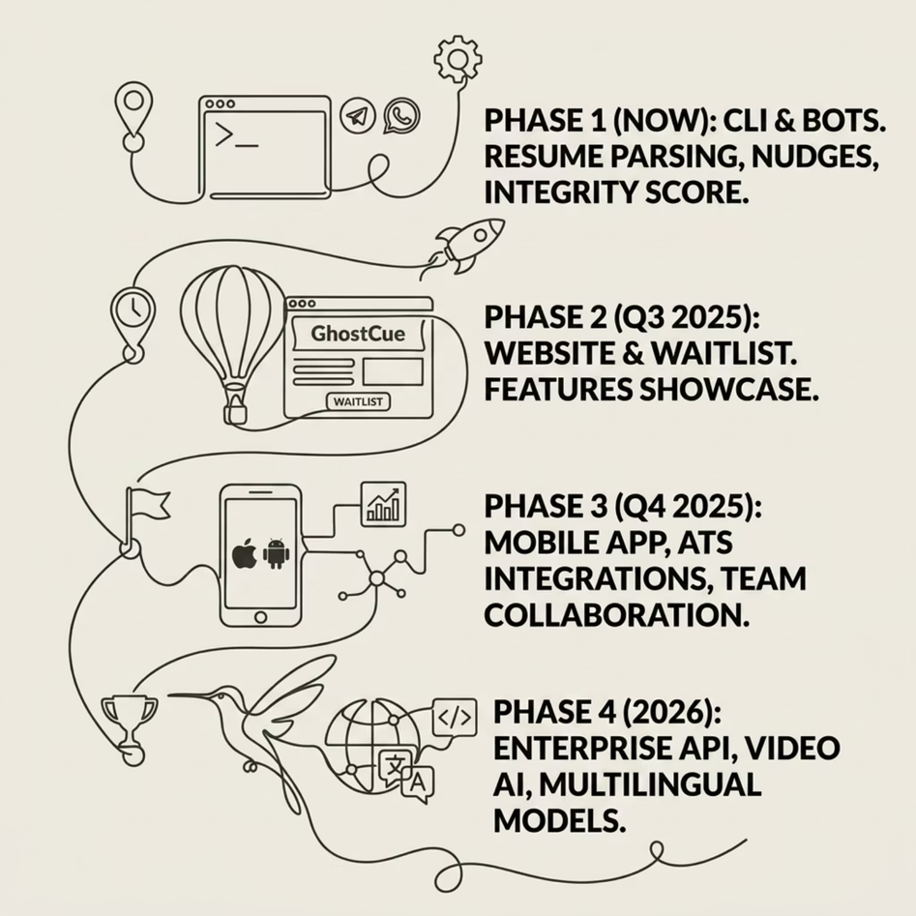

What's Next for GhostCue
🌐 ghostcue.app
A Clean, Minimal Website
A fast landing page with product tagline, core features, interface overview, and an early access signup form. Simple. Fast. Sharp.
Try GhostCue Today — Terminal. Telegram. WhatsApp. Web. "Built for the future of hiring. Available everywhere you already work."

