Slide 1


Slide 2
Memory Layout of a C/C++ program
Text segement
Initialized data segment
BSS (uninitialized data segment)
Stack
heap

Slide 3
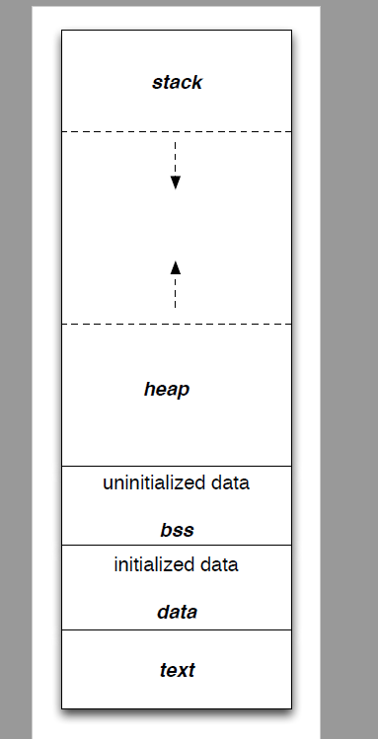
Memory Layout

