Slide 1
GLASS IDENTIFICATION USING MACHINE LEARNING MODELS
TEAM MEMBERS
QIHANG LI(S3625051)
NADEEM KHAN(S3764302)

Slide 2
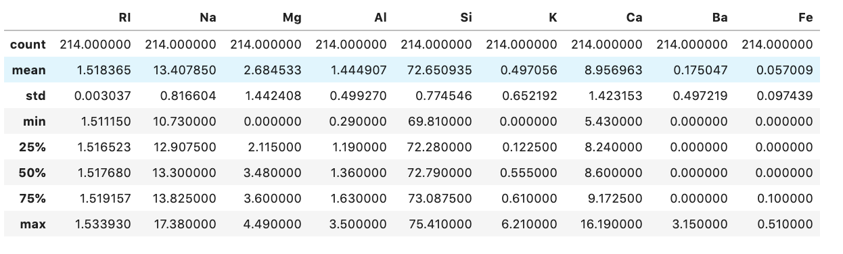
Aim of the project
The main goal in this report is to investigate the classification of a fragment of glass by implementing K Nearest Neighbour (K-NN) classifier and Decision Tree and get a recommendation for criminological investigators after comparing the performance and accuracy of those two Classification models.
About dataset
Glass Identification Data is obtained from UCI Repository Of Machine Learning Databases
This dataset has 214 instances and 10 variables.
The quantitative variables are RI and elemental compositions, consisting of oxides of Na, Mg, Al, Si, K, Ca, Ba and Fe.
The type of glass is class attribute, such as building windows float processed(1), building windows non-float processed(2), vehicle windows float processed(3), containers(5) ,tableware(6), headlamps(7)
Descriptive statistics

Slide 3
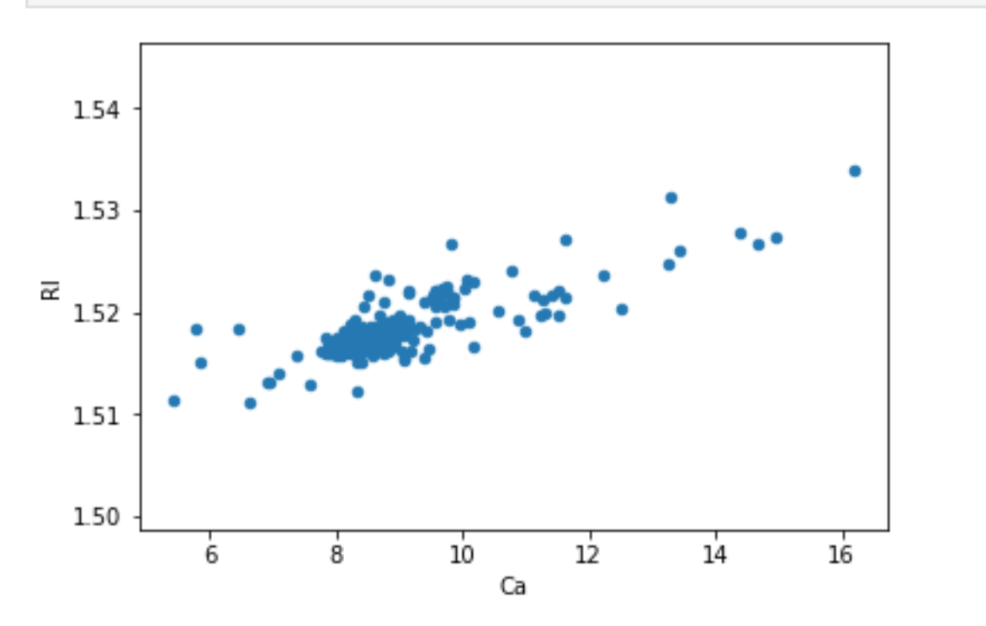
HYPOTHESIS
Data preparation
First we check the missing values
Then we checked the outliers
Feature selection is done using hill climbing but all feature are require to get maximum accuracy as all element composition is necessary to predict different glasses
Data Exploration using different graphs
1) Can glass type is predicted based upon chemical composition using machine learning algorithms
2) Are there any relations between different elements in the glass composition.
Above scatter plot show the relation between RI and Ca

Slide 4
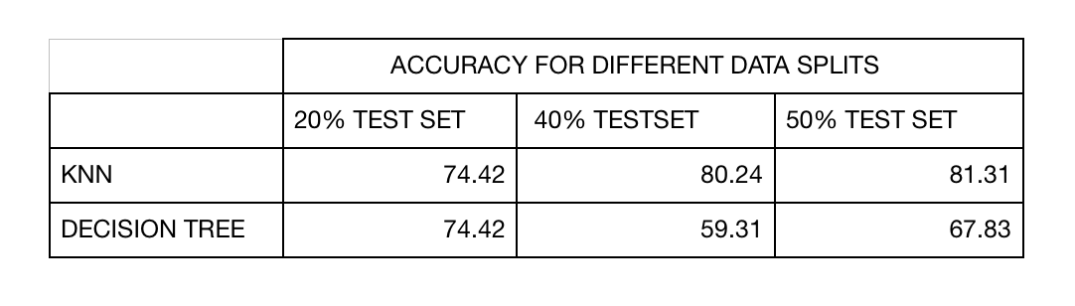

Model selection
In case of knn, different k values are plotted against error rate to calculate best k.
In case of decision tree, max depth is plotted against error to calculate best depth of tree which does not cause the problem of tree overfitting
RESULTS
Conclusion:
As the accuracy of both knn and decision tree with different splits suggest that knn is better in this dataset for predicting glass type.
Recommendation
KNN model is recommended to do classification of glass in criminological investigation as it do better prediction than decision tree

