Slide 1
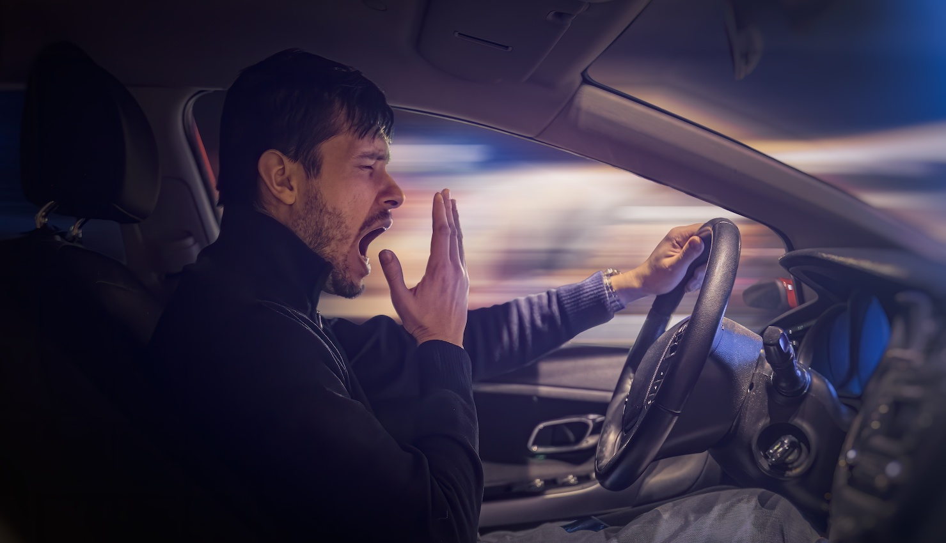
DRIVER DROWSINESS DETECTION
SYSTEM
GUIDED BY,
MRS. CHITHRA B
ASST. PROFESSOR, BCA
PRESENTED BY,
NAME : PRINTO MATHEW
CLASS : S6 BCA
REG NO : 220021087299

Slide 2
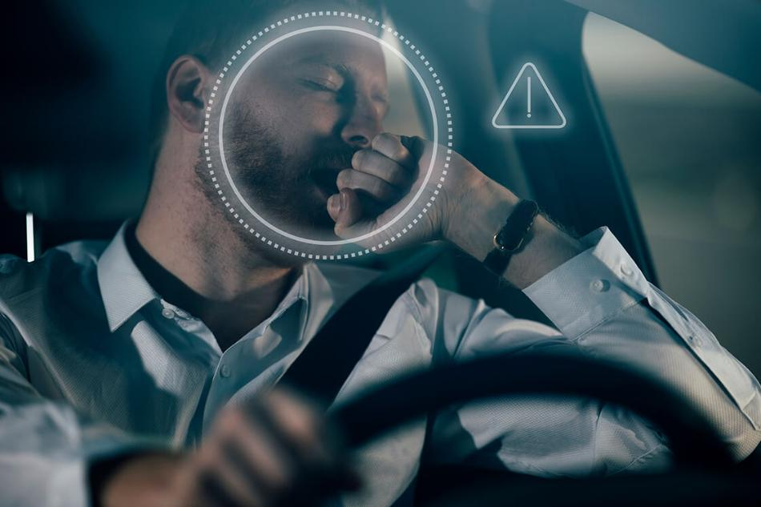
CONTENTS
Driver Drowsiness Detection System 2022-2025
INTRODUCTION
WHAT IS FACE RECOGNITION?
WHAT IS FACIAL LANDMARKS?
PROPOSED SYSTEM
APPLICATIONS
SYSTEM COMPONENTS
SYSTEM ARCHITECTURES
SYSTEM FLOWCHART

Slide 3
CONTENTS
Driver Drowsiness Detection System 2022-2025
ADVANTAGES
DISADVANTAGES
SYSTEM DEMONSTRATION
CONCLUSION
REFERENCES

Slide 4
INTRODUCTION
Driver Drowsiness Detection System 2022-2025
Drowsy driving is a major cause of accidents, leading to severe injuries and fatalities.
25% of road accidents are caused by drowsy drivers.
Driver Drowsiness Detection System is a safety technology designed to monitor driver behavior in real-time.
The system detects driver fatigue in real-time to prevent accidents.
2/25/2025

Slide 5
WHAT IS FACE RECOGNITION ?
Driver Drowsiness Detection System 2022-2025
Face recognition is a biometric technology that identifies or verify a person.
It analyzes facial features from images or videos.
Widely used in security , authentication , and surveillance.
2/25/2025

Slide 6
WHAT IS FACIAL LANDMARKS?
Driver Drowsiness Detection System 2022-2025
Facial landmarks are specific key points on the face.
Used in facial recognition ,animation , medical analysis and AI.
Helps to identifying expressions, emotions, and facial structure.
2/25/2025

Slide 7
WHAT IS FACIAL LANDMARKS?
Driver Drowsiness Detection System 2022-2025
68-point Facial Landmark model is used in our proposed system.
Identifies 68 key facial points.
It helps to detect drowsiness of driver

Slide 8
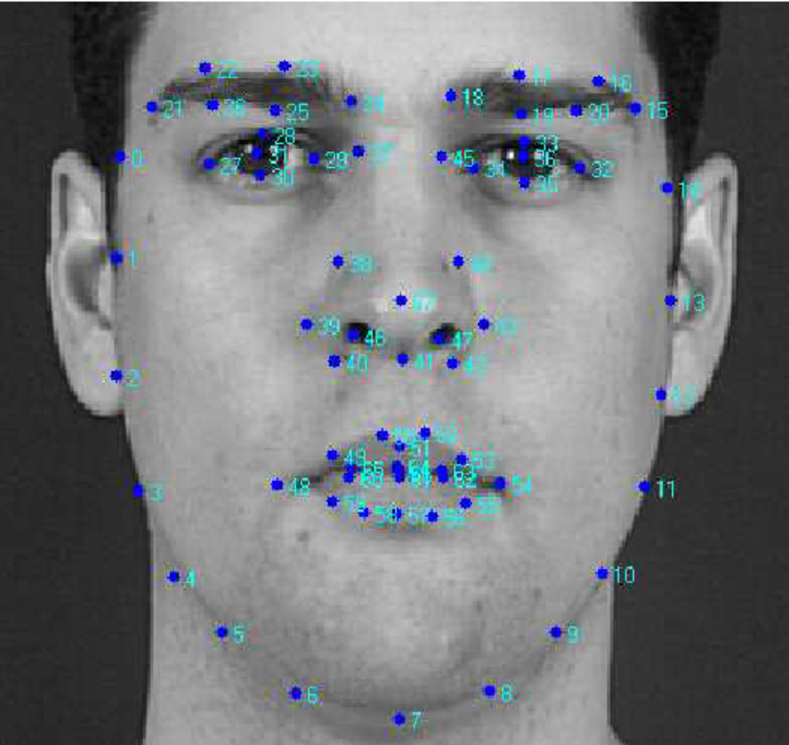
WHAT IS FACIAL LANDMARKS?
Driver Drowsiness Detection System 2022-2025
68 point Facial Landmark Points breakdown:
Jawline 1-17 points
Eyebrows 18-27 points
Nose 28-36 points
Eye 37-48 points
Mouth & Lips 49-68 points

Slide 9
PROPOSED SYSTEM
Driver Drowsiness Detection System 2022-2025
Detects driver drowsiness in real-time using video or webcam technology.
Prevents accidents caused by driver fatigue by providing timely alerts.
The system monitors facial features such as eye closure , blinking rate , and yawning to identify signs of fatigue.
2/25/2025

Slide 10
PROPOSED SYSTEM
Driver Drowsiness Detection System 2022-2025
Triggers alarms , when drowsiness is detected based on the following criteria:
If the eyes are closed for more than 1.5 seconds.
If the driver yawns more than 3 times within a specific time frame (60 seconds).

Slide 11

SYSTEM COMPONENTS
Driver Drowsiness Detection System 2022-2025
HARDWARE COMPONENTS
Infrared (IR) Camera: Captures real-time images of the driver's face.
2/25/2025

Slide 12
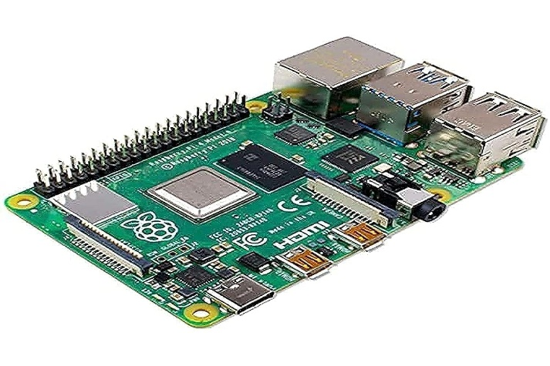
SYSTEM COMPONENTS
Driver Drowsiness Detection System 2022-2025
HARDWARE COMPONENTS
Processing Unit: Analyzes video frames for drowsiness.
Figure : Raspberry Pi -4

Slide 13
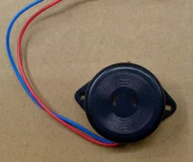
SYSTEM COMPONENTS
Driver Drowsiness Detection System 2022-2025
HARDWARE COMPONENTS
Buzzer : Triggers alarms when drowsiness is detected.

Slide 14
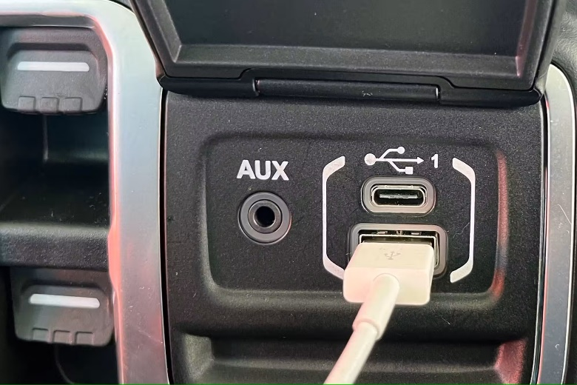
SYSTEM COMPONENTS
Driver Drowsiness Detection System 2022-2025
HARDWARE COMPONENTS
Power Supply: Provides power for continuous operation.
Figure : Uses the car's USB port as a power source.

Slide 15
SYSTEM COMPONENTS
Driver Drowsiness Detection System 2022-2025
SOFTWARE COMPONENTS
Python: Primary programming language for implementation.
OpenCV: Used for image processing and face detection.
Dlib: Detects facial landmarks like eyes and mouth.

Slide 16
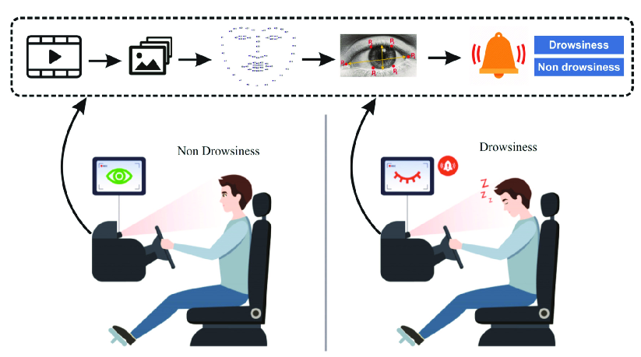
SYSTEM ARCHITECTURE
Driver Drowsiness Detection System 2022-2025
Figure 1: Facial recognition & Eyes Detection System

Slide 17
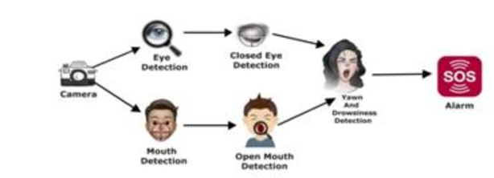
SYSTEM ARCHITECTURE
Driver Drowsiness Detection System 2022-2025
Figure 2: Eyes Detection & Yawn detection

Slide 18
SYSTEM ARCHITECTURE
Driver Drowsiness Detection System 2022-2025
Video Sequence:
The system starts with a video sequence, which is a continuous stream of video frames captured by a camera focused on the driver.
Face Detection and Tracking:
The system uses image processing and face recognition techniques to detect and track the driver’s face in real-time.
2/25/2025

Slide 19
SYSTEM ARCHITECTURE
Driver Drowsiness Detection System 2022-2025
Drowsiness Detection:
Eye Detection :
It checks if the eyes are closed for an extended period (more than 1.5 seconds), that indicates potential drowsiness.
2/25/2025

Slide 20
SYSTEM ARCHITECTURE
Driver Drowsiness Detection System 2022-2025
Yawn Detection :
When the mouth opens wide, it may indicate yawning.
If the driver yawns more than 3 times within 60 seconds, that indicates potential drowsiness.

Slide 21
SYSTEM ARCHITECTURE
Driver Drowsiness Detection System 2022-2025
Alert System Activation:
Combining eye closure and yawning data, the system determines if the driver is drowsy.
If drowsiness is confirmed, an alarm is triggered to alert the driver that can be visual or auditory.
2/25/2025

Slide 22
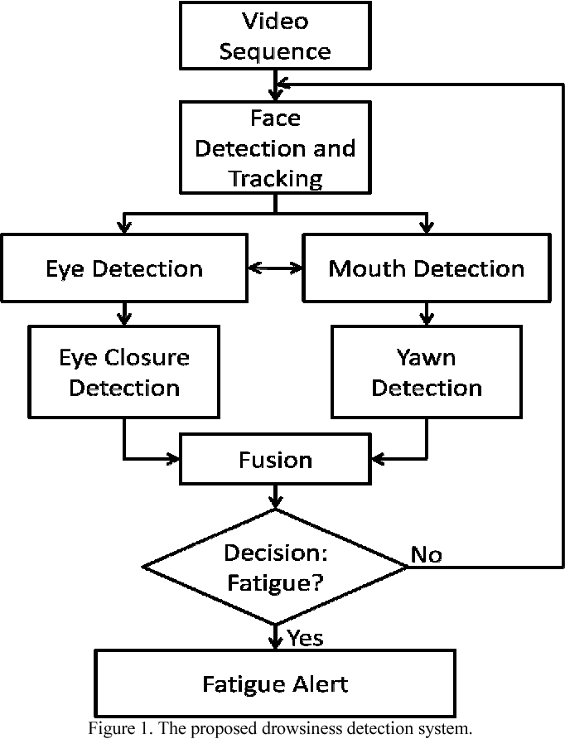
SYSTEM FLOWCHART
Driver Drowsiness Detection System 2022-2025
2/25/2025

Slide 23
ADVANTAGES
Driver Drowsiness Detection System 2022-2025
Prevents Accidents:
Reduces road accidents caused by driver fatigue.
Works in Low Light:
Infrared (IR) cameras ensure night-time detection.
Non-Intrusive:
Uses a camera for detection, no need for wearable sensors.

Slide 24
ADVANTAGES
Driver Drowsiness Detection System 2022-2025
Real-Time Monitoring:
Continuously tracks driver behavior and alerts instantly.
Cost-Effective:
Uses affordable hardware like webcams and open-source AI tools.

Slide 25
DISADVANTAGES
Driver Drowsiness Detection System 2022-2025
Lighting Conditions:
Low-quality cameras may struggle to perform accurately in extreme lighting, such as bright sunlight or low-light environments.
Hardware Limitations:
System accuracy depends on high-quality cameras and other components, which may not always be affordable.

Slide 26
DISADVANTAGES
Driver Drowsiness Detection System 2022-2025
Head Movements:
Excessive or sudden head movements by the driver can cause face detection algorithms to fail, reducing system reliability.
False Alerts & Accuracy Issue:
May trigger alerts for normal actions like blinking or brief glances.
Frequent alerts can be annoying or distracting, reducing user adoption.
2/25/2025

Slide 27
SYSTEM DEMONSTRATION
Driver Drowsiness Detection System 2022-2025

Slide 28
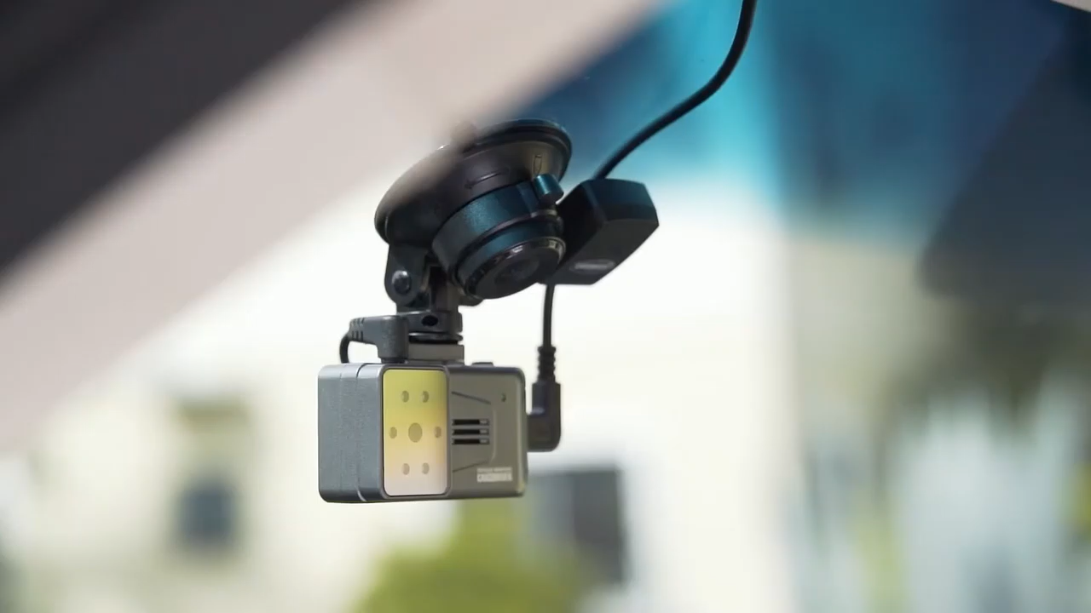
Driver Drowsiness Detection System 2022-2025

Slide 29
CONCLUSION
Driver Drowsiness Detection System 2022-2025
The proposed system provides an effective solution for detecting driver drowsiness.
Future advancements may include integration with vehicle automation systems, leading to autonomous emergency braking or driver intervention.

Slide 30
REFERENCES
Driver Drowsiness Detection System 2022-2025
Boon-Giin Lee and Wan-Young Chung published “Driver Alertness Monitoring Using Fusion of Facial Features and Bio-Signals”, (IEEE) Sensors journal, vol. 12, no. 7,2012
“Detecting Driver Drowsiness Based on Sensors A Review”,pp.16937-16953, ISSN 1424-8220, Malaysia 2012.
Rau P. “Driver Drowsiness Detection and Warning System for Commercial Vehicle” “Driver’s Field Operational Test Design, Analysis, and Progress”.
2/25/2025

Slide 31
THANK YOU
Driver Drowsiness Detection System 2022-2025

Slide 32
QUERIES
Driver Drowsiness Detection System 2022-2025

