Slide 1
Software Design Presentation
CSE416
Seungjoo Ham & Jibeom Ryu

Slide 2
Problem
Solution
General AI responses
No personalization
Same answer for everyone
MBTI-based AI responses
Personalized perspectives
Compare multiple viewpoints
Problem & Solution

Slide 3
What users can do
Core features
Why this matters
Calendar Requirements
Select date / data range
View selected schedule
(right panel)
Clear time visualization
Create / Edit / Delete event
Multiple views
Month
Week
Day
Agenda
Not just a chat service
Connect AI with real planning
MBTI-based planning recommendation

Slide 4
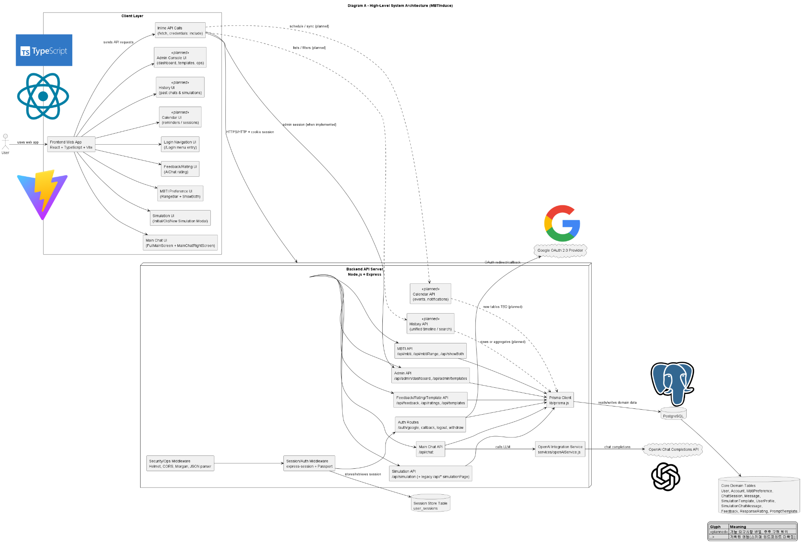

System Architecture & Tech

Slide 5
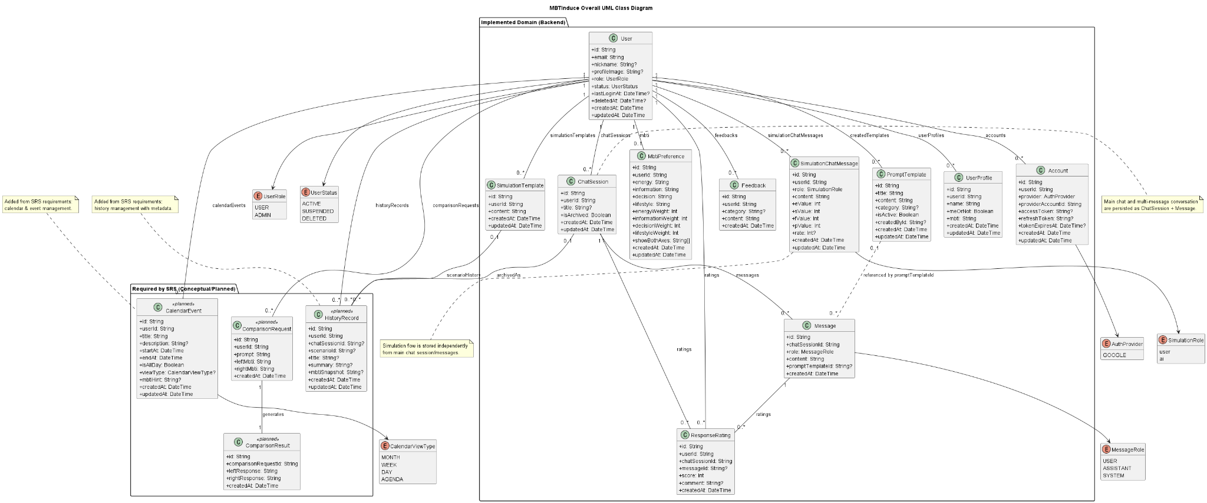
Data Design

Slide 6
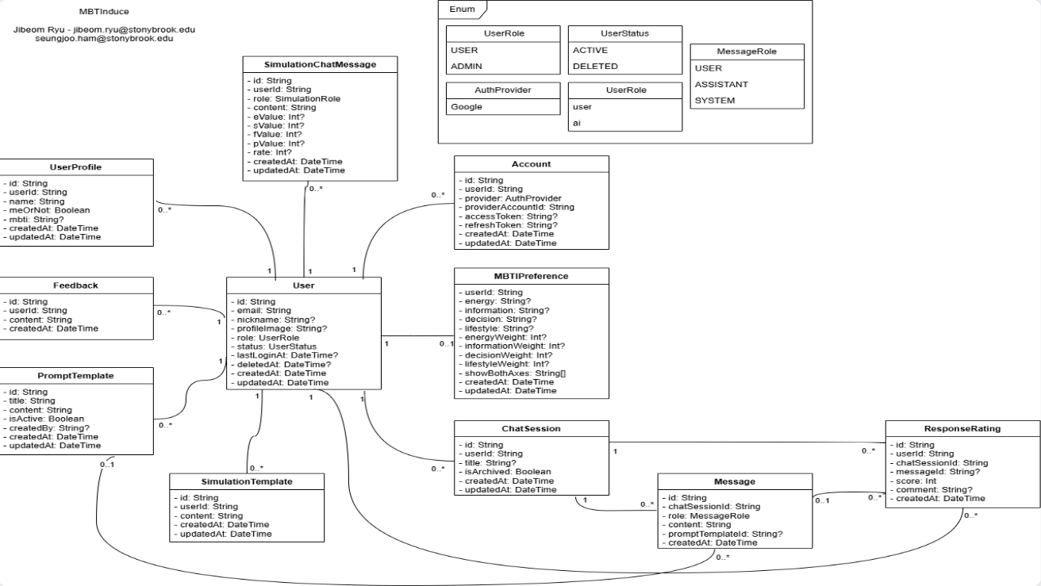
Data Design

Slide 7
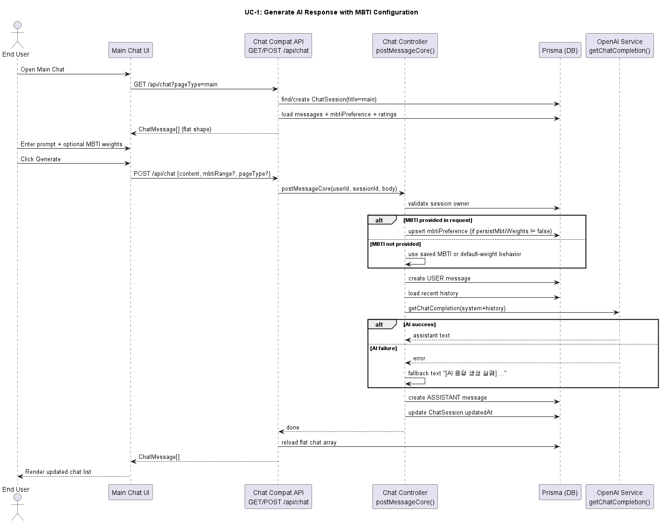
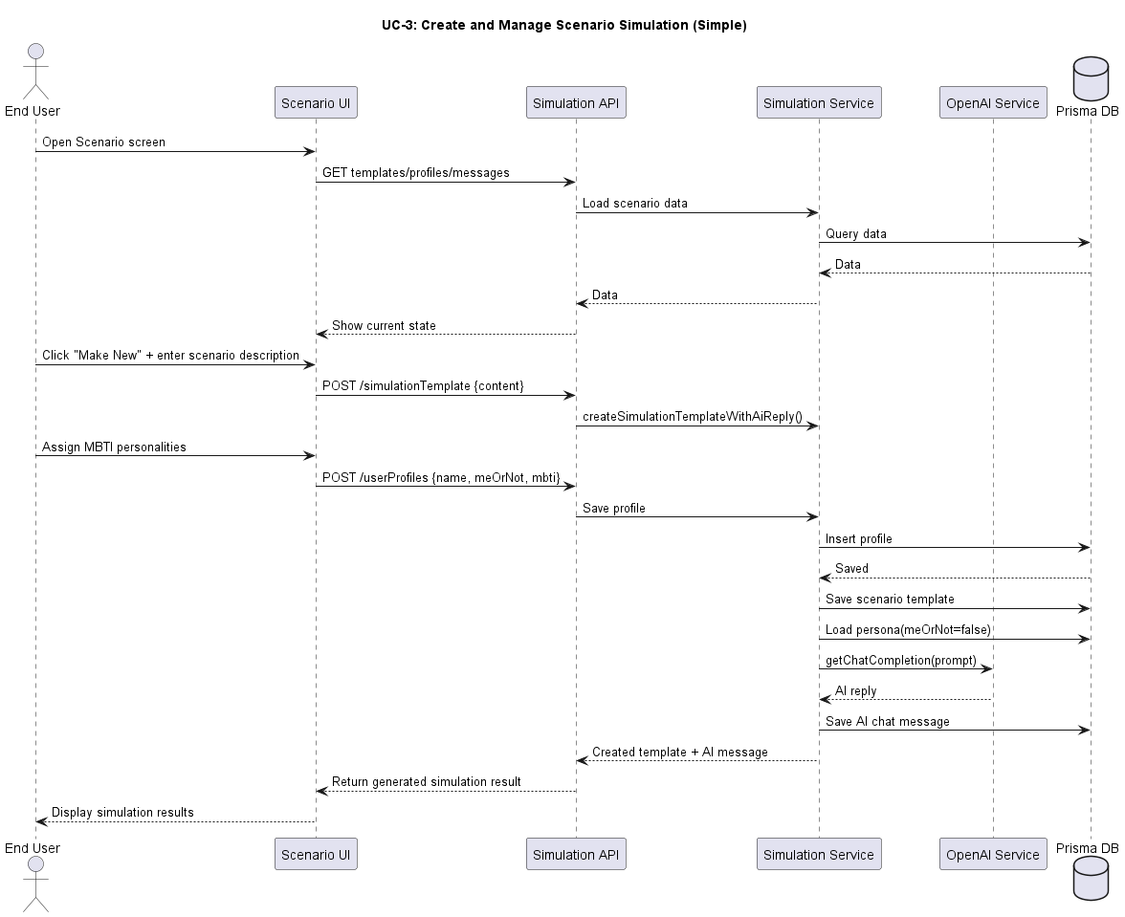
Sequence Diagrams

Slide 8
Both front and back will be deployed separately
Improves system stability and flexibility
Follows a CI / CD (Continuous integration and continuous deployment) workflow
Automated workflow -> reduce deployment errors and improves development efficiency
Deployment - Railway

Slide 9
Code conventions
Frontend
Backend
React components -> PascalCase
State values -> camelCase
TypeScript interfaces and types -> PascalCase
Files and folders -> lowercase or camelCase
API route handlers, controller functions, service functions, variables
-> camelCase
Database models -> PascalCase
Constants
Formatting
Constants and environment-related values
-> UPPER_SNAKE_CASE
Use 2 spaces for indentation
Use semicolons at the end of statements
Prefer single quotes for strings

Slide 10
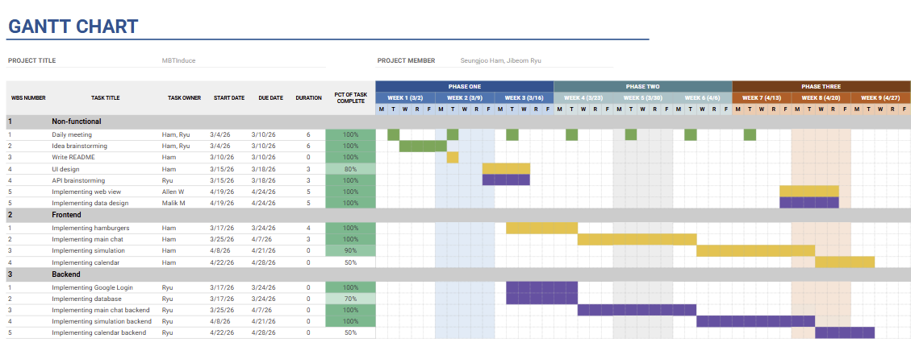
So far

Slide 11
Plan
Milestone 1 (5/11)
Milestone 2 (5/13)
Core UI pages
Database
Google login
Admin dashboard
User stats
Ratings / questions
Milestone 3 (5/20)
Milestone 4 (5/27)
Backend logic
AI tuning
Chat / Simulation / Calendar
Deployment
Beta release

Slide 12
Thank you!
CSE416

