Slide 1
ACCIDENT SEVERITY PREDICTION
19.09.2020 Priyanka Jain

Slide 2
Problem Understanding
To reduce the number of vehicle collisions in a community, we have to predict the severity of an accident given variable features like weather, road and visibility conditions.
The analysis is to predict the severity of accident occurrence using data provided with features like vehicle count ,weather conditions and road conditions in order to inform the public over probability of occurrence of severity of an accident on roads to take well informed measures beforehand. The analysis would help the department of transportation to improve upon the ways and minimize accidents and the public for the purpose of increasing the quality of life for the residents, increasing transparency, accountability and comparability, promoting economic development and research, and improving internal performance management.

Slide 3
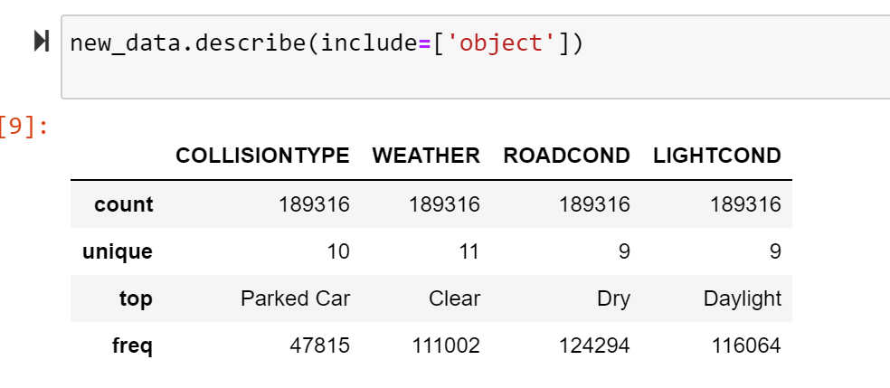
Data Understanding And Preparation
Our predictor or target variable will be “SEVERITYCODE” which is used to measure the severity of an accident from 1 to 2 in the dataset.
Attributes used to weigh the severity of an accident are “WEATHER”,”ROADCOND”, “LIGHTCOND” and “VEHCOUNT”.
I have used label encoding to convert the features to our desired data type.
The original data set consists of 194673 rows ,, after dropping the number of rows reduces to 189316 .

Slide 4
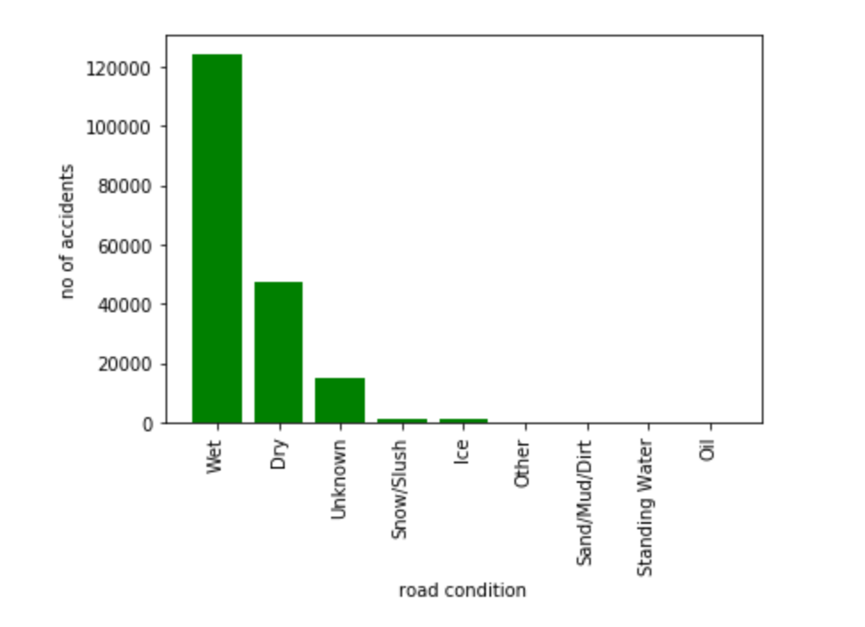
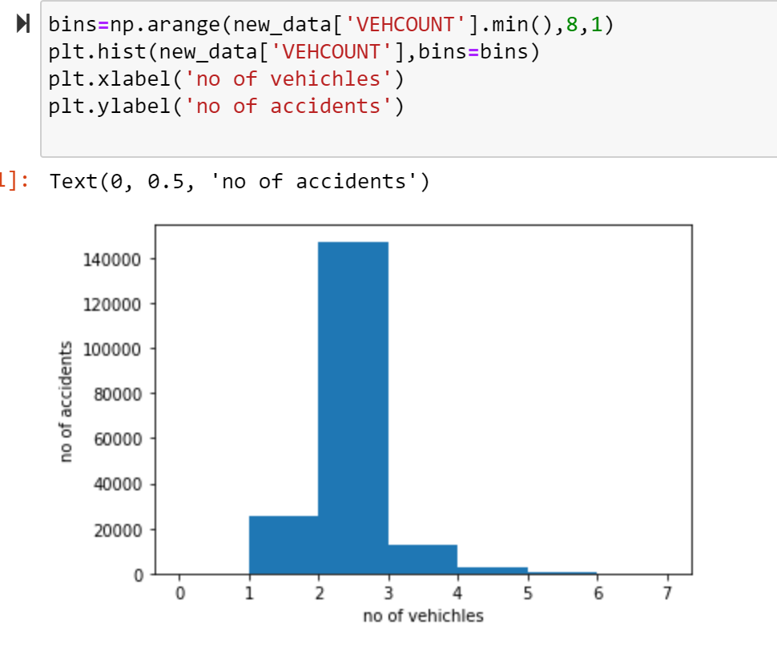
Data Visualization
The data is visualised comparing the number of vehicles,road accidents,weather and light condition individually with respect to the number of accidents.

Slide 5
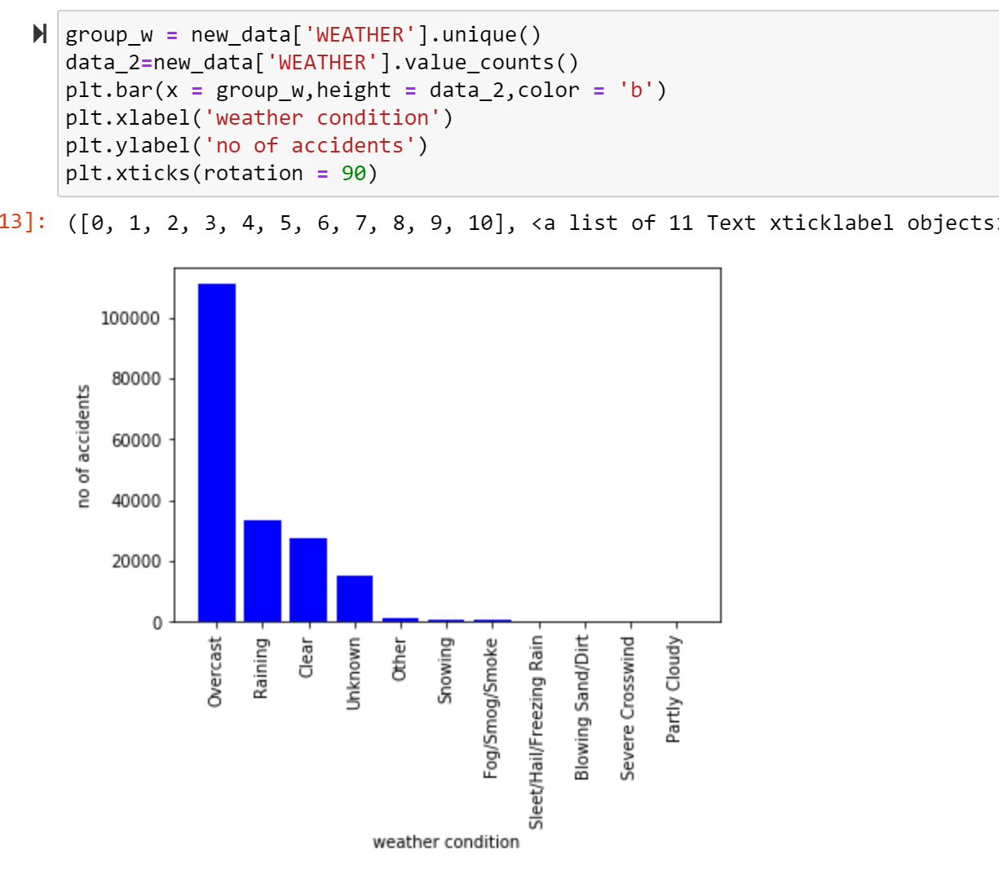
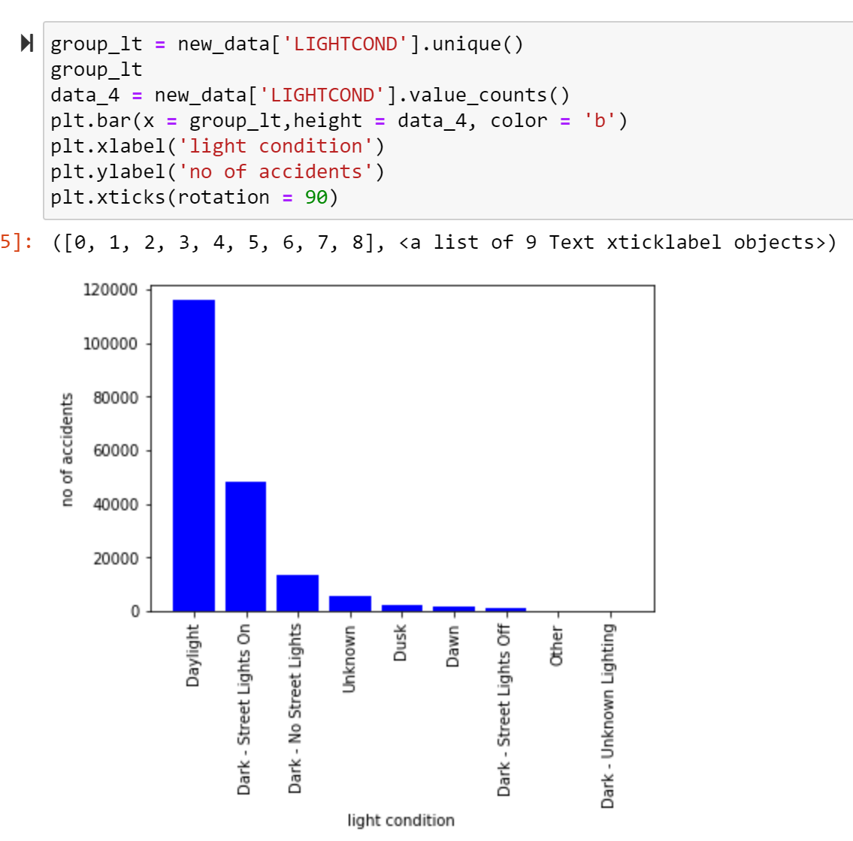
Data Visualization

Slide 6
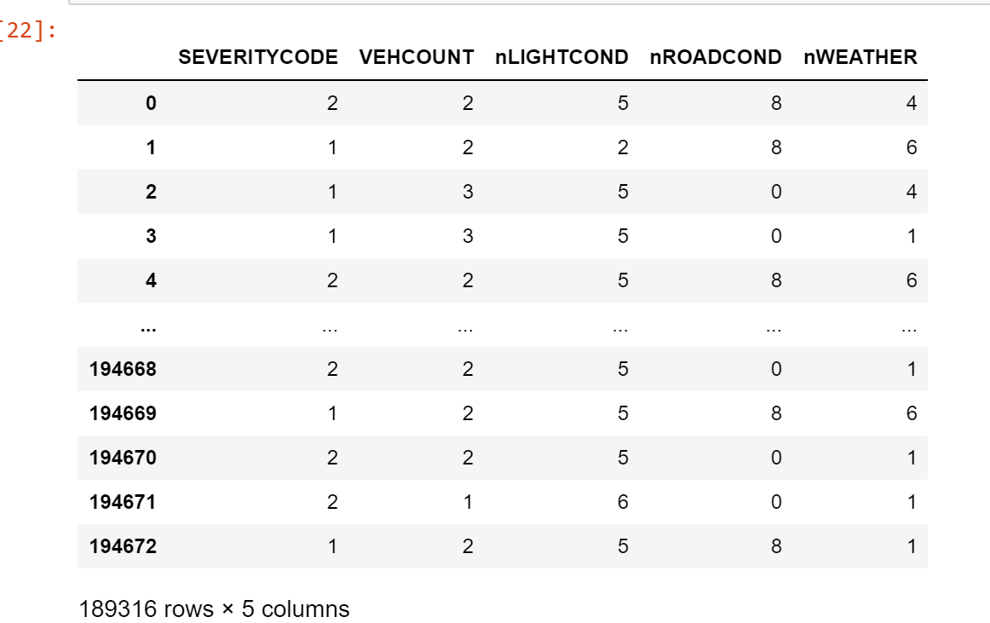
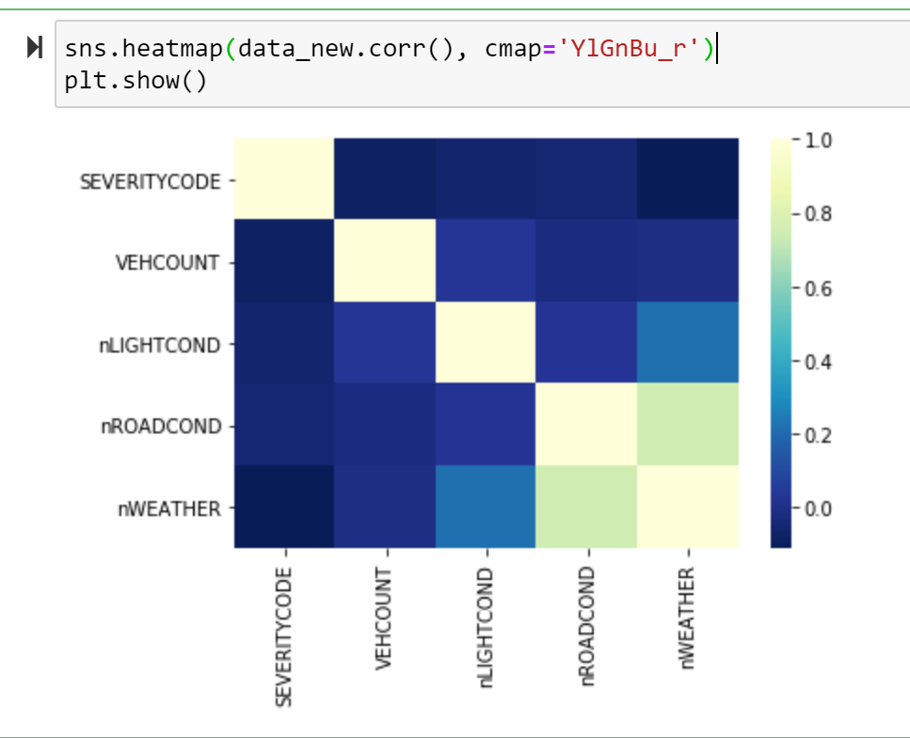
Final Data set and the correlation between all the features of the data set are shown using heatmap.

Slide 7
Methodology (Modelling and Evaluation)
The data is labeled and uses supervised learning models to predict the category of data. We will use the following models
K-Nearest Neighbor (KNN)
Decision Tree
Logistic Regression
Logistic Regression
SVM Model
Linear Regression

Slide 8
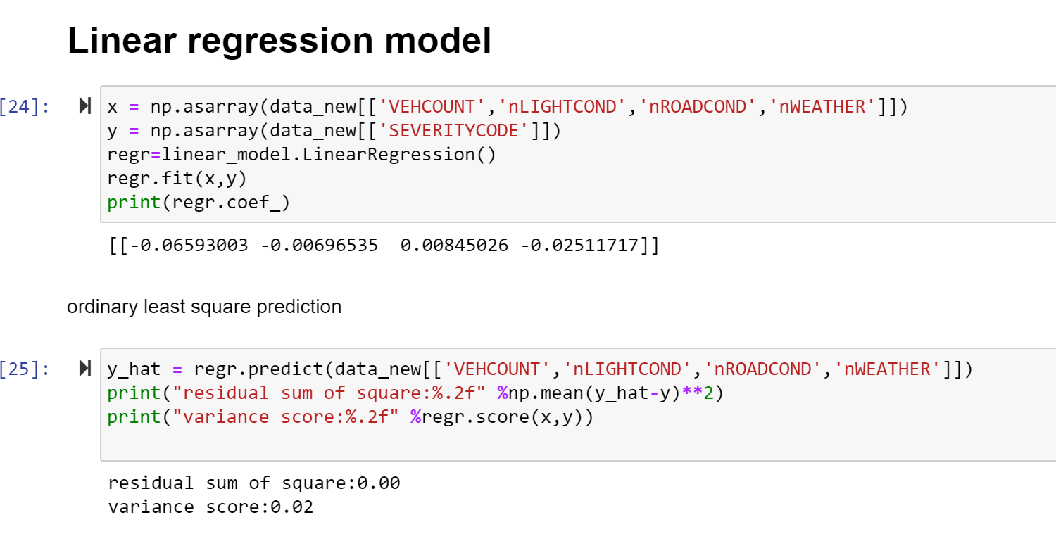
Linear Regression Model
A linear regression line has an equation of the form Y = a + bX, where X is the explanatory variable and Y is the dependent variable. The slope of the line is b, and a is the intercept (the value of y when x = 0).The linear regression model best fits the data with residual sum of square error as 0.0 and variance score 0.02.

Slide 9
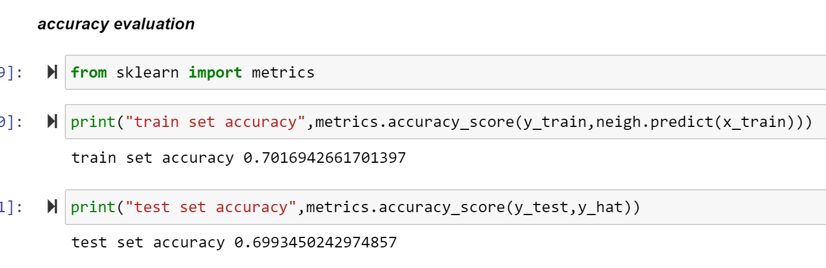
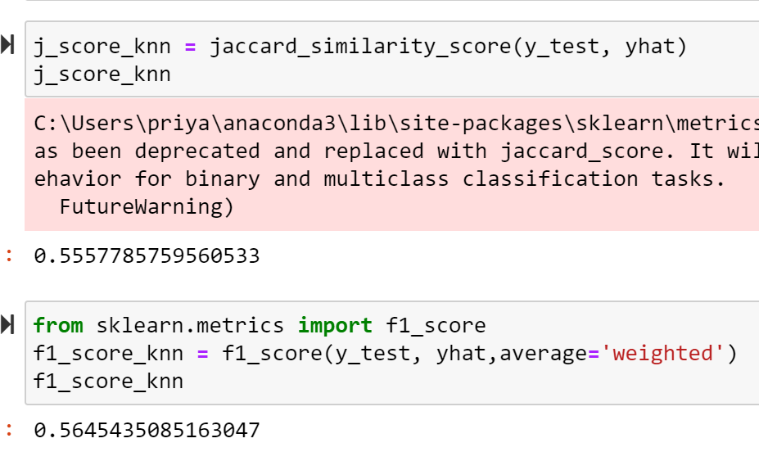
K Nearest Neighbor Algorithm (KNN)
K nearest neighbors is a simple algorithm that stores all available cases and classifies new cases based on a similarity measure .For my model I have used k =20.The accuracy score,jaccard score and F1 score are calculated.

Slide 10
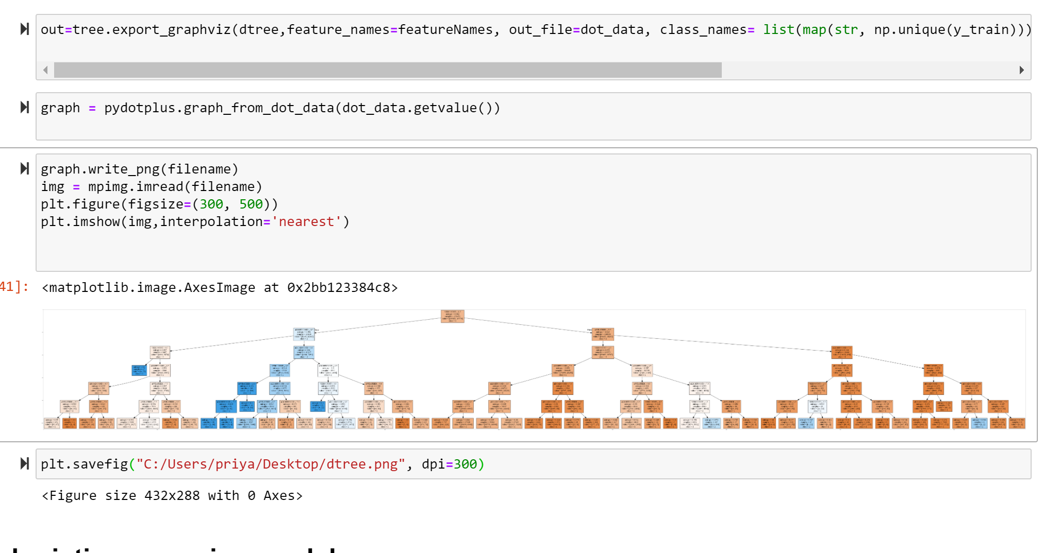
Decision Tree Algorithm
Decision Tree a tree based classifier, which splits the sample data into two or more sets.To choose a differentiator (predictor), the algorithm considers all features and does a binary split on them (for categorical data, split by category; for continuous, pick a cut-off threshold). It will then choose the one with the least cost (i.e. highest accuracy), and repeats recursively, until it successfully splits the data in all leaves.Information gain for a decision tree classifier can be calculated Entropy measure gain. The decision tree for the model is shown below.

Slide 11
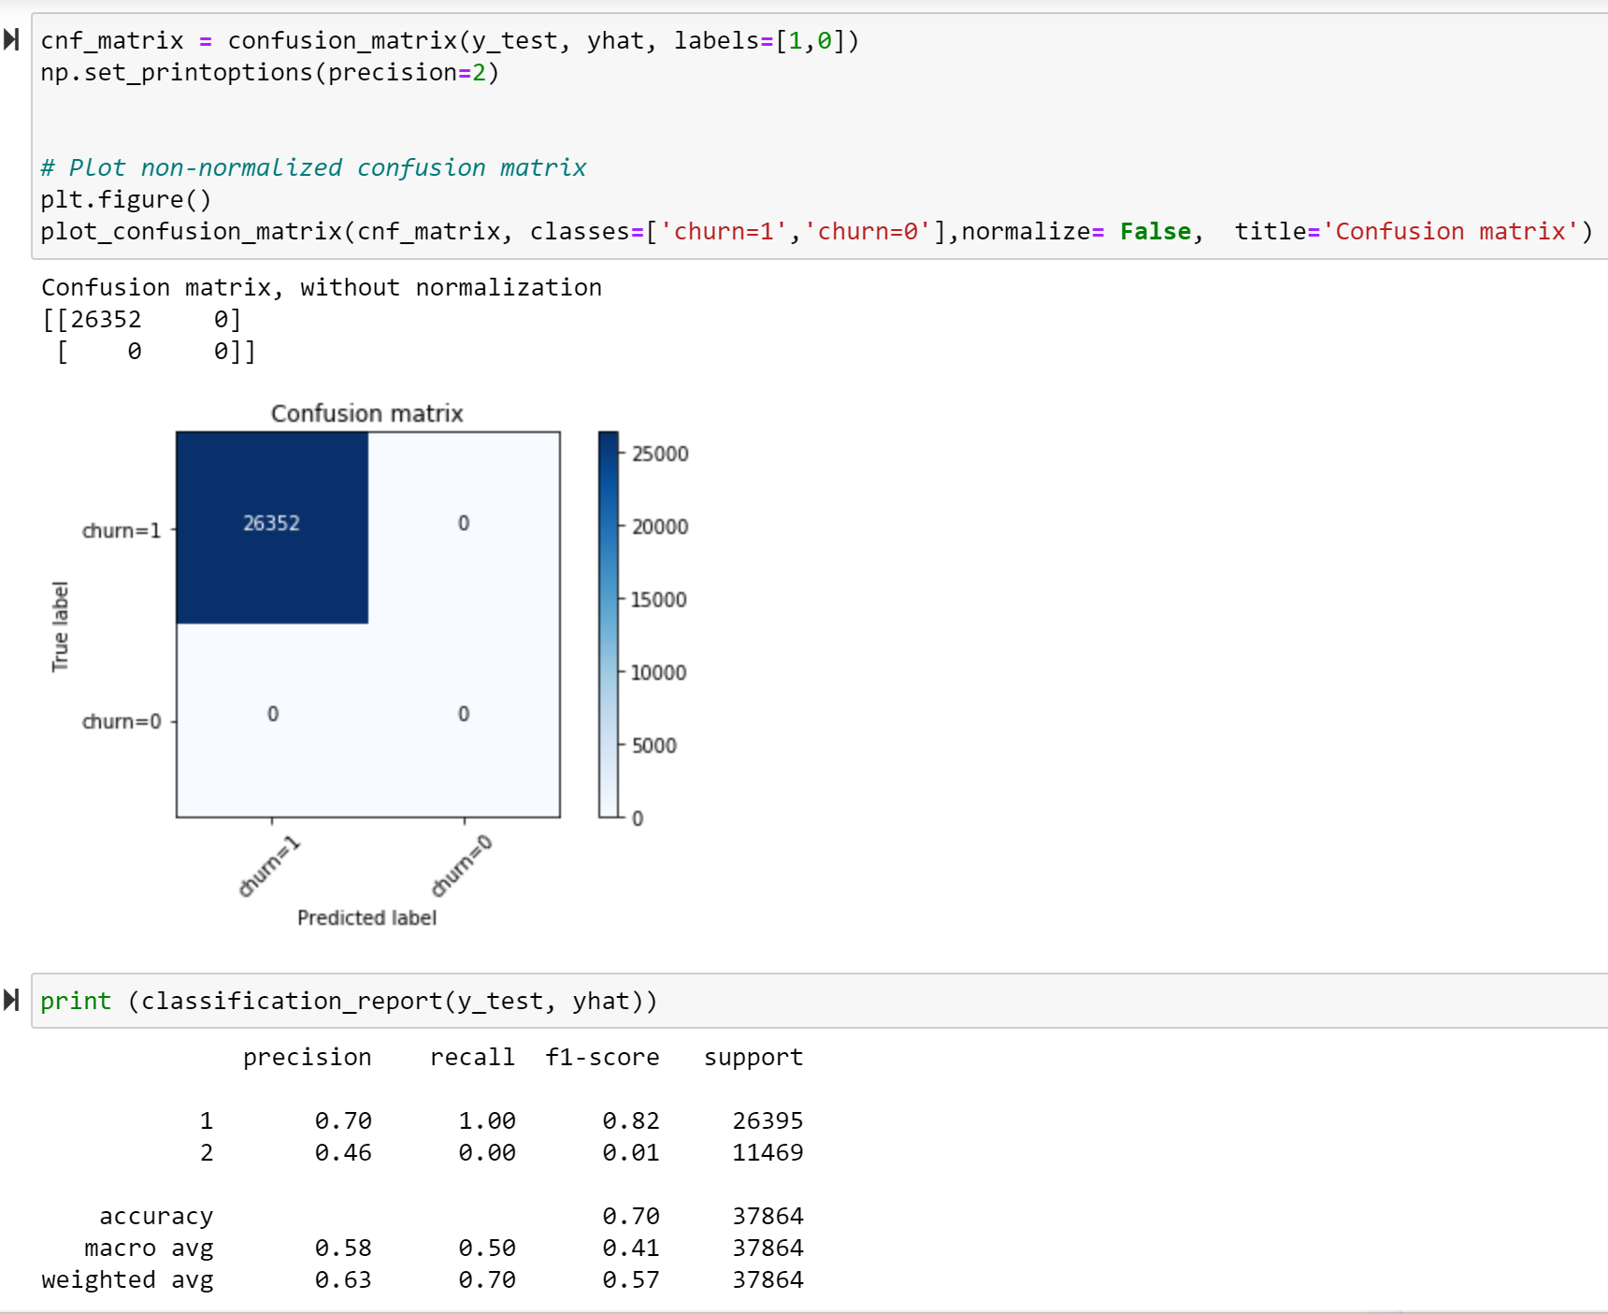
Logistic Regression
Logistic Regression is a classifier that estimates discrete values (binary values like 0/1, yes/no, true/false) based on a given set of independent variables. It basically predicts the probability of occurrence of an event by fitting data to a logistic function. Hence it is also known as logistic regression. The values obtained would always lie within 0 and 1 since it predicts the probability.The chosen dataset has more than two target categories in terms of the accident severity code assigned.

Slide 12
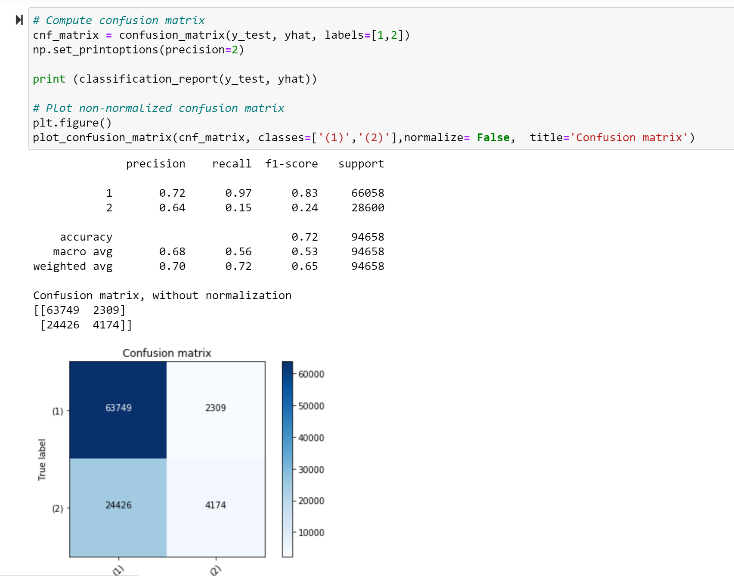
SVM Model
Support Vector Machine is a linear model for classification and regression problems.The algorithm creates a line or a hyperplane which separates the data into classes.I have used feature set and target set and have trained the data on half the size of original data as it took too long to train the data.The confusion matrix and precision and recall values are as shown.

Slide 13
Conclusion
For the linear regression model the residual sum of square and variance score is calculated.This model is a perfect fit for the data as the residual sum of square is zero and the variance is low.
For the k nearest neighbor algorithm the predicted train and test set accuracy is 0.701 and 0.699. This model is fairly good to predict the data outcome as the accuracy is good.
The decision tree model predicts with an accuracy score of 0.719.
The logistic model used for evaluation also indicates that the data fit the model fairly as Jacquard similarity score is 0.696 and the log loss calculated is 0.601.
The SVM model used took time to train the data as the data set is long.The accuracy of the model is calculated using f1 score and jacquard similarity score.F1 score is 0.648 and jacquard index is 0.717.

