Slide 1

GROUP 1
Madhu Madhavan, Scott Normore, Saksham Ohri, Eze Adiele, Gao Liu and Liam MacDiarmid

Slide 2

Client Company
AK COMPUTERS

Slide 3


Business imperative: what problem is solved?
Premier IT Service provider
Effortless services search

Slide 4



Overview of Requirements
3 MAIN ENTITIES
Customer
Technician
Administrator

Slide 5

Overview of Requirements
Customer
Technician
Administrator
Choose a Service
Available Jobs
Manage Customers
Book a Service
Ongoing Jobs
Manage Technicians
Post Reviews
Schedule
Generate Reports
Feedback
Revenue info
Manage Services
View Past Services
Feedback & Rating
Financial Data

Slide 6




Overview of Requirements
Location Bound
Secure Logins
Ease of Usability
Guest

Slide 7




Overview of Requirements
Easy Payments and Transfers
Secure Services
Familiar Systems
Data Encryption

Slide 8
Overview of Requirements
Technician
Customer
Easily generated invoices
Easy payment systems
Easy payment collection
Confirmation emails
Limited interaction required
Required Signature for payment

Slide 9
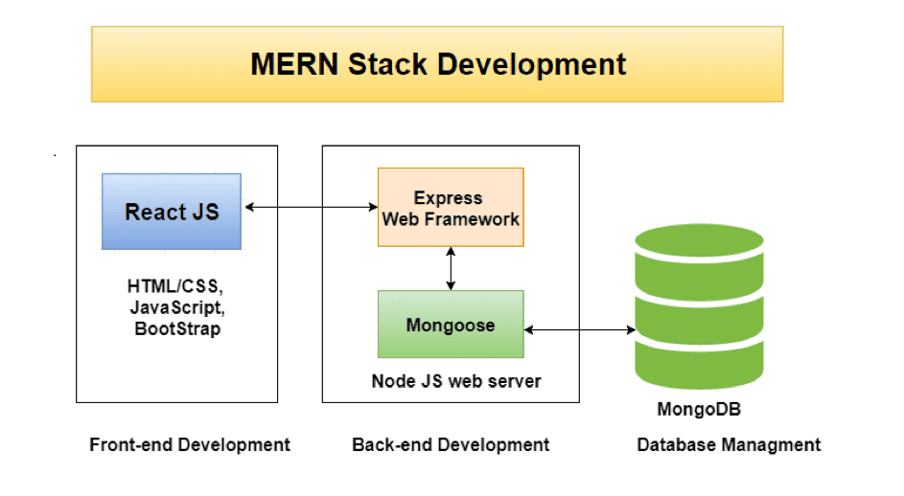
Overview of Internal System Structures

Slide 10
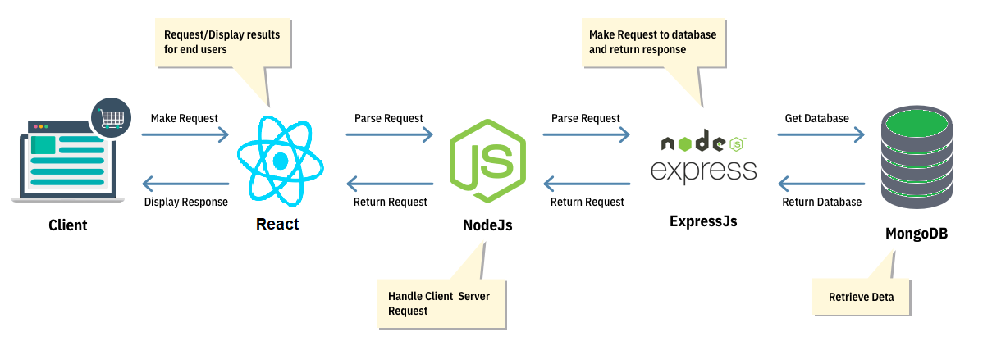
Overview of Internal System Structures

Slide 11

HCI standards
Flexible
- Error messages
- Alert
- Inquiry request form
- System feedback

Slide 12

HCI standards
Error Messages
- Missing fields in the form
- Wrong input pattern
- Failed authentication

Slide 13

HCI standards
Responsive
- Web components respond to user’s behavior and environment based on screen size
ex. nav bar will become hamburger bar when screen size is small
- Web pages look good on all devices!

Slide 14

HCI standards
Focused
- Keep the current task clear and in focus
- Color: orange (primary), white (secondary)
- Font: Segoe UI, Roboto, Oxygen
Cantrell, Open Sans, Helvetica Neue, Sans-Serif
- Differentiate the active window from inactive windows

Slide 15

Plan for Project Completion
Two major parts:
The Execution
The Deployment

Slide 16

Plan for Project Completion: Execution
Time Management
Collaboration
- Communication to each other
- Sharing of code

Slide 17

Plan for Project Completion: Deployment
Hosting of database
- MongoAtlas
Deployment of Site
-Docker, AWS, Heroku, Azure, etc...

Slide 18
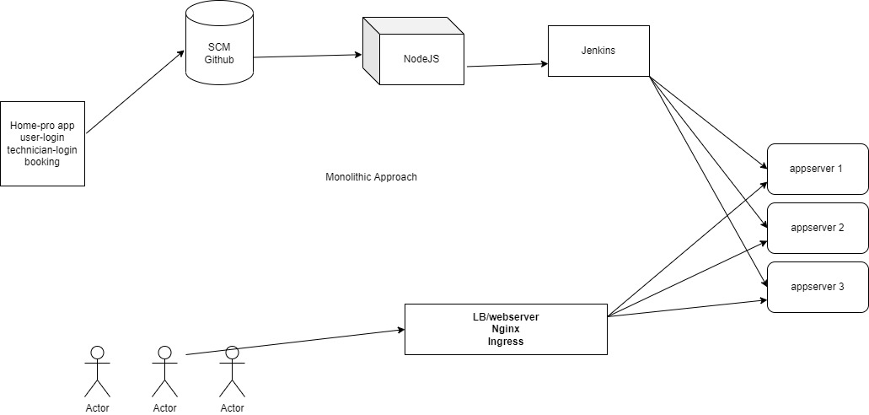
Deployment: Monolithic

Slide 19
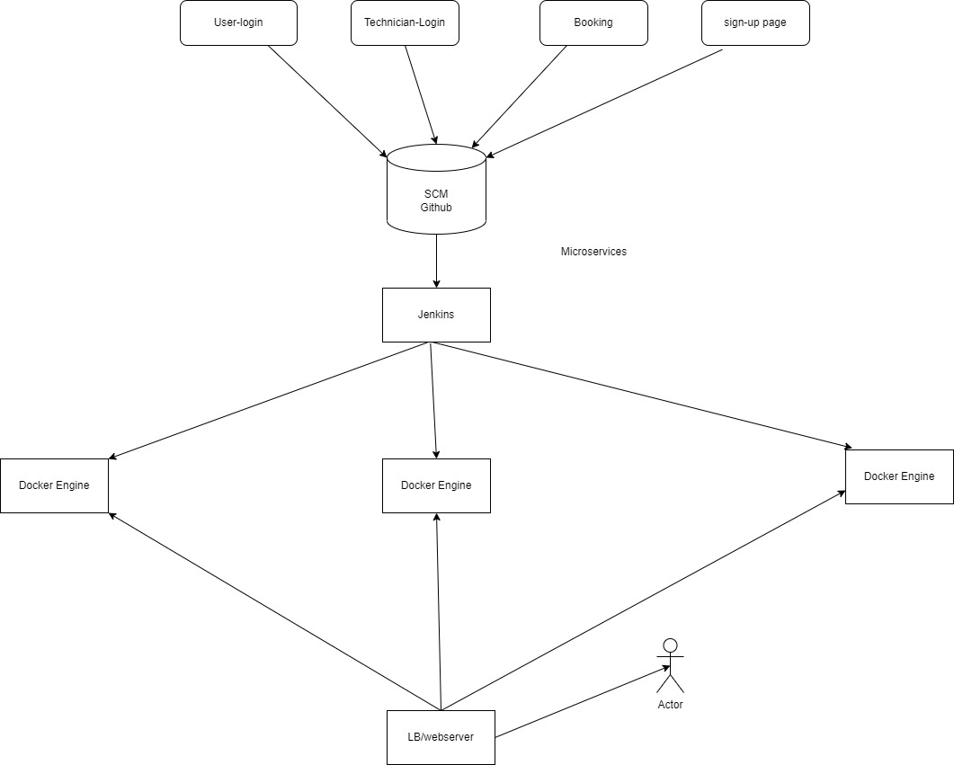
Deployment: Microservices

Slide 20
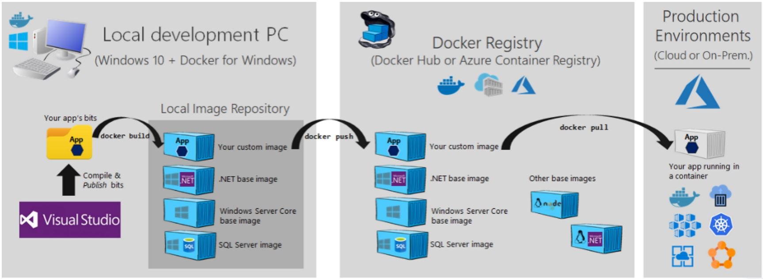
Plan for Project Completion: Deployment
Deployment of Site
-Docker

Slide 21
Thank you!

