Slide 1



GROUP 1

Slide 2



Business Imperative
AK COMPUTERS
Premier IT Service provider
Effortless services search

Slide 3
Front-End Programming & Testing
Gao Liu
Eze Adiele
Saksham Ohri
Back-End Programming & Database Management
Scott Normore
Madhu Madhavan
Payment Gateway setup & Testing
Liam MacDiarmid
Deployment
Eze Adiele
Scott Normore

Slide 4



Overview of Requirements
Customer
Technician
Administrator
Choose a Service
Available Jobs
Manage Customers
Book a Service
Ongoing Jobs
Manage Technicians
Post Reviews
Schedule
Generate Reports
Feedback
Revenue info
Manage Services
View Past Services
Feedback & Rating
Financial Data

Slide 5




Overview of Requirements
Location Bound
Secure Logins
Ease of Usability
Guest

Slide 6




Overview of Requirements
Easy Payments and Transfers
Secure Services
Familiar Systems
Data Encryption

Slide 7
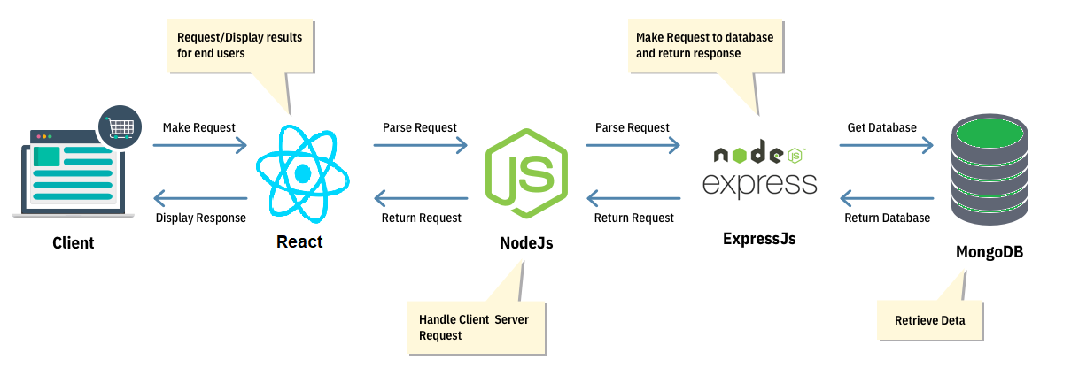
Internal System Structures

Slide 8

HCI standards
Focused
- Keep the current task clear and in focus
- Color: orange (primary), white (secondary)
- Font: Segoe UI, Roboto, Oxygen
Cantrell, Open Sans, Helvetica Neue, Sans-Serif
- Differentiate the active window from inactive windows

Slide 9
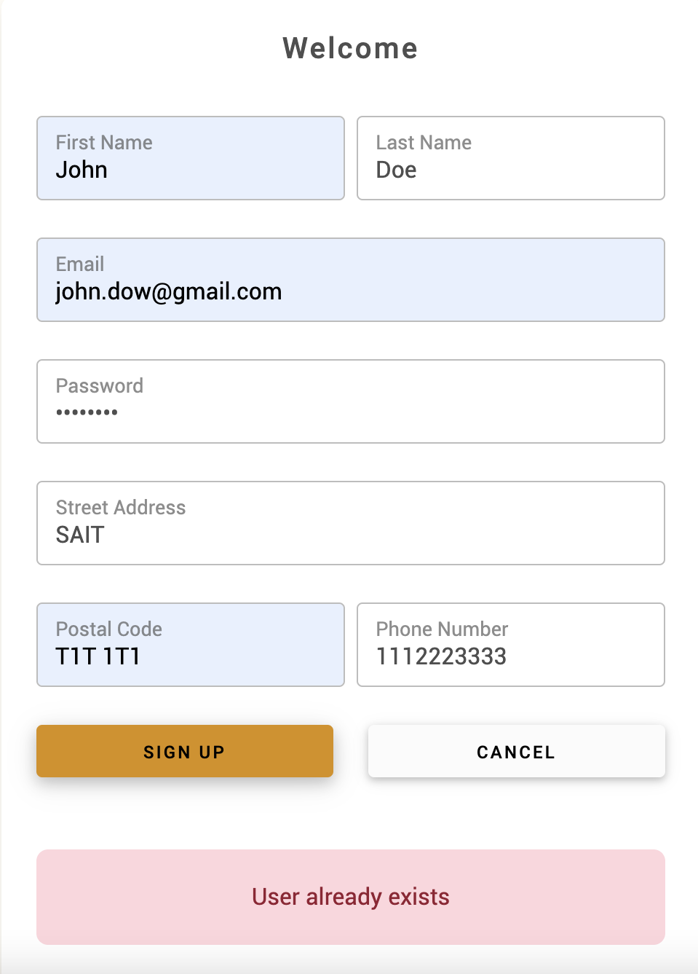
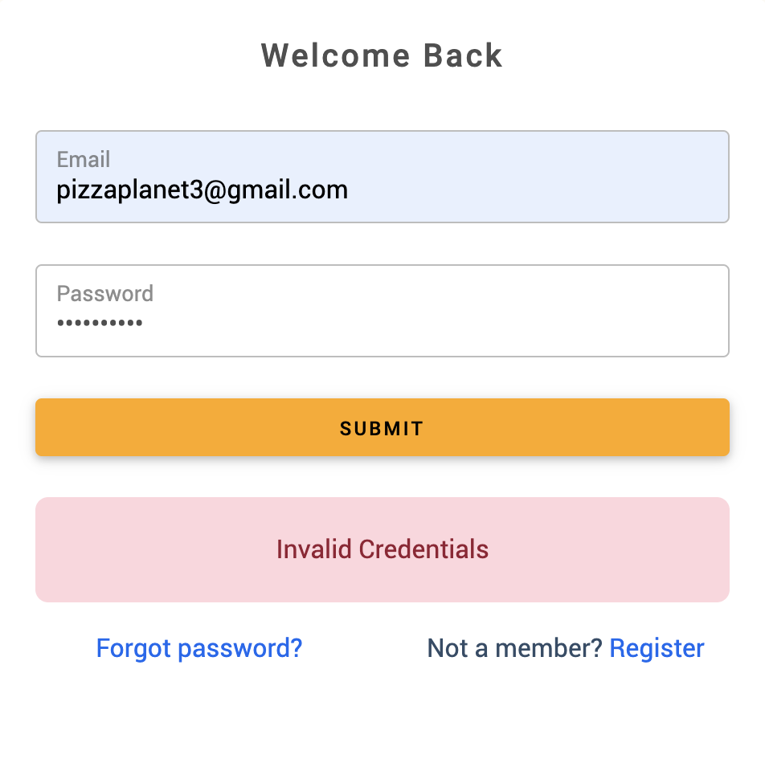
HCI components – error message

Slide 10
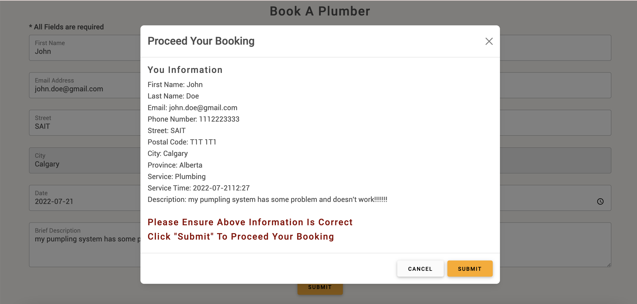
HCI components - modal

Slide 11

HCI components - confirmation

Slide 12



Technical challenges and solutions
Backend Database and Server Interaction
Connectivity
Validation

Slide 13
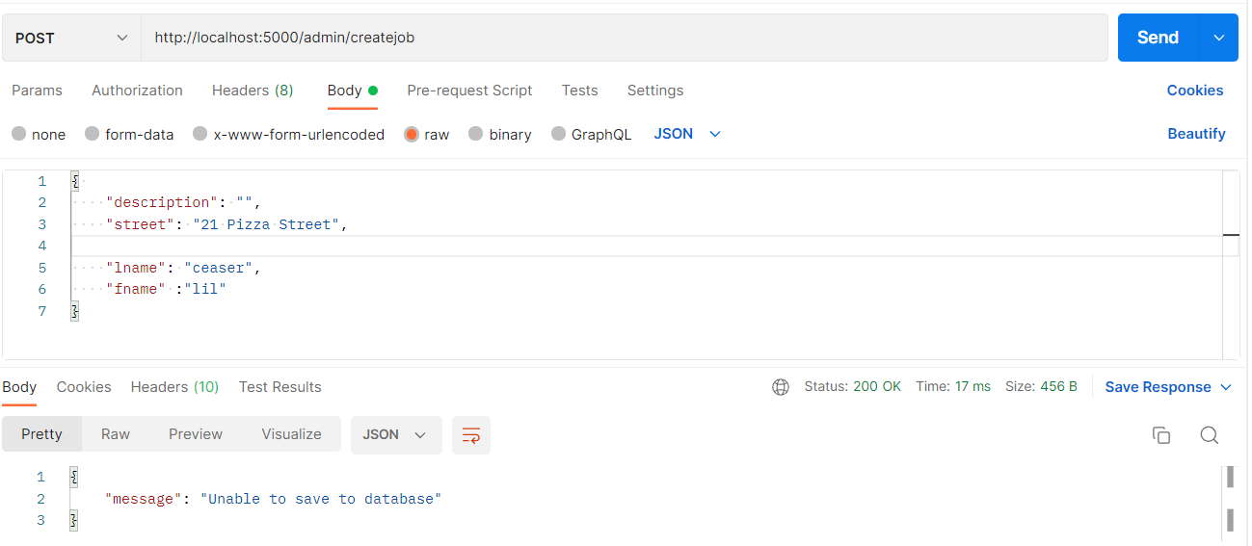
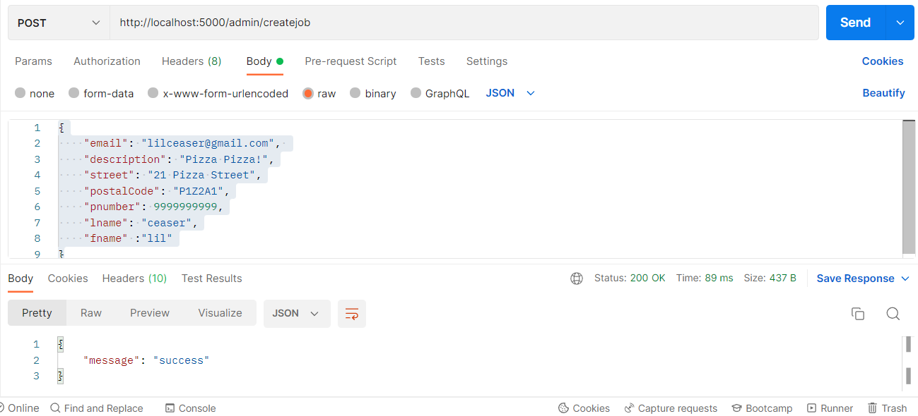
Technical challenges and solutions
2 Images of Postman request, one showing a missing field, the other being a success

Slide 14



Technical challenges and solutions
System Security
Authentication
Authorization

Slide 15
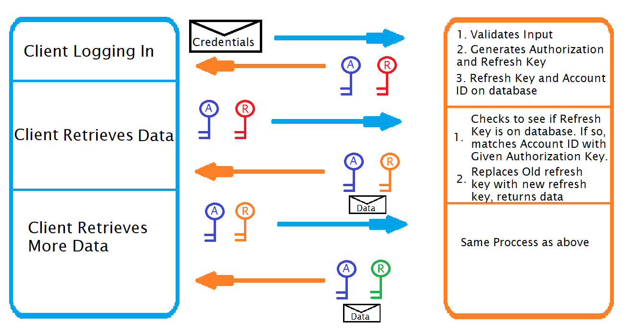
Technical challenges and solutions

Slide 16
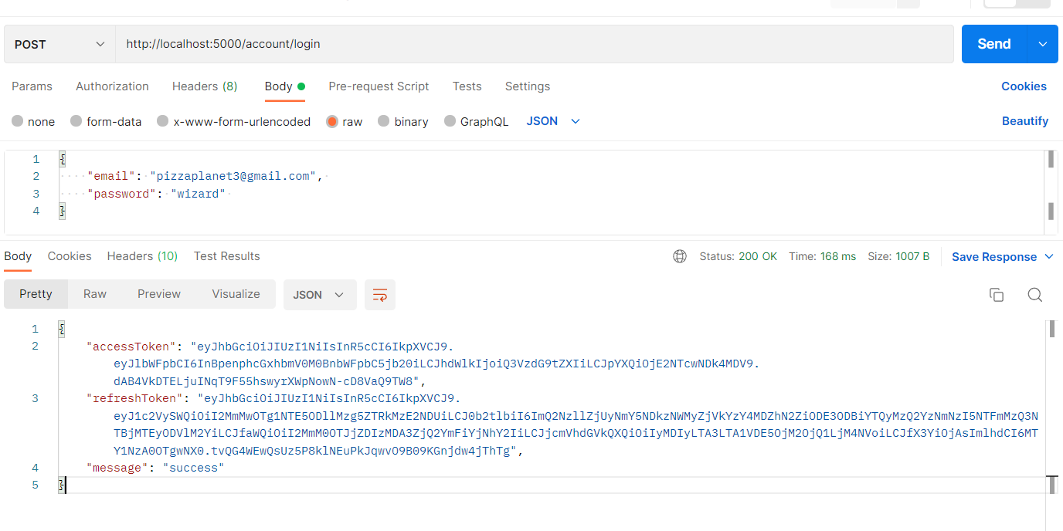
Technical challenges and solutions

Slide 17

DEMO

Slide 18
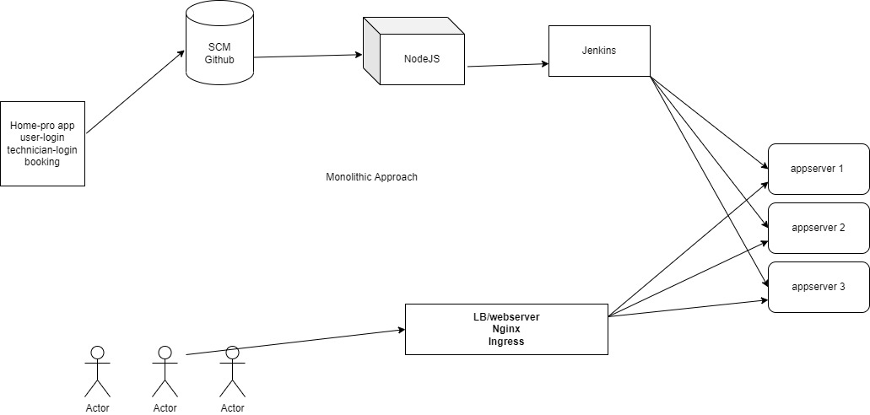
Deployment: Monolithic

Slide 19
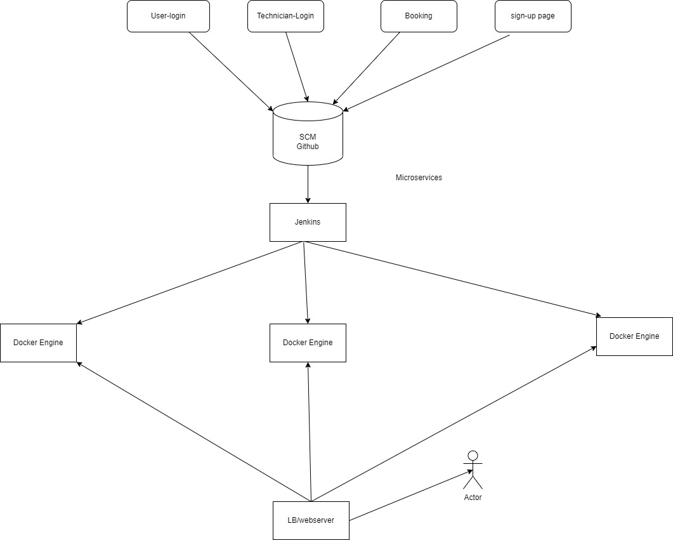
Deployment: Microservices

Slide 20

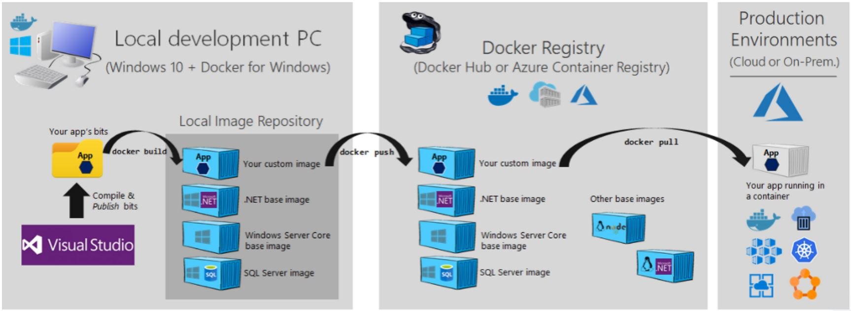
Plan for Project Completion: Deployment
Deployment of Site
-Docker

Slide 21

Thank you!

