Slide 1
SMU IBM Sobeys Hackathon
Imran Nilroy, Priom Chowdhury, Methew Guda, Ali Kazerani

Slide 2

Coming up with an Idea
Notes:
- Quickly realized it is easy to get lost in 15 million rows of data

Slide 3



Criteria
Win win for Sobeys and its customers
Align with Sobeys’ current initiatives
Using IBM’s tools and applications

Slide 4
Survey Says
Notes:
We went outside the building to try and find the pain points of the customers
Survey 52 people – online and in person
Specially true when it comes to students
They want to spend minimal time and money, and not have to think when they’re in a grocery store

Slide 5
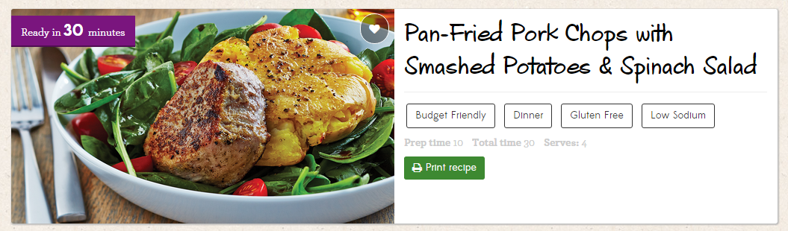
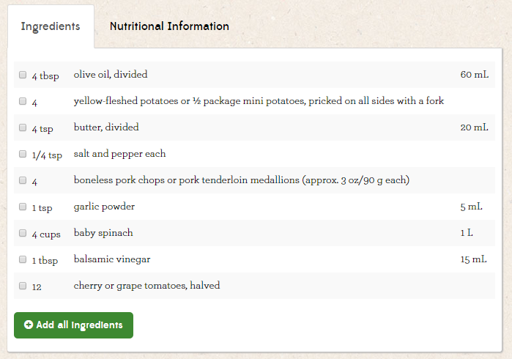
Our Idea
Focus on Food Items
Going one step further
Providing customers with specific suggestions for ingredients
Based on Customer Budget
Based on Lowest/Highest Selling Items from one period to another
Notes:
Bundle
Show Watson
Chicken (Lowest-selling)
Best Thing about the campaign: Measurable because…

