Slide 1
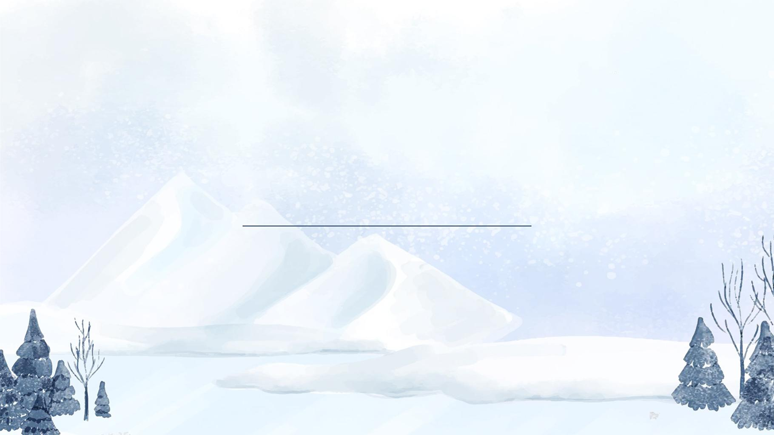
Exploring Squares and Rectangles: Our Shape Adventure!

Slide 2
Recognize and name the basic attributes of a square and a rectangle (e.g., number of sides,

Slide 3
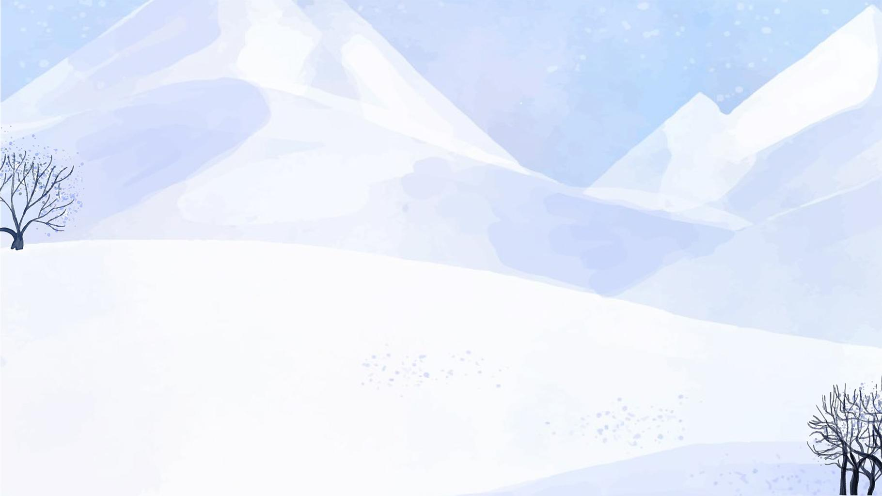
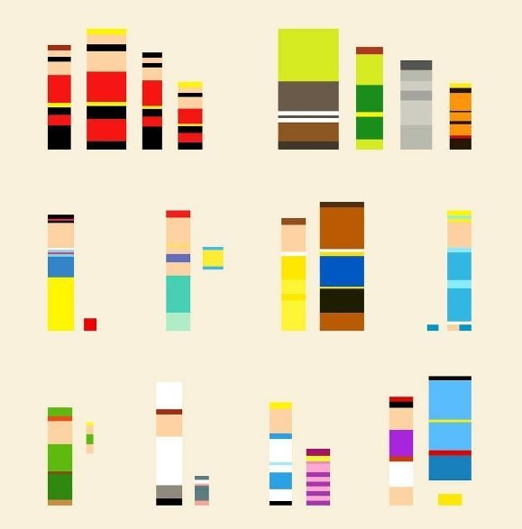
Welcome to Shape World!
Today, we're going on an adventure to learn about squares and rectangles!
These shapes are everywhere around us.
Can you think of any objects in your classroom that look like squares or rectangles?
Notes:
Image from: https://www.pinterest.com/pin/can-you-name-the-cartoon-minimalist-illustration--524176844132149380/

Slide 4
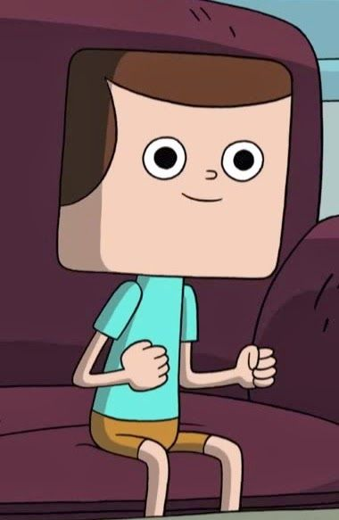
Meet Square Sam
Square Sam has 4 sides.
All of Square Sam's sides are the same length.
Square Sam has 4 corners (we call them vertices).
What else do you notice about Square Sam?
Notes:
Image from: https://www.pinterest.com/karilyp/square-characters/

Slide 5
Meet Rectangle Rita
Rectangle Rita also has 4 sides.
Rectangle Rita has 2 long sides and 2 short sides.
Rectangle Rita has 4 corners (vertices) too.
How is Rita different from Sam?

Slide 6
Counting Sides
Both squares and rectangles have 4 sides.
Let's count together: 1, 2, 3, 4!
Can you draw a shape with 4 sides in the air with your finger?

Slide 7
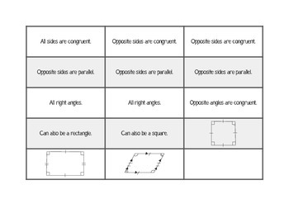
Comparing Sides
In a square, all 4 sides are equal in length.
In a rectangle, opposite sides are equal in length.
Which shape do you think is easier to draw?
Notes:
Image from: https://www.teacherspayteachers.com/Product/Square-Rectangle-and-Parallelogram-Comparison-Venn-Diagram-1345334

Slide 8
Corner Countdown
Squares and rectangles both have 4 corners.
We call these corners "vertices" (ver-tuh-seez).
Can you point to the 4 vertices on your desk or a book?

Slide 9
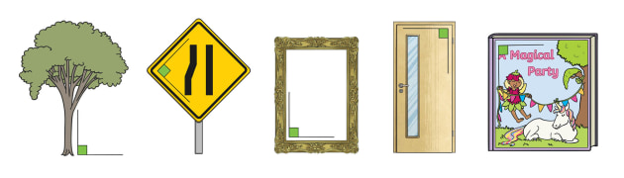
Right Angles Everywhere!
Both squares and rectangles have 4 right angles.
A right angle looks like the corner of a piece of paper.
Can you find right angles in your classroom?
Notes:
Image from: https://www.twinkl.com/teaching-wiki/right-angle

Slide 10
Square or Rectangle?
Let's play a game! I'll show you some objects.
You decide if they're more like Square Sam or Rectangle Rita.
Remember, all squares are rectangles, but not all rectangles are squares!

Slide 11
Shape Hunt
Now it's your turn to be a shape detective!
Look around your room or house.
Can you find 3 things shaped like squares?
Can you find 3 things shaped like rectangles?

Slide 12
Drawing Time
Let's practice drawing squares and rectangles.
For a square, make sure all sides are the same length.
For a rectangle, make two sides longer than the other two.
Which one is easier for you to draw?

Slide 13
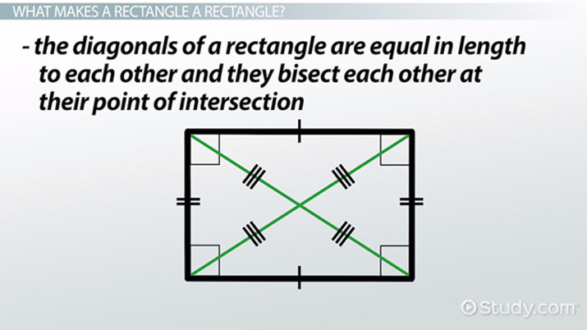
Square and Rectangle Recap
Squares and rectangles both have 4 sides and 4 vertices.
Squares have all sides equal.
Rectangles have two pairs of equal sides.
Both have 4 right angles.
You're now shape experts!
Notes:
Image from: https://study.com/learn/lesson/rectangle-types-examples-what-is-a-rectangle.html

Slide 14
Welcome to Shape Quiz!
Are you ready to test your knowledge about squares and rectangles?
We'll have 10 fun questions for you to answer.
Do your best and have fun!
Remember, there's only one correct answer for each question.

Slide 15
Question 1: Sides of a Square
How many sides does a square have?
a) 3
b) 4
c) 5
d) 6
Think carefully and choose the best answer!

Slide 16
Question 2: Rectangle's Sides
In a rectangle, which sides are equal in length?
a) All sides
b) No sides
c) Only the top and bottom sides
d) Opposite sides
Remember what we learned about Rectangle Rita!

Slide 17
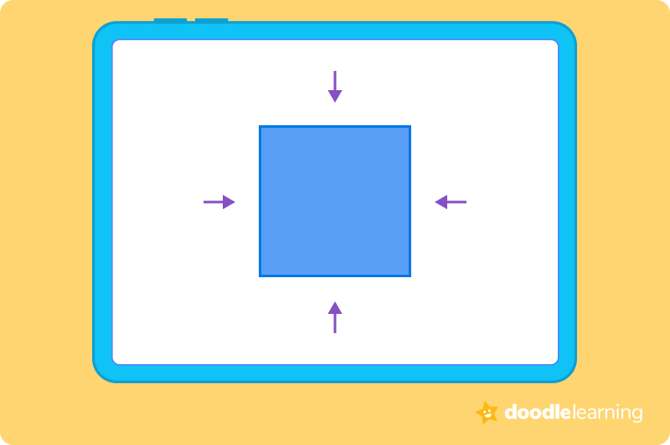
Question 3: Corners of Shapes
What do we call the corners of squares and rectangles?
a) Points
b) Angles
c) Vertices
d) Edges
Hint: It's a special word we learned for corners!
Notes:
Image from: https://doodlelearning.com/maths/skills/geometry/vertices

Slide 18
Question 4: Right Angles
How many right angles does a rectangle have?
a) 2
b) 3
c) 4
d) 5
Think about the corners of a rectangle!

Slide 19
Question 5: Square's Special Feature
What makes a square different from other rectangles?
a) It has more sides
b) It has no right angles
c) All its sides are equal in length
d) It has more corners
Remember Square Sam's special quality!

Slide 20
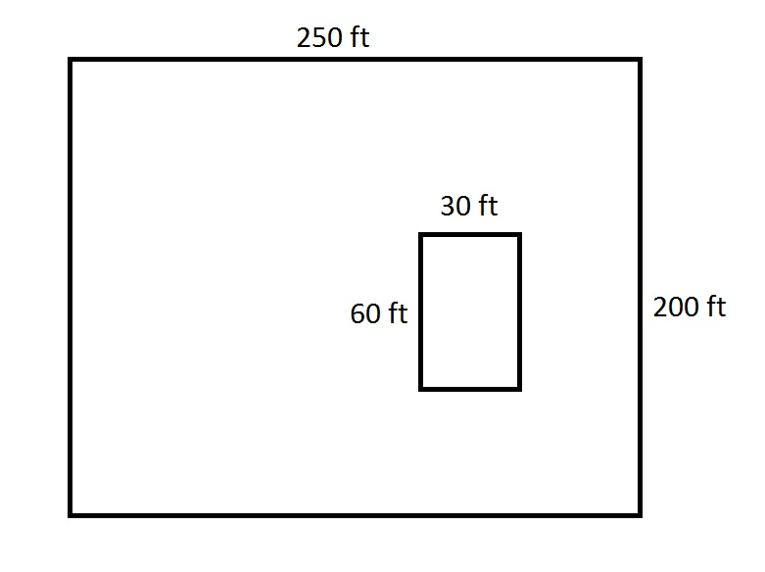
Question 6: Comparing Shapes
Notes:
Image from: https://www.varsitytutors.com/isee_lower_level_quantitative-help/how-to-find-the-area-of-a-rectangle

Slide 21
Question 7: Everyday Objects
Which of these is most likely to be a square?
a) A door
b) A window
c) A chess board
d) A book cover
Picture each object in your mind!

Slide 22
Question 8: Counting Vertices
How many vertices (corners) does a rectangle have?
a) 2
b) 3
c) 4
d) 5
Remember, vertices are the pointy parts!

Slide 23
Question 9: Drawing Shapes
To draw a square, you need to make sure:
a) Two sides are longer than the others
b) It has 5 sides
c) All sides are different lengths
d) All sides are the same length
Think about what makes a square special!

Slide 24
Question 10: Shape Properties
Which property do squares and rectangles share?
a) All sides are equal
b) They have 4 right angles
c) They have 3 vertices
d) Two sides are always longer
What did we learn that's true for both shapes?

Slide 25

Great Job!
You've completed the quiz! Well done!
Let's check your answers on the next slide.
Remember, it's okay if you didn't get them all right.
Learning is a journey, and you're doing great!
Notes:
Image from: https://stockcake.com/i/joyful-children-celebrating_1278989_1116526

Slide 26
Answer Key
Here are the correct answers:
1. b) 4
2. d) Opposite sides
3. c) Vertices
4. c) 4
5. c) All its sides are equal in length
6. b) All squares are rectangles
7. c) A chess board
8. c) 4
9. d) All sides are the same length
10. b) They have 4 right angles
How many did you get right?

