Slide 1
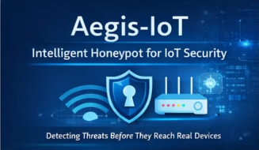
Aegis-Net
A Hackathon project presentation on the security
Of the IoT devices.
Project by:- Prioneer Quantum
Team Members:- Dhiraj Alhawat, Shivansh Kapoor & Mithun
Team Leader:- Shivansh Kapoor

Slide 2
But! What is Aegis-Net 🤔
Aegis-Net is a smart security system that uses fake login traps to detectattackers, understand how risky they are, and instantly alert networkowners before any real damage happens.

Slide 3
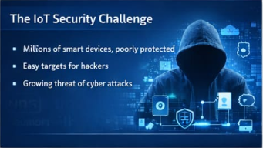
What is the need?🤞
The Basic Need of The Aegis-Net Is :-
Home User's Security.
Attacks Happen Silently.
Monitors The Activity.

Slide 4
What We Actually Made? 🙌
A Risk Intelligence Engine, Not a simple fake login page.
A system that sends immediate alert to the owner.
Sends the exact time of Login.

Slide 5
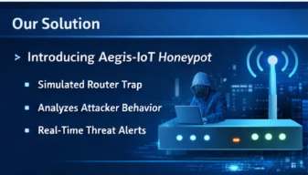
What Is The Possible Solution?
· Fake router login page (honeypot)
· Logs attacker credentials
· Analyzes password strength
· Generates risk score

Slide 6
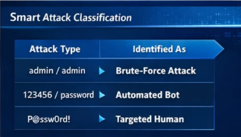
What Makes Our Project Special? 💪
Smart Attack Classification :-
Smart Attack Classification analyzes login behavior,password patterns, and device information toidentify whether an attack is automated, brute-force,or targeted, helping assess threat severity quicklyand accurately.

Slide 7

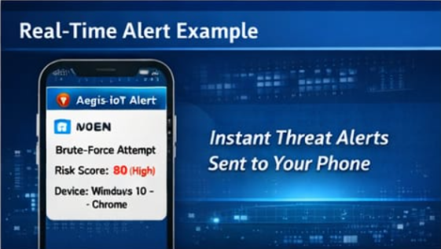
Another One…
2) Real Time Alert system.
Whenever someone tries to log into the private network This system sends real time telegram notification to the owner's phone

Slide 8
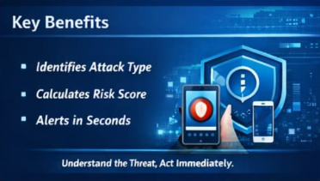
Key Benefits! 🗝️
Identifies & classifies the Attack Type.
Calculate risk score.
Alerts in seconds.
Honeypot.

Slide 9
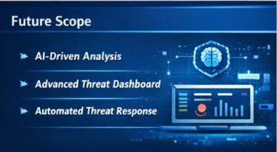
What About The Future Scope? ⌚
Future Scope of Aegis-Net:-
- Al-based behavior analysis for more accurate attack.
- Real-time device isolation and automated response actions.
- Centralized dashboard for network-wide threat analysis.

Slide 10
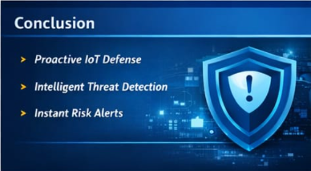
Finally The Conclusion! 🙈
Aegis-Net demonstrates how deception can detect attacks before real damage occurs
Smart attack classification helps understand attacker intent and risk.
Real-time alerts improve security awareness for non-technical users
The system is lightweight, scalable, and suitable a for loT and public networks

Slide 11
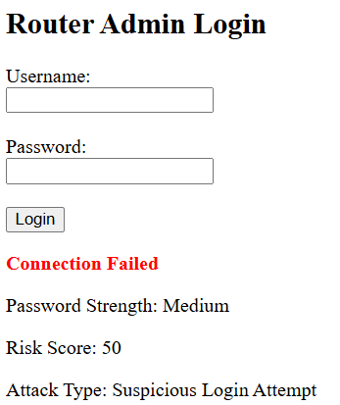
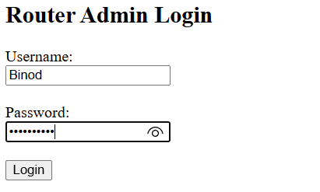
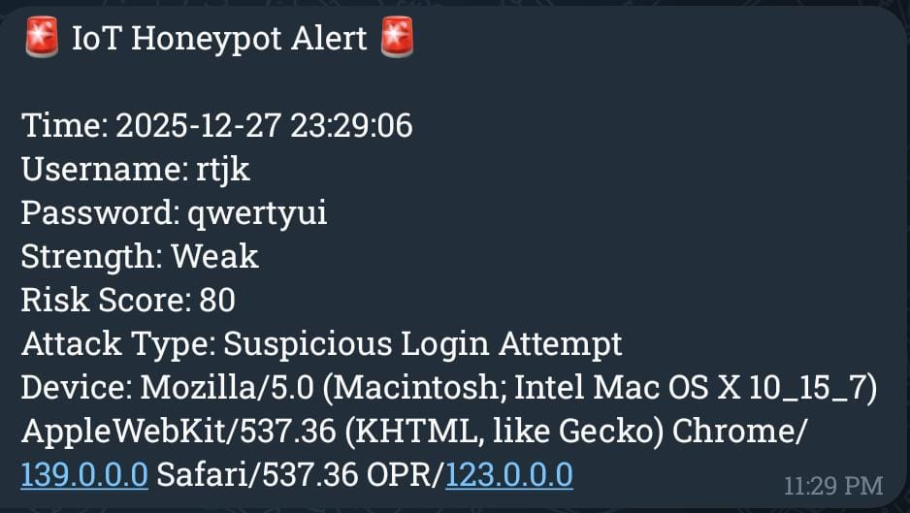
Real Screenshots Of the project👌
Real Text Message To The Owner
After The Login

