Slide 1




prioritizr Systematic conservation planning in R R
Session 1
Jeffrey Hanson
jeffrey.hanson@uqconnect.edu.au
prioritizr.net

Slide 2
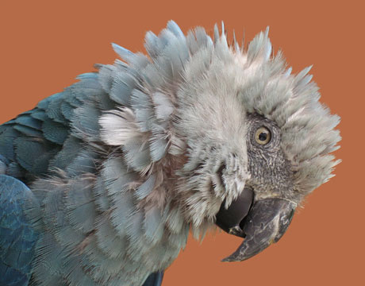
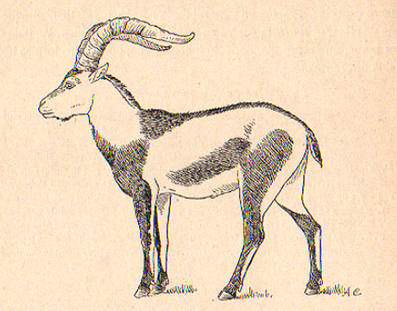
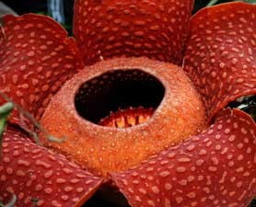
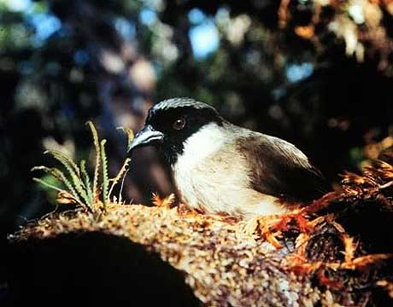
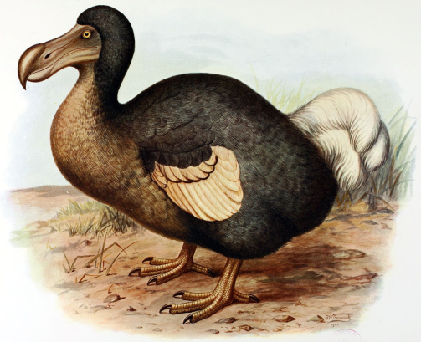
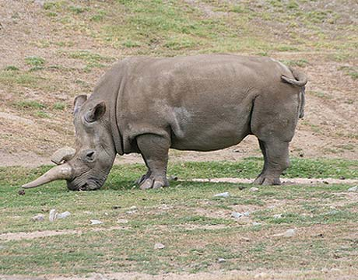
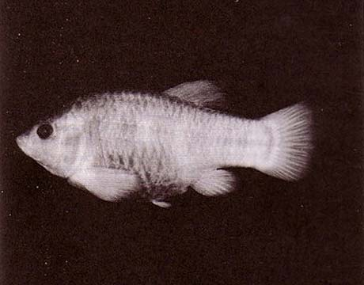
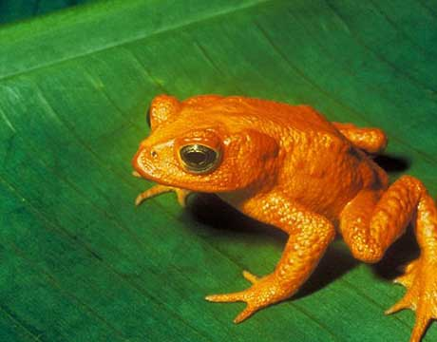
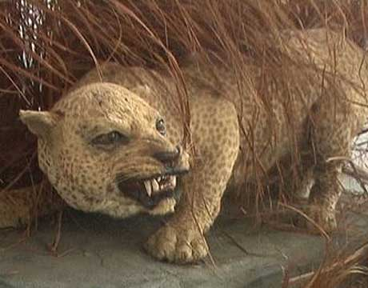
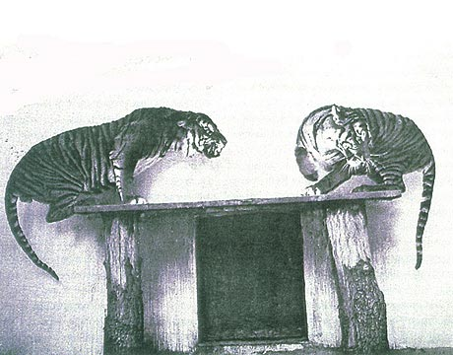
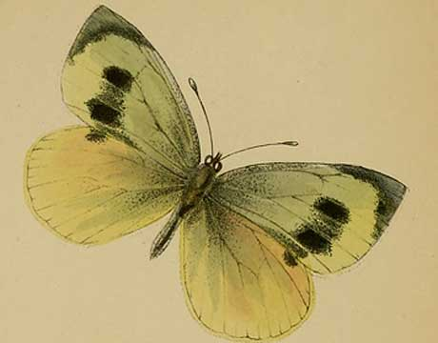
Global biodiversity crisis
Notes:
- high extinction rate
- conservation aims to maintain existing patterns of biodiversity and the processes that sustain them
- areas set aside to preserve biodiversity, and spearhead direct management actions

Slide 3
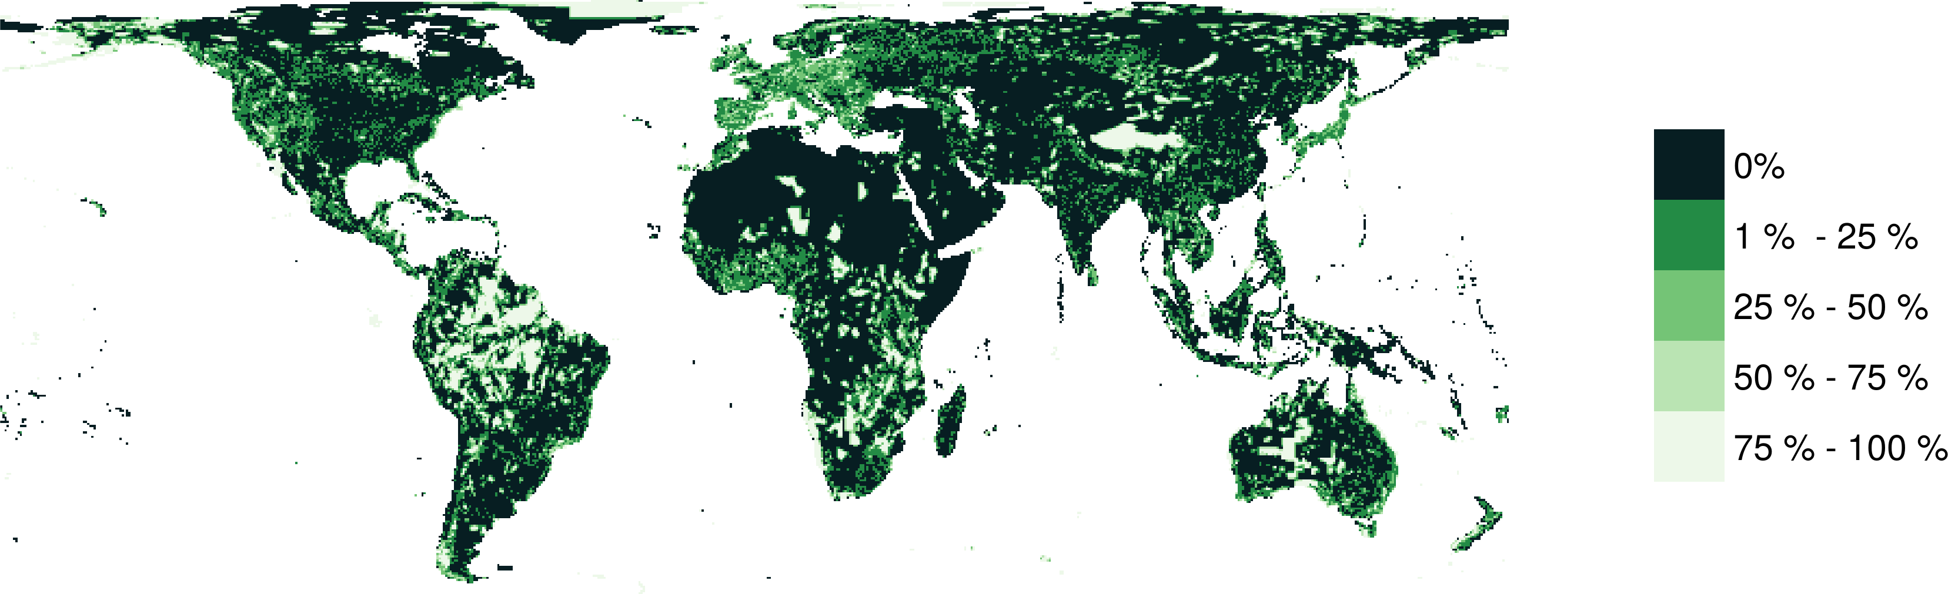
Protected areas

Slide 4
Reserve selection
Features
Notes:
- not all remaining habitat can be preserved
- achieve conservation objectives for minimal cost
- modern systematic conservation planning primarily focusses on representing species
- however, this ignores intra-specific biodiversity

Slide 5
Reserve selection
Planning units

Slide 6
Reserve selection
?
?
?
?
?
?

Slide 7

CARE Principles
Comprehensive
Adequate
Representative
Efficient
Kukkala & Moilanen (2013) Biol Rev, doi:10.1111/brv.12008

Slide 8




CARE Principles
Comprehensive
Adequate
Representative
Efficient
versus

Slide 9
CARE Principles
Comprehensive
Adequate
Representative
Efficient
versus

Slide 10
CARE Principles
Comprehensive
Adequate
Representative
Efficient
versus

Slide 11
CARE Principles
Comprehensive
Adequate
Representative
Efficient
versus

Slide 12
Principle complementarity
Protected areas should “complement” each other to maximize the performance of the overall protected area network (including. existing protected areas)
Vane-Wright, et al (1991) Biol Cons, doi:10.1016/0006-3207(91)90030-D

Slide 13
Reserve selection
?
?
?
?
?
?

Slide 14
Reserve selection

Slide 15


Report card
Comprehensive
Adequate
Representative*
Efficient
Principle complementarity
*Assuming that no significant intra-specific variation

Slide 16
Framing conservation as a decision science problem
Goal: what is our vision for the future?
Objective: what quantity are we maximizing/minimizing to help achieve the goal?
Constraints: what things must our solution do to help achieve the goal?
Decisions: what actions could we do to maximize/minimize the objective?

Slide 17
Framing conservation as a decision science problem
Goal: what is our vision for the future?
Objective: what quantity are we maximizing/minimizing to help achieve the goal?
Constraints: what things must our solution do to help achieve the goal?
Decisions: what actions could we do to maximize/minimize the objective?

Slide 18





Reserve selection as optimization
Goal: conserve biodiversity
Objective: min. # of islands
Constraints: sufficient habitat for each species
Decisions: create a reserve on an island or not?

Slide 20
1
2
3
4
5
6
7
8
9

Slide 21
1
2
3
4
5
6
7
8
9
1
2
3
4
5
6
7
8
9

Slide 22
1
2
3
4
5
6
7
8
9

Slide 23
Min €:
+1
+1
+1
+1
+1
+1
+1
+1
+1
1
2
3
4
5
6
7
8
9

Slide 24
2
Min €:
+1
+1
+1
+1
+1
+1
+1
+1
+1
1
2
3
4
5
6
7
8
9

Slide 25
Min €:
+1
+1
+1
+1
+1
+1
+1
+1
+1
1
2
3
4
5
6
7
8
9
+1
+1
1
2
3
4
5
6
7
8
9

Slide 26
Min €:
+1
+1
+1
+1
+1
+1
+1
+1
+1
1
2
3
4
5
6
7
8
9
+1
+1
+1
1
2
3
4
5
6
7
8
9

Slide 27
Min €:
+1
+1
+1
+1
+1
+1
+1
+1
+1
+1
1
2
3
4
5
6
+1
7
8
9
+1
+1
+1
1
2
3
4
5
6
7
8
9

Slide 28
Min €:
+1
+1
+1
+1
+1
+1
+1
+1
+1
+1
+1
+1
+1
+1
+1
+1
+1
+1
+1
+1
+1
1
2
3
4
5
6
7
8
9

Slide 29
Min €:
+1
+1
+1
+1
+1
+1
+1
+1
+1
+1
≥ 1
+1
+1
≥ 1
+1
+1
≥ 1
+1
≥ 1
+1
+1
+1
+1
+1
+1
≥ 1
1
2
3
4
5
6
7
8
9

Slide 30



Min €:
+1
+1
+1
+1
+1
+1
+1
+1
+1
+1
≥ 1
+1
+1
≥ 1
+1
+1
≥ 1
+1
≥ 1
+1
+1
+1
+1
+1
+1
≥ 1
1
2
3
4
5
6
7
8
9

Slide 31
Min €:
+1
+1
+1
+1
+1
+1
+1
+1
+1
+1
≥ 1
+1
+1
≥ 1
+1
+1
≥ 1
+1
≥ 1
+1
+1
+1
+1
+1
+1
≥ 1
1
2
3
4
5
6
7
8
9

Slide 32
1
2
3
4
5
6
7
8
9
1
2
3
4
5
6
7
8
9

Slide 33
Reserve selection as optimization
Goal: conserve biodiversity
Objective: min. # of islands
Constraints: sufficient habitat for each species
Decisions: create a reserve on an island or not?

Slide 34
Asset maps vs. priority maps
Asset maps: where is biodiversity?
potential data for informing reserve selection
Priority maps: where to act?
have explicit actions (e.g. protect)
have explicit well-defined objectives
have explicit constraints (e.g. targets, budgets)

Slide 35
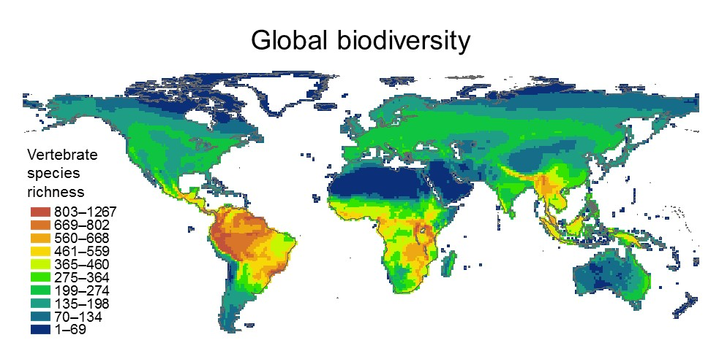
Asset map or priority map?

Slide 36
Asset map or priority map?
Totally useless!
The underlying data on each species distribution is needed

Slide 37
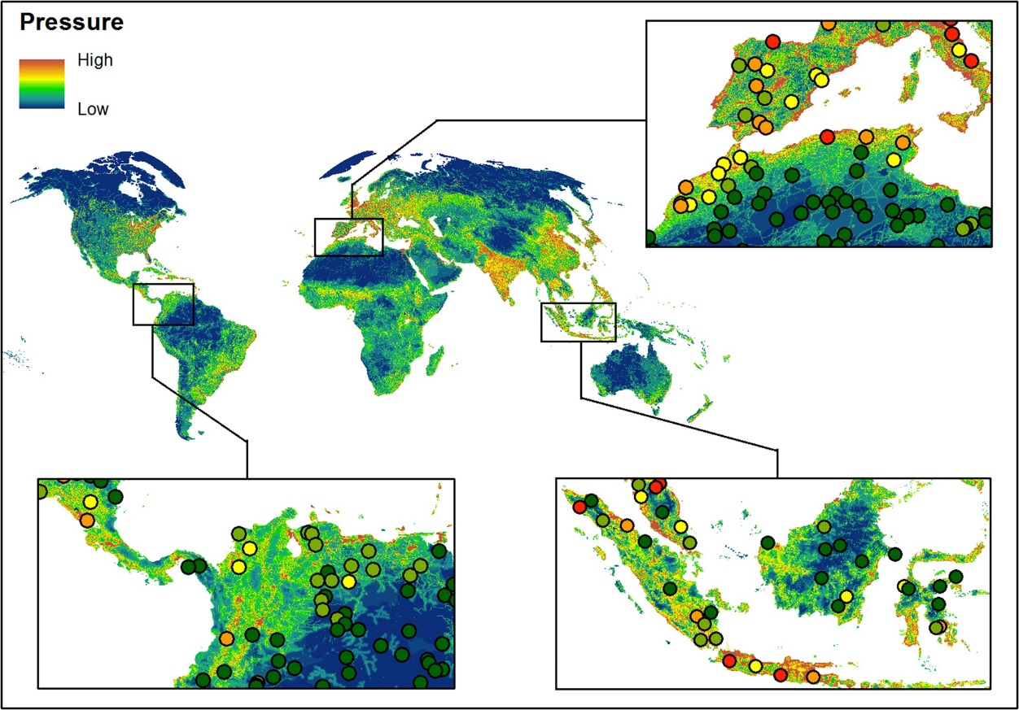
Asset map or priority map?
Human footprint index; higher = more anthropogenic alteration
Venter, et al. (2016), Scientific Data, doi:10.1038/sdata.2016.67

Slide 38
Asset map or priority map?
(orange) places for protected area establishment
(dark green) existing protected areas
(light green) remaining forested areas
Methods: “we prioritized the input features for each of seven categories (i.e., plants, butterflies, vertebrates, aboveground carbon, forest types, elevational connectivity, and dispersal corridors) […] with the objective of maximizing the number of features that meet a specified target without exceeding a land area budget.”
Williams, et al. (2020) Cons Biol,
doi:10.1111/cobi.13450

Slide 39
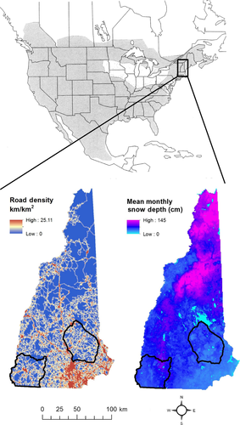
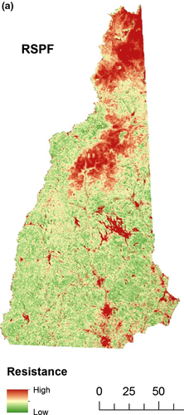
Asset map or priority map?
Landscape resistance to
Bobcat connectivity
Red = High barrier to connectivity
Green = Low barrier to connectivity
Reed, et al. (2017) Anim Conserv,
doi:10.1111/acv.12325

Slide 40
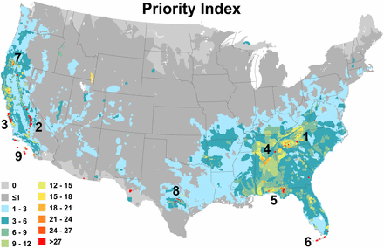
Asset map or priority map?
Methods: “To prioritize lands for future conservation, we focused on the >1,200 endemic species […]. For each species, we calculated a priority score equal to the proportion of the species’ range that is unprotected (i.e., not in IUCN I to VI protected areas) divided by the area of the species’ range. This score increases as range size decreases, in accordance with the well-established relationship between range area and extinction risk (20⇓–22) Priority maps sum scores […] all taxonomic groups (Fig. 4).”
“[..] analysis indicates that remaining habitat in these areas, and potential for restoring habitat, is a top priority for biodiversity conservation.”
Jenkins, et al. (2015) PNAS, doi:10.1073/pnas.1418034112

Slide 41
Asset map or priority map?
“In their recent article, Jenkins et al. (1) identify “priorities for future conservation investment” in the continental United States...”
“Such scoring systems defy contemporary planning approaches, and have repeatedly been shown to identify priorities that are biologically ineffective and economically inefficient (2).”
Brown, et al. (2015) PNAS, doi:10.1073/pnas.1509189112

Slide 42
Asset map or priority map?
“First, priority setting requires explicit and defensible objectives (2) […] The locations highlighted by Jenkins et al. (1) simply contain the largest number of relatively unprotected and restricted-range species, and it is unclear whether protecting these locations would achieve any particular objective.”
Brown, et al. (2015) PNAS, doi:10.1073/pnas.1509189112

Slide 43
Asset map or priority map?
“Second, conservation plans should prioritize actions, not species or places (2). Prioritizing species does not clarify what actions should be taken to avert species’ declines. Jenkins et al. (1) refer to protected areas, yet they also mention restoration and easements. Each of these actions has different costs and probabilities of success. Ignoring the costs and feasibilities of these different actions results in inefficient plans (2).”
Brown, et al. (2015) PNAS, doi:10.1073/pnas.1509189112

Slide 44
Asset map or priority map?
“Third, conservation plans should consider at least some of the economic, political, and social constraints on actions.”
Brown, et al. (2015) PNAS, doi:10.1073/pnas.1509189112

Slide 45
Asset map or priority map?
“Finally, a central principle of conservation planning is that decisions account for the composition of species assemblages across sites (“complementarity”; see ref. 4). Considering complementarity ensures that protection is directed at all species, not simply those colocated in species-richness hotspots.”
Brown, et al. (2015) PNAS, doi:10.1073/pnas.1509189112

Slide 46
What you will do today
Workshop manual sections 1—4.
Learn how to work with spatial data in R
Perform a gap analysis
Answer questions in the manual
https://prioritizr.github.io/massey-workshop

Slide 47
Getting help
prioritizr website
https://prioritizr.net
RDocumentation
https://www.rdocumentation.org
Geocompr
https://geocompr.robinlovelace.net/

Slide 48



jeffrey.hanson@uqconnect.edu.au
github.com/prioritizr/prioritizr
prioritizr.net

