Slide 1

DSWG ICCB Workshop
prioritizr session
Jeffrey Hanson and Richard Schuster

Slide 2
Systematic conservation planning
“Systematic conservation planning aims to provide a rigorous, repeatable, and structured approach for designing new protected areas that efficiently meet conservation objectives”
Margules & Pressey (2000) Nature, DOI:10.1038/35012251
Schuster et al. (2020) PeerJ, DOI:10.7717/peerj.9258

Slide 3
Reserve selection
Features
Notes:
- not all remaining habitat can be preserved
- achieve conservation objectives for minimal cost
- modern systematic conservation planning primarily focusses on representing species
- however, this ignores intra-specific biodiversity

Slide 4
Reserve selection
Planning
units

Slide 5
Reserve selection
?
?
?
?
?
?

Slide 6
Reserve selection
Prioritization

Slide 7

CARE Principles
Comprehensive
Adequate
Representative
Efficient
Kukkala & Moilanen (2013) Biol Rev, doi:10.1111/brv.12008

Slide 8




CARE Principles
Comprehensive
Adequate
Representative
Efficient
versus

Slide 9
CARE Principles
Comprehensive
Adequate
Representative
Efficient
versus

Slide 10
CARE Principles
Comprehensive
Adequate
Representative
Efficient
versus

Slide 11
CARE Principles
Comprehensive
Adequate
Representative
Efficient
versus

Slide 12
Principle of complementarity
Protected areas should “complement” each other to maximize performance of the overall prioritization
Vane-Wright et al. (1991) Biol Cons, DOI:10.1016/0006-3207(91)90030-D

Slide 13
Connectivity
“improve population resilience to disturbance, increase metapopulation viability, promote genetic diversity and maintain energetic pathways among ecosystems”
Within-reserve connectivity
Daigle et al. (2020) Methods Ecol Evol, DOI:10.1111/2041-210X.13349

Slide 14
Connectivity
“improve population resilience to disturbance, increase metapopulation viability, promote genetic diversity and maintain energetic pathways among ecosystems”
Between-reserve connectivity
Highway
Daigle et al. (2020) Methods Ecol Evol, DOI:10.1111/2041-210X.13349

Slide 15
Representation targets
Minimum coverage of features by the prioritization
Policy “As a habitat-specific target, we used 17% of the total number of PUs where the respective habitat occurs, adopting Aichi target 11”
Friedrichs et al. (2018) Plos ONE, DOI:10.1371/journal.pone.0208264
Taylor et al. (2017) Plos ONE, DOI:10.1371/journal.pone.0169629
Jung et al. (2021) Nat Ecol Evol DO:10.1038/s41559-021-01528-7

Slide 16
Representation targets
Minimum coverage of features by the prioritization
Policy “As a habitat-specific target, we used 17% of the total number of PUs where the respective habitat occurs, adopting Aichi target 11”
Statistical models “We modelled […] scenarios based on […] the [population viability analysis] by Todd et al. (2016). The reserve scenarios were based on the protected area required to achieve a less than 5% chance of the Leadbeater’s Possum population falling to (or below) 500 or fewer adult females in 40 generations ”
Friedrichs et al. (2018) Plos ONE, DOI:10.1371/journal.pone.0208264
Taylor et al. (2017) Plos ONE, DOI:10.1371/journal.pone.0169629
Jung et al. (2021) Nat Ecol Evol DO:10.1038/s41559-021-01528-7

Slide 17
Representation targets
Minimum coverage of features by the prioritization
Policy “As a habitat-specific target, we used 17% of the total number of PUs where the respective habitat occurs, adopting Aichi target 11”
Statistical models “We modelled […] scenarios based on […] the [population viability analysis] by Todd et al. (2016). The reserve scenarios were based on the protected area required to achieve a less than 5% chance of the Leadbeater’s Possum population falling to (or below) 500 or fewer adult females in 40 generations ”
Expert thresholds “We set species targets to conserving the minimum amount of species’ habitat necessary to qualify it for the conservation status ‘Least Concern’ following IUCN Red List criteria”
Friedrichs et al. (2018) Plos ONE, DOI:10.1371/journal.pone.0208264
Taylor et al. (2017) Plos ONE, DOI:10.1371/journal.pone.0169629
Jung et al. (2021) Nat Ecol Evol DO:10.1038/s41559-021-01528-7

Slide 18



Decision support tools
Zonation
Marxan
prioritizr
www.github.com/cbig/zonation-core/releases
www.marxansolutions.org
www.prioritizr.net

Slide 19

prioritizr
Design your problem
Guaranteed quality
Solve it fast

Slide 20
Package workflow
Data
(e.g., costs, biodiversity, stakeholder preferences, land-use, land cover, existing reserves, targets)
Prepare
Solve problem
Problem formulation
Maps
Statistics

Slide 21
Package workflow
Data
(e.g., costs, biodiversity, stakeholder preferences, land-use, land cover, existing reserves, targets)
Prepare
Solve problem
Problem formulation
Maps
Statistics

Slide 22
Design your problem
Goal: what is our vision for the future?
Objective: primary quantity we should maximize/minimize?
Penalties: additional quantities we should minimize/maximize?
Targets: what is the minimum desirable amount of each feature?
Constraints: what limits our ability to implement actions in certain planning units, or certain combinations of planning units?
Decisions: what type of action(s) can we implement?

Slide 23




Design your problem
Objective:
minimize # islands
Targets:
≥ 1 population per species
Constraints:
none
Decisions:
protect or not (binary)
What’s the solution?

Slide 24
Design your problem
Objective:
minimize # islands
Targets:
≥ 1 population per species
Constraints:
none
Decisions:
protect or not (binary)
Prioritization

Slide 25
Design your problem
Objective:
minimize # islands
Targets:
≥ 1 population per species
Constraints:
existing reserves (locked in)
Decisions:
protect or not (binary)
What’s the solution?

Slide 26
Design your problem
Objective:
minimize # islands
Targets:
≥ 1 population per species
Constraints:
existing reserves (locked in)
Decisions:
protect or not (binary)
Prioritization

Slide 27

Design your problem
Objective:
minimize opportunity cost
Targets:
≥ 1 population per species
Constraints:
existing reserves (locked in)
Decisions:
protect or not (binary)
What’s the solution?

Slide 28
Design your problem
Objective:
minimize opportunity cost
Targets:
≥ 1 population per species
Constraints:
existing reserves (locked in)
Decisions:
protect or not (binary)
Prioritization

Slide 29
Design your problem
Mental model
problem <- data +
objective +
penalties +
targets +
constraints +
decision type +
solver
solution <- solve(problem)

Slide 30
Design your problem
Mental model
R Code
problem <- data +
objective +
penalties +
targets +
constraints +
decision type +
solver
solution <- solve(problem)
p <- problem(areas, feats) %>%
add_min_set_objective() %>%
add_boundary_penalties(5) %>%
add_relative_targets(0.1) %>%
add_locked_in_constraints(“pa”) %>%
add_binary_decisions() %>%
add_cbc_solver()
solution <- solve(p)

Slide 31



Guaranteed quality
Heuristic
algorithms
Meta-heuristic
algorithms
Exact algorithms
Estimate of best solution
Quality
Different
solutions
Different
solutions
Different
solutions

Slide 32
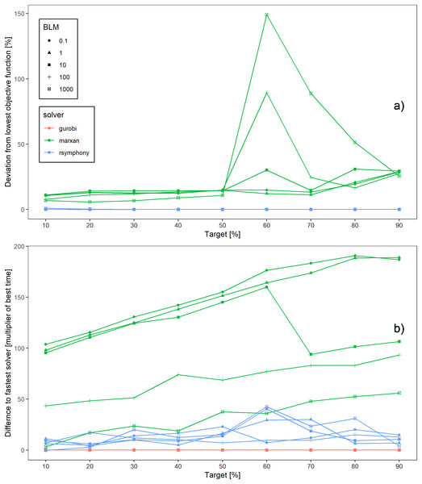
Solve it fast!
Schuster et al. (2020) PeerJ, DOI:10.7717/peerj.9258

Slide 33
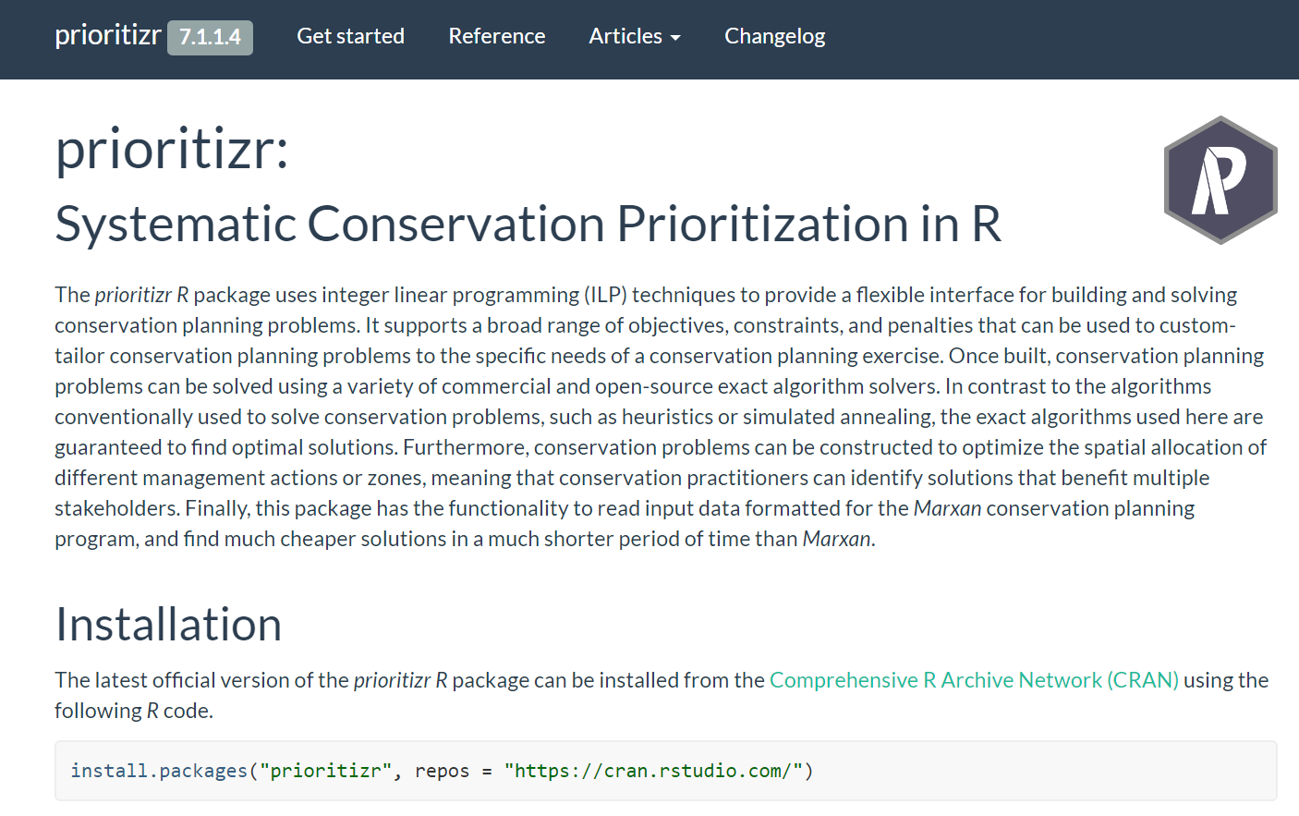
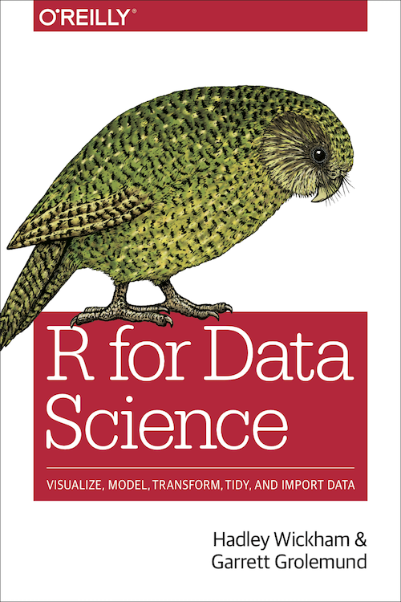
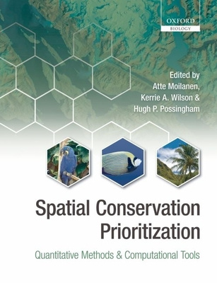
Getting help
Manual, tutorials, news updates,
and links to code repository to submit
bug reports and ask questions:
https://prioritizr.net
Available for free:
https://r4ds.had.co.nz
Amazing book!

Slide 34
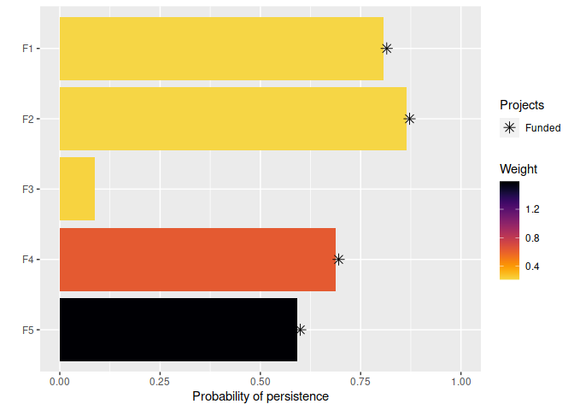
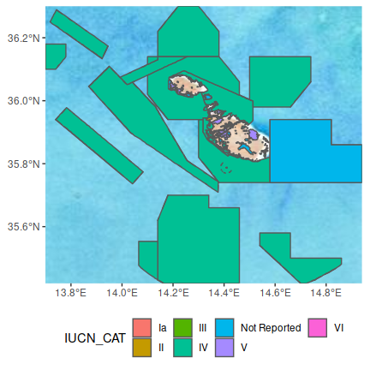
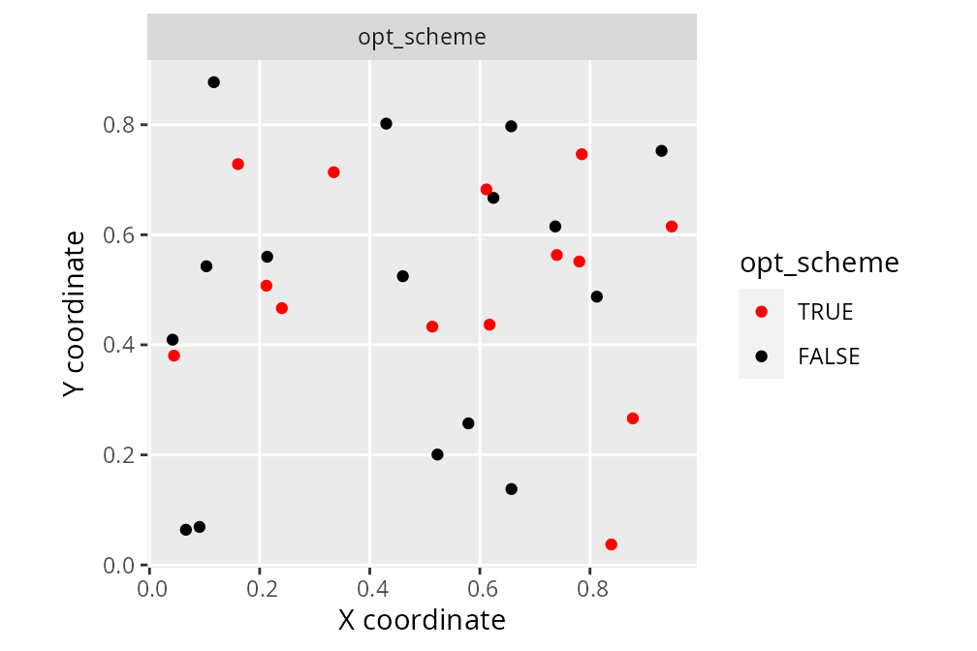
You might also be interested in…
oppr R package
wdpar R package
surveyvoi R package*
Prioritize projects for funding using exact algorithms
(PPP and PTM problems)
Prioritize sites for
ecological surveys by maximizing value
of information
Download and clean WDPA and WDOECM data
from ProtectedPlanet
*under review

Slide 35
DEMO

Slide 36
Frequently asked
questions

Slide 37
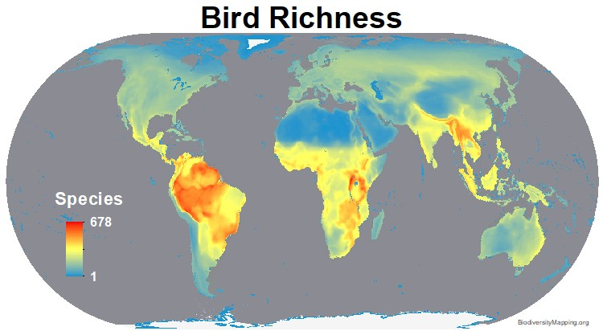
Can’t we just protect places with the greatest species richness/diversity?
Doesn’t account for:
Costs
Species’ requirements
Connectivity
Complementarity
Stakeholder preferences
Previous conservation efforts
https://biodiversitymapping.org
Brown et al. (2015) PNAS, DOI:10.1073/pnas.1509189112

Slide 38
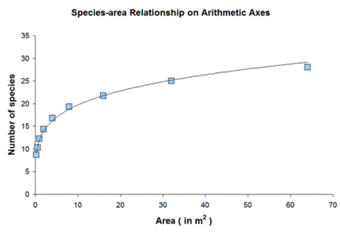
Biogeography says you get more species with larger area, so why not just maximize total amount of land inside protected areas?

Slide 39
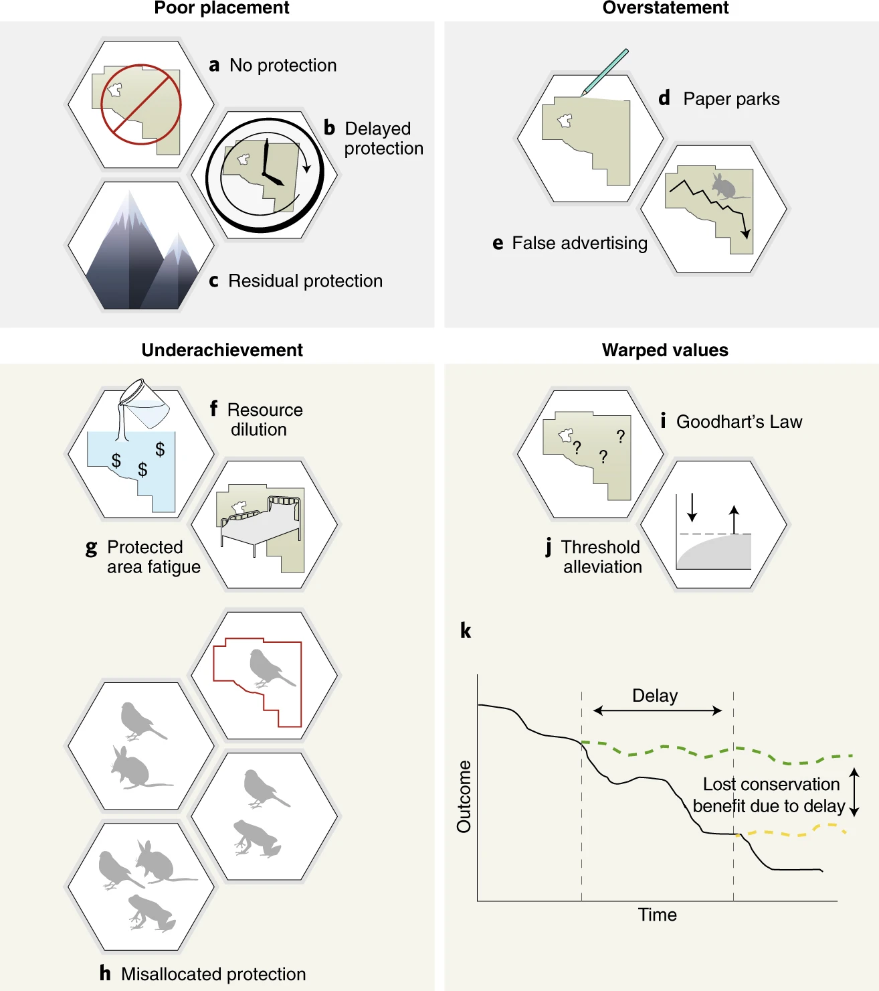
Focussing on protected area size creates perverse incentives
Failure to protect highly threatened, diverse, connected but small areas
Expansion results in delayed protection in areas where protected area (PA) establishment could have had much higher biodiversity benefits
Protection of low-threat, unrepresentative areas, generating limited protective effect
Fails to account for resources allocated to PA management; rewards lack of staff and equipment
Biodiversity losses in a PA remain undetected, but the area is celebrated as ‘protected’
Barnes et al. (2018) Nat Eco Evol, DOI:10.1038/s41559-018-0501-y

Slide 40
Focussing on protected area size creates perverse incentives
Protected area (PA) expansion without associated increases in budget or staff capacity reduces management capacity in situ and across the entire PA network.
PA expansion may induce apathy or resistance to establishing new PAs.
Poorly targeted expansions result […] in actions where biodiversity does not benefit, and limits opportunities for conservation.
Barnes et al. (2018) Nat Eco Evol, DOI:10.1038/s41559-018-0501-y

Slide 41
Focussing on protected area size creates perverse incentives
The real underlying values and objectives of halting biodiversity decline are subsumed by the metric of just protecting more land
As existing protected area coverage targets are thresholds, perceptions of success are binary, failing to account for continual improvements
Any delay or misallocation of limited resources causes long-term harm that may not be reversible at human timescales.
Barnes et al. (2018) Nat Eco Evol, DOI:10.1038/s41559-018-0501-y

Slide 42
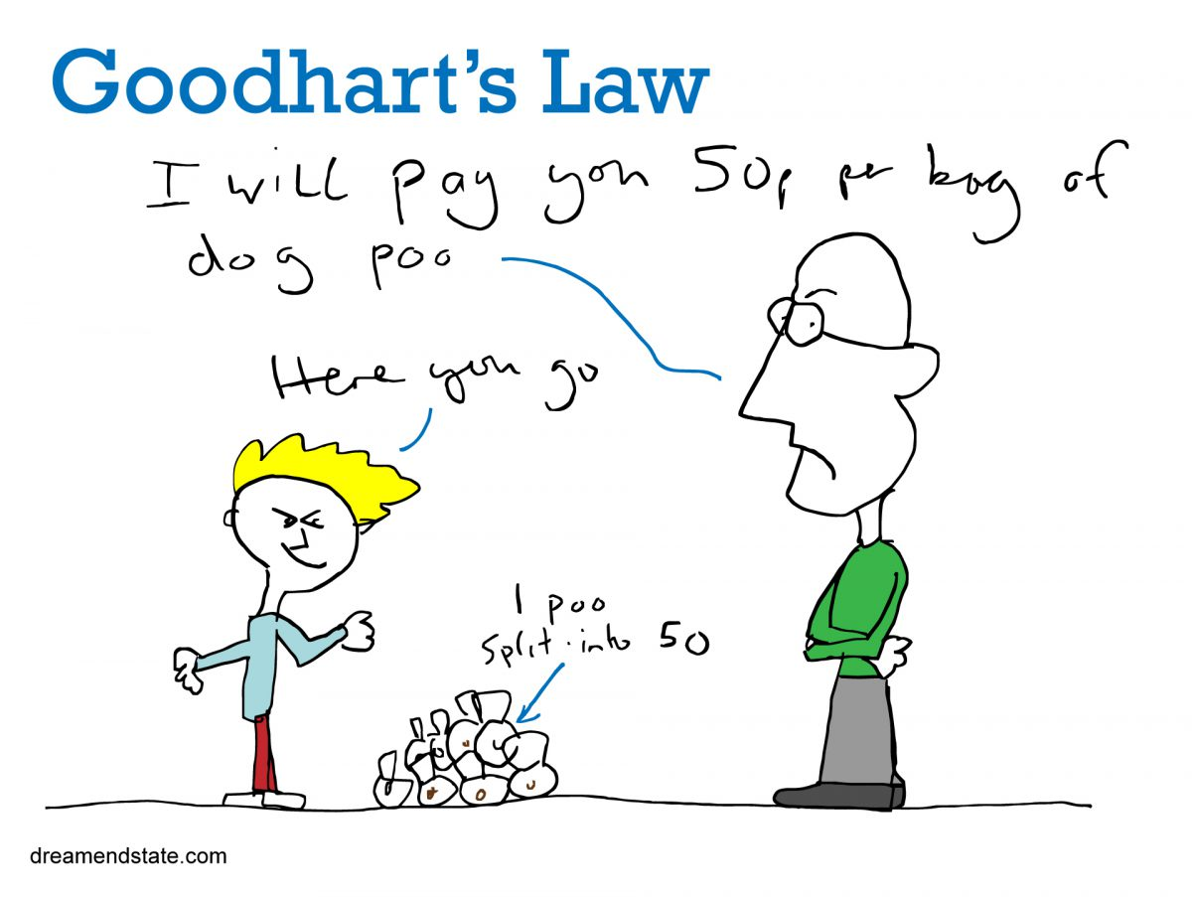
Focussing on protected area size creates perverse incentives

Slide 43
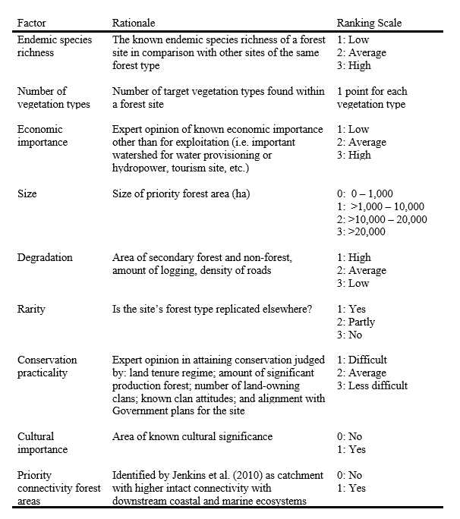
Can’t we just use a scoring system (formula) to rank candidate protected areas?
Game et al. (2013) Cons Biol,
DOI:10.1111/cobi.12051
Klein et al. (2014) Marine Policy,
DOI:10.1016/j.marpol.2013.10.001
Klein et al. (2014) Marine Policy,
DOI:10.1016/j.marpol.2014.03.008

Slide 44
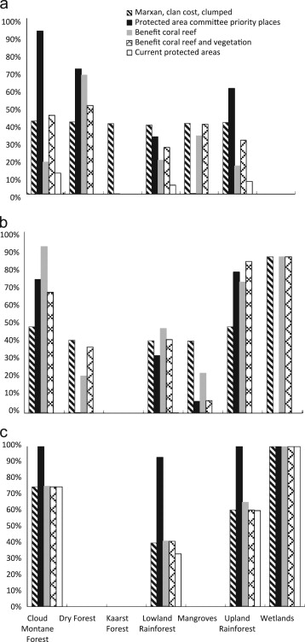
Can’t we just use a scoring system (formula) to rank candidate protected areas?
Plan for protected area network based on systematic conservation planning tool
Proportion of remaining vegetation represented in candidate protected area networks
Plan for protected area network based on scoring system
Representation target
Klein et al. (2014) Marine Policy,
DOI:10.1016/j.marpol.2013.10.001

Slide 45
Can’t we just use a scoring system (formula) to rank candidate protected areas?
Plan for protected area network based on systematic conservation planning tool
Proportion of remaining vegetation represented in candidate protected area networks
Plan for protected area network based on scoring system
Representation target
Klein et al. (2014) Marine Policy,
DOI:10.1016/j.marpol.2013.10.001

Slide 46
Look, I’m sure I could come up with a better formula?
“A major drawback of a listing of priority areas on the basis of a single application of a formula is that there is no guarantee that the priority area second or third on the list might not duplicate the species, communities or habitats that could successfully be preserved in the first priority area.”
Kirkpatrick (1983) Biol Cons, DOI: 10.1016/0006-3207(83)90056-3

Slide 47
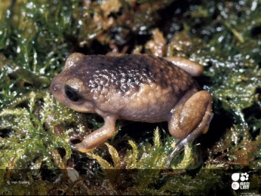
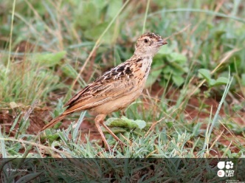

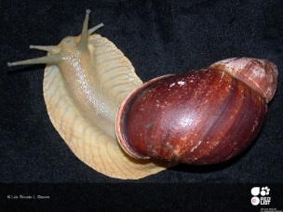
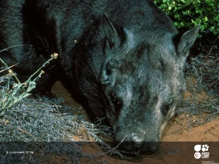
Representation targets don’t seem scientific, can’t the algorithm optimize this for me?
Carwardine et al. (2009), Cons Lett, DOI:10.1111/j.1755-263X.2008.00042.x

Slide 48
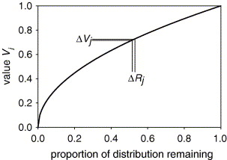
Zonation doesn’t use targets, doesn’t that make it more robust?
Zonation doesn’t use targets, but needs you to specify trade-off curves instead
These specify (1) how much worse covering X% of a species’ range is than Y%, and (2) how much worse loosing coverage of one species is compared to another
Here now
How bad is removing a certain planning unit?
Moilanen (2007) Biol Cons, DOI:10.1016/j.biocon.2006.09.008

Slide 49
Zonation doesn’t use targets, doesn’t that make it more robust?
1
Examples of different trade-off curves:
Rare species
Generalist species
Culturally important species
Only going below 5% coverage causes
steep drop
Fairly steady decrease in performance with reduction in coverage
Value
Going below ~90% coverage causes steep drop in performance
0
0%
50%
100%
Proportion of distribution remaining

Slide 50
You really think people will listen to a computer?
Systematic conservation planning helps:
support decision making – it doesn’t make decisions or dictate them
identify priority areas (just because the algorithm doesn’t say a place is a priority doesn’t necessarily mean it’s not important!)
facilitate discussions between stakeholders by navigating trade-offs
land-use and sea-scape planning by considering multiple zones (e.g. prioritizing places for recreational fishing and conservation)
real-world decision making, such as Great Barrier Reef (Australia), Gulf of California (Mexico), Cape Floristic Region, (South Africa), and marine planning (Montserrat)
Cowling et al. (2003) Biol Cons, DOI:10.1016/S0006-3207(02)00425-1
Álvarez-Romero et al. (2013) Aquatic Conserv, DOI:10.1002/aqc.2334
Fernandes et al. (2005) Conserv Biol, DOI:10.1111/j.1523-1739.2005.00302.x
Flower et al. (2020) Conserv Sci Prac, DOI:10.1111/csp2.158

Slide 51
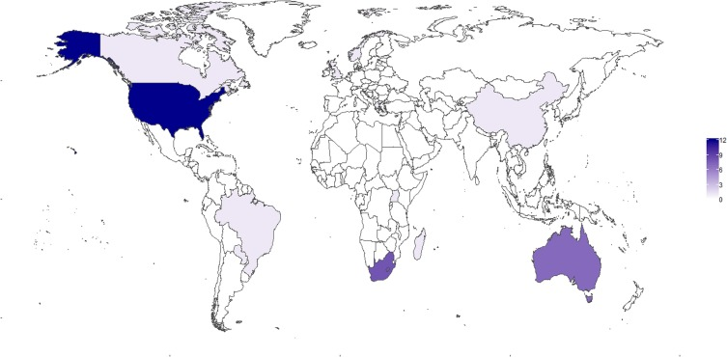
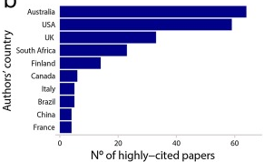
Isn’t conservation planning just something Australian’s do?
N° of highly-cited papers, based on study area
Ribeiro & Atadeu (2019) J. Nat. Conserv., DOI:10.1016/j.jnc.2019.125714

