Slide 1
Data Encapsulation Data Abstraction

Slide 2
Learning Objectives
To know about:
Data Encapsulation and data hiding
Benefits of Data Encapsulation
Data Abstraction
Benefits of Data Abstraction
Data Encapsulation vs. Data Abstraction

Slide 3
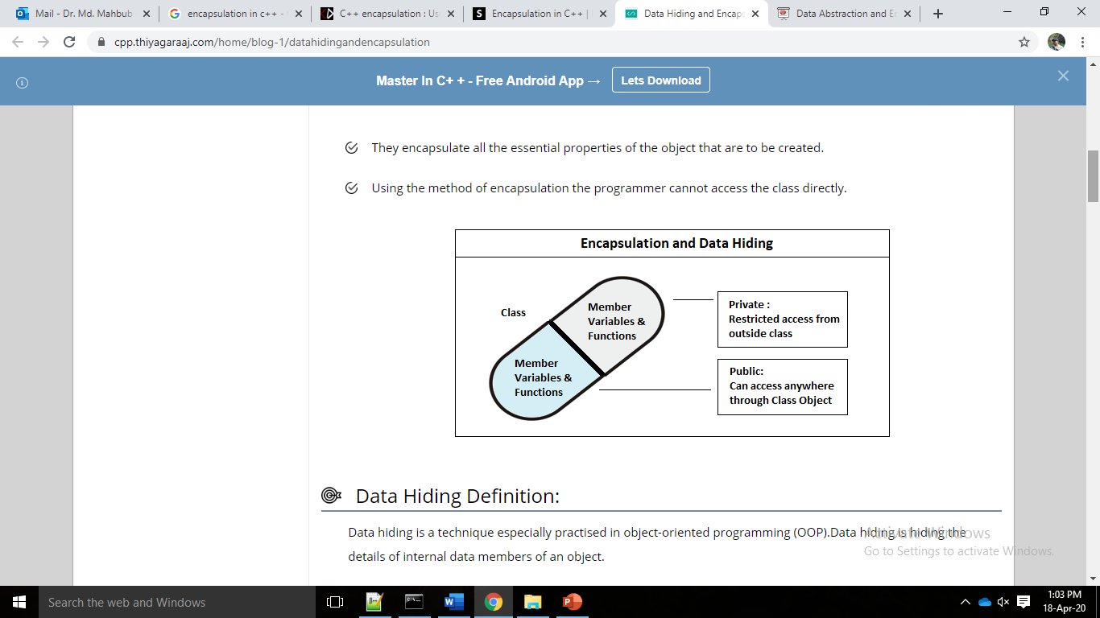
Data Hiding
Data hiding is a technique especially practiced in object-oriented programming (OOP).Data hiding is hiding the details of internal data members of an object.
Data hiding is also known as Information hiding.
Sometimes Data Hiding includes Encapsulation. Thus Data Hiding is heavily related to Abstraction and Encapsulation
Data Hiding is the one most important OOP mechanism. Which is hide the details of the class from outside of the class.
The Class used by only a limited set of variables and functions, others are hidden by the class.

Slide 4
Data Encapsulation
Encapsulation is an Object Oriented Programming concept that binds together the data and functions that manipulate the data
It keeps data and functions safe from outside interference and misuse
Data encapsulation led to the important OOP concept of data hiding
C++ supports the properties of encapsulation and data hiding through the creation of user-defined types, called classes

Slide 5
Benefits of Data Encapsulation
The advantage of data encapsulation comes when the implementation of the class changes but the interface remains the same
It is used to reduce the human errors
The data and function are bundled inside the class that take total control of maintenance
Makes maintenance of application easier
Improves the understandability of the application
Enhanced security

Slide 6
Example
#include <iostream>
using namespace std;
class A{
private:
int a;
int b;
public:
void setData(int x, int y){
a=x;
b=y;
}
void getData(){
cout<<a<<endl;
cout<<b<<endl;
}
};
int main(){
A ob1;
ob1.setData(12,11);
ob1.getData();
return 0;
}

Slide 7
Data Abstraction
Data abstraction refers to, providing only essential information to the outside world and hiding their background details
Data abstraction is a programming (and design) technique that relies on the separation of interface and implementation
C++ classes provides great level of data abstraction
They provide sufficient public methods to the outside world to play with the functionality of the object and to manipulate object data without actually knowing how class has been implemented internally

Slide 8
Benefits of Data Abstraction
Data abstraction provides two important advantages:
Class internals are protected from inadvertent user-level errors, which might corrupt the state of the object
The class implementation may evolve over time in response to changing requirements or bug reports without requiring change in user-level code

Slide 9
Example
#include <iostream>
using namespace std;
class Adder{
public:
// constructor
Adder(int i = 0)
{
total = i;
}
// interface to outside world
void addNum(int number)
{
total += number;
}
// interface to outside world
int getTotal()
{
return total;
};
private:
// hidden data from outside world
int total;
};
int main( )
{
Adder a;
a.addNum(10);
a.addNum(20);
a.addNum(30);
cout << "Total " << a.getTotal() <<endl;
return 0;
}
Above class adds numbers together, and returns the sum. The public members addNum and getTotal are the interfaces to the outside world and a user needs to know them to use the class. The private member total is something that is hidden from the outside world, but is needed for the class to operate properly.

Slide 10
Data Encapsulation vs. Data Abstraction
Data Encapsulation is a mechanism of bundling the data, and the functions that use them and
Data Abstraction is a mechanism of exposing only the interfaces and hiding the implementation details from the user

Slide 11
THANK YOU

