Slide 1
Inheritance

Slide 2
Learning Objectives
To know about:
Inheritance
Access Modifier
Private Inheritance
Protected Inheritance
Public Inheritance
Multilevel Inheritance
Multiple Inheritance
Virtual Base Class
Constructor Calling Order in Inheritance
Containership Relationship

Slide 3
Inheritance
Reusability is an important feature of OOP
It is always nice if we could reuse something that already exists rather than trying to create the same all over again.
It would not only save time and money but also reduce frustration and increase reliability.
The reuse of a class that has already been tested, debugged and used many times can save the effort of developing and testing the same again.
C++ strongly supports the concept of reusability.
C++ classes can be reused in several ways.

Slide 4
Inheritance
The mechanism of deriving a new class from an old class/previous written class in known as inheritance.
It is also known as is a/kind of/is a kind of relationship.
The class which is inherited is called base class/parent class/super class.
The class that inherits the base class is known as sub class/child class/derived class.
Private members can never be inherited.
A class can be inherited in 3 ways-
Public
Protected
Private

Slide 5
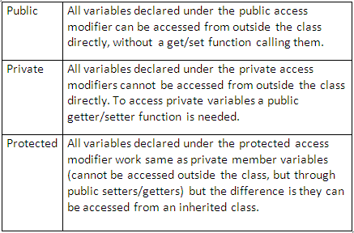
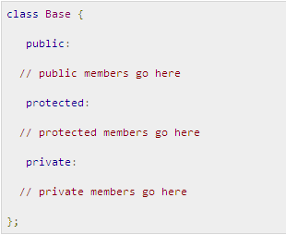
Access Modifier

Slide 6
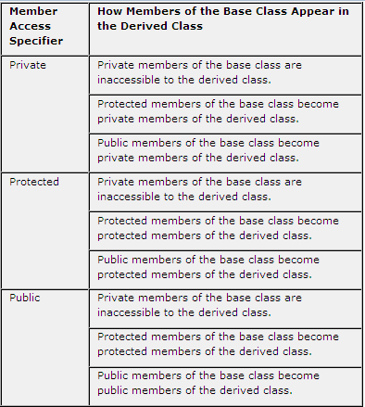

Access Modifier

Slide 7
Public, Protected, and Private inheritance have the following features:
Public inheritance makes public members of the base class public in the derived class, and the protected members of the base class remain protected in the derived class.
Protected inheritance makes the public and protected members of the base class protected in the derived class.
Private inheritance makes the public and protected members of the base class private in the derived class.

Slide 8
Protected Members of a Class
Protected members can be inherited
The inherited/Child class can access and use protected member functions and data; but any object from outside those classes cannot access them.
Therefore, we cannot access the protected members from any function outside the class by using an object & dot(.) operator.
In other words, protected members behave exactly same as private members with the exception that protected members can be inherited.

Slide 9
Example: Private Inheritance
int main()
{
A aa;
aa.a3 = 10;
aa.geta();
aa.puta();
B bb;
bb.b3 = 5;
bb.getb();
bb.putb();
return 0;
}
class B:private A
{
private:
int b1;
int a2;
int a3;
void geta();
void puta();
protected:
int b2;
public:
int b3;
void getb(){}
void putb(){}
};
class A
{
private:
int a1;
protected:
int a2;
public:
int a3;
void geta(){}
void puta(){}
};

Slide 10
Example: Protected Inheritance
class B:protected A
{
private:
int b1;
protected:
int b2;
int a2;
int a3;
void geta();
void puta();
public:
int b3;
void getb{};
void putb{};
};
int main()
{
A aa;
aa.a3 = 10;
aa.geta();
aa.puta();
B bb;
bb.b3 = 5;
bb.getb();
bb.putb();
return 0;
}
class A
{
private:
int a1;
protected:
int a2;
public:
int a3;
void geta();
void puta();
};

Slide 11
Example: Public Inheritance
class B:public A
{
private:
int b1;
protected:
int b2;
int a2;
public:
int b3;
void getb(){}
void putb(){}
int a3;
void geta();
void puta();
};
int main()
{ A aa;
aa.a3 = 10;
aa.geta();
aa.puta();
B bb;
bb.b3 = 5;
bb.getb();
bb.putb();
bb.a3 = 7;
bb.geta();
bb.puta();
return 0;
}
class A
{
private:
int a1;
protected:
int a2;
public:
int a3;
void geta();
void puta();
};

Slide 12
Access Mode of Inherited Class Members
Whenever a class is inherited, the derived class gets members (both function & data) accessibility mode as the more secured one between base-class accessibility mode and inheritance accessibility mode.

Slide 13
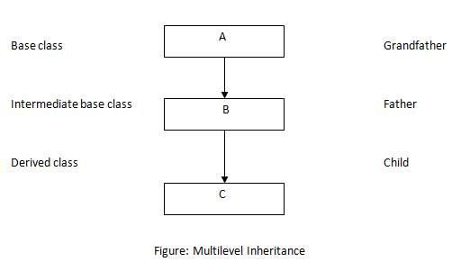
Multilevel Inheritance
It is not uncommon that a class is derived from another derived class.
The class A serves as a base class for the derived class B which in turn serves as a base class for the derived class C.
The class B is known as intermediate base class since it provides a link for the inheritance between A and C.
The chain ABC is known as inheritance path.

Slide 14
Multilevel Inheritance
class A
{
int a1;
protected:
int a2;
public:
int a3;
void geta();
void showa();
};
class B:public A
{
int b1;
protected:
int b2;
int a2;
public:
int b3;
void getb();
void showb();
int a3;
void geta();
void showa();
};

Slide 15
Multilevel Inheritance
class C:protected B
{
int c1;
protected:
int c2;
int b2;
int a2;
int b3;
void getb();
void showb();
int a3;
void geta();
void showa();
public:
int c3;
void getc();
void showc();
};
int main()
{ A aa;
B bb;
C cc;
aa.a3=10;
aa.geta();
aa.showa();
bb.b3=10;
bb.getb();
bb.showb();
bb.a3 = 5;
bb.geta();
bb.getb();
cc.c3=10;
cc.getc();
cc.showc();
return 0;}

Slide 16
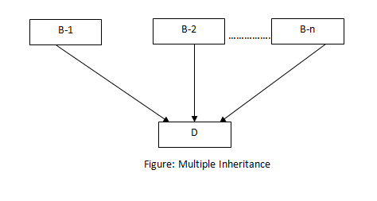
Multiple Inheritance
A class can inherit the attributes of two or more classes
This is known as multiple inheritance
Multiple inheritance allows us to combine the features of several existing classes as a starting point for defining new classes.
It is like a child inheriting the physical features of one parent and the intelligence of another.

Slide 17
Multiple Inheritance (Example)
class M
{
protected:
int m;
public:
void setdata(int x)
{
m = x;
}
void display()
{
cout<<m<<endl;
}
};
class N
{
protected:
int n;
public:
void setdata(int x)
{
n = x;
}
void display()
{
cout<<n<<endl;
}
};

Slide 18
Multiple Inheritance (Example)
class P: public M, public N
{
public:
void display()
{
M::display();
N::display();
}
};
int main()
{
P pp;
pp.M::setdata(10);
pp.N::setdata(20);
pp.display();
}
Output:
10
20

Slide 19
Multiple Inheritance (Example 2)
class M
{
protected:
int m;
public:
int confusing;
void setdata(int x)
{
confusing = m = x;
}
void display()
{
cout<<m<<endl;
cout<<confusing;
cout<<endl;}
};
class N
{
protected:
int n;
public:
int confusing;
void setdata(int x)
{
confusing = n = x;
}
void display()
{
cout<<n<<endl;
cout<<confusing;
cout<<endl;
}
};

Slide 20
Multiple Inheritance (Example 2)
class P: public M, public N
{
public:
void display()
{
M::display();
N::display();
}
void M::setdata();
void N::setdata();
void M::display();
void N::display();
int M::confusing;
int N::confusing;
protected:
int m;
int n;
};
int main()
{
P pp;
pp.M::setdata(10);
pp.N::setdata(20);
pp.M::confusing=5;
pp.display();
return 0;
}
Output:
10
5
20
5

Slide 21
Virtual Base Class
Consider the following relationship
Parent
int a;
Here, Child1 and Child2 should inherit Parent virtually
Child1
int Parent::a;
Child2
int Parent::a;
GrandChild
??

Slide 22
Virtual Base Class
Duplication of inherited members due to these multiple path can be avoided by making the common base class (ancestor class) as virtual base class.

Slide 23
Virtual Base Class
class parent
{
protected:
int p;
public:
void set(int x)
{
p=x;
}
void show()
{
cout<<"parent= "<<p<<endl;
}
};
class child1:public virtual parent
{
protected:
int c1;
int p;
public:
void set(int x)
{
c1=x;
}
void show()
{
cout<<"child1= "<<c1<<endl;
}
};

Slide 24
Virtual Base Class
class child2:public virtual parent
{
protected:
int c2;
int p;
public:
void set(int y)
{
c2=y;
}
void show()
{
cout<<"child2= "<<c2<<endl;
}
};
class grandchild:
public child1,public child2
{
protected:
int gc;
int parent::p;
public:
void set(int z)
{
gc=z;
}
void show()
{
cout<<"grandchild="<<gc;
cout<<endl;
}
};

Slide 25
Virtual Base Class
int main()
{
grandchild gc1;
gc1.parent::p = 10;
cout<<gc1.p<<endl;
gc1.child1::p = 20;
cout<<gc1.p<<endl;
gc1.child2::p = 30;
cout<<gc1.p<<endl;
gc1.p= 40;
cout<<gc1.p<<endl;
gc1.parent::set(1);
gc1.parent::show();
gc1.child1::set(2);
gc1.child1::show();
gc1.child2::set(4);
gc1.child2::show();
return 0;
}
Output:
10
20
30
40
parent= 1
child1= 2
child2= 4

Slide 26
Constructor Calling Order in Inheritance
When any object of child class is created, parent constructor is always called before the child constructor.
When the parent has more than one constructor, then the child constructor will call the default constructor of parent if not specifically mentioned.

Slide 27
Constructor Calling Order in Inheritance
class B:public A
{
int b;
public:
B()
{
cout<<"default B\n";
}
B(int a,int b)
{
this->b=b;
cout<<"non-default B=“; cout<<b<<endl;
}
~B()
{
cout<<"destructor B\n";
}
};
class A
{
int a;
public:
A()
{
cout<<"default A\n";
}
A(int a)
{
this->a=a;
cout<<"non-default A = “; cout<<a<<endl;
}
~A()
{
cout<<"destructor A\n";
}
};

Slide 28
Constructor Calling Order in Inheritance
int main()
{
A aa;
A aa1(5);
B bb;
B bb1(10,20);
return 0;
}
Output:
default A
non-default A = 5
default A
default B
default A
non-default B=20
destructor B
destructor A
destructor B
destructor A
destructor A
destructor A

Slide 29
Constructor Calling Order in Inheritance
class A
{
int a;
public:
A()
{
cout<<"default A\n";
}
A(int a)
{
this->a=a;
cout<<"non-default A = “; cout<<a<<endl;
}
~A()
{
cout<<"destructor A\n";
}
};
class B:public A
{
int b;
public:
B()
{
cout<<"default B\n";
}
B(int a,int b):A(a)
{
this->b=b;
cout<<"non-default B=“; cout<<b<<endl;
}
~B()
{
cout<<"destructor B\n";
}
};

Slide 30
Constructor Calling Order in Inheritance
int main()
{
A aa;
A aa1(5);
B bb;
B bb1(10,20);
return 0;
}
Output:
default A
non-default A = 5
default A
default B
non-default A = 10
non-default B=20
destructor B
destructor A
destructor B
destructor A
destructor A
destructor A

Slide 31
Constructor in Derived Class
class A
{
int a;
public:
A(int a=0)
{
this->a=a;
cout<<"c for A= "<<a<<endl;
}
~A()
{
cout<<"d for A= "<<a<<endl;
}
};
class B
{
int b;
public:
B(int b=0)
{
this->b=b;
cout<<"c for B= "<<b<<endl;
}
~B()
{
cout<<"d for B= "<<b<<endl;
}
};

Slide 32
Constructor in Derived Class
int main()
{
C cc(3);
{
B bb(10);
C *cc1;
cc1=new C(5);
delete cc1;
}
return 0;
}
class C:public A,public B
{
int c;
public:
C(int c=0):B(c*2),A(c*5)
{
this->c=c;
cout<<"c for C= "<<c<<endl;
}
~C()
{
cout<<"d for C= "<<c<<endl;
}
};

Slide 33
Containership/”has a” relationship
When one class has objects of other classes as a data member then the relationship is known as “has a” relationship/containership/composition.
A car has an engine, has tires
A University has students.

Slide 34
Containership Example
class alpha
{
int a;
public:
alpha(int a=0)
{
this->a=a;
cout<<“Alpha ”;
cout<<a<<endl;
}
};
class beta
{
int b;
public:
beta(int b=0)
{
this->b=b;
cout<<“Beta ”;
cout<<b<<endl;
}
};

Slide 35
Containership Example
class gamma
{
int c;
alpha aa;
beta bb;
public:
gamma (int a=0,int b=0,int c=0)
:beta(b), alpha(a)
{
this->c=c;
cout<<“Gamma ”;
cout<<c<<endl;
}
};
int main()
{
gamma g(10,20,30);
return 0;
}
Output:
Alpha 10
Beta 20
Gamma 30

Slide 36
Constructor in Containership
class A
{
int a;
public:
A(int a=0)
{
this->a=a;
cout<<"c for A="<<a<<endl;
}
~A()
{
cout<<"d for A= "<<a<<endl;
}
};
class B
{
int b;
public:
B(int b=0)
{
this->b=b;
cout<<"c for B= "<<b<<endl;
}
~B()
{
cout<<"d for B= "<<b<<endl;;
}
};

Slide 37
Constructor in Containership
Output:
C for a=35
C for b=50
C for c=5
D for c=5
D for b=50
D for a=35

Slide 38
THANK YOU

